Slide 1
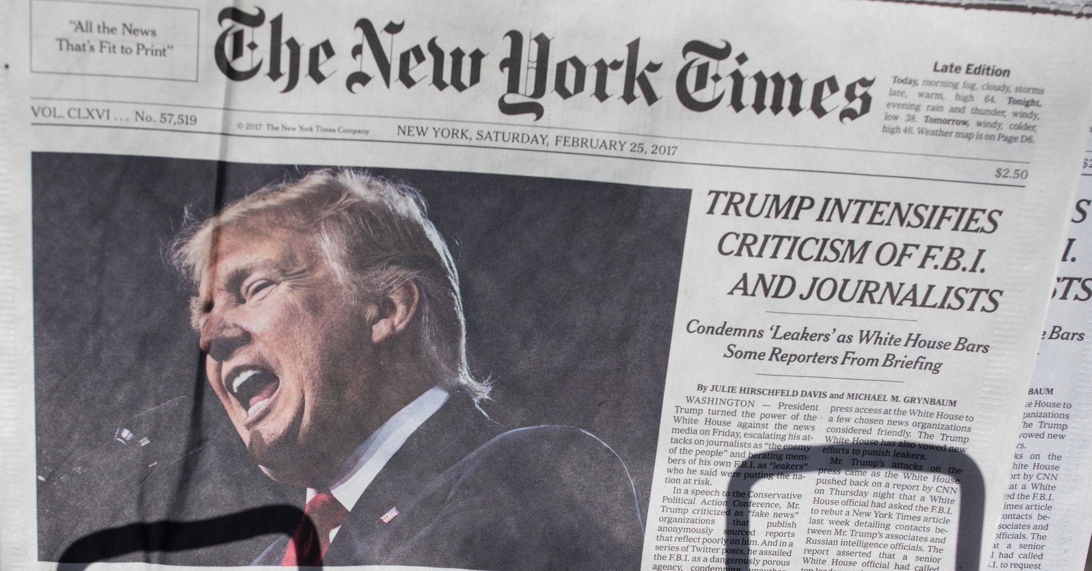
Presentation title
How the New York Times
Stole the Presidency
Tho Bishop | Mises U 2022
https://www.lewrockwell.com/2022/07/david-stockman/europes-economic-suicide/
Mirjam Nilsson

Slide 2
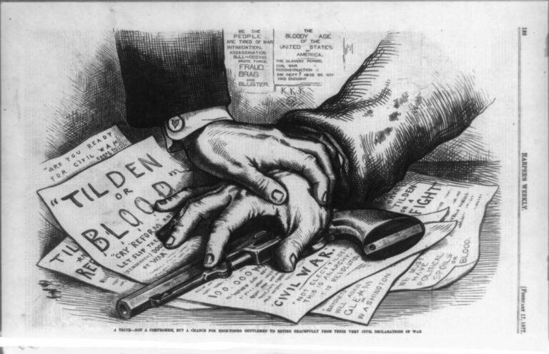
Presentation title
How the New York Times
Stole the Presidency
Tho Bishop | Mises U 2022
https://www.lewrockwell.com/2022/07/david-stockman/europes-economic-suicide/
Mirjam Nilsson

Slide 3
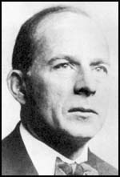
“There are those who still think they are holding the pass against a revolution that may be coming up the road. But they are gazing in the wrong direction.”
GARET GARRETT The Revolution Was

Slide 4
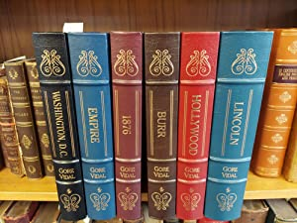
“The year 1876 was probably the low point in our republic’s history, and knowing something about what happened then is, I think, useful to us now as times are again becoming rather too interesting for comfort.”
Gore Vidal, 1876

Slide 5
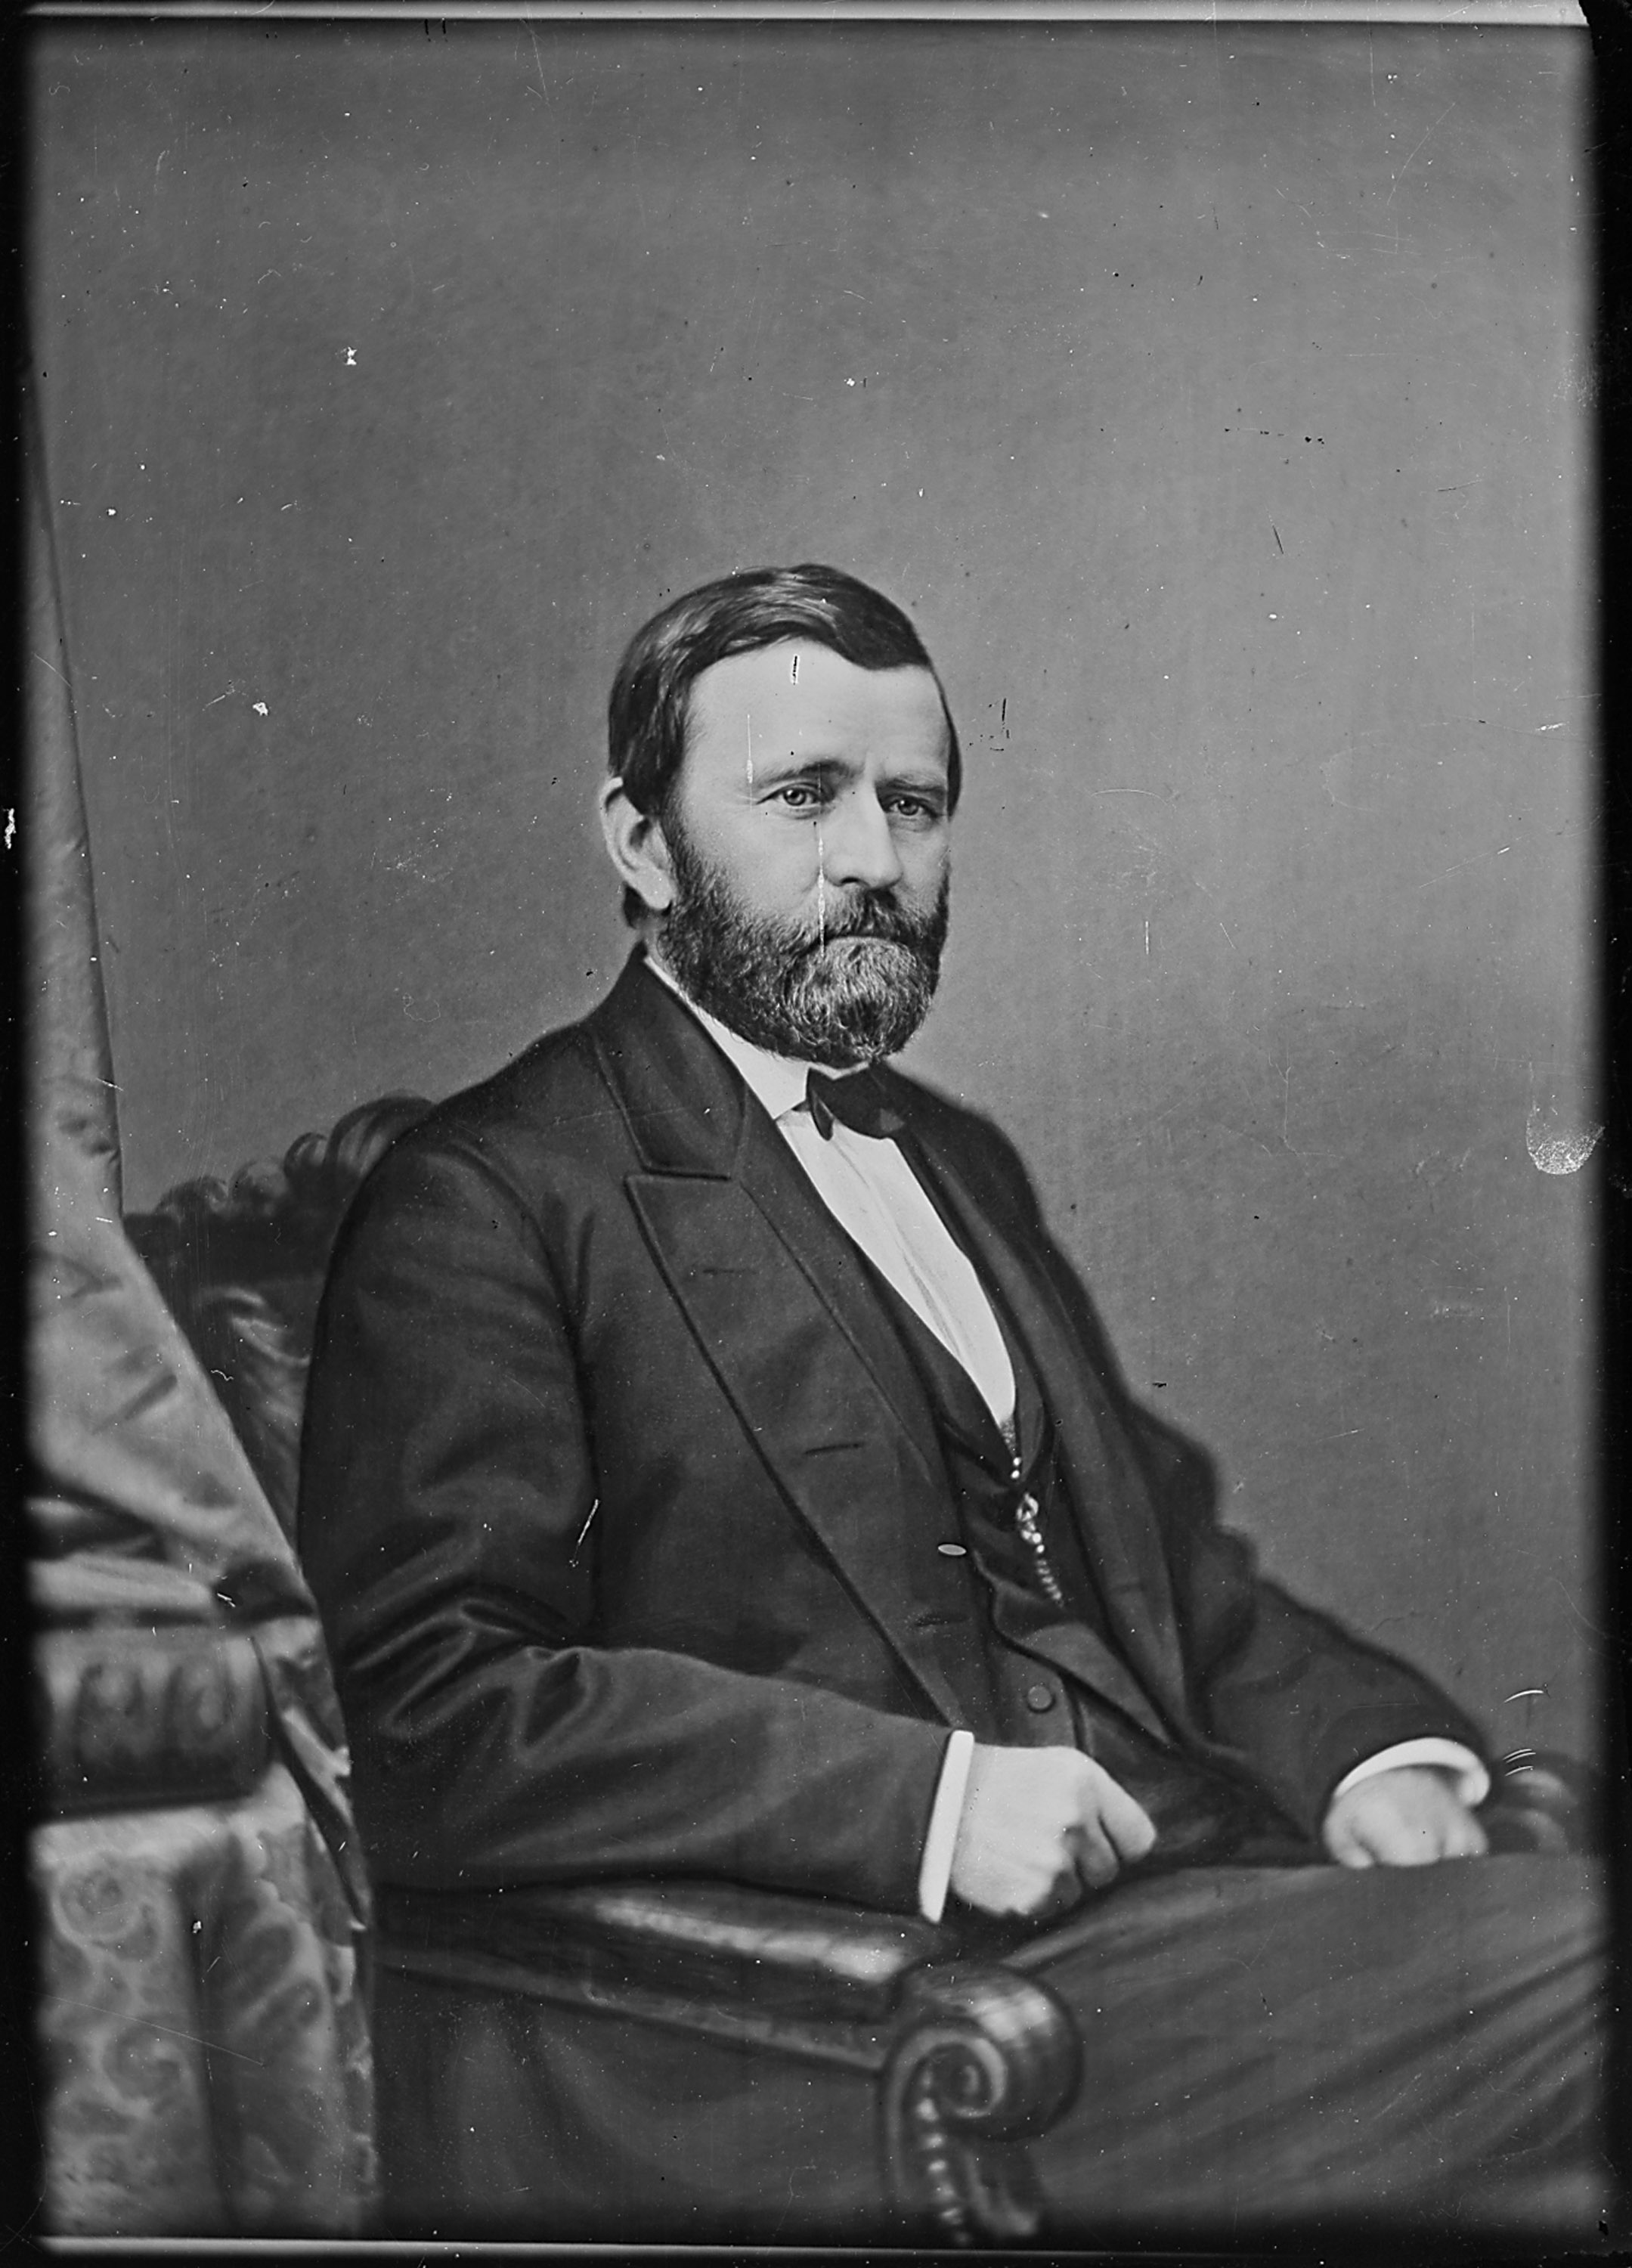
Black Friday Gold Panic 1869
New York Custom House ring
Sanborn Incident, 1874
Whiskey Ring, 1875

Slide 6
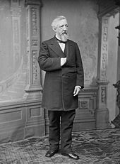
“The transcontinentals set the stage for the corruption and corporate capitalism that now defines the Gilded Age in the minds of many.... “In the end, the railroads constituted a huge transfer of wealth from taxpayers, Indians, Mexicans, and more efficient enterprises who found themselves competing with these subsidized behemoths.” – Ryan McMaken, Crony Capitalism and the Transcontinental Railroads

Slide 7
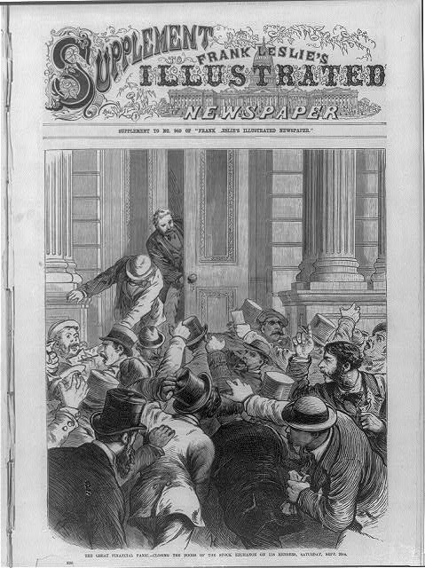
The Panic of 1873
“The original Great Depression”

Slide 8
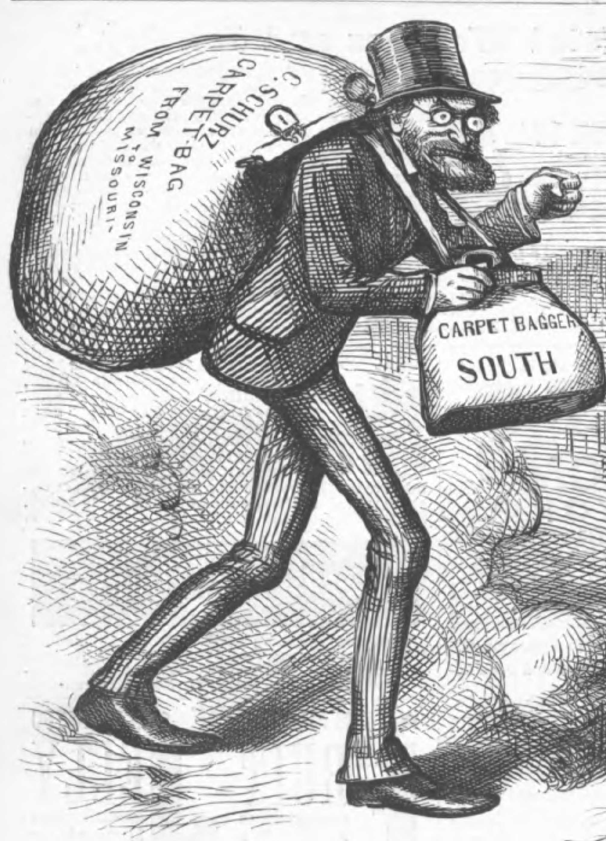
RECONSTRUCTION
Scalawags and Carpetbaggers
“From the start, Congressional Reconstruction was as much about hard-core partisan politics as it was about racial equality. The widespread disenfrancisement of former Confederates…had the practical effect of driving the Democratic party underground.”
– Roy Morris, Fraud of the Century

Slide 9
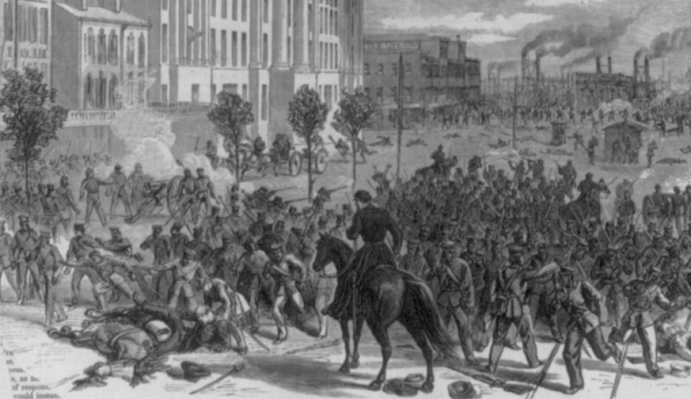
Louisiana Contested election of 1872
Democrat
John McEnery
Vs
Republican
William Pitt Kellogg

Slide 10
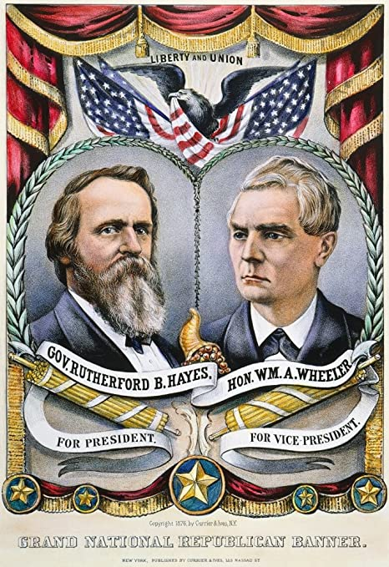
Governor of Ohio
Civil War veteran
Nomination on 7th ballot
RUTHERFORD B HAYES
“A third-rate nonentity whose only recommendations are that he is obnoxious to no one.“
- Henry Adams

Slide 11
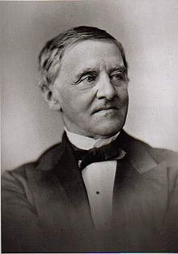
SAMUEL TILDEN
Protégé of Martin Van Buren
Railroad Attorney
Champion against corruption

Slide 12
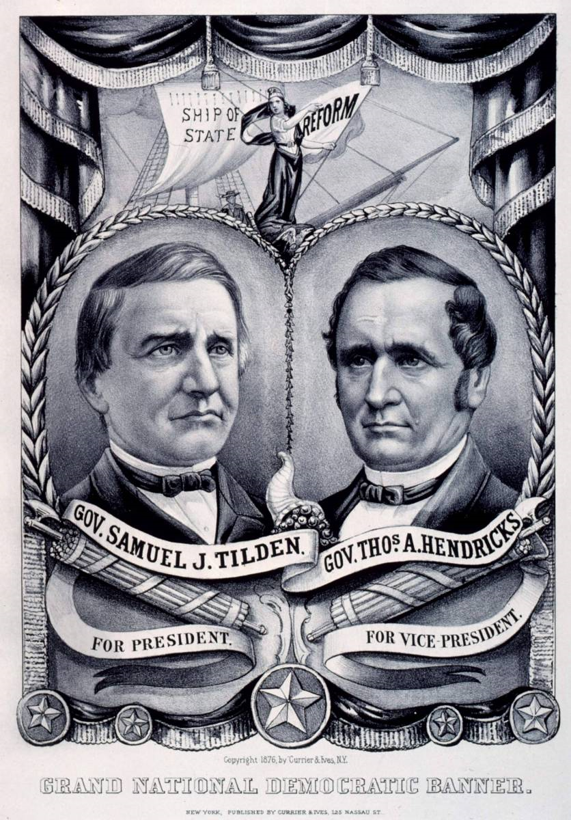
End of reconstruction
Civil reform to end corruption
Slash spending
Sound currency
SAMUEL TILDEN
“This reform will be resisted at every step; but it must be pressed persistently.” - Sam Tilden

Slide 13
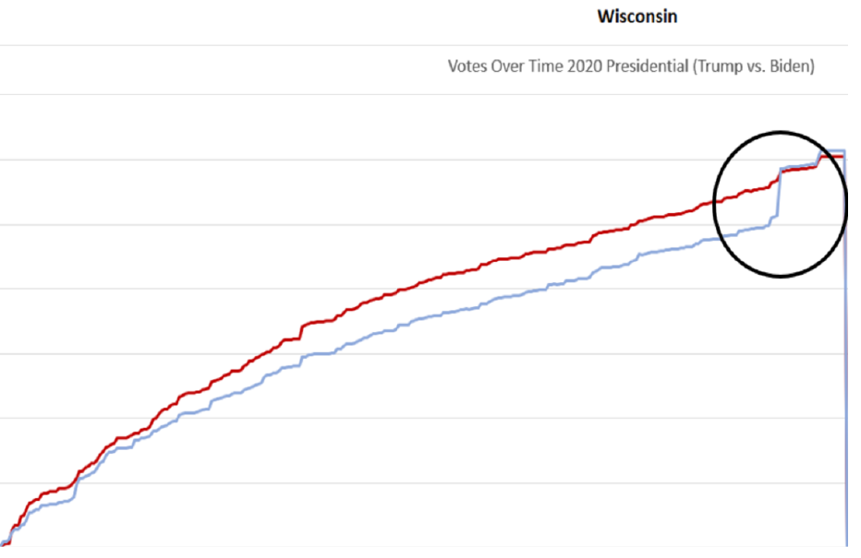
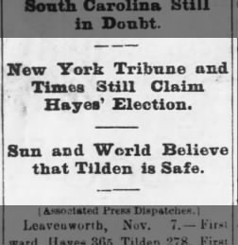
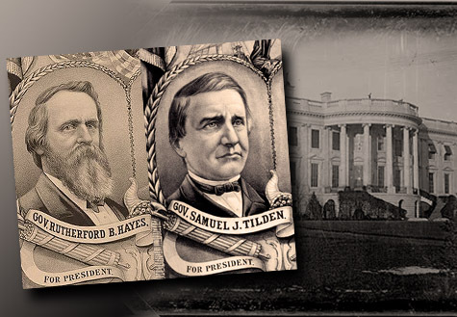
1876 election
Tilden wins new york
Florida and Louisiana Republicans telegraph losses
South Carolina and Oregon uncertain
"Lost. The Country Given Over to
Democratic Greed and Plunder.
- Chicago Tribune Nov 8, 1876

Slide 14
“The Times final edition was a lot more than a partisan and unrealistic prediction of what could happen. It became a Republican party and U.S. government prescription of what should happen.”
Mark Harmon
The New York Times and the Theft of the 1876 Presidential Election
Journal of American Culture, 1987

Slide 15
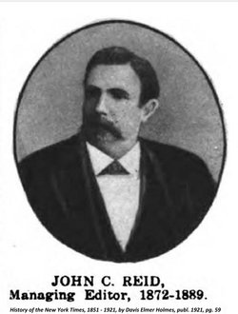
JOHN C. REID
New York Times editor
Partisan Republican, Civil War POW
Mobilized Republican election night response

Slide 16
JOHN C. REID
“The Times had attacked Tilden during the campaign with a bitterness explainable only by a fear that he was going to be elected. Had it not been for the stubborn resistance of that journal, Tilden’s election might have been quietly acknowledged.”
- Alexander Clarenre Flick

Slide 17
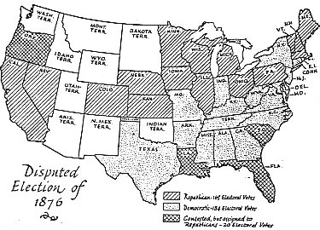
Four Contested state delegations
20 Electoral Votes in question
165 Hayes
184 Tilden
Florida, South Carolina, and Louisiana only southern states with Republican governors

Slide 18
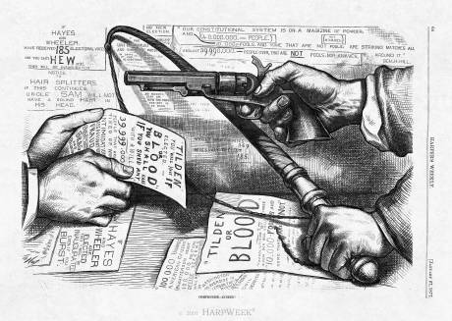
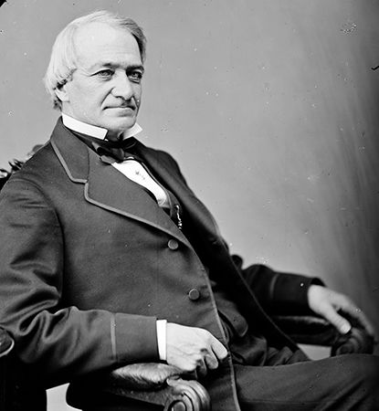
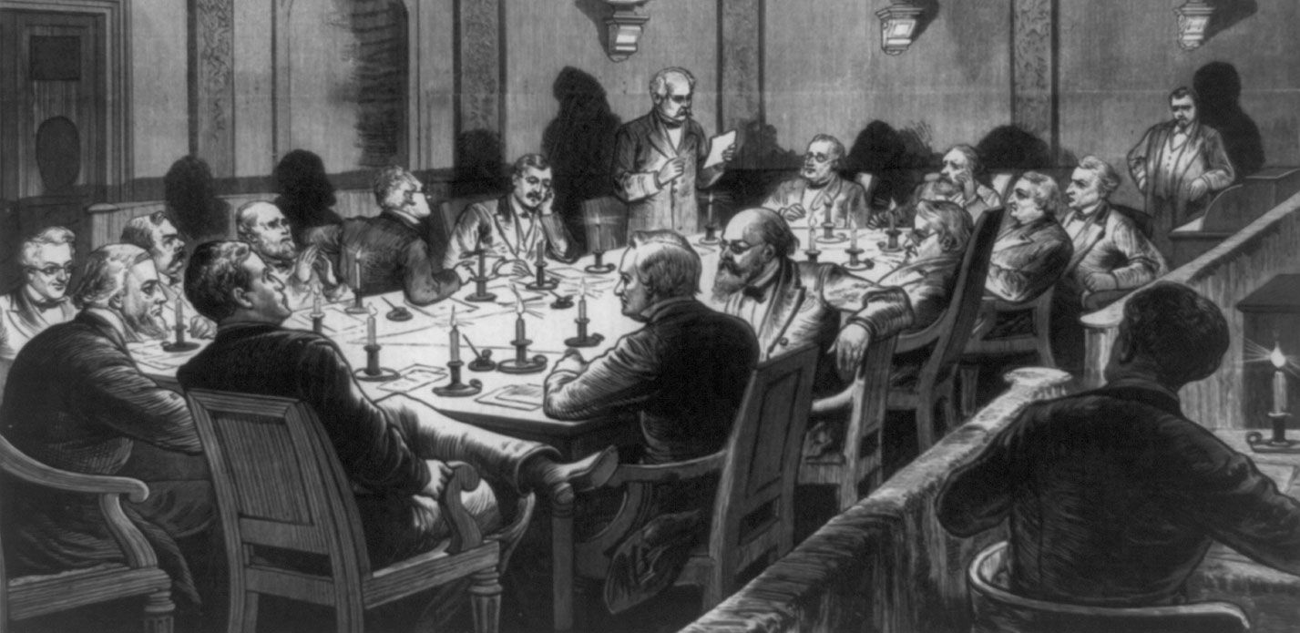
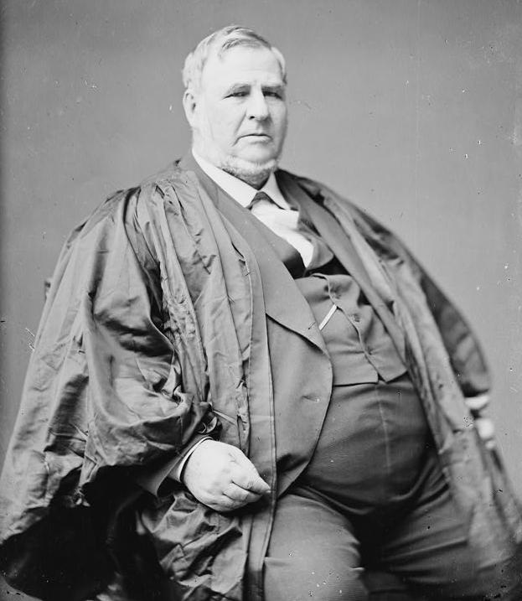
Election commission

Slide 19
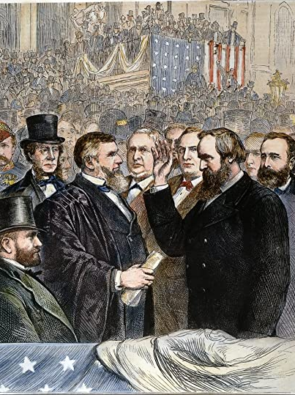
COMPROMISE OF 1877
The removal of all remaining U.S. military forces from the former Confederate states.
The inauguration of Democrat Wade Hampton over Daniel Chamberlain as SC Governor.
Promises for economic aid and railroad industry investment.
The right for southern states to set racial policies.
The appointment of at least one Southern Democrat to Hayes' cabinet. (David M. Key of Tennessee was appointed as Postmaster General.)

Slide 20
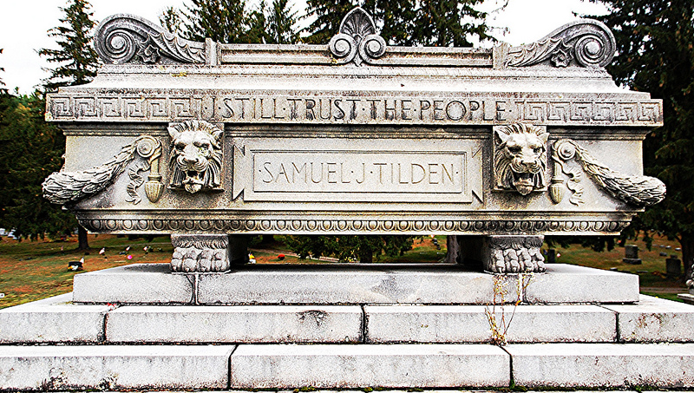
Aftermath

Slide 21
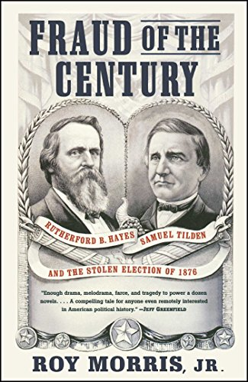
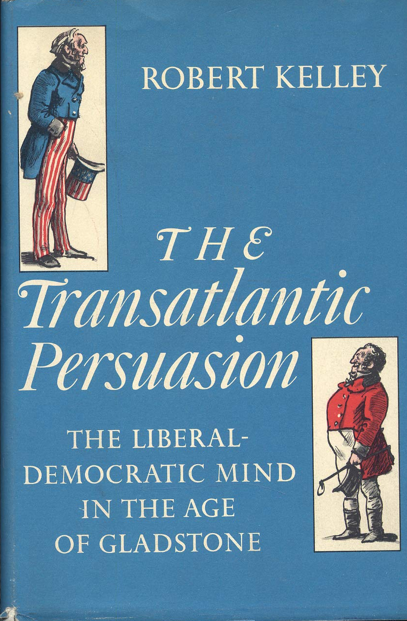
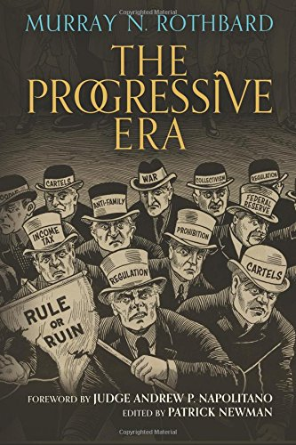
Recommended reading

