Slide 1
Economic Inequality
Dr. Mark Thornton
Mises University
July 29, 2022

Slide 2
Introduction
Austrians “love” economic inequality
Many types of “equality” and “inequality”
Socialists voice opposition to economic inequality
That “voice” is filled with lies, distortions, and “the unseen”
Reality is your guide

Slide 3
Inequality as Reality
If men were like ants, there would be no interest in human freedom. If individual men, like ants, were uniform, interchangeable, devoid of specific personality traits of their own, then who would care whether they were free or not? Who, indeed, would care if they lived or died? The glory of the human race is the uniqueness of each individual, the fact that every person, though similar in many ways to others, possesses a completely individuated personality of his own. It is the fact of each person's uniqueness — the fact that no two people can be wholly interchangeable — that makes each and every man irreplaceable and that makes us care whether he lives or dies, whether he is happy or oppressed. And, finally, it is the fact that these unique personalities need freedom for their full development that constitutes one of the major arguments for a free society. MNR

Slide 4
Aspects of Human Inequality
Physical and Biological differences (e.g., sex and sex preference)
Tastes and preferences (e.g., good and services)
IQ, Interests, Talents, education, training, experiences
Tastes for labor vs. leisure (i.e., energetic vs. lazy, e.g., “go-getters”)
Time preferences (i.e., now vs. later thinking, e.g., savers)
Risk taking preferences (e.g., entrepreneurs vs. wage labor)
All of this can be distorted by government, but not “fixed”
Reality is the perplexing brew of all these factors
Law of Comparative Advantage: We all have one!
Income distribution is not a process, a result on the market!

Slide 5
Dubious Types of Equality in Markets
Innate equality (at birth) – obviously wrong
Equality “by birth” – obviously wrong
Equality of opportunity – obviously wrong
Equality of result – obviously wrong
Attempts fail
Attempts harm
Attempts backfire
Attempts can destroy civilization
Economics recognizes reality and demonstrates its benefits for all!

Slide 6
Systems of Inequality
Natural Law—equality & justice (basic)
Rule of Law—equality & justice (legal)
Theocracy—caste system & injustice
Monarchy—caste system & injustice
Democracy—caste system & injustice
Dictatorship—caste system & injustice
Socialism & Progressivism—caste system & injustice
Capitalism or Anarcho-Capitalism and Law—equality and justice

Slide 7
Human Development Requirements
Reality: “the diversity of Nature, which does not repeat itself but creates the universe in infinite, inexhaustible variety. ...” von Mises
Freedom—despotism of all sorts stymies humanity
Development →>> Subsistence (Industrial Revolution)
Division, specialization, and comparative advantage=productivity
↑Productivity → Wages > Subsistence; Wages – C = savings
Economic Growth → Savers-> Capitalists-> Entrepreneurs=>capitalism
Capitalism paid Interest to contribute savings/capital (stocks and bonds)
Entrepreneurs borrow and pay labor now for later revenues
Entrepreneurs bear uncertainty → $ Profit and Loss

Slide 8
Every Role is Harder than it looks
The global division of labor is amazing in terms of standards of living, population, life expectancy, equality of results and achievement. We all serve everyone else to our mutual benefit.
Capitalist families deprive themselves to acquire capital. Most consume all or most of what they produce. The return after risk of repayment, bankruptcy, fluctuation, inflation, and taxes is very low.
Entrepreneurs bear uncertainty of the market (consumers). We see the extreme success stories, but most fail even with “good” products. Bubbles make it look easy, but most of them fail too!!
Labor has to work more and invest in their education, training, and experience to ↑Wages (college, apprenticeship, minor leagues) @ Opp. Cost + saving for higher incomes

Slide 9
Socialist Proposition: Efficiency and Equity
Mises and reality showed socialism was inefficient at best
Socialist (Heilbroner and Piketty) Equity and Ecology
Equity—Redistribute wealth and income
Welfare and Progressive Income Tax, etc.
Ecology—Global warming, climate change
Regulating everything to change the weather
Involves technocratic controls in issues without science (includes Covidia)

Slide 10
How Government Biases the Debate
Does not count the total number of Welfare dollars given away*
Does not count the total number of Tax dollars taken*
Does not consider all the business failures and bankruptcies (where capitalists and entrepreneurs suffer)
Does not consider all the foregone economic potential:
Rent seekers earn abnormally high incomes and competitors are “stymied.”
Welfare recipients are almost all capable to earning more income.
Taxpayers are widely discouraged from maximizing their free market incomes.
Incomes and the “economic pie” could be much larger (PPF)***

Slide 11
The Myth of American Inequality: How Government Biases Policy Debate Gramm, Ekelund, and Early, Forthcoming 2022
Looked at government statistics from 1967 to 2017
Recalculated these statistics to include:
All forms of welfare benefits (income redistribution); many missing from stats.
All forms of taxation (income redistribution); many missing from the stats.
This greatly increased the consumable income of low-income quintile households.
This greatly reduced the consumable income from high-income quintiles.
This turned all the reported stats on their heads.
Things are better or the same, not worse over the last 50 years!

Slide 12
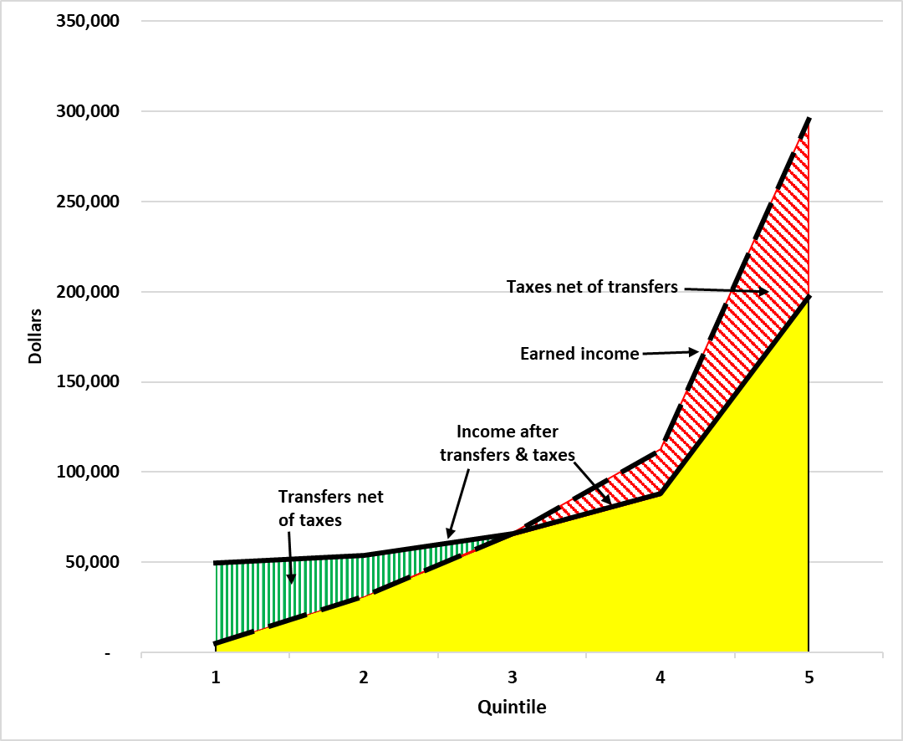
Gramm, Ekelund, and Early, forthcoming 2022
Notes:
Earned income 60:1---Reported 16.7:1----Recalculated 4:1 by quintile (20% of households)

Slide 13
Official Poverty: 1947-2017
Notes:
Gini coefficient goes lower instead of much higher. USA goes from “most unequal” to middle of the pack OECD.

Slide 14
Takeaways
You have been misled by Piketty et al, the media, the government
Inequality (of all sorts) is a good thing in the free market and people have more equality of various sorts in a market society (paradox)
Economic equality is a disastrous government policy that leads to economic ruin for all, including the poor and workers.
Government monopolies (rent seeking) protectionism for the wealthy.

Slide 15
Thank You!

Slide 16
References
Murray Rothbard, “Freedom, Inequality, Primitivism, and the Division of Labor,” Rothbard, 1970.
Murray Rothbard, “Egalitarianism as a Revolt Against Nature (and other essays)”
Murray Rothbard, Egalitarianism and the Elites, Review of Austrian Economics, 1995.
Joseph Salerno, "Ludwig von Mises as Social Rationalist,“ Review of Austrian Economics 4 (1990): 26–54.
Ludwig von Mises, Economic Calculation in the Socialist Commonwealth 1990 edition, plus Salerno, "Postscript,"
Gramm, Ekelund, Early, The Myth of American Inequality: How Government Biases Policy Debate, forthcoming.

