Slide 1
Wokeness and Big Tech
Peter G. Klein
Mises University
2022
@petergklein
#MisesU

Slide 2
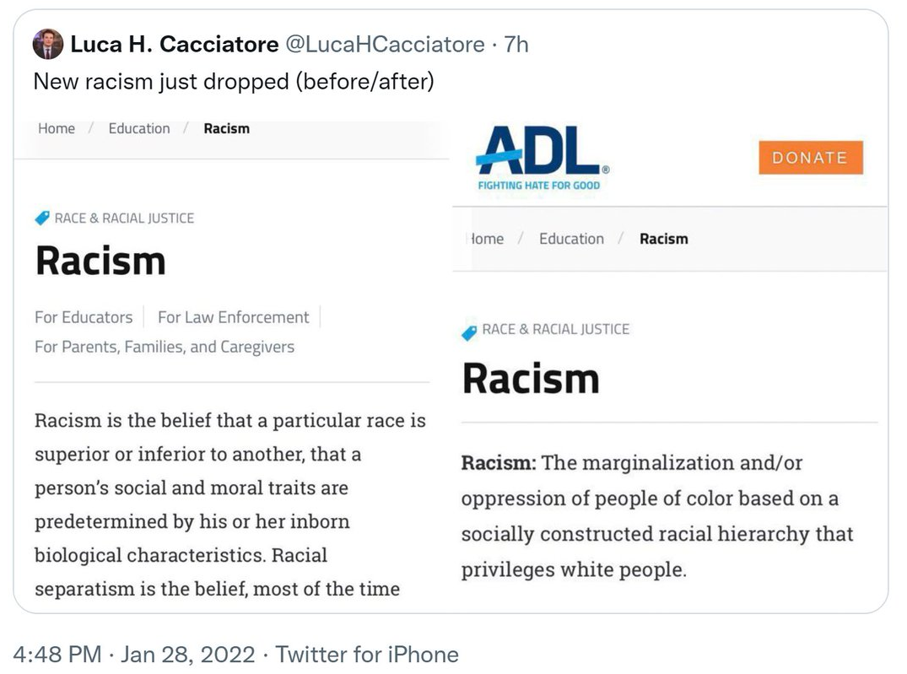
Wokeness
Concern with “social justice,”
especially related to race,
gender, sexual orientation, and
sexual identity
Philosophical origins in Frankfurt School
Epistemology: primacy of subjective, personal experience over logical argument, data
Ontology: emphasis on group characteristics and social structures rather than individual behavior; emphasis on ostracism, intolerance (“cancel culture”)
Theory of history: inevitable conflict among groups, with inexorable upward march (“cultural Marxism”)

Slide 3
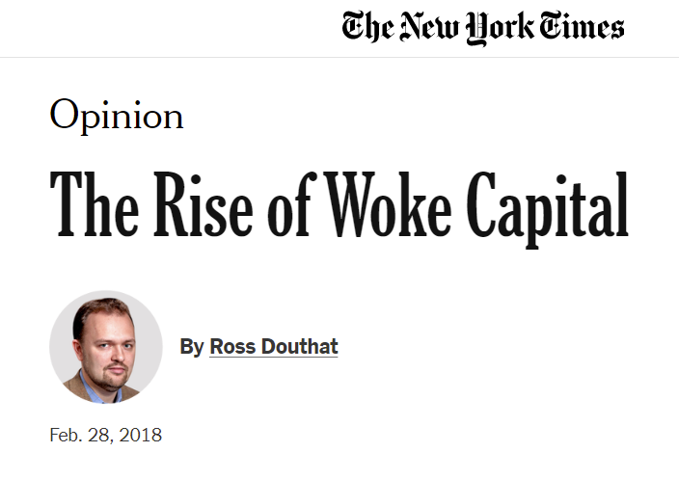
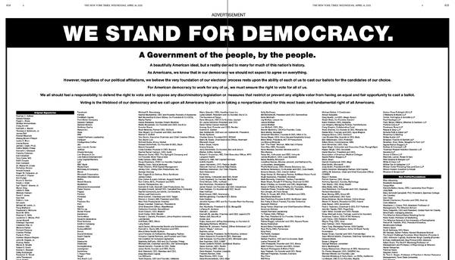
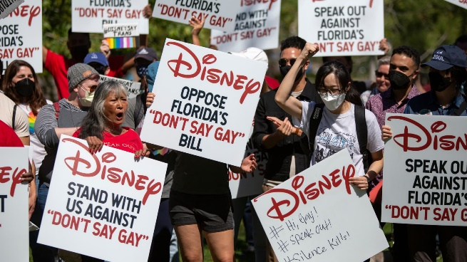
The woke corporation
Examples
DEI programs
Marketing and public relations
Philanthropy, lobbying
Causes
Normative versus instrumental motives (“wokewashing”)
Investor or executive preference?
Attempts to recruit and retain woke employees?
Delegation to woke middle managers (HR, public relations)

Slide 4
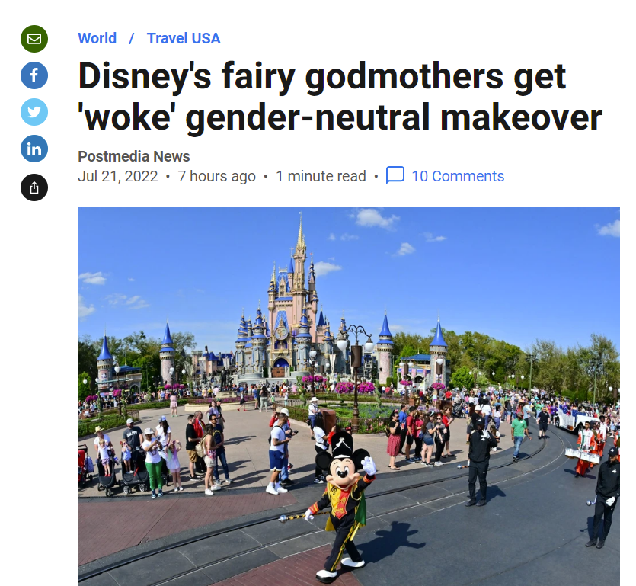
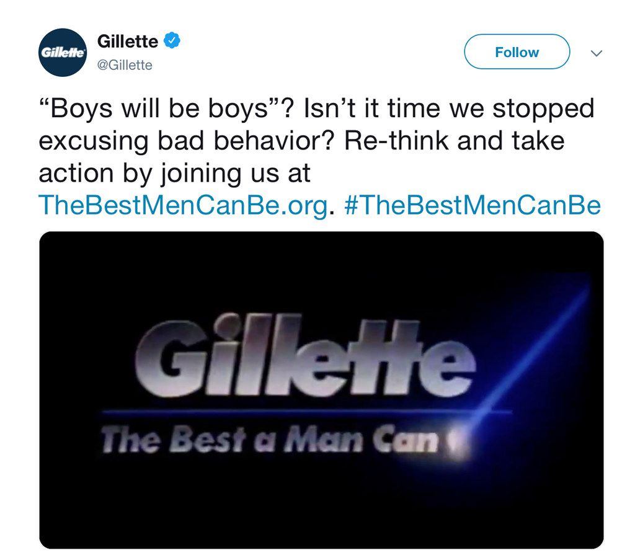
Broader context
Corporate social responsibility, stakeholder governance
Instrumental versus normative motives
Differences from wokeism
Concentration of woke in certain industries
Mostly in entertainment, retail, tech (not manufacturing, oil and gas, business services, etc.)

Slide 5
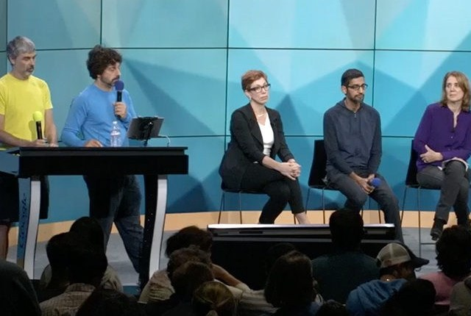
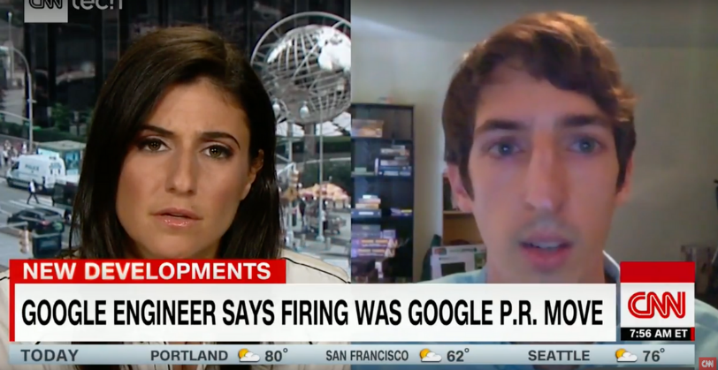
Wokeness and big tech
Tech firms as victims of wokeness
External pressure
Desire to please woke employees (but workforce not very diverse)
Delegation to middle managers
Tech firms as drivers of wokeness
Netflix, Amazon, Disney, other content providers and distributors
Social media, retailers, exchanges: deplatforming, spreading misinformation
Analogy with the woke university (secondhand dealers in ideas)

Slide 6
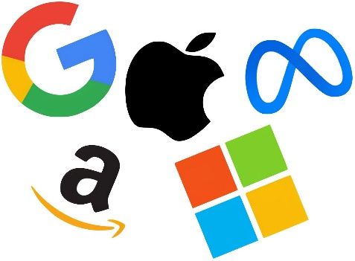
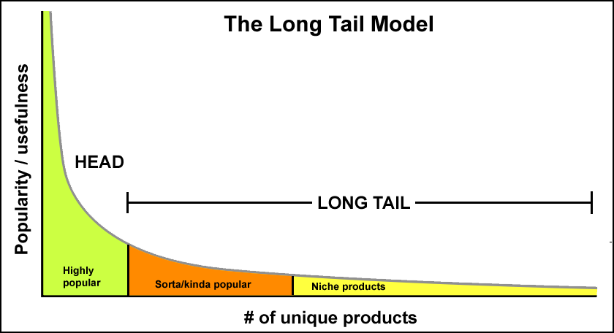
Why (some) tech companies, like universities, are woke
Business models and primary revenue streams
Costs of wokeness on the periphery
Analogy with book publishing
The case of academia

Slide 7
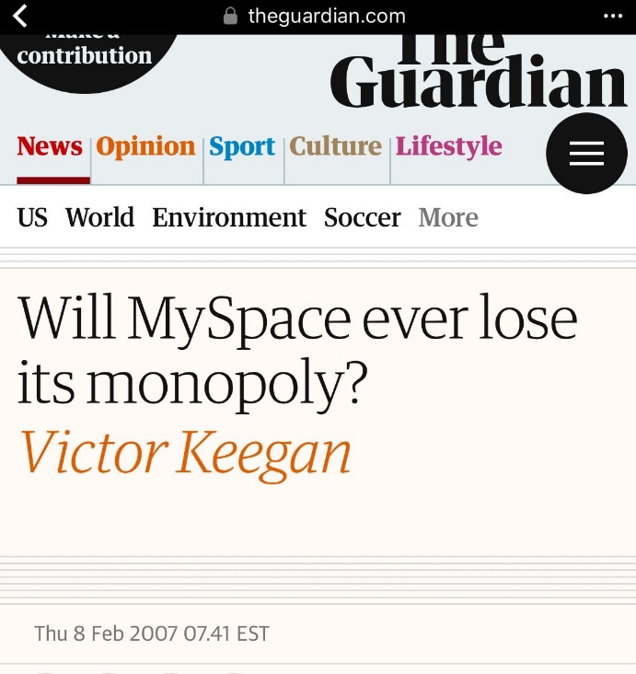
Do tech firms have monopoly power?
Large market shares (sometimes)
Network effects
Large fixed costs, low marginal costs
First-mover advantages (winner-take-most markets)
Path dependence
But still competition, absent government protection

Slide 8
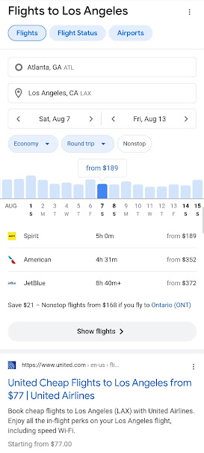
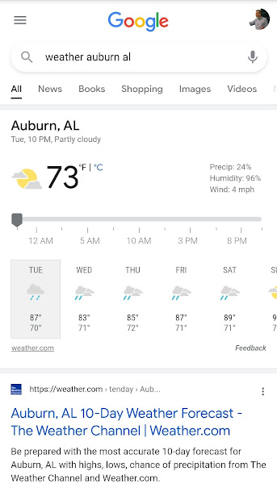
Platforms, ecosystems, and two-sided markets
Platforms
Access restrictions
Competition with providers

Slide 9
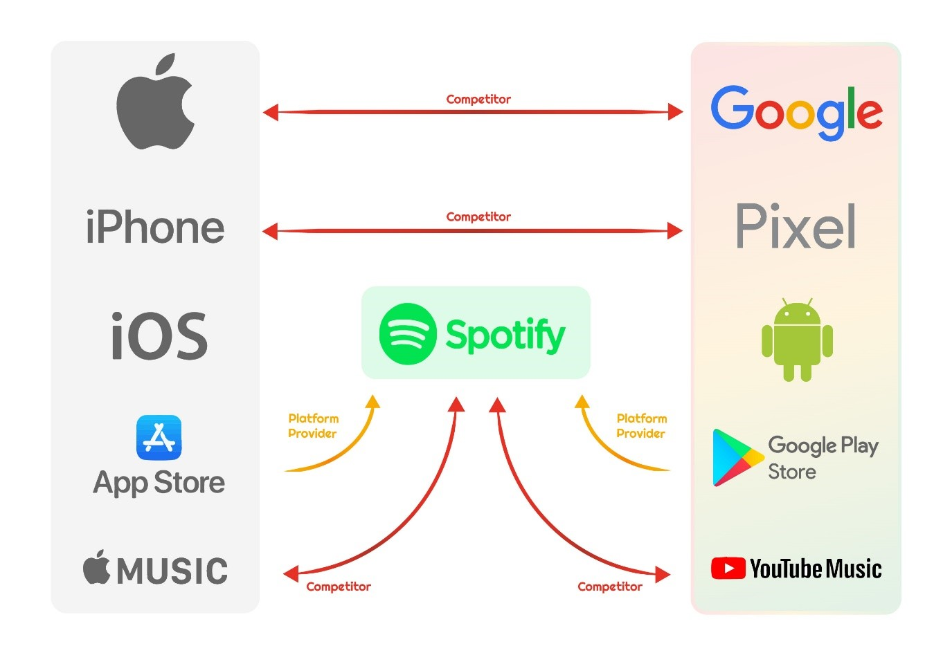
Platforms, ecosystems, and two-sided markets
Platforms
Access restrictions
Competition with providers
Ecosystems

Slide 10
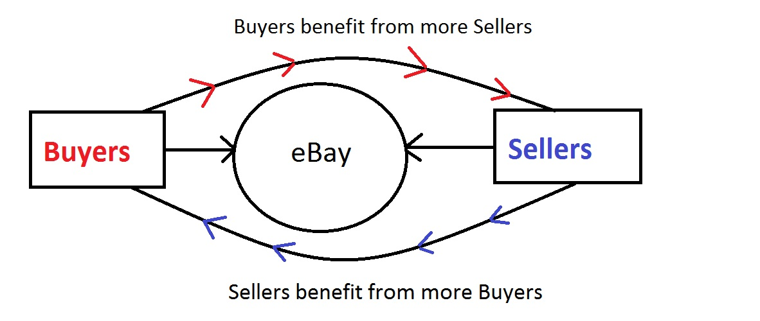
Platforms, ecosystems, and two-sided markets
Platforms
Access restrictions
Competition with providers
Ecosystems
Two-sided markets

Slide 11
Platforms, ecosystems, and two-sided markets
Platforms
Access restrictions
Competition with providers
Ecosystems
Two-sided markets
Freemium pricing
Other business-model issues: subscriptions or ads, data collection and sharing, upgrade strategies, licenses or subscriptions, etc.

Slide 12
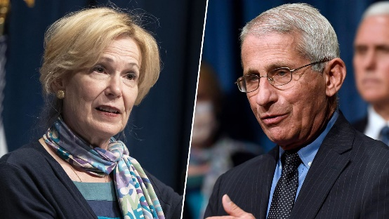
Do these characteristics give rise to monopoly power?
Standard monopoly arguments
“Natural monopoly”
Platforms as public utilities
“Misinformation” projects: result of intense pressure from the state
Are tech firms “part of the state”?
Origins in public funding
Data sharing
Deplatforming
Section 230 and other privileges
The public-private boundary in a mixed economy
Ownership
Control

Slide 13
Policy toward big tech
Breakups, public ownership
Regulation
Content neutrality (common-carrier status, the “public square,” etc.), bans on private-label placement
Mandatory data portability, bans on collecting user data (would then need alternative pricing models)
Note on privacy
In some ways, platforms create more privacy
We can pay (in $$$ or inconvenience, reduced usability) for more privacy, yet very few do
Patronage
Remove all privileges, protection
Sec 230, CDA

