Slide 1
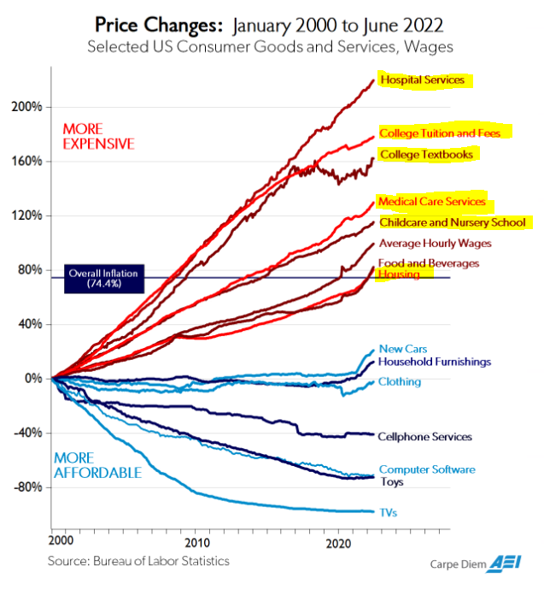
Higher Education In Crisis
Timothy D. Terrell
Mises University 2022
@timothyterrell
terrelltd@wofford.edu

Slide 2
Crisis 1: College Doesn’t Do What It Advertises Crisis 2: Government Subsidies are Backfiring Crisis 3: Stifled Academic Discourse

Slide 3
Crisis 1: College Doesn’t Do What It Advertises

Slide 4
What Does College Do?
Transfer skills (“human capital”)?
Signal work ethic or disposition toward higher-order thinking?
Provide a consumption good for higher-income individuals?

Slide 5
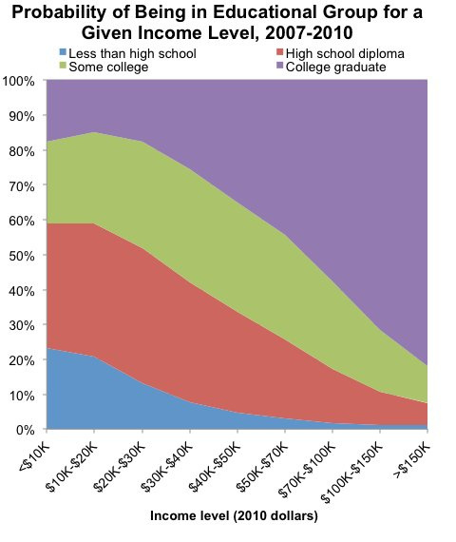

Slide 6
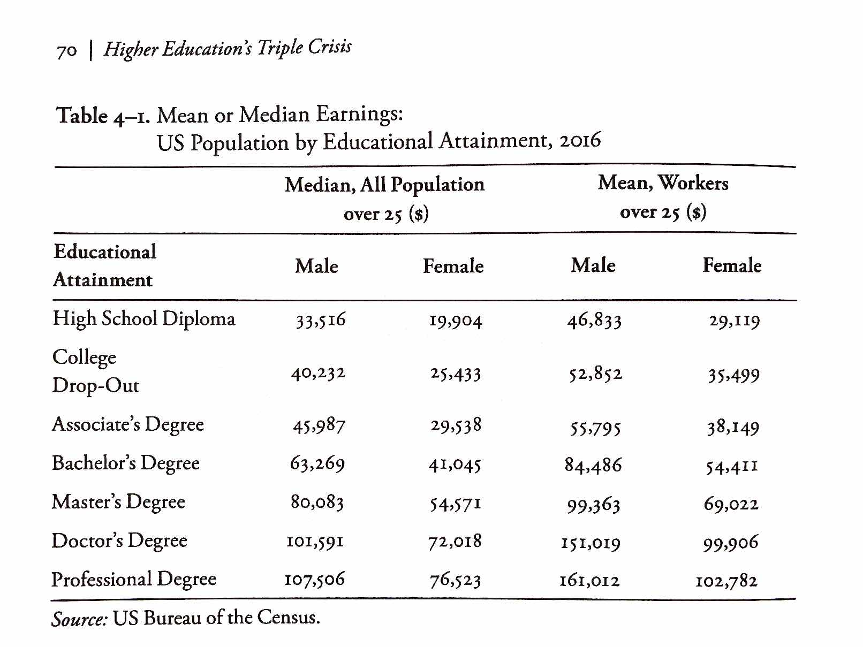
From Richard Vedder, Restoring the Promise, p. 70.

Slide 7
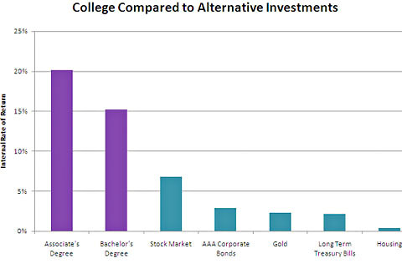

Slide 8
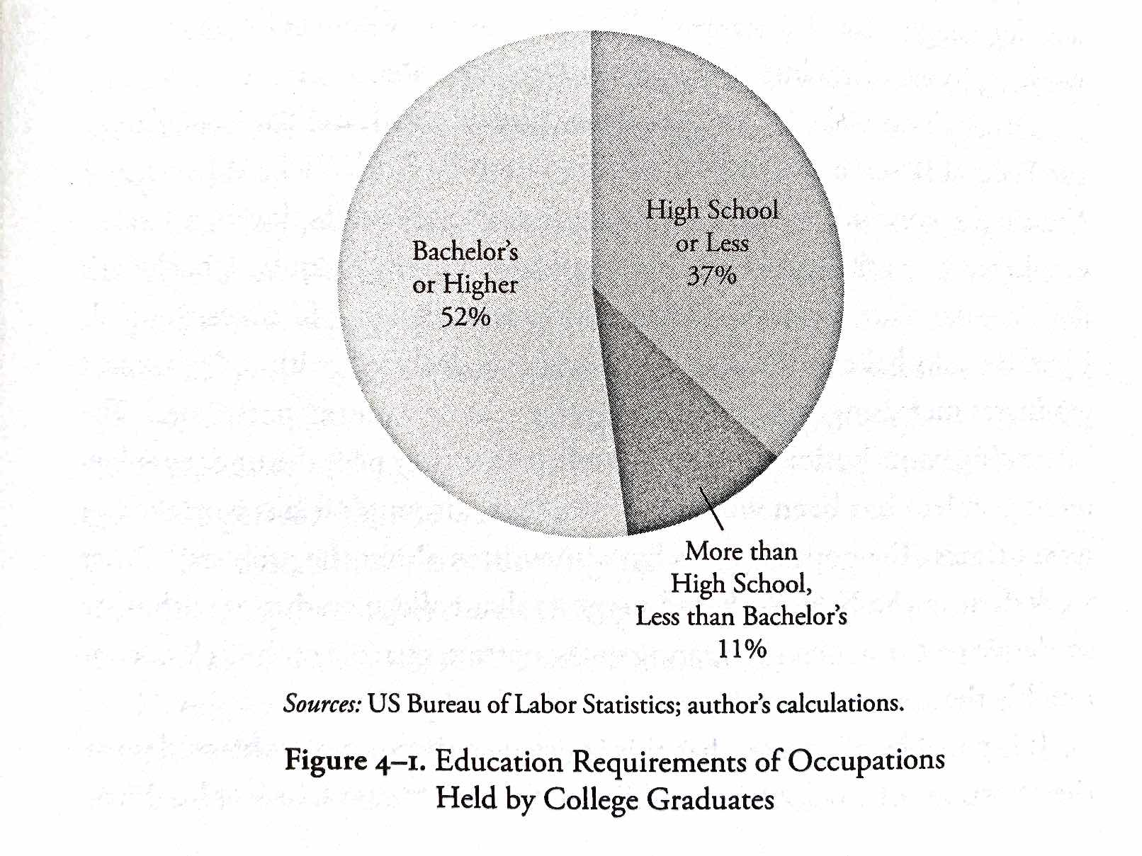
From Richard Vedder, Restoring the Promise, p. 71.

Slide 9
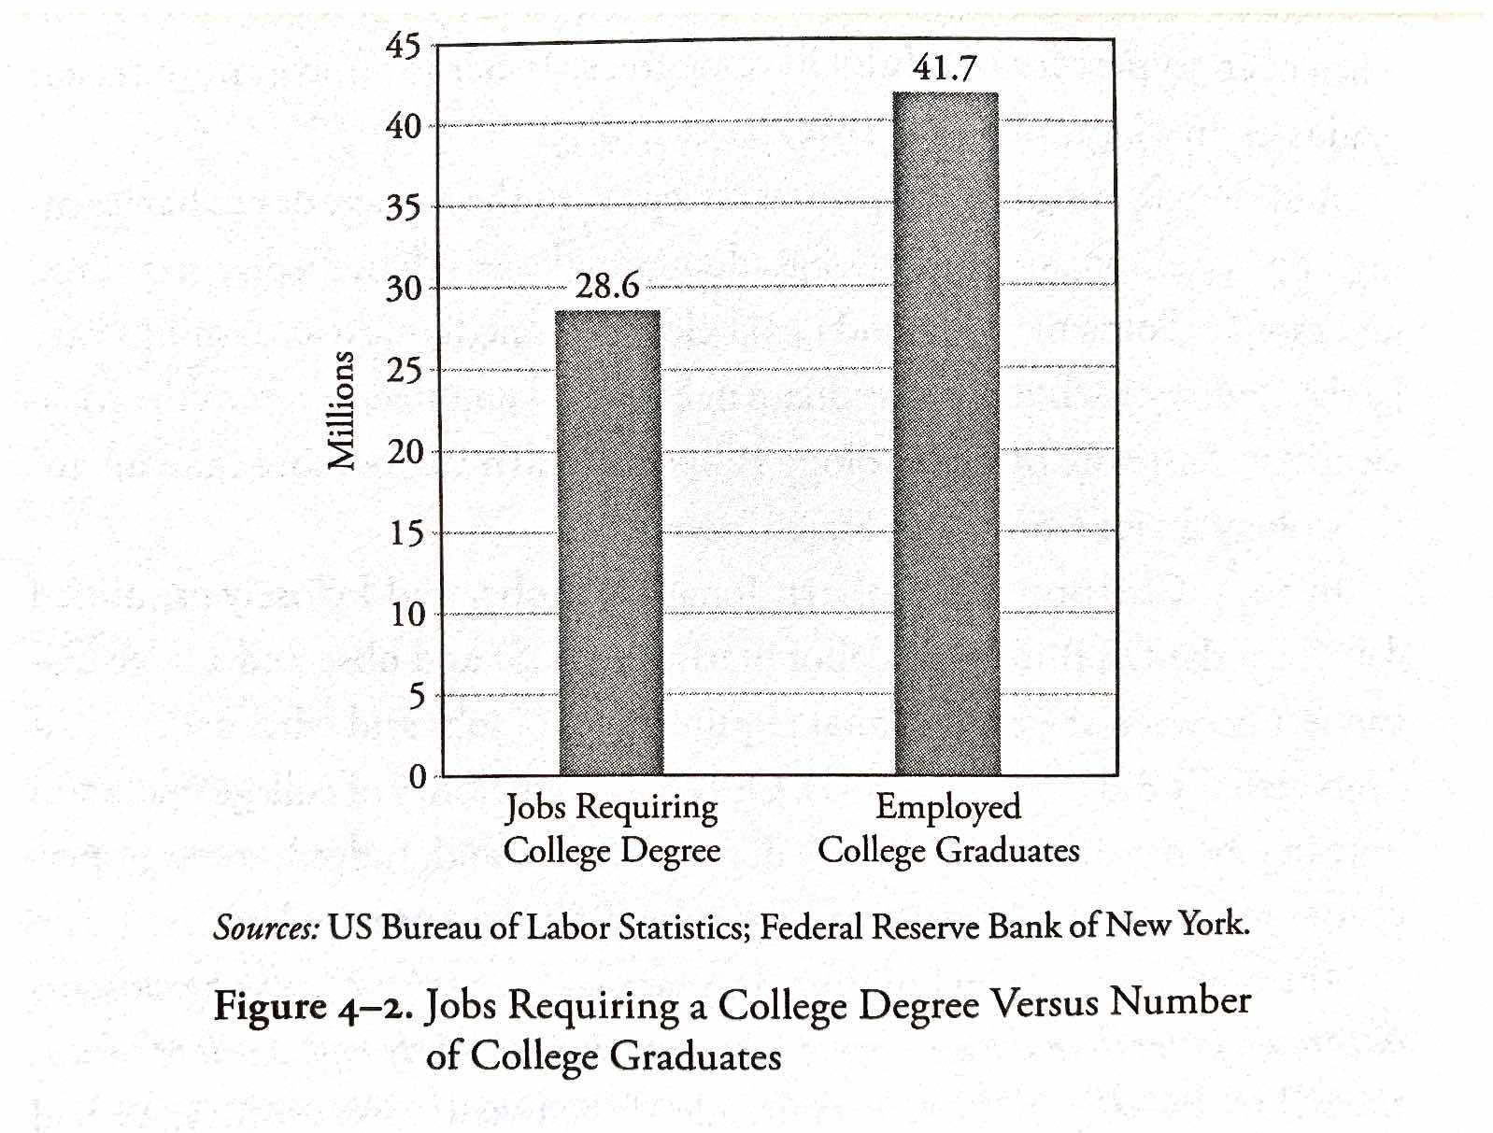
From Richard Vedder, Restoring the Promise, p. 72.

Slide 10
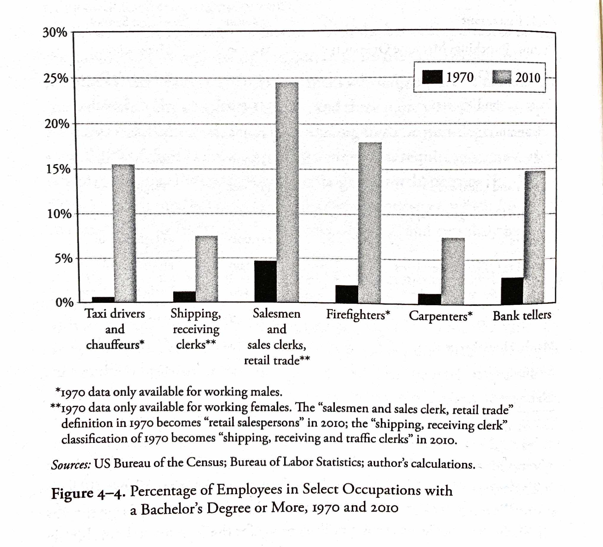
From Richard Vedder, Restoring the Promise, p. 76.

Slide 11
Higher Education as Signaling
Filter for motivation, perseverance, intelligence
Certified motivated, persevering, intelligent
Pass
To filter
Population
Uncertified motivated, persevering, intelligent
+
Unmotivated, undisciplined, unintelligent
Fail/dropout
Bypass filter

Slide 12
Higher Education as Signaling
$
Taxes
Filter for motivation, perseverance, intelligence
(less effective)
Certified motivated, persevering, intelligent
Pass
Subsidies
Population
To filter
Uncertified motivated, persevering, intelligent
+
Unmotivated, undisciplined, unintelligent
Fail/dropout
Bypass filter

Slide 13
Higher Education as Signaling
“[O]nce workers have been ranked, giving everyone extra years of education is socially wasteful. Furthermore, since the status quo is supported by hundreds of billions of dollars of subsidies, we’re probably underusing alternative certification methods like apprenticeships, testing, boot camps, and so on.”
“Signaling… explains why students are far more concerned about grades than actual learning. They want ‘easy A’s’—not professors who teach lots of job skills. Signaling explains why cheating pays—a successful cheater profits by impersonating a good student. And signaling explains why students readily forget course material the day after the final exam. Once you’ve got the good signal on your transcript, you can usually safely forget whatever you learned.”
-- Bryan Caplan
http://blog.press.princeton.edu/2018/01/23/bryan-caplan-on-the-case-against-education/

Slide 14
Higher Education as Signaling
“Above all, we need far less education. And the cleanest way to get far less education is to sharply cut government education spending. …[E]mployers will no longer expect you to have the education you can no longer afford. In other words, spending cuts will cause credential deflation. You’ll once again be able to get low- and middle-skill jobs with a high school degree—or less.”
“[T]here’s little sign that education causes much enlightenment or civic understanding. Even at top schools, most students are intellectually and culturally apathetic, and most professors are uninspiring.”
-- Bryan Caplan
http://blog.press.princeton.edu/2018/01/23/bryan-caplan-on-the-case-against-education/

Slide 15
Plagiarism and Incentives
Administrators are incentivized to accept applicants who may have little experience in writing.
Administrators have little incentive to vigorously prosecute plagiarism.
Increasing online formats foster an environment where cheating is low-cost.
Faculty (and GTAs) have little incentive to create work for themselves by following a bureaucratized academic dishonesty process.

Slide 16
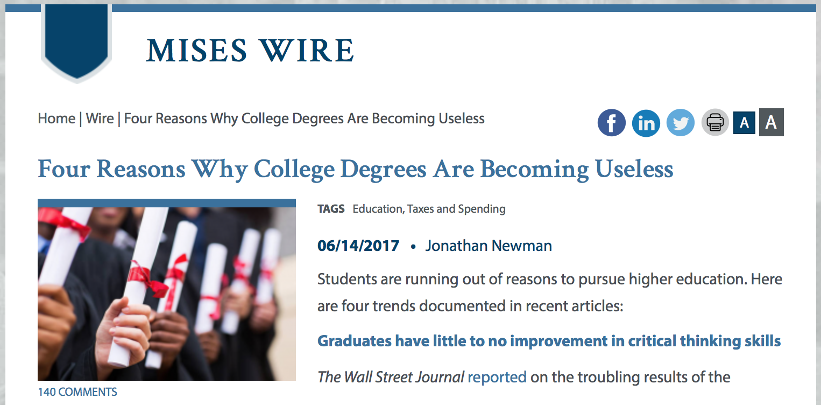

Slide 17
Does College Deliver?
“At some of the most prestigious flagship universities, test results indicate the average graduate shows little or no improvement in critical thinking over four years.”
Jonathan Newman, “Four Reasons Why College Degrees are Becoming Useless,” https://mises.org/wire/four-reasons-why-college-degrees-are-becoming-useless

Slide 18
Grade Inflation
“At Yale College, where 62 percent of grades are in the A range, proposals to curb grade inflation are in doubt following student protests and faculty concern.”*
“[Arthur Levine] found in a national survey that 41 percent of students had grade point averages of A-minus or higher in 2009, compared to just 7 percent in 1969.”*
Denning, Eide, Mumford, Patterson, and Warnick (2022): The increase in graduation rates over the last three decades is driven by grade inflation. (“Why Have College Completion Rates Increased?” American Economic Journal: Applied Economics 14, no. 3 [July] https://www.aeaweb.org/research/college-completion-grade-inflation-us)
*Marcella Bombardieri, “Harvard, Other Schools Still Fighting Grade Inflation,” https://www.bostonglobe.com/metro/2013/12/05/with-its-most-common-grade-harvard-earns-disapproval-but-has-company/kCeheDYfuDjSRcM1sVljfK/story.html

Slide 19
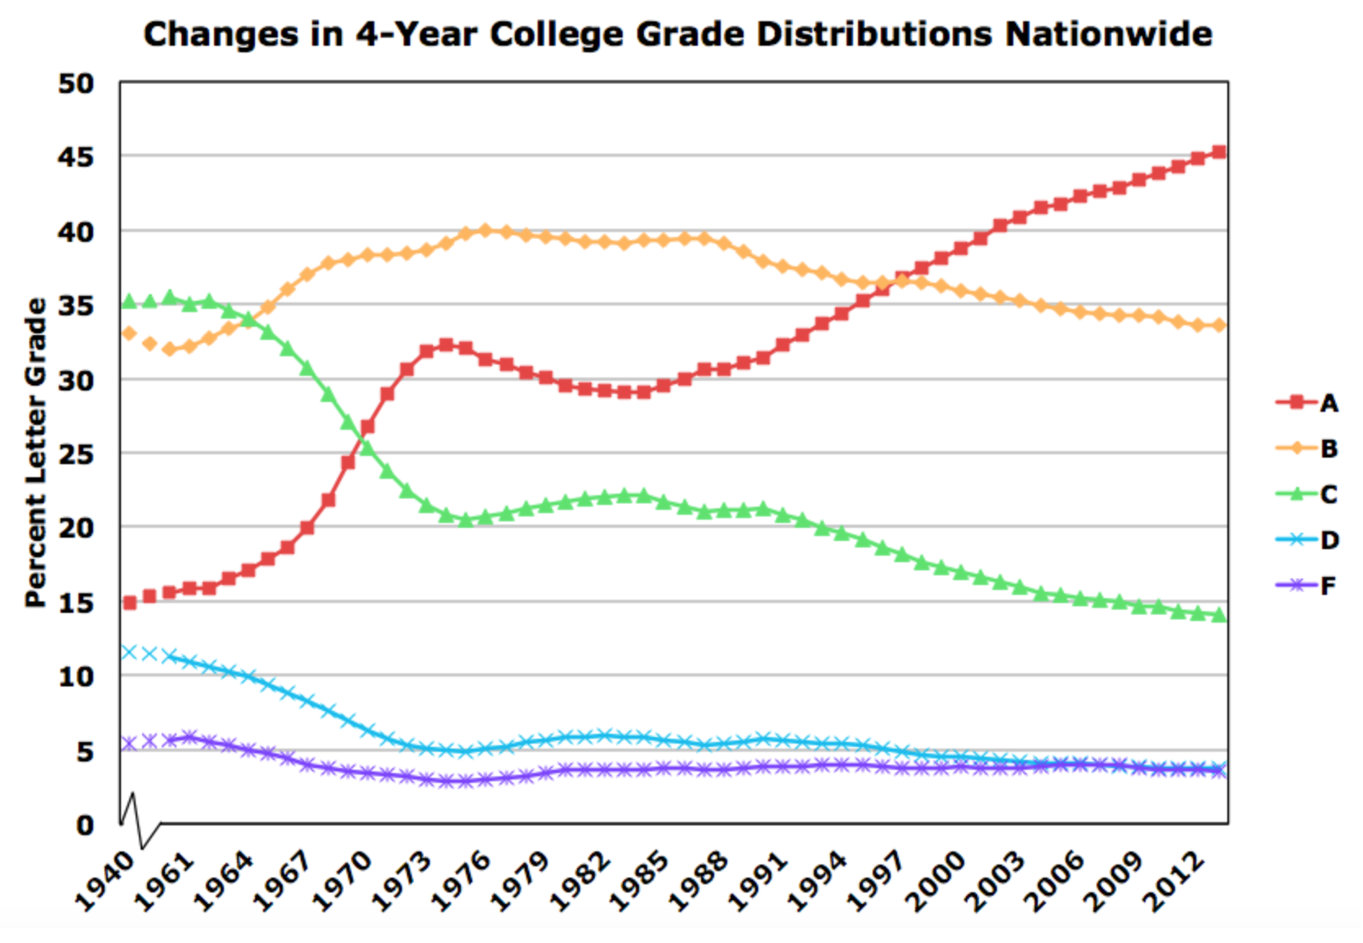
Source: gradeinflation.com

Slide 20
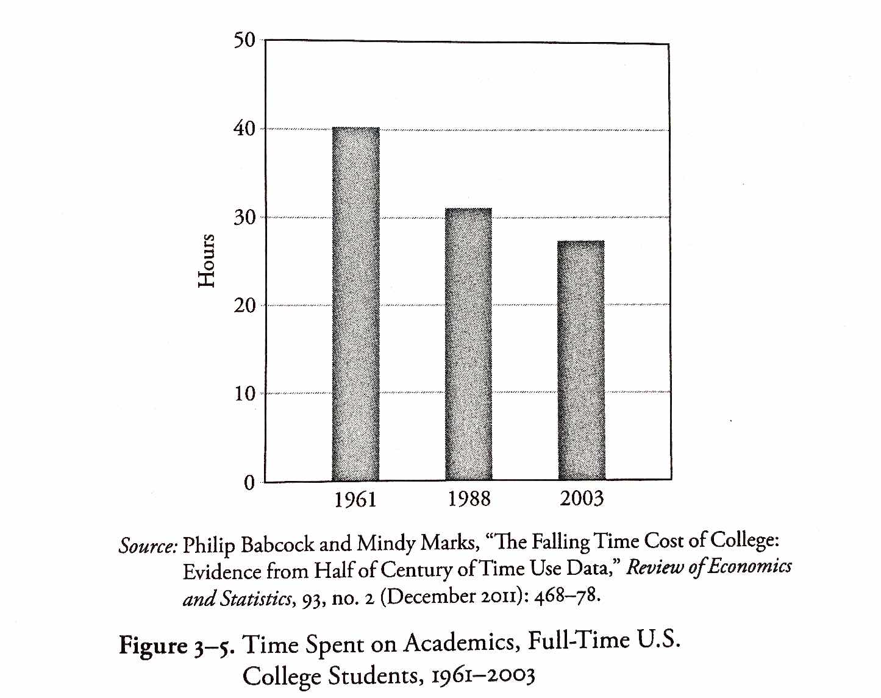
From Richard Vedder, Restoring the Promise, p. 57.

Slide 21
Crisis 2: Government Subsidies Are Backfiring

Slide 22
Student Loan Debt
$1.75 trillion in total student loan debt*
$28,950 average debt per borrower*
92% federal; remainder is private*
60% of student loan debt is held by those in the top 40% of household income.**
* Source: https://www.forbes.com/advisor/student-loans/average-student-loan-statistics/ ** Source: https://www.sofi.com/learn/content/average-student-loan-debt-by-career/

Slide 23
Tuition and Costs
Jonathan Newman, “Busting the ‘Free College’ Myth,” https://mises.org/wire/busting-free-college-myth

Slide 24
https://www.zerohedge.com/news/2014-04-06/ongoing-inflation-higher-education-bubble

Slide 26
For-Profit Education
“[A] market has natural mechanisms for punishing credit abusers, mechanisms that decrease the likelihood that these individuals will be the beneficiaries of credit in future transactions. Unfortunately, much to the dismay of the American taxpayer, such mechanisms are not intrinsic in FFA, where everyone enjoys equal status regardless of their ability to satisfy debt-related obligations.

Slide 27
For-Profit Education
“Only in rare instances, such as prior default on student loans, will government restrict access to this ubiquitous program. While some may champion FFA by arguing the merits of readily accessible education, they fail to heed the lessons taught to us by Henry Hazlitt in his masterpiece Economics in One Lesson. In particular, advocates conveniently overlook the unintended consequences of systematically extending credit to undeserving debtors: higher prices and default.”
-- A.G. Smith, “The Bubble in For-Profit Schooling,” https://mises.org/library/bubble-profit-schooling

Slide 28
Federal Aid and Student Costs
The “Bennett Hypothesis”
“[I]ncreases in financial aid in recent years have enabled colleges and universities blithely to raise their tuitions.”
-- William Bennett, former secretary of education, 1987

Slide 29
Federal Aid and Student Costs
“A prominent question in public debate is whether Pell grants tend to be appropriated by universities through increases in tuition—consistent with what is known as the Bennett hypothesis. Based on a panel of 1554 colleges and universities from 1989 to 1996, we find little evidence of the Bennett hypothesis for in-state tuition for public universities. For private universities, though, increases in Pell grants appear to be matched nearly one for one by increases in list (and net) tuition. Results for out-of-state tuition for public universities are similar to those for private universities, suggesting that they behave more like private ones in setting out-of-state tuition.”
Larry Singell, Joe Stone, 2007. “For Whom the Pell Tolls: The Response of University Tuition to Federal Grants-in-Aid,” Economics of Education Review 26, no. 3: 285–295.
https://eric.ed.gov/?id=EJ762744

Slide 30
Federal Aid and Student Costs
“…intended cost reductions of tax-based federal student aid are substantially offset by institutional price increases for a sample of 4-year colleges and universities. Contrary to the goal of policymakers, I find that tax-based aid crowds out institutional aid roughly dollar-for-dollar.”
Nicholas Turner, 2012. “Who Benefits from Student Aid? The Economic Incidence of Tax-Based Federal Student Aid,” Economics of Education Review 31, no. 4: 463–481.

Slide 31
Federal Aid and Student Costs
“We find that the Title IV institutions [eligible to participate in federal student aid programs] charge tuition that is about 78 percent higher than that charged by comparable institutions whose students cannot apply for federal financial aid.”
Stephanie Riegg Cellini, Claudia Goldin, 2013. “Does Federal Student Aid Raise Tuition? New Evidence on For-Profit Colleges,” NBER Working Paper No. 17827
https://www.sciencedirect.com/science/article/pii/S0272775711001968
http://www.nber.org/papers/w17827

Slide 32
Federal Aid and Student Costs
“We study the link between the student credit expansion of the past fifteen years and the contemporaneous rise in college tuition. …We find a pass-through effect on tuition of changes in subsidized loan maximums of about 60 cents on the dollar, and smaller but positive effects for unsubsidized federal loans. The subsidized loan effect is most pronounced for more expensive degrees, those offered by private institutions, and for two-year or vocational programs.”
David O. Lucca, Taylor Nadauld, and Karen Shen, 2017. “Credit Supply and the Rise in College Tuition: Evidence from the Expansion in Federal Student Aid Programs,” FRBNY Staff Report.
https://www.newyorkfed.org/research/staff_reports/sr733.html

Slide 33
Federal Aid and Student Costs
“The demand-side shocks [e.g., expanded subsidized student loan availability] cause tuition to jump by 91%. With all other changes except the demand-side shocks, tuition only increases by 14%.”
Grey Gordon and Aaron Hedlund, 2017. “Accounting for the Rise in College Tuition,” Chapter forthcoming in Charles R. Hulten and Valerie A. Ramey, eds., Education, Skills, and Technical Change: Implications for Future US GDP Growth, University of Chicago Press, NBER Book Series Studies in Income and Wealth.
http://www.nber.org/chapters/c13711.pdf

Slide 34
Where Does the Money Go?
Dormitory improvements, campus amenities, and administration, for the most part.
Princeton spent $136 million on a student dormitory ”with leaded glass windows and a cavernous oak dining hall…. The dorm’s cost approached $300,000 per bed.”
Since 2000, NYU ”has provided $90 million in loans, many of them zero-interest and forgivable, to administrators and faculty to buy houses and summer homes on Fire Island and the Hamptons.”
Richard Vedder, 2013, http://www.wsj.com/articles/SB10001424127887324619504579029282438522674

Slide 35
Where Does the Money Go?
“Former Ohio State President Gordon Gee… earned nearly $2 million in compensation last year while living in a 9,630 square-foot Tudor mansion on a 1.3 acre estate. The Columbus Camelot includes $673,000 in art décor and a $532 shower curtain in a guest bathroom. Ohio State also paid roughly $23,000 per month for Mr. Gee’s soirees and half a million for him to travel the country on a private jet.”
”Colleges have also used the gusher of taxpayer dollars to hire more administrators to manage their bloated bureaucracies…. The University of California system employs 2,358 administrative staff in just its president’s office.”
Richard Vedder, 2013, http://www.wsj.com/articles/SB10001424127887324619504579029282438522674

Slide 36
Where Does the Money Go?
Vedder: “Thirty percent of the adult population has college degrees…. The Department of Labor tells us that only 20% or so of jobs require college degrees. We have 115,520 janitors in the United States with bachelor’s degrees or more. Why are we encouraging more kids to go to college?”
”’In housing, we had artificially low interest rates. The government encouraged people with low qualifications to buy a house. Today, we have low interest rates on student loans. The government is encouraging kids to go to school who are unqualified just as it encouraged people to buy a home who are unqualified.’”
“…ultimately, the way to improve college affordability is for the government to disinvest in higher ed and wean students from subsidies.”
Richard Vedder, 2013, http://www.wsj.com/articles/SB10001424127887324619504579029282438522674

Slide 37
Crisis 3: Stifled ACADEMIC Discourse

Slide 38
Stifled Academic Discourse
“Shouting matches have invaded campuses across the country”
“At Evergreen State College in Washington, student protests have hijacked classrooms and administration. Protestors took over the administration offices last month, and have disrupted classes as well. It has come to the point where enrollment has fallen so dramatically that government funding is now on the line.”
“The chaos at Evergreen resulted in ‘anonymous threats of mass murder, resulting in the campus being closed for three days.’”
Jonathan Newman, “Four Reasons Why College Degrees are Becoming Useless,” https://mises.org/wire/four-reasons-why-college-degrees-are-becoming-useless

Slide 39
Stifled Academic Discourse
2017 study of college students: “Some students say shouting down speakers and using violence is sometimes acceptable”
“Many colleges struggle when inviting controversial figures to speak on campus. Ninety percent of college students say it is never acceptable to use violence to prevent someone from speaking, but 10 percent say it is sometimes acceptable. A majority (62 percent) also say shouting down speakers is never acceptable, although 37 percent believe it is sometimes acceptable.” (medium.com)
“Students have become more likely to think the climate on their campus prevents people from speaking their mind because others might take offense.” (knightfoundation.org)
Gallup-Knight Foundation survey of U.S. college students, https://www.knightfoundation.org/reports/free-expression-on-campus-what-college-students-think-about-first-amendment-issues and https://medium.com/informed-and-engaged/8-ways-college-student-views-on-free-speech-are-evolving-963334babe40

Slide 40
Stifled Academic Discourse
2017 study of 1,500 U.S. citizen undergraduates at 4-year colleges and universities:
“fewer than half of the respondents believe that the First Amendment protects hate speech.”
“A public university invites a very controversial speaker to an on-campus event. The speaker is known for making offensive and hurtful statements. A student group opposed to the speaker uses violence to prevent the speaker from speaking. Do you agree or disagree that the student group’s actions are acceptable?” “19% of the respondents stated that they agreed with the student group’s actions….”
Eugene Volokh, “Freedom of Expression on Campus: An Overview of Some Recent Surveys,” Washington Post, Oct. 23, 2017. https://www.washingtonpost.com/news/volokh-conspiracy/wp/2017/10/23/freedom-of-expression-on-campus-an-overview-of-some-recent-surveys/?utm_term=.baea637297f6
Image: https://www.newyorker.com/magazine/2016/05/30/the-new-activism-of-liberal-arts-colleges

Slide 41
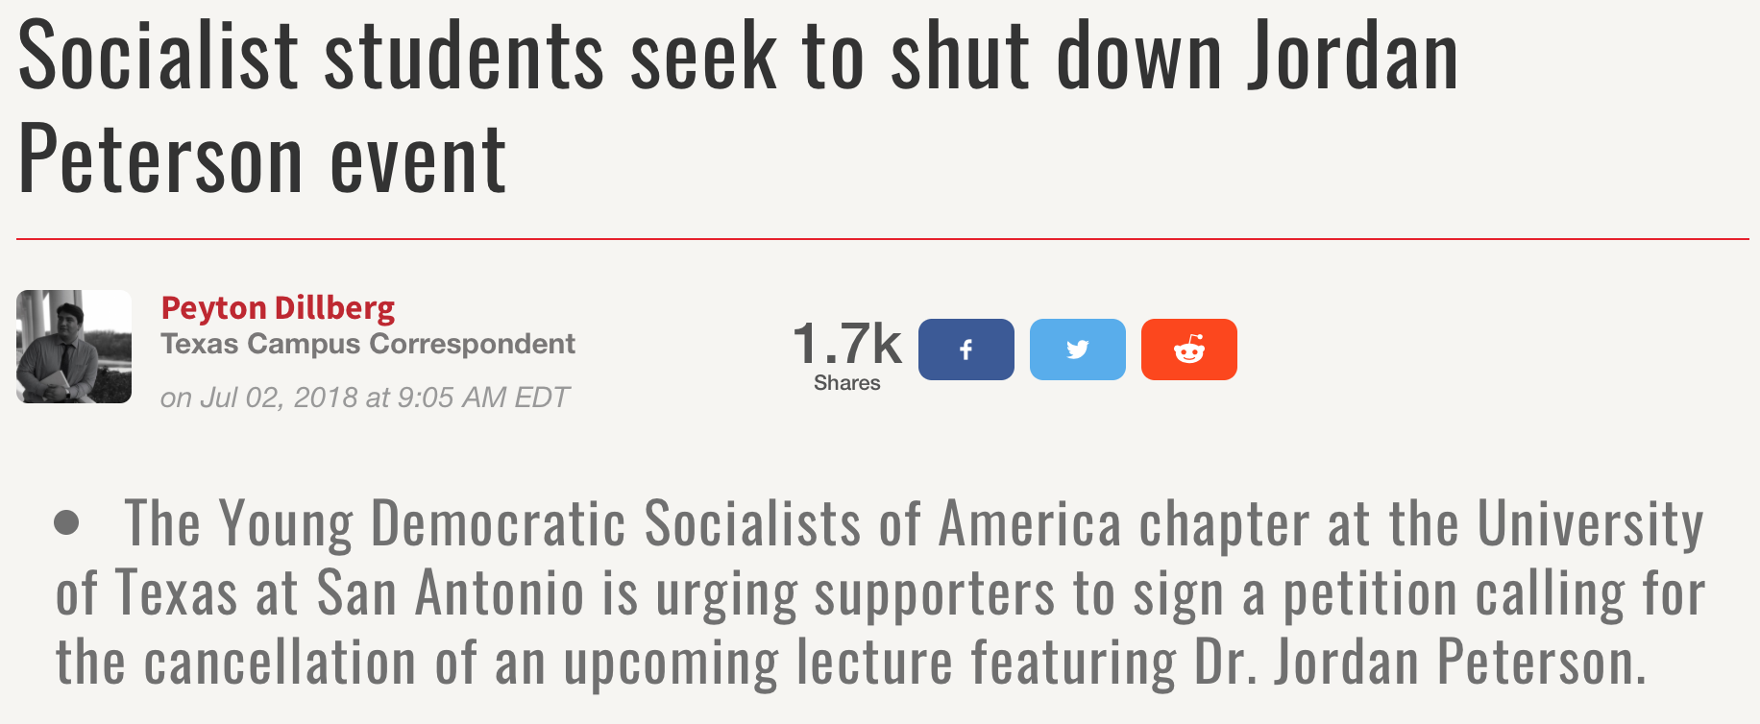
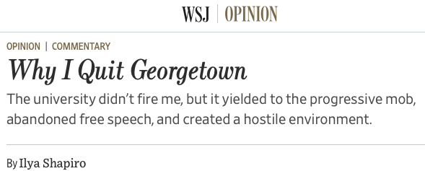
https://www.campusreform.org/?ID=11082
https://www.newyorker.com/magazine/2016/05/30/the-new-activism-of-liberal-arts-colleges

Slide 42
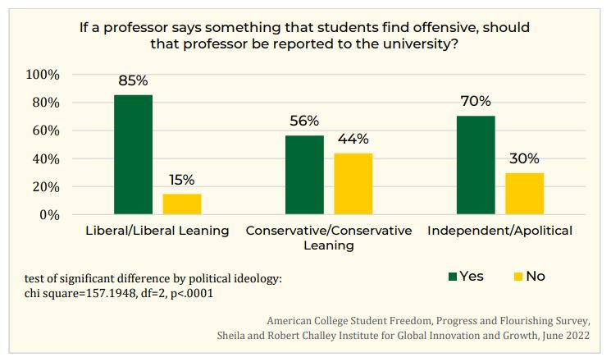
Stifled Academic Discourse

Slide 43
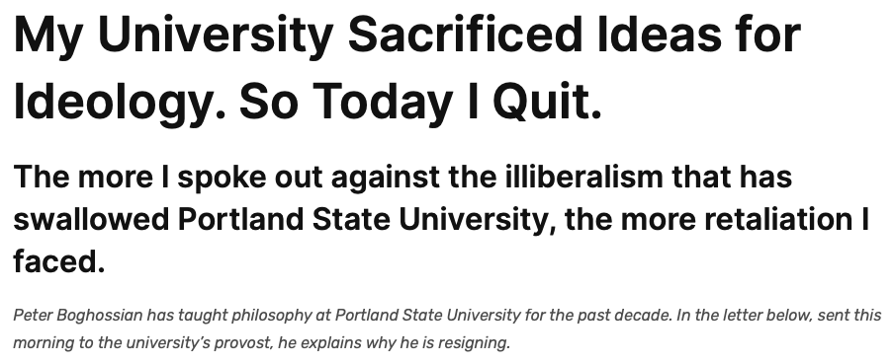
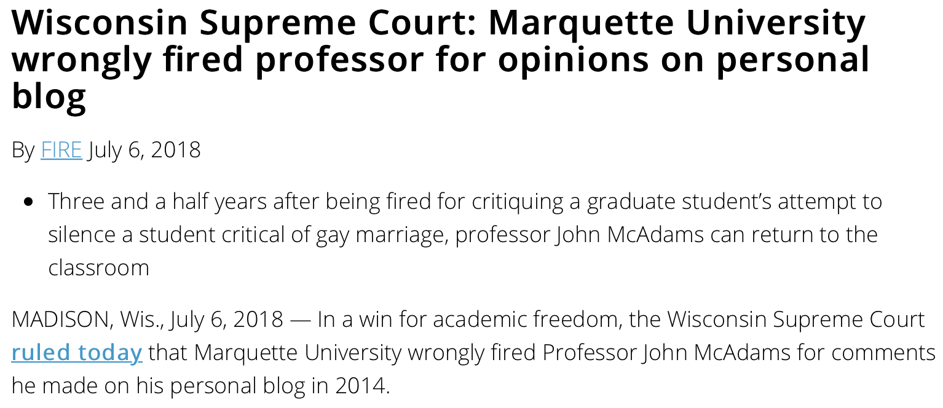
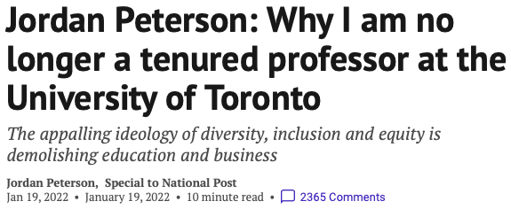
Bureaucracy and the University
University bureaucracies wield fearsome power over faculty, cheered on by many students who apparently regard shutting down academic discourse as a victory.
Even baseless and absurd accusations against faculty can lead to long investigations lacking in due process—creating job security for university bureaucrats but stress and often self-censorship on the part of faculty.
E.g., Peter Boghossian, Jordan Peterson, Ilya Shapiro
Notes:
From Peter Boghossian’s resignation letter to Portland State University: And it became increasingly clear to me that the incidents of illiberalism I had witnessed over the years were not just isolated events, but part of an institution-wide problem.
The more I spoke out about these issues, the more retaliation I faced.
Early in the 2016-17 academic year, a former student complained about me and the university initiated a Title IX investigation. (Title IX investigations are a part of federal law designed to protect “people from discrimination based on sex in education programs or activities that receive federal financial assistance.”) My accuser, a white male, made a slew of baseless accusations against me, which university confidentiality rules unfortunately prohibit me from discussing further. What I can share is that students of mine who were interviewed during the process told me the Title IX investigator asked them if they knew anything about me beating my wife and children. This horrifying accusation soon became a widespread rumor.
With Title IX investigations there is no due process, so I didn’t have access to the particular accusations, the ability to confront my accuser, and I had no opportunity to defend myself. Finally, the results of the investigation were revealed in December 2017. Here are the last two sentences of the report: “Global Diversity & Inclusion finds there is insufficient evidence that Boghossian violated PSU’s Prohibited Discrimination & Harassment policy. GDI recommends Boghossian receive coaching.”
Not only was there no apology for the false accusations, but the investigator also told me that in the future I was not allowed to render my opinion about “protected classes” or teach in such a way that my opinion about protected classes could be known — a bizarre conclusion to absurd charges. Universities can enforce ideological conformity just through the threat of these investigations.

Slide 44
About Free Speech
“Take, for example, the ‘human right’ of free speech. Freedom of speech is supposed to mean the right of everyone to say whatever he likes. But the neglected question is: Where? Where does a man have this right? He certainly does not have it on property on which he is trespassing. In short, he has this right only either on his own property or on the property of someone who has agreed, as a gift or in a rental contract, to allow him on the premises. In fact, then, there is no such thing as a separate ‘right to free speech’; there is only a man's property right: the right to do as he wills with his own or to make voluntary agreements with other property owners.”
Murray Rothbard, Ethics of Liberty, ch. 15.

Slide 45
Additional Reading
Bombardieri, Marcella. 2013. “Harvard, Other Schools Still Fighting Grade Inflation,” https://www.bostonglobe.com/metro/2013/12/05/with-its-most-common-grade-harvard-earns-disapproval-but-has-company/kCeheDYfuDjSRcM1sVljfK/story.html
Cellini, Stephanie Riegg, Claudia Goldin, 2013. “Does Federal Student Aid Raise Tuition? New Evidence on For-Profit Colleges,” NBER Working Paper No. 17827
Denning, Eide, Mumford, Patterson, and Warnick, 2022. “Why Have College Completion Rates Increased?” American Economic Journal: Applied Economics 14, no. 3 (July) https://www.aeaweb.org/research/college-completion-grade-inflation-us)
French, Doug. “No End in Sight for Higher-Education Malinvestment,” https://mises.org/library/no-end-sight-higher-education-malinvestment
Gordon, Grey, and Aaron Hedlund, 2017. “Accounting for the Rise in College Tuition,” Chapter forthcoming in Charles R. Hulten and Valerie A. Ramey, eds., Education, Skills, and Technical Change: Implications for Future US GDP Growth, University of Chicago Press, NBER Book Series Studies in Income and Wealth.
Lindsay, Tom. 2019. “The ‘Other’ College Scandal: Grade Inflation Has Turned Transcripts into Monopoly Money,” Forbes, https://www.forbes.com/sites/tomlindsay/2019/03/30/the-other-college-scandal-grade-inflation-has-turned-transcripts-into-monopoly-money/?sh=682598754182
Lucca, David O., Taylor Nadauld, and Karen Shen, 2017. “Credit Supply and the Rise in College Tuition: Evidence from the Expansion in Federal Student Aid Programs,” FRBNY Staff Report.
Newman, Jonathan. 2017. “Four Reasons Why College Degrees are Becoming Useless,” https://mises.org/wire/four-reasons-why-college-degrees-are-becoming-useless
Singell, Larry, Joe Stone, 2007. “For Whom the Pell Tolls: The Response of University Tuition to Federal Grants-in-Aid,” Economics of Education Review 26, no. 3: 285–295.
Turner, Nicholas. 2012. “Who Benefits from Student Aid? The Economic Incidence of Tax-Based Federal Student Aid,” Economics of Education Review 31, no. 4: 463–481.
Vedder, Richard. 2013, http://www.wsj.com/articles/SB10001424127887324619504579029282438522674
Vedder, Richard. 2019. Restoring the Promise, p. 57.
Volokh, Eugene. 2017. “Freedom of Expression on Campus: An Overview of Some Recent Surveys,” Washington Post, Oct. 23. https://www.washingtonpost.com/news/volokh-conspiracy/wp/2017/10/23/freedom-of-expression-on-campus-an-overview-of-some-recent-surveys/?utm_term=.baea637297f6

