Slide 1
The Panic of 1819 and its Relevance for Today
Patrick Newman
Mises University 2020

Slide 2
What is it with the year 20?
1720—South Sea Bubble
1820—Panic of 1819
1920—Depression of 1920
2020—The Coronacation

Slide 3
What is this presentation about, and why should I care?
Taken from my forthcoming book on Liberty versus Power: A History of Cronyism in the United States, 1607-1849 (2021?)
Special interest legislation
Discusses the extremely important (but neglected) Panic of 1819
Caused by Second Bank of the United States’ credit expansion
Intense cronyism surrounding everything about the Panic of 1819/SBUS
Panic of 1819 led to growth in free market thought, revival in Antifederalism, and future Jacksonian coalition
Hopefully our future reformers will learn from 1819 (and my presentation)

Slide 4
The War of 1812—I remember it like it was 208 years ago
First Bank of the United States (1791-1811)
In early 1813, prominent Republican financiers, Stephen Girard and John Jacob Astor purchase $10 million of high risk government debt
Girard and Astor want to reduce risk of purchase, in early 1814 they lobby Congress to charter another central bank
They want investors to be able to purchase stock with government debt
August 1814: state banks suspend specie payments
October 1814: Girard and Astor lobby to make their Philadelphia lawyer Alexander J. Dallas new secretary of the treasury

Slide 5
After the war
January 1816: Congressmen Henry Clay, John Calhoun, and SOT Dallas push for the chartering of a new central bank
Corporate charter (i.e., a license) contained privileges very similar to what the FBUS possessed
Twenty year monopoly over interstate banking (Philadelphia main office)
$35 million market capitalization (20% million government owned
$21 of $28 million of private ownership could be purchased with government debt
Federal government keeps deposits at bank (massive subsidy)

Slide 6
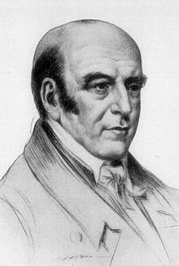
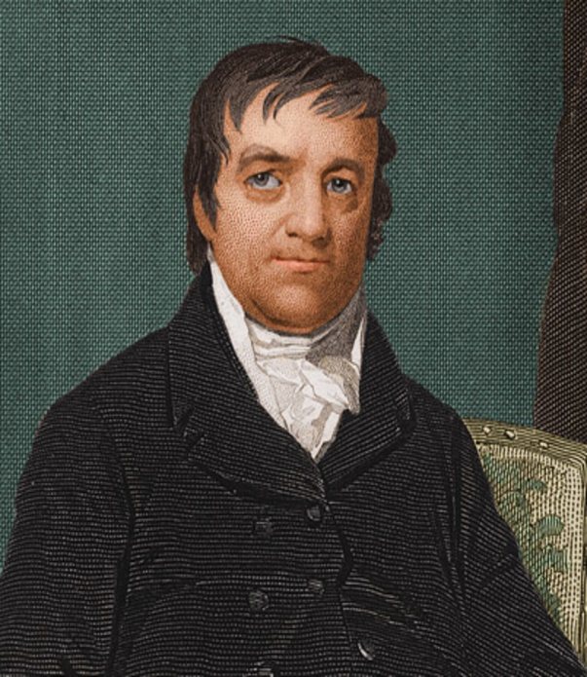
After the war
Congress passed in April 1816, Girard estimates profits “will be immense.”
Girard becomes largest shareholder
Girard and Astor two of five government appointed directors at main office
Astor became President of New York branch

Slide 7
But unfortunately for Girard and Astor
Other crony businessmen seize control of SBUS during election of the main office’s president
Bank charter—one shareholder, no matter the size, can only exercise a maximum of 30 votes
Baltimore: proxies!
Lawyer George Williams: controlled 1,172 shares legally owned by his clients
15 men in Baltimore control 75% of shares legally held by 16,000 people
Baltimore secures election of former Secretary of the Navy William Jones (a political stooge), Girard and Astor fuming

Slide 8
You can take that to the bank, the highly inflationary bank
January 1817: SBUS opens for business, starts inflating
Lends $6 million to New York City, Philadelphia, Baltimore, Richmond banks to resume specie payments (they don’t)
From 1817 to mid-1818, SBUS’ increases credit expansion by 57%
From 1815 to 1817, money supply increases by 25%
SBUS’ branches and state banks lend for building construction, long term agricultural improvements, slaves, turnpikes, shipbuilding, steamboats
From 1816 to 1818 wholesale prices fell seventeen percent, but they rose in above sectors

Slide 9
Baltimore branch leads the pack
James Buchanan
Partner in Smith & Buchanan mercantile house (Congressman Samuel Smith)
Government appointed director at main branch
President of Baltimore branch
Buchanan, James McCulloch (bank cashier), and George Williams (remember him?) loaned themselves $1 million, fraudulently claimed they secured loans with collateral
They bribe SBUS President William Jones to look the other way

Slide 10
But the good times can’t last forever
During this time, Secretary of the Treasury William Crawford, quasi-Old Republican, pushes for specie redemption to return to gold standard
Election of 1824
State banks refused to convert, but not the SBUS
First half of 1818, specie reserves at SBUS start to decline
Second half of 1818, SBUS engages in a massive credit contraction (41%)
Fall 1818, Congress investigates bank, particularly Baltimore branch
1817 to 1818 money supply falls 10%

Slide 11
The Panic of 1819
Thomas Jefferson to John Adams: “the paper bubble is then burst.”
From 1818 to 1820 wholesale prices fell 28%
From 1818 to 1819 daily wages for agricultural workers and unskilled turnpike workers plummeted 60-80%

Slide 12
Was it so bad?
Federal government practiced appropriate countercyclical policy
Money supply remained flat from 1818 to early 1820s
1819 to 1821 federal government spending declined 26%
But, no real effect on economic activity
1816 to 1818 real GDP per capita constant
1819 real GDP per capita fell 1.1%
1819 to 1824 real GDP per capita increased 1.5% per annum

Slide 13
Joseph Davis (2006) on the nominal illusion
Joseph Davis, “An Improved Annual Chronology of U.S. Business Cycles since the 1790s,” Journal of Economic History (March 2006).
“One plausible explanation for the disparity [in nineteenth century depressions] may be that the media confused commercial crises with financial ones, because the latter were better characterized by falling commodity and security prices, rather than declines in real industrial activity.”

Slide 14
The people are still upset. They start to attack the SBUS
But the SBUS employs friends in high places
Intellectual defense: establishment National Intelligencer receives loans from bank (also receives lucrative printing contracts from Congress)
Political defense: Congressmen Henry Clay and Daniel Webster receive loans from the bank as well as a retainer for providing legal services
Clay’s annual retainer $6000 (more than the secretary of state!)
Central banking defense: Nicholas Biddle government appointed director in January 1819, early 1823 bank’s president

Slide 15
McCulloch v. Maryland
Legal defense: Chief Justice John Marshall (stockholder in the bank)
Can states tax the SBUS’ branches like they tax their own state banks?
Important: Daniel Webster on bank’s legal team, Marshall sold shares right before case
Marshall ruling in March 1819: states cannot tax SBUS branches, and for that matter, the federal government can pretty much do whatever it wants
Week after decision: investigations reveal bank cashier James McCulloch as a massive embezzler; McCulloch, Buchanan, and Williams soon get off scot free

Slide 16
What does all of this cronyism cause? Growth in free market economic thought
After the War of 1812, and increasingly after the panic, hard money economic theories flourish
David Ricardo
Jean-Baptiste Say
Destutt de Tracy
Jefferson and others promote Destutt de Tracy and Say’s work in colleges and public forums
April 1821 Condy Raguet wrote to David Ricardo: “the whole of our population are either stockholders of banks or in debt to them. It is not the interest of the first to press the banks and the rest are afraid.”

Slide 17
What does all of this cronyism cause? Rebirth in Antifederalist thought
McCulloch v. Maryland (1819) continued consolidating trend of Supreme Court (1816 Martin v. Hunter’s Lessee)
Old Republican John Randolph: decision “wrong, wrong, all wrong”
Old Republican John Taylor, Construction Construed and Constitutions Vindicated (1820) and New Views of the Constitution (1823)
Ohio dismissed McCulloch v. Maryland, state legislature went so far as to “recognize and approve” the Kentucky and Virginia Resolutions for showing states “have an equal right to interpret the Constitution themselves.”
SBUS refused to pay Ohio’s tax, Osborn v. Bank of United States (1824), Clay and Webster bank’s legal counsel, Supreme Court protects SBUS

Slide 18
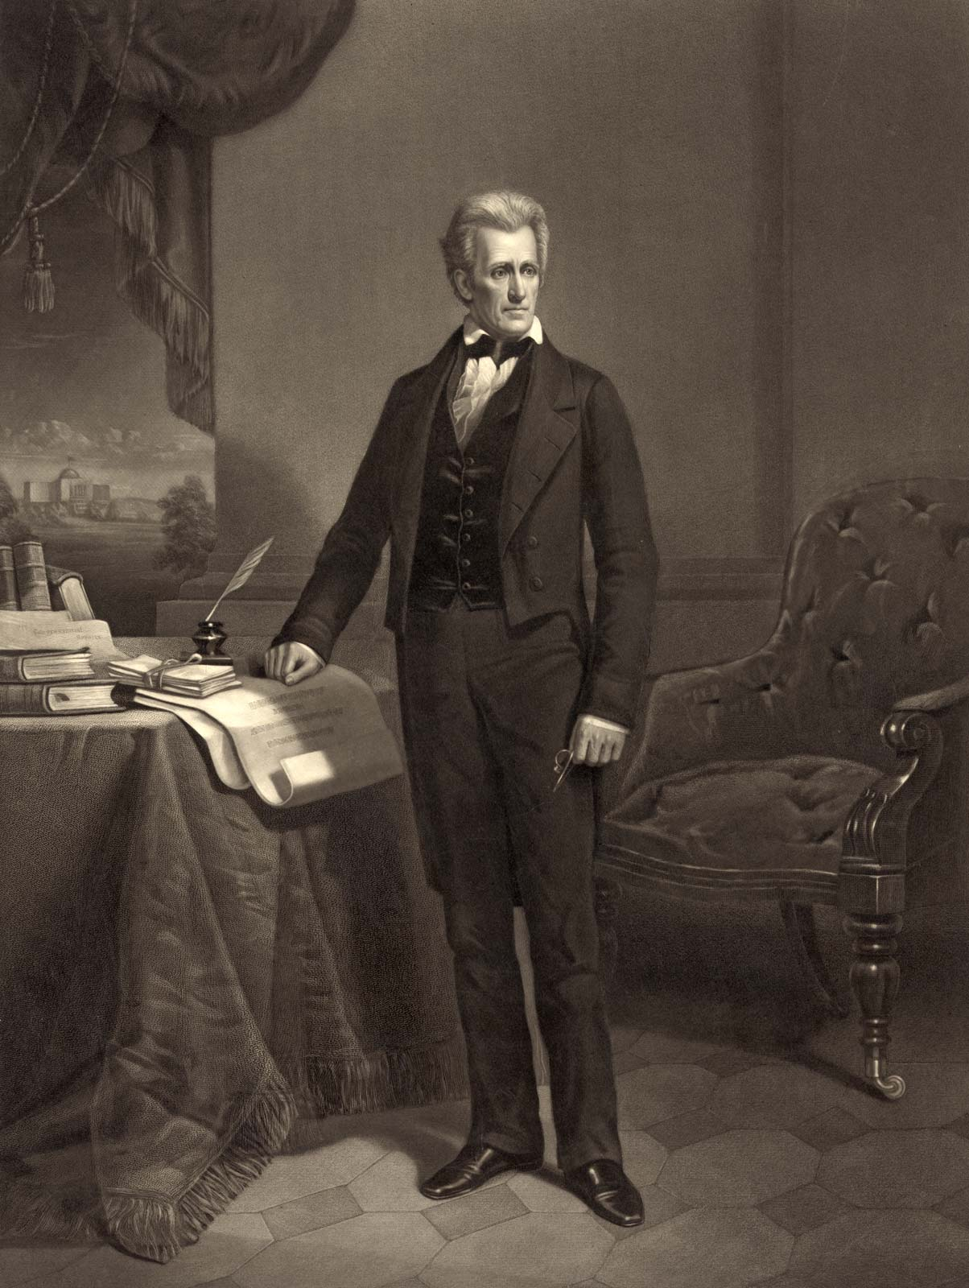
What does all of this cronyism cause? The Jacksonian coalition
In 1820, Tennessee state legislature contemplates passing paper money government loan office
General Andrew Jackson sends petition to legislature, citing “judicious political economists” who demonstrated that the “large emissions of paper from the banks by which the country was inundated, have been the most prominent causes of those distresses of which we at present complain.”
Jackson later vetoed SBUS recharter in 1832

Slide 19
Conclusion
The Panic of 1819 was a defining moment in American history
Demonstrated the immense corruption after the War of 1812
Led to growth in free market thought and future reform efforts
Please read my book when it comes out!

