Slide 1
The OODA Loop

Slide 2
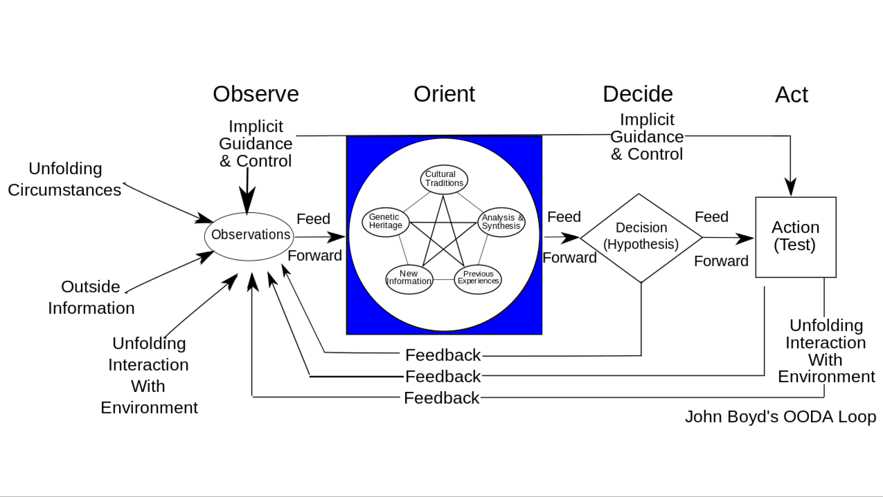
OODA Loop
Notes:
The OODA Loop is the continuous cycle of Observe, Orient, Decide, and Act, or, Observation, Orientation, Decision, and Action.
Observe - Using our senses, we see unfolding circumstances, acquire information, and interact with our environment. These observations feed forward into our...
Orientation - This is our filter of how we interpret and make sense of the world. It is made up our cultural traditions, our genetic heritage, our ability (and willingness) to learn, new information, and our previous experiences. Our Orientation, like an internal processor, determines how we see the world, and how we operate in it. As observations process and feed forward through it, we then...
Decide - We now form a hypothesis about what we think will happen given our understanding of what we see. We then....
Act - We test our hypothesis by acting on it. The effects are immediately observed, and the whole process begins again at the beginning with a new set of observations.
This process continues as time moves forward. The agile individual or team continuously learns and builds their orientation in order to make faster decisions and act on them quicker than their opponents act. This continuous learning is called “reorienting.” In other words, the Orientation remains dynamic by being open and flexible, thus allowing rapid adaptation to changing environments where chaos and disorder constantly increase. On the other hand, a static Orientation, or one that does not reorient and learn, begins to slow in its decisions and actions. Ultimately, a slowing OODA Loop will freeze and be shattered, no longer able to function, thus it will be defeated by the more agile individual or team.
There are three key reasons, rooted in science, why Boyd thought that OODA Loop was necessary, and why Orientation needed to be constantly “reorienting” to remain competitive.
The three reasons were:
1. Uncertainty―As explained by Heisenberg’s Uncertainty Principle, basically saying that we are not able to determine both the speed and location of a body or particle at the same time. Precision in determining one increases uncertainty in the other.
2. Incompleteness―As explained by Gödel’s Incompleteness Theorem, basically saying that any model of what we see or perceive must be continuously refined and adjusted in light of new information and observations.
3. Entropy – As explained by the Second Law of Thermodynamics, basically stating that in closed systems, entropy, that is to say disorder, will continuously increase.
Without going into the scientific details of each, it all may be summed up as follows:
“Given that VUCA is constant, and that we can never have perfect information to formulate our decisions and actions, we must maintain an open and flexible (agile) approach (orientation) in order to avoid the imminent defeat brought on by a closed mindset and its resulting entropy.”
In other words, paraphrasing John Boyd, if we are able to keep pace with the rate of change, and continuously learn from our decisions, actions and experiences, we can survive and thrive in VUCA rather than be consumed by it.
VUCA is nothing to be afraid of. It is not going to go away. Adopting the OODA Loop as a model creates an adaptive mindset that empowers us to better deal with rapid change. Thus, we are able to thrive in VUCA.

