Slide 1
Wall Street and the Origins of Bretton Woods
Dr. Patrick Newman
Mises Institute Supporters Summit: The End of the Dollar Era

Slide 2
Bretton Woods: The System
Dollar redeemable internationally ($35 = 1 oz), other currencies redeemable in dollars
International Monetary Fund: government funded, would loan dollars for currency stabilization
World Bank: government and private funded, would loan dollars for infrastructure development

Slide 3
Wall Street and Bretton Woods
  Wall Street banks and affiliated think tanks lobbied for Bretton Woods
  They wanted other countries to
    hold the dollar as reserves
    borrow more from Wall Street
    not default on loans

Slide 4
Wall Street in the 1920s
Post WW1 Wall Street and the New York Fed create an international gold exchange standard
  Only dollars and pounds redeemable in gold ($20 = 1 oz), other currencies redeemable in dollars and pounds
  Council on Foreign Relations (est. 1921) advocates

Slide 5
The 1930s Currency Situation
Great Depression destroys the gold exchange standard
Many South American countries default on their loans
In 1933 the U.S. left the domestic gold standard (internationally $35 dollars = 1 oz.)
Wall Street, led by Chase National Bank board chairman Winthrop Aldrich, wants a new gold-exchange standard
  Aldrich a member of the CFR

Slide 6
The CFR Gets Involved
  When WW2 breaks out CFR’s Foreign Affairs editor talks to State Department about postwar order
    WW2 provides U.S. with a “grand opportunity” to become “the premier power in the world”
Economic and Financial Group to devise new economic order

Slide 7
Bretton Woods—on Wall Street’s Terms
Aldrich and Wall Street did not want IMF making long term loans because they would compete with their loans
They also want World Bank/IMF loans given only to countries that paid back earlier loans from Wall Street
  1945: 87% of European bonds and 60% of South American bonds in default
  Congress revises Bretton Woods—IMF loans would only be for short-term currency stabilization
    Ratifies in mid-1945

Slide 8
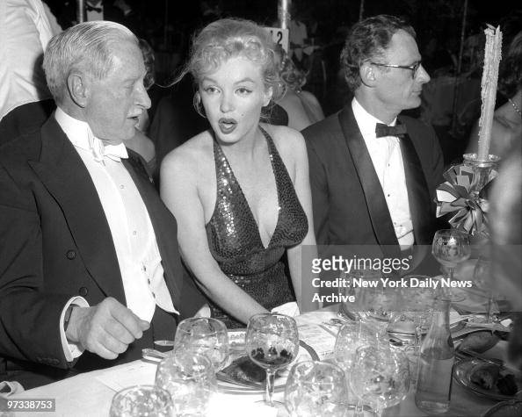
Aldrich Explains Bretton Woods to Marilyn Monroe

Slide 9
Who Runs Bretton Woods?
The real center of attention on the World Bank—juicy reconstruction loans!
  Wall Street lends money to World Bank
  World Bank then lends to countries that repay earlier loans from Wall Street (raise taxes)
  Wall Street collects two checks
Aldrich gets Truman to appoint John J. McCloy as president of the World Bank
  Prominent lawyer for Chase

Slide 10
Bretton Woods in Action
In the late 1940s and early 1950s the World Bank makes loans in Asia, Latin America, Africa, and the Middle East
Chase’s postwar foreign loans increase by 85%
Chase and other banks establish branches around the world
The dollar becomes the world reserve currency

Slide 11
Conclusion
Wall Street lobbied for a new international monetary system and got key personnel appointed
Bretton Woods led to dollar dominance and benefitted leading U.S. banks
You should buy Cronyism: Rise of the Corporatist State when it comes out!

