Slide 1
Abundance, Generosity, and the State Inquiry into Economic Principles
J.G. Hülsmann
13 October 2023
Mises Institute Supporter Summit

Slide 2
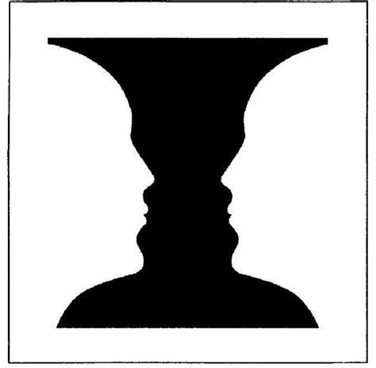
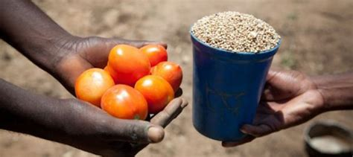
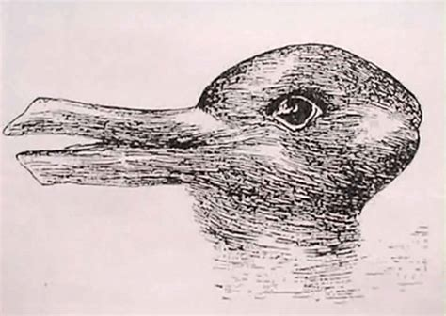
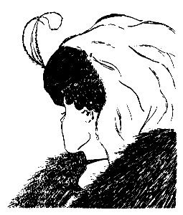

Slide 3
Benedict XVI, Caritas in Veritate (2009)
“Charity in truth places man before the astonishing experience of gift. Gratuitousness is present in our lives in many different forms, which often go unrecognized because of a purely consumerist and utilitarian view of life.” (CV 34)
“The great challenge before us […] is to demonstrate, in thinking and behaviour, not only that traditional principles of social ethics like transparency, honesty and responsibility cannot be ignored or attenuated, but also that in commercial relationships the principle of gratuitousness and the logic of gift as an expression of fraternity can and must find their place within normal economic activity.” (CV 36)

Slide 4
Reading from the Preface
Donations
Gifts and other signs of devotion
Donating as a category of human action
Donations and the market economy
Over-proportional growth and decline
Inheritance
Foundational virtues
Side-effect goods
Side effects of leisure
Cultural commons
Ownership
Examples
Errors
Technological progress
Wealth effects of the pricing process
Interventionism and Gratuitous Goods
Gifts by Fiat are False Gifts
Impoverishing households
Crowding out private welfare
Fostering materialism
Philanthro-cronyism
Destruction of side-effect goods
Table of Contents
Preface & Introduction
PART ONE: THE NATURE OF GRATUITOUS GOODS
1. Gratuitous Goods
2. The Nature of Donations
3. Motivations of Donations
4. Reciprocations
PART TWO: GRATUITOUS GOODS IN A FREE ECONOMY
5. The Economics of Donations
6. Beneficial Side Effects of Human Action
7. The Equivalence Postulate
8. Natural Limits of Gratuitous Goods
PART THREE: GRATUITOUS GOODS AND THE STATE
9. Interventionism
10. The State as a Provider of Gratuitous Goods
11. Haunted Donations
12. Interventionism and Side-Effect Goods
Epilogue

Slide 5
Abundance, Generosity, and the State Inquiry into Economic Principles
J.G. Hülsmann
13 October 2023
Mises Institute Supporter Summit

