Slide 1
Economics Prosperity
Mises University
Auburn, Alabama

Slide 2
Relevant Literature
Böhm-Baverk, The Positive Theory of Capital
Mises, Human Action; “The Plight of the Underdeveloped Nations.”
Rothbard, Man, Economy, and State
Osterfeld, Prosperity versus Planning
Huerta de Soto, Money, Bank Credit, and Economic Cycles; “Dynamic Efficiency”
Holcombe, Entrepreneurship and Economic Progress
Shenoy, Towards a Theoretical Framework for British and International Economic History: Early Modern England. A Case Study.
Ben Powell, Out of Poverty

Slide 3
Economic Progress
Expansion: More goods per person
Development: Greater variety and quality of goods

Slide 4
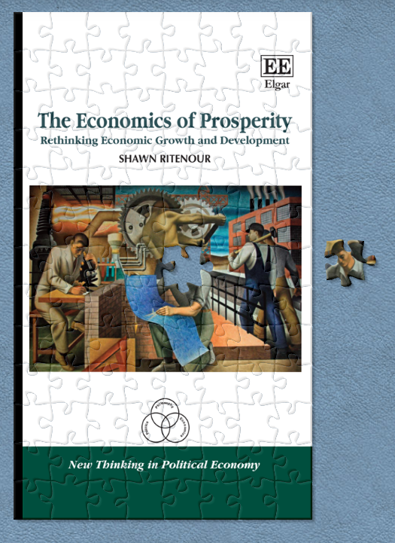
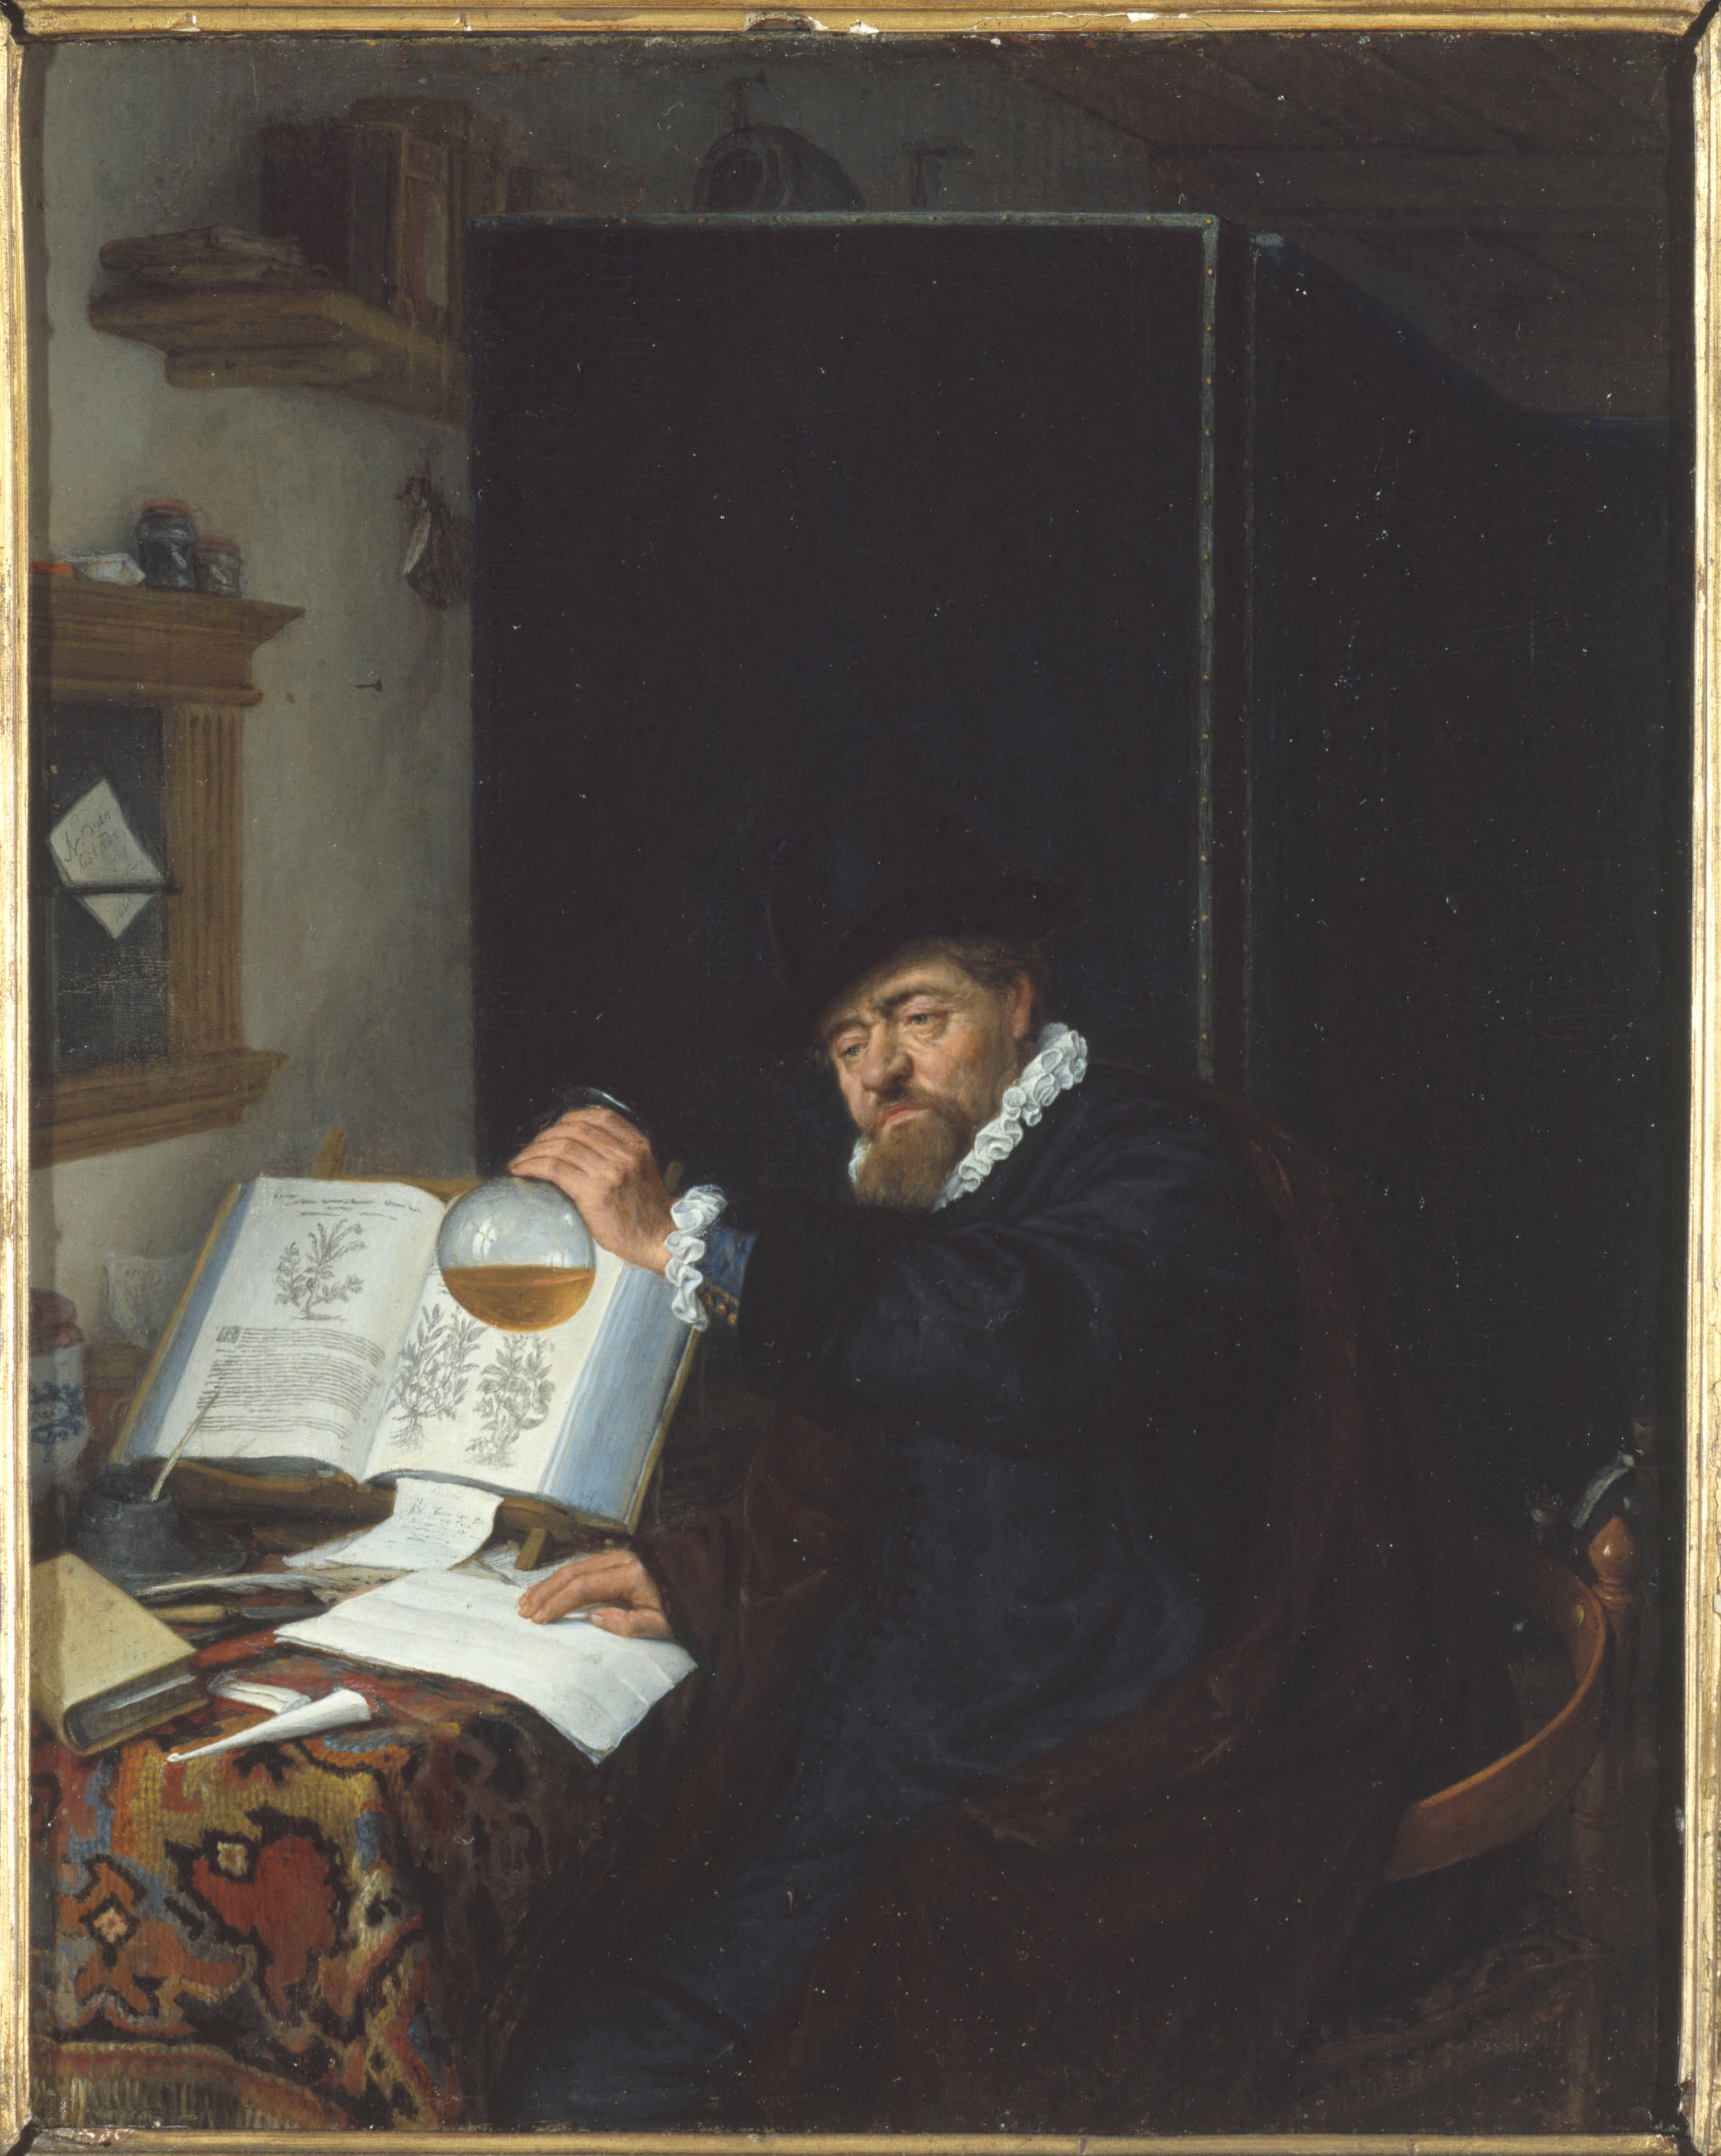
Economics of Prosperity
Analysis: Breaking complex substance into smaller parts to gain better understanding of it.
Synthesis: putting the pieces back together again in a new or different whole.

Slide 5
Economics of Prosperity
“A theory of the trade cycle, if it is not to be mere botching, can only be written as the last chapter or the last chapter but one of a treatise dealing with all economic problems.” Eugen von Böhm-Bawerk, quoted by Ludwig von Mises.

Slide 6
The Division of Labor
Specialization according to efficiency
The Law of Association
Specializing according to efficiency is more productive than isolated action of self-sufficient individuals.

Slide 7
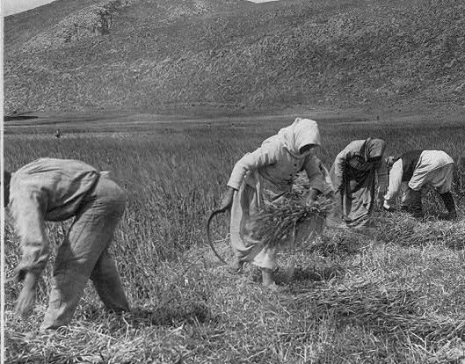
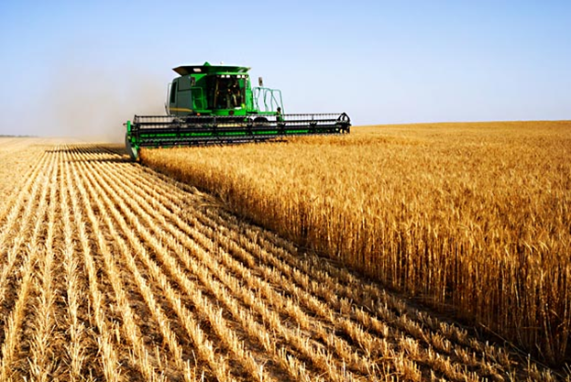
Capital Accumulation
Capital intensive processes are more productive

Slide 8
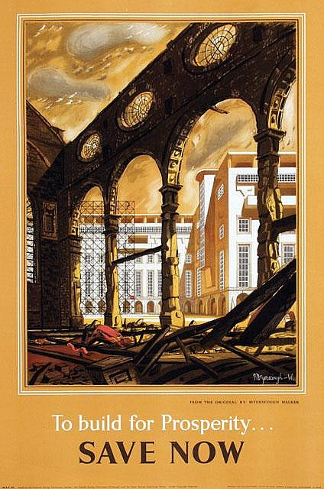
Capital Accumulation
Requires Saving and Investment
Expands Capital Structure
Increases Productivity

Slide 9
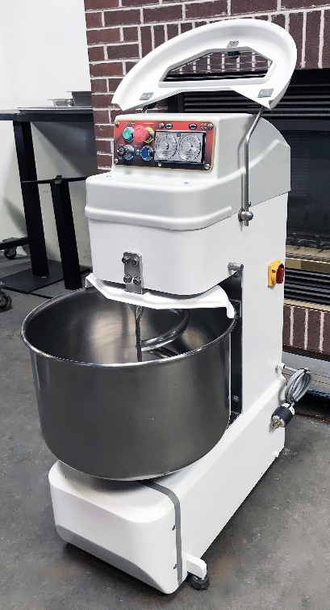
Technology
VS.
VS.
VS.
VS.
More or less productive capital goods

Slide 10
Technology
More productive arrangement of production process

Slide 11
Technology
Improvement in consumer goods

Slide 12
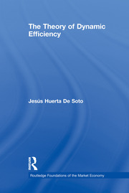
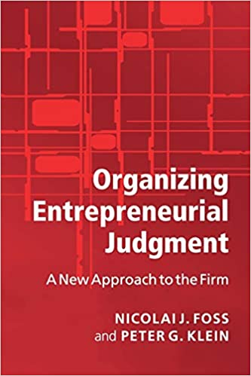
Entrepreneurship
Provides for Dynamic Efficiency
All the production in the economic order requires entrepreneurial judgement.
Driving force of production
Directs scarce factors toward their most productive use.
Innovation

Slide 13
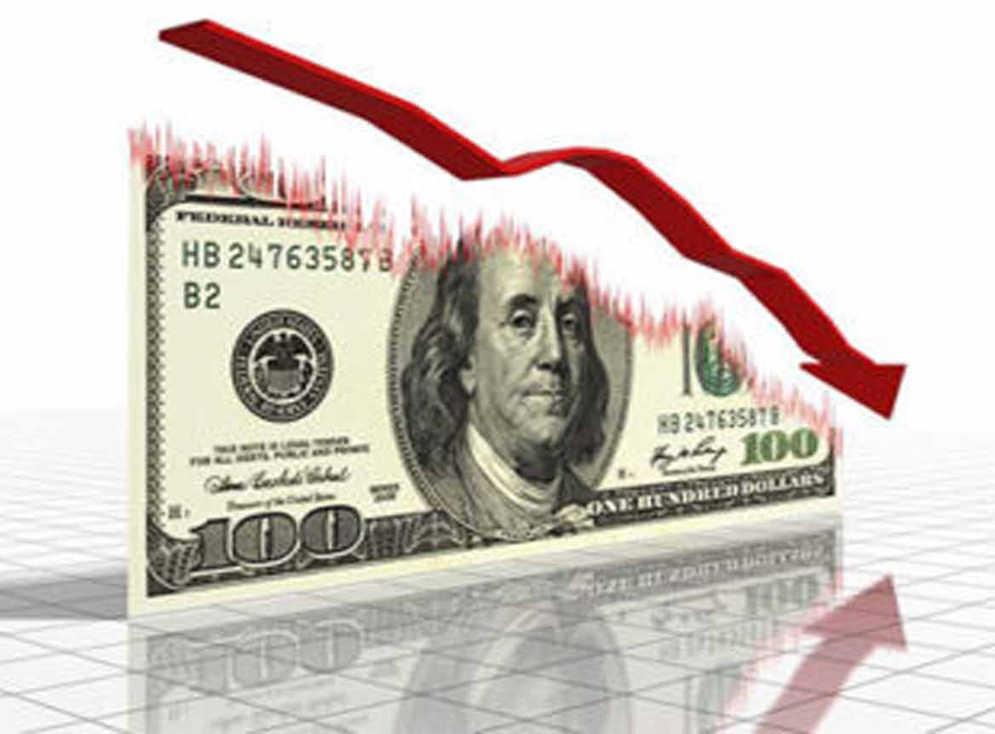
Entrepreneurship
Mitigates waste of accumulated capital
Possible because of uncertainty.
Entrepreneurial error results in losses

Slide 14
Entrepreneurship
“You can take Hollywood for granted like I did, or you can dismiss it with the contempt we reserve for what we don't understand. It can be understood too, but only dimly and in flashes. Not half a dozen men have ever been able to keep the whole equation of pictures in their heads.” –Cecilia Brady, narrator of F. Scott Fitzgerald’s The Love of the Last Tycoon

Slide 15
Entrepreneurship
Many margins:
Product
Capital Investment
Technology
Economic calculation is crucial

Slide 16
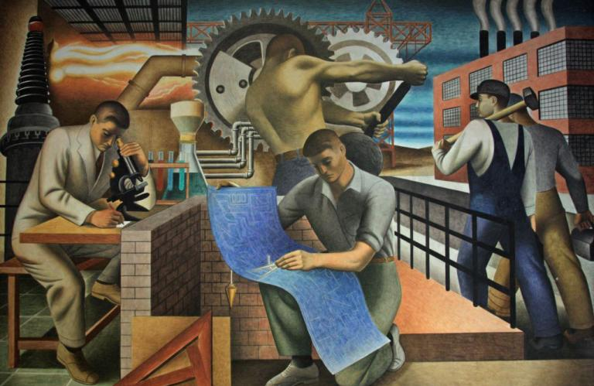
Economic Progress
Process of Dynamic Efficiency
The happy consequence of a highly developed division of labor, taking advantage of an increasing capital stock embodying better technology, wisely invested by entrepreneurs.

Slide 17
Limits to the Division of Labor
The extent of the market
Without trade, must produce everything we consume.
Exchange requires private property.
Hence, in order to take advantage of the division of labor, society must have private property.

Slide 18
Limits to the Division of Labor
Extent of Saving and Investment
Saving and investment in specific tools and machinery allows for more specialized production.
Reduction in Saving and Investment would limit the division of labor.

Slide 19
Limits to the Division of Labor
Challenge of Production for the Market
Producers do not know exactly what other people want.
Must make objective production decisions about future subjective preferences of other people.
Specialized production of higher order capital goods require a corresponding quantity of other complementary producer goods.

Slide 20
Economic Institutions
Enablers of Economic Progress

Slide 21
Development Policy
Voluntary vs. Political Means
Free Trade vs. Protectionism
Foreign Direct Investment vs. Foreign Aid
Sound Money vs. Inflation
Free Market vs. Intervention

Slide 22
Development Policy
Private property enables prosperity
Interventionism breeds poverty

