Slide 1
Do Big Data and AI Solve the Socialist Calculation Problem?
Tate Fegley (with Karras Lambert)
Mises University 2023

Slide 2
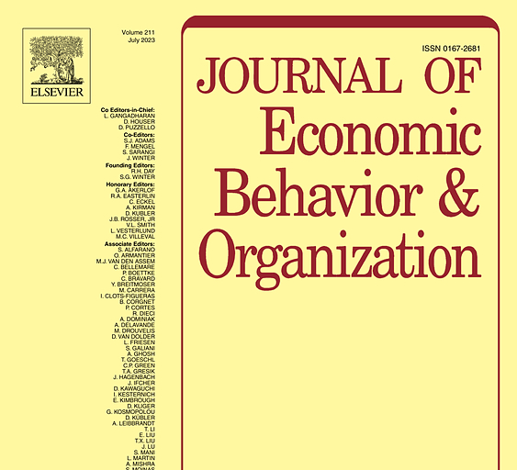
JEBO Special Issue:
Machine v. Market: Economic Calculation and Business Organization in the Age of Modern Computing
Question of the special issue: “Will modern computing techniques pose a fundamental transformation of economic organization?”

Slide 3
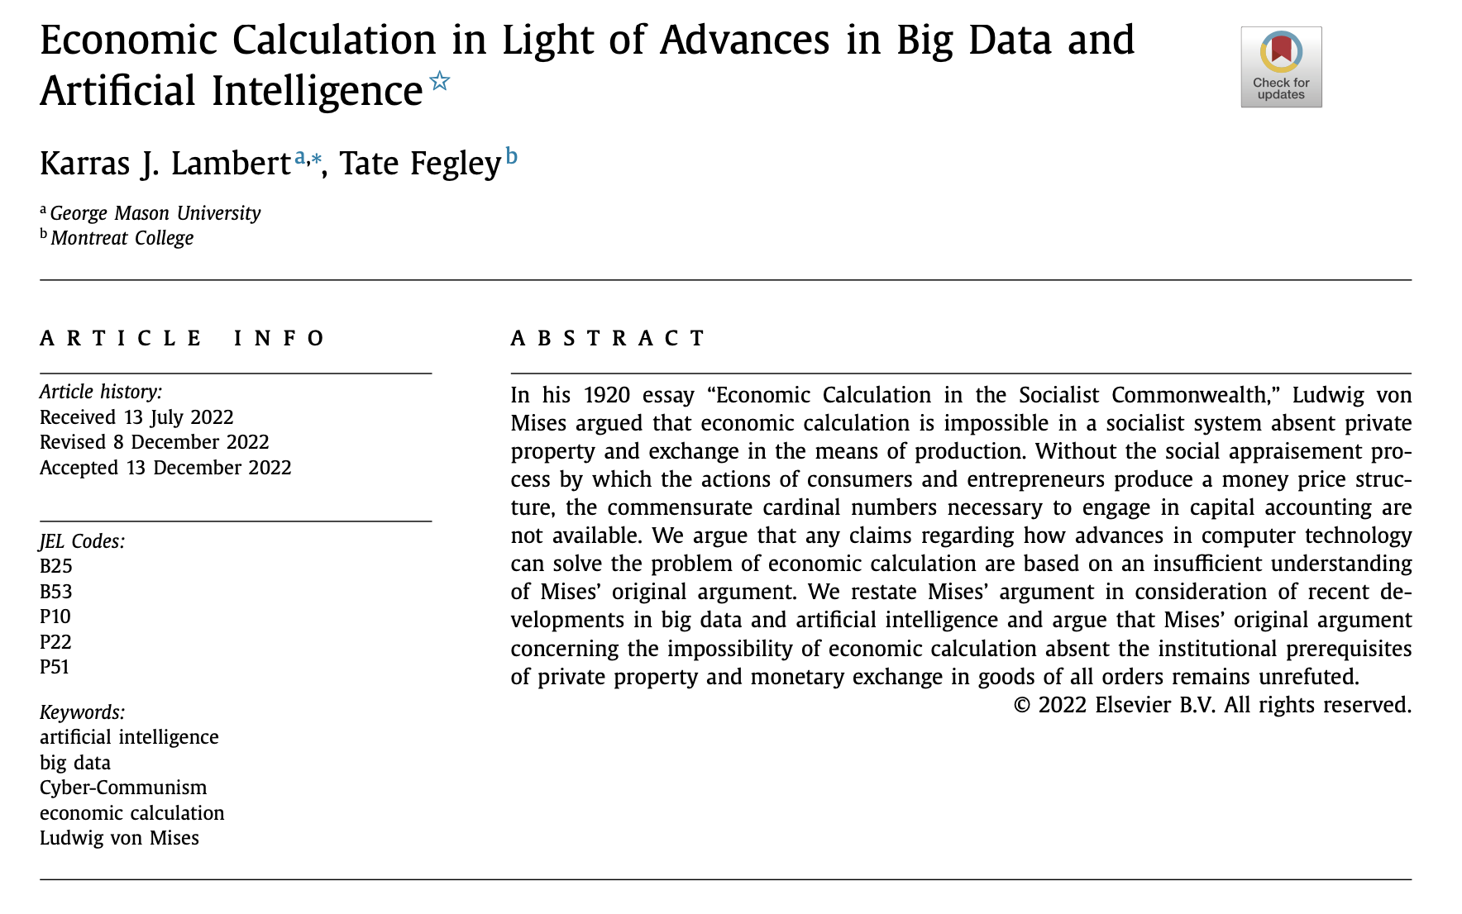
Our Paper

Slide 4
The Problem of Economic Calculation
Calculation: Arithmetic operations (addition, subtraction, etc.)
Economizing: Using available means in such a way that no more highly valued feasible ends are forsaken (ex-ante)
Subjective valuation involves ordinal rankings (I like “this” more than “that”), which cannot be subject to arithmetic operations
Producer goods can be arranged in various quantitative combinations to produce technologically feasible consumer goods (e.g. H = 4A+2B = 3A+6C =5A+3F)
The Problem: Need some way to arithmetically compare means and ends to mentally ascertain whether means are being used in an economizing way

Slide 5
The Nature of Economic Calculation
There can be no economic calculation using (ordinal, intensive, and subjective) “values”
No (cardinal, extensive, and objective) unit naturally available to determine the effectiveness of actions (ex-ante or ex-post) through arithmetic operations
How to move from ordinal subjective valuations to precise calculation of anticipated or experienced profit/loss?
Answer: The market economy (the “social appraisement process”)

Slide 6
The Social Appraisement Process
Producers value producer goods according to anticipated consumer valuation of consumer goods.
Use of money in exchanges produces a unified price structure, bridging subjective valuations and objective money prices across goods of all orders.
Entrepreneurs can mentally ascertain, using basic arithmetic, which production processes are anticipated to yield monetary profit.
Of course entrepreneurial appraisal could be in error, resulting in monetary loss.

Slide 7
Dr. Joseph Salerno
“There thus comes into being the market’s monetary price structure, a genuinely ‘social’ phenomenon in which every unit of exchangeable goods and services is assigned a socially significant cardinal number and which has its roots in the minds of every single member of society yet must forever transcend the contribution of the individual human mind.”

Slide 8
Mises on the Importance of Value Theory to Calculation Problem
“All attempts at disproving the conclusiveness of my thesis were destined for failure because they did not penetrate the value theory at the core of the problem. All of these books, theses, and essays tried to rescue socialism. They wanted to show that it was indeed possible to construct a socialist commonwealth in which economic calculations could be performed. They failed to see that one must begin with the question of how in an economy consisting of preferring or deferring–that is, making unequal valuations–one can arrive at comparable valuations and the use of equations. So it was that they came upon the absurd idea of recommending the equations of mathematical catallactics, which depict an image devoid of human action, as a substitute for the monetary calculation of the market economy.” (Mises, Memoirs p. 95)
Notes:
“The illusion that a rational order of economic management is possible in a society based on public ownership of the means of production owed its origin to the value theory of the classical economists and its tenacity to the failure of many modern economists to think through consistently to its ultimate conclusions the fundamental theorem of the subjectivist theory.” (Mises, Human Action Scholar’s Edition p. 207)

Slide 9
Economics vs. Technology
The minimization of physical resource expenditure in pursuit of one particular end, regardless of alternative possible employments of those resources, does not deal with economizing but merely reduces resource use to a technological problem.
“Technology operates with countable and measurable quantities of external things and effects; it knows causal relations between them, but it is foreign to their relevance to human wants and desires. Its field is that of objective use-value only.” (Mises, Human Action Scholar’s Edition p. 208)

Slide 10
An Example to Illustrate the Difference between Technology and Economics
Suppose a central planner is magically endowed with knowledge of all quantitative causal relations involving the resources under his control and only cares about his own well-being.
The planner decides he wants a bridge to nowhere.
Various combinations of heterogeneous producer goods can be used to construct the bridge.
Question: How to select the combination of producer goods that yields the bridge most economically with respect to alternative employments of the requisite producer goods?

Slide 11
The Planner’s Problem
Our planner wants to ensure he’s getting the most out of the resources under his control to achieve his own happiness, but he’s only armed with knowledge of his own (ordinal) subjective valuations and the technical substitution ratios between available inputs and feasible outputs.
To ensure producer goods are being used economically, the planner needs to compare yield and cost to ensure the selected production process does not squander resources.
Comparison of yield and cost must take the form of arithmetic calculation, which requires the terms be reckoned in a commensurate cardinal unit (cannot subtract “5 apples” from “3 oranges”).
Planner can decide in isolation that he prefers the bridge to the inputs used up in production, but those same inputs could have been used to produce other goods the planner also considers valuable.
Economizing requires goods of all orders be reckoned in a commensurate cardinal unit in order to take (opportunity) cost into consideration and determine whether resources were used effectively.
Notes:
“effective” means yield is greater than cost

Slide 12
(Very) Simplified Numerical Example
To build a platinum bridge (P):
A units (kg) of platinum
B units (hours) of labor
C units (m²) of land
To build a stone bridge (S):
D units (kg) of stone
B units (hours) of labor
C units (m²) of land
How to compare A + B + C with P, D + B + C with S (or A with D)?
Claiming (P - A) < (S - D) and therefore the stone bridge should be constructed instead of the platinum bridge is meaningless and there can be no precise calculation.

Slide 13
Mises on the Premise of the Example
“Today we calculate from the point of view of our present knowledge and of our present anticipation of future conditions. We do not deal with the problem of whether or not the director will be able to anticipate future conditions. What we have in mind is that the director cannot calculate from the point of view of his own present value judgments and his own present anticipations of future conditions, whatever they may be.” (Human Action Scholar’s Edition, p. 696)

Slide 14
The Market Economy
There is a difference in-kind between a market economy in which one good serves as money (general MoE) and a society without money
“Value calculation” is impossible in a society without money
The economic (“catallactic”) category “capital” presupposes a market economy characterized by exchange of goods of all orders in terms of money
Capital accounting is impossible under socialism and therefore there is no “economy” whatsoever (in Mises’s sense of the term)

Slide 15
The Problem Facing the Central Planner
A socialist planner may draw up an output target and ascertain the quantities of factors of production necessary to attain the desired ends.
However, such a planner would still be unable to economize on the employment of higher order goods with consideration of genuine (opportunity) costs.
In the words of Mises, the central planner will instead be “floundering in the ocean of possible and conceivable economic combinations without the compass of economic calculation.”
Notes:
Without the commensurate cardinal number of money prices, meaningfully generated through entrepreneurial appraisal and market exchange, assigned to producer goods as well as consumer goods, the planner will literally be unable to compare inputs and outputs in an arithmetic sense and will therefore be unable to economize in principle.
No single will can create a price structure which accurately reflects the opportunity costs of economic goods.

Slide 16
“Of course, some stubborn Marxians raised objections.” - Bureaucracy, p. 48

Slide 17
The Institutional Prerequisites for Economic Calculation
1. Private property and exchange in goods of higher orders are necessary to produce numerical exchange ratios for goods of all orders
2. A common medium of exchange must be present to serve as a common denominator for these exchange ratios.
Any argument that technological advances can overcome the calculation problem and avoid these two conditions must overcome certain hurdles or else there is no “economic calculation” occurring at all.

Slide 18
The hurdles to overcome
1. Commensurate cardinal units must be available for use in economic decision-making concerning the economically efficient employment of scarce resources.
2. There must be some mechanism that translates the ordinal preferences of individuals into commensurate cardinal numbers.
3. There must be some capability of forecasting future arrangements of market data, including but not limited to consumer valuations of novel products, and organizing economic resources in production accordingly.

Slide 19
Can “big data” overcome these hurdles?
No.
The data are entirely that of the past. Human appraisal is still necessary for arranging forward-looking production processes.
Advances in storage capacities and processing speeds may assist in keeping inventory records and the comprehension of technical substitution relations between producer goods but does not solve the problem of converting these technological relations into economic ones.
Notes:
Mises already considered this in that although “historians and statisticians content themselves with prices of the past…prices of the past are merely a help in anticipating future prices.”
Imputation from prices of consumer goods to prices of producer goods is not possible so long as factors of production are not perfectly specific with regards to their products or not perfectly non-specific with regards to all other producer goods. Since producer goods are heterogeneous with non-specific uses, no amount of technological data or processing capability can generate a price structure that meaningfully corresponds with actual consumer preferences.
There is no necessary relationship between past and future prices.

Slide 20
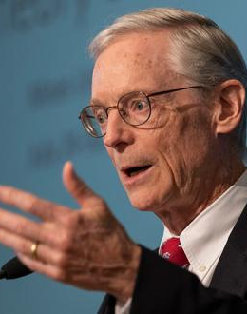
Dr. Jeffrey Herbener
“No ‘advances in supercomputers’ can overcome the impossibility of adding together apples and oranges.”

Slide 21
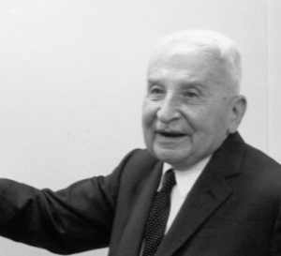
Mises
“[E]ven if we know the present conditions, we are unable to say anything of a quantitative nature, on the basis of this knowledge, about the pattern of future values…A quantitative treatment of economic problems can only be economic history, it can never be economic theory. And there is no economic history of the future.”
Notes:
Neither is the issue one of sheer data aggregation, which Cottrell and Cockshott (1993) argue could be overcome by a network of cheap personal computers. While the existence of the computational power necessary to make use of this data is disputed (Engelhardt 2013), the central point is that these technologies do not generate a substitute for market prices of factors of production.
Advances in data aggregation may be helpful for entrepreneurs operating in a society characterized by genuine market prices, but failure to generate these prices in the first place would categorically preclude the possibility of economic calculaton.

Slide 22
What about AI?
The analysis is similar in most ways.
Just as past data can be valuable for entrepreneurs, it is easy to imagine an AI machine operating within a market order with a functioning pricing process.
An AI tasked with guiding production absent money prices in goods of all orders will, just like any human counterpart, be unable to economize on the available scarce means of production.
Notes:
Additional difficulties:
Phelan discusses the difficulties in imagining that AI will be able to engage in entrepreneurial appraisal on account of the fact that “in order to anticipate consumer needs, an AGI [artificial general intelligence] must possess a ‘theory of mind’ about the preferences of others in order to successfully predict their behavior.’
It is also dubious whether AI will ever be able to “break frame” and make decisions outside pre-specified parameters.
Even granting a scenario where present ordinal valuations of consumers regarding concrete goods can be transferred to the Ai, the AI by itself, just like its human counterpart when endowed with the same knowledge by assumption, cannot generate the price structure necessary to perform meaningful calculation using a common cardinal unit.”
Therefore, technology alone provides no substitute for the pricing process of the market.

Slide 23
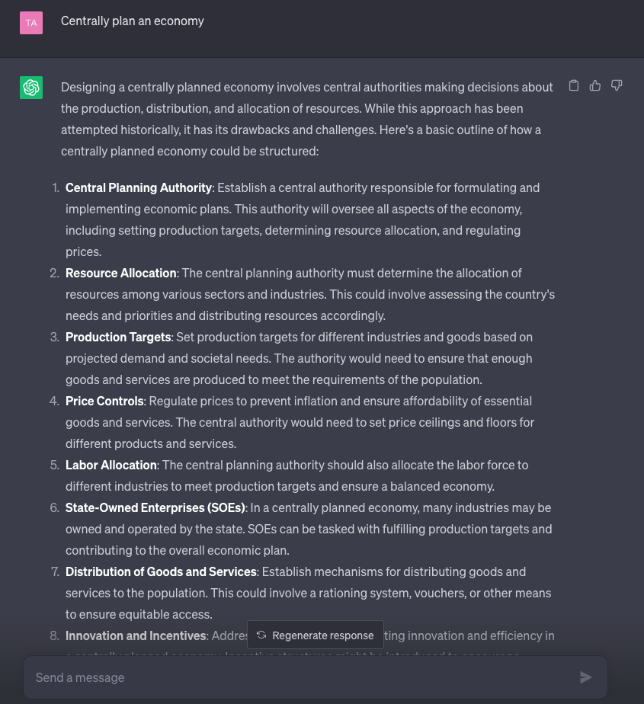
²

Slide 24
Can labor time serve as a basis for economic calculation?
No.
The most fundamental flaw is that the central planner is then left to economize with respect to labor only.
If the calculation is performed simply with respect to labor time, the heterogeneous uses of produced factors of production are not considered.
Such numbers have no relevance for prevailing conditions of demand based on the perceived importance of the factors in alternative uses.
Notes:
Cyber-communists set out a system by which workers receive non-transferable certificates based on labor hours worked, which can only be exchanged directly for consumer goods, with various nuances to account for differences in productivity and skills.
Produced factors of production are rendered in terms of indirect labor hours, commensurate with the direct labor hours required as complementary factors of production. However, calculation with respect to labor time ignores the central problem of economic calculation, which is how to ascertain numerically whether a specific quantity of a factor of production is better served in one line of production or another. Each produced factor of production will presumably be assigned the same quantity of labor hours across the various potential lines of production in which it can render a useful service. Since the effects of one physical factor of production is not constant across alternative employments, how can a planner determine where a specific produced factor is best assigned?

Slide 25
Cyber-Communism
Cockshott & Cottrell (1993): Start with “plan targets” (specified outputs to be produced in fixed ratios) and use mathematical optimization to meet the targets given resource constraints.
After initial production: issue tokens tied to labor contribution, permit markets in consumer goods, mark goods with labor values, let token prices vary according to consumer demand, planners adjust production based on divergence of token prices from labor values.
Note: this procedure has nothing to do with economic calculation since the initial production problem pre-specifies what outputs will be produced, reducing the problem to technological optimization.
Also, the “feedback mechanism” only concerns consumer goods already produced and not alternative potential consumer goods. Producing outside the pre-specified planning target requires entrepreneurial judgement, which under socialism cannot make use of economic calculation.
Notes:
Cyber-communists set out a system by which workers receive non-transferable certificates based on labor hours worked, which can only be exchanged directly for consumer goods, with various nuances to account for differences in productivity and skills.
Produced factors of production are rendered in terms of indirect labor hours, commensurate with the direct labor hours required as complementary factors of production. However, calculation with respect to labor time ignores the central problem of economic calculation, which is how to ascertain numerically whether a specific quantity of a factor of production is better served in one line of production or another. Each produced factor of production will presumably be assigned the same quantity of labor hours across the various potential lines of production in which it can render a useful service. Since the effects of one physical factor of production is not constant across alternative employments, how can a planner determine where a specific produced factor is best assigned?

Slide 26
Further Issues with Cyber-Communism
Falls prey to standard issues with labor theory of value (LTV) and “trial and error” methods (see Chapter XXVI of Human Action)
Phillip Dapprich (2022) recognizes problem with the LTV and proposes a method to compute “shadow prices” of producer goods, but the resulting figures are arbitrary with respect to the genuine opportunity cost that would prevail in the market
Nieto & Mateo (2020) thinks the operations of Wal-Mart and Amazon show how advances in technology make economic planning possible, but Wal-Mart and Amazon operate in a market economy and can make use of economic calculation to guide their business decisions…

Slide 27
Read Mises
Study Human Action carefully to understand the nature and scope of economics as a science, and particularly the importance of economic calculation
Economic problems must not be confused with strictly technological problems
“The measurements of physics and chemistry make sense for practical action only because there is economic calculation. It is monetary calculation that made arithmetic a tool in the struggle for a better life. It provides a mode of using the achievements of laboratory experiments for the most efficacious removal of uneasiness.” (Mises, Human Action Scholar’s Edition p. 231)

Slide 28
Closing Quote
“Our civilization is inseparably linked with our methods of economic calculation. It would perish if we were to abandon this most precious intellectual tool of acting.” (Mises, Human Action Scholar’s Edition p. 231)

Slide 29
Cyber-Communism References
W. Paul Cockshott & Allin Cottrell, 1993, Towards a New Socialism
Max Nieto & Juan Pablo Mateo, 2020, “Dynamic Efficiency in a Planned Economy: Innovation and Entrepreneurship Without Markets,” Science & Society 84 (1)
Jan Philipp Dapprich, 2022, “Optimal Planning with Consumer Feedback: A Simulation of a Socialist Economy,” Review of Political Economy

