Slide 1
Wokeness and Big Tech
Peter G. Klein
Mises University
2023
@petergklein
#MisesU

Slide 2
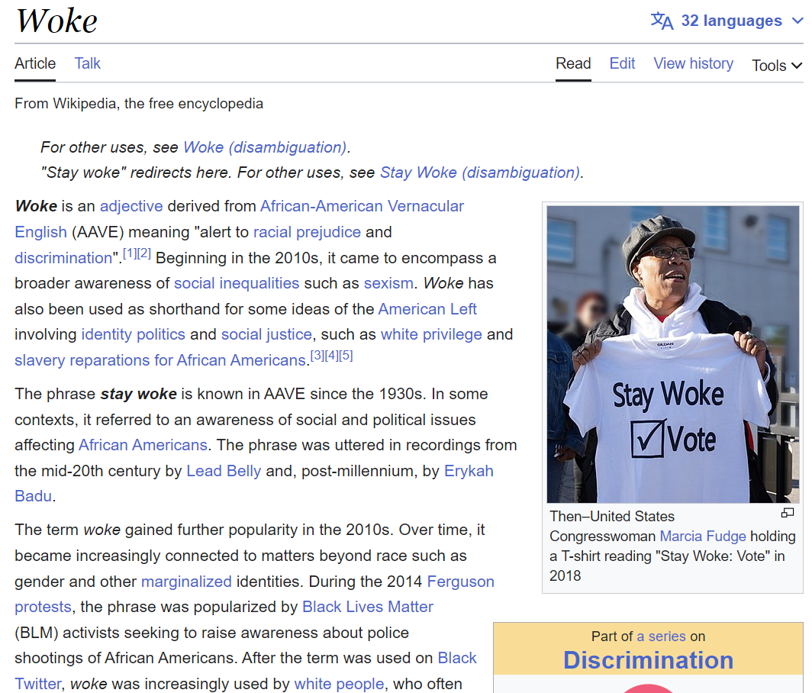

Slide 3
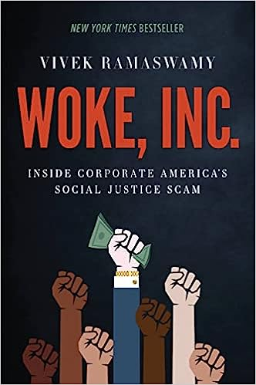

Slide 4
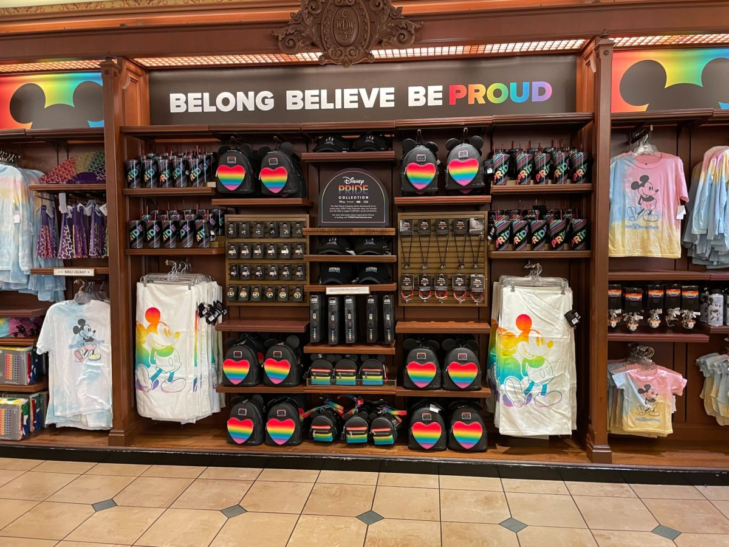

Slide 5
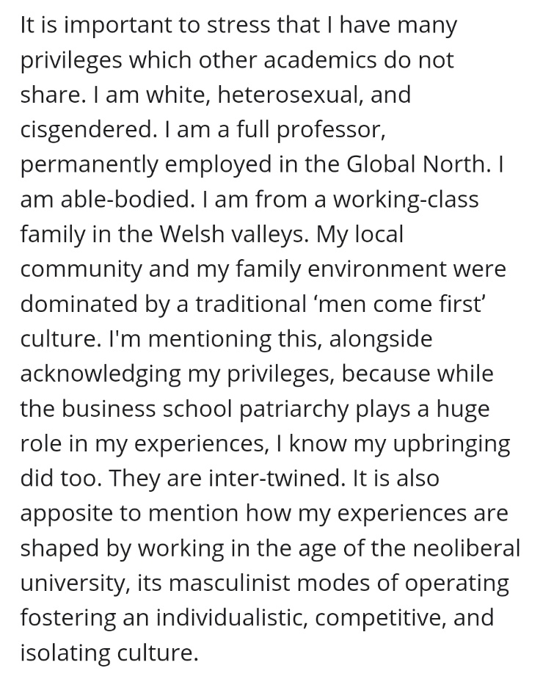
Wokeness
Primary concern with “social justice,” especially related to race, gender, sexual orientation, and sexual identity
Philosophical origins in Frankfurt School + French postmodernist thought (critical theory)
Primacy of subjective, personal experience over logical argument, data (“speak your truth”)
Polylogism / truth as positional
Emphasis on group characteristics and social structures rather than individual behavior, responsibility (“structural racism,” “patriarchy,” “intersectionality”)
Oppressor/victim dynamic (“cultural Marxism”) (“check your privilege”)
Whig theory of history (“right side of history”)

Slide 6
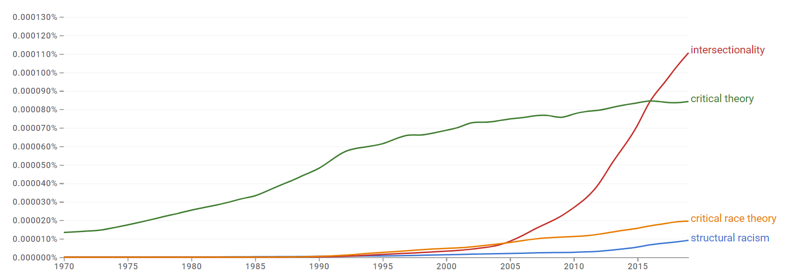

Slide 7
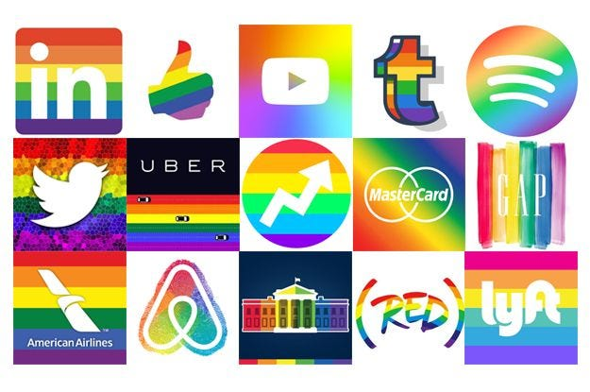
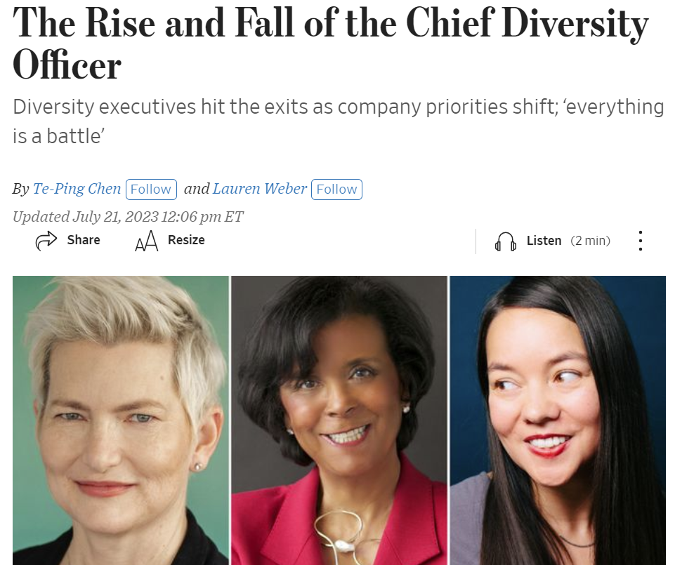
Wokeness in companies, universities
Probably not driven primarily by ideology
Instrumental motives
Appeal to woke customers, investors, employees (faculty, students, donors)
Attempts to curry favor with woke regulators, judges
Pressure from external parties (institutional investors, ratings agencies)
Fear of negative publicity
Results
Explosion in DEI programs – now seeing pushback
Marketing and public relations
Philanthropy, lobbying
Additional driver: entrenched middle managers
Nicolai J. Foss and Peter G. Klein, “Why Do Companies Go Woke?” Academy of Management Perspectives, forthcoming.
Nicolai J. Foss and Peter G. Klein, “Strategy Under Woke Capitalism,” in Marcus Larsen, Michael Leiblein, and Jeffrey Reuer, eds., Strategy in a Turbulent Era (Edward Elgar, forthcoming).

Slide 8
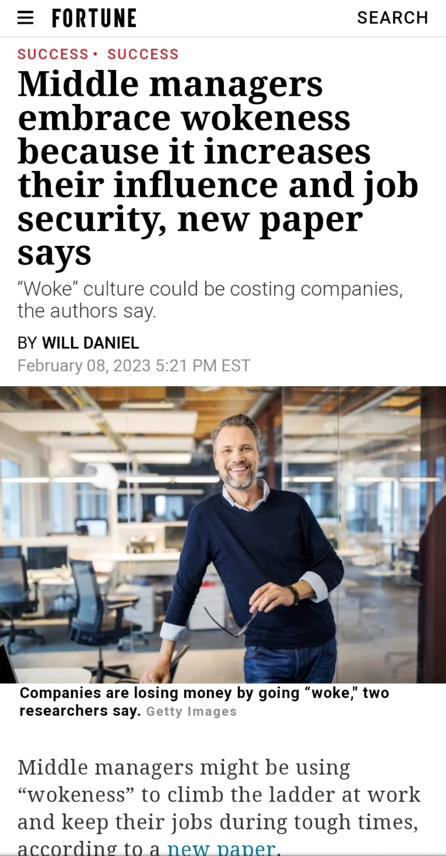
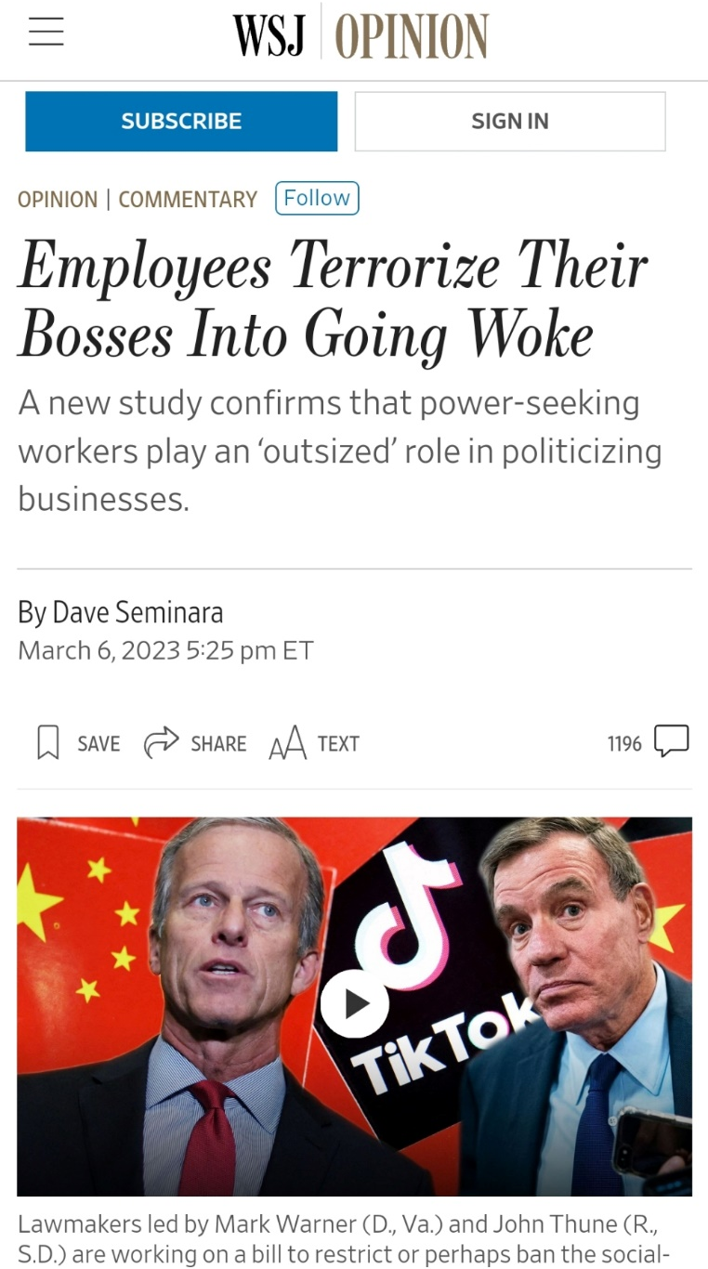
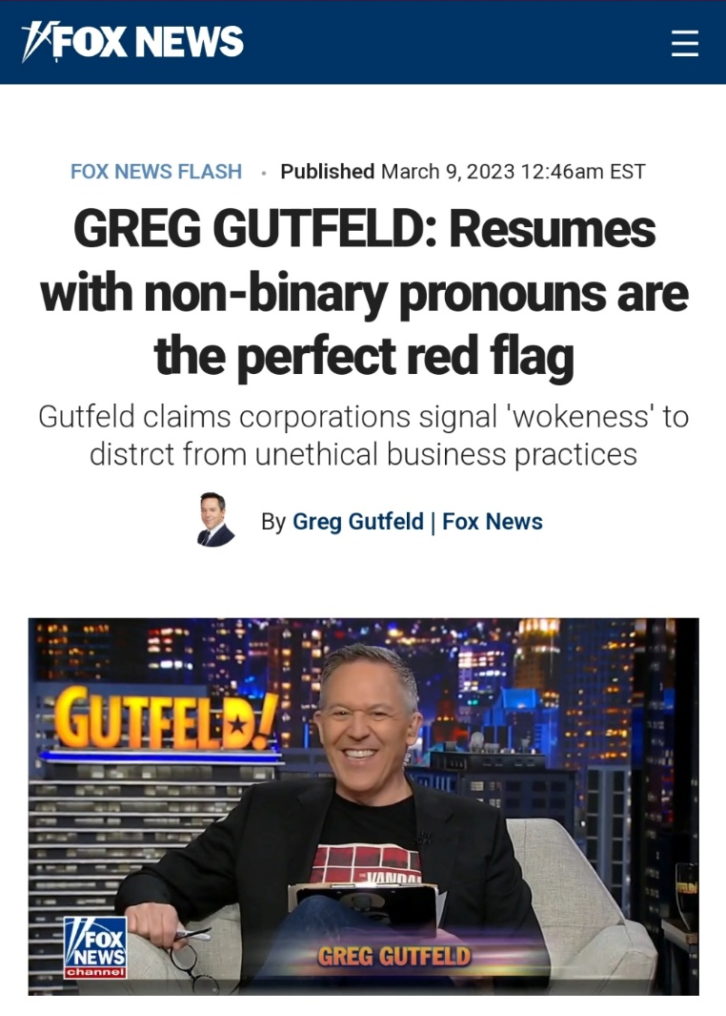
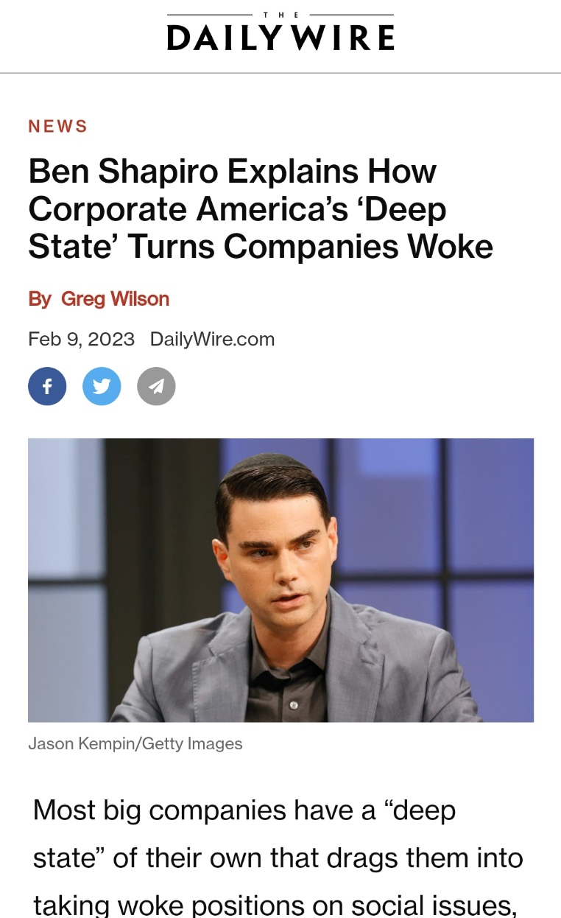

Slide 10
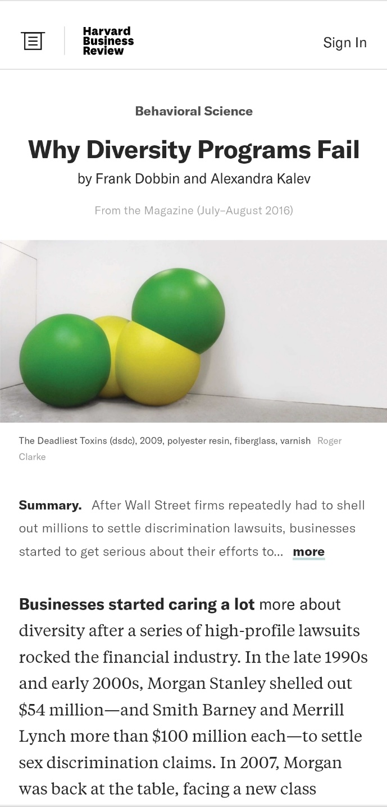
Wokeness as a source of managerial entrenchment
No evidence that owners, boards, top executives are woke
Employees generally ignore DEI programs
If anything, attitudes toward diversity get slightly worse (many studies)
Key beneficiaries mostly middle managers
Top executives need plausible deniability, regulatory protection
DEI programs largely run by HR, marketing departments
Obscure, specialized vocabulary facilitates entrenchment
Equity, antiracism, fragility
Cis, BIPOC, BAME, URM, Latinx, Phillipinx
Intersectionality, performativity, heteronormative
Deadname
Microaggression

Slide 11
Wokeness and big tech 1/
Empirical puzzle: wokeness appears to cluster by industry
Entertainment, journalism, education, finance, tech
But not manufacturing, energy, transportation, many services
Possible explanations
Ability to sustain nonproductive employees
Higher regulatory burden
Employee/manager/investor self-selection?

Slide 12
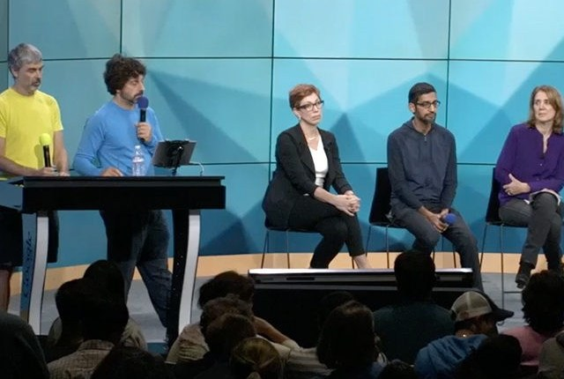
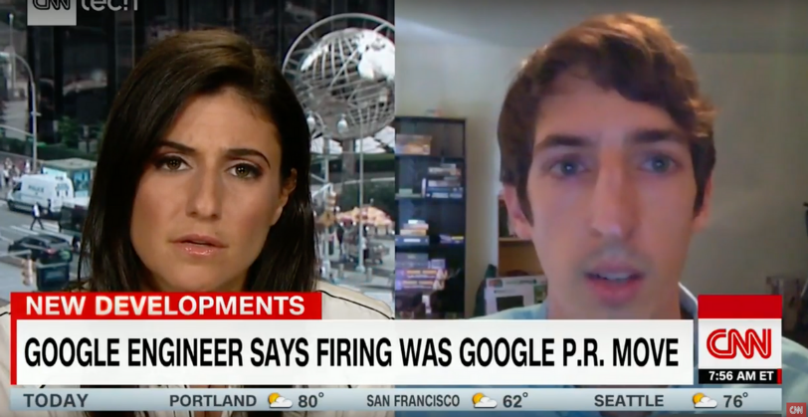
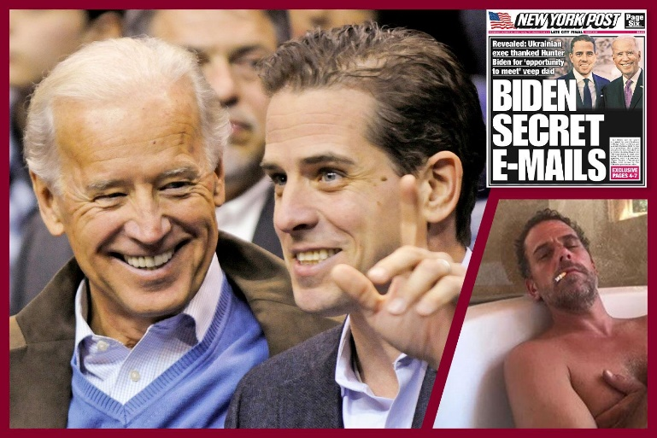
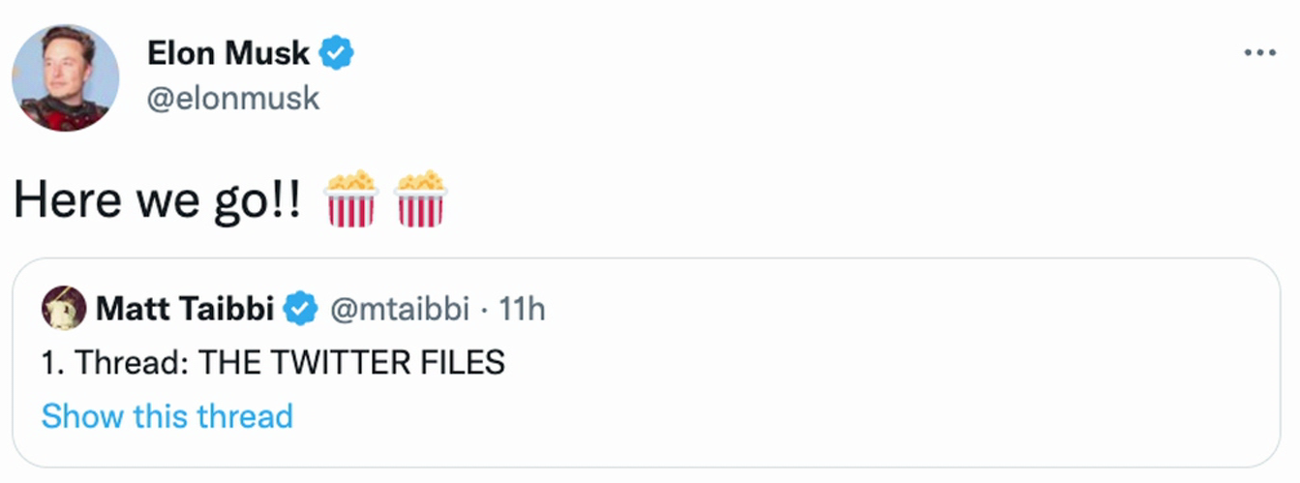
Wokeness and big tech 2/
Tech firms as victims of wokeness
Government pressure
Desire to please woke employees
Delegation to middle managers
Tech firms as drivers of wokeness
Netflix, Amazon, Disney, other content providers and distributors
Social media, retailers, exchanges: deplatforming, suppressing politically inconvenient material, spreading misinformation, working with government officials

Slide 13
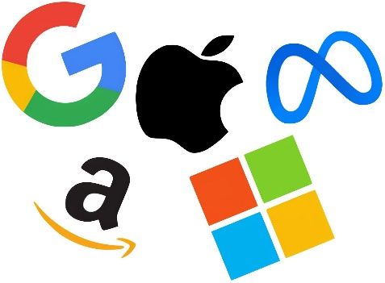
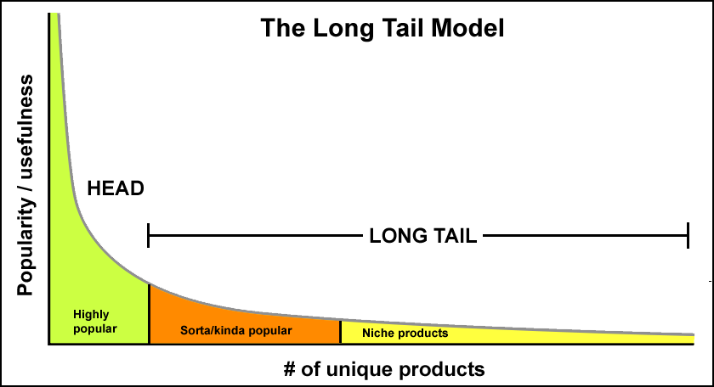
Why (some) tech companies, like universities, are woke
Business models and primary revenue streams
Low costs of wokeness on the periphery
Analogy with book publishing
The case of academia

Slide 14
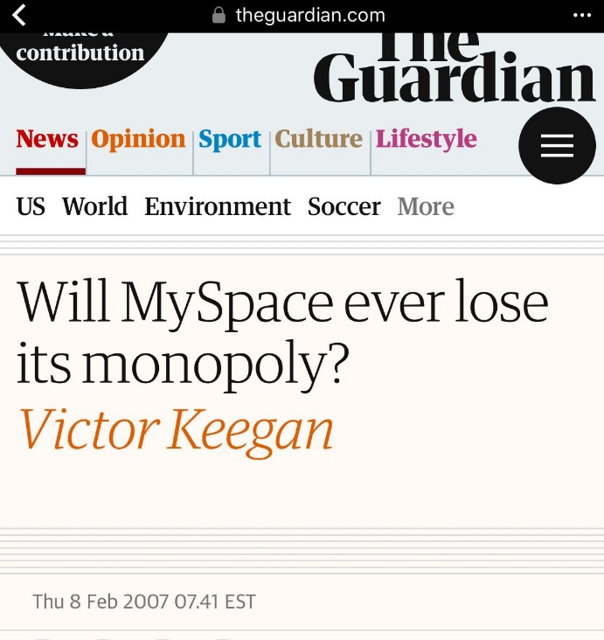
Do woke tech firms have monopoly power?
Large market shares (sometimes)
Network effects
Large fixed costs, low marginal costs, leading to first-mover advantages (winner-take-most markets)
Ability to profit from ecosystem
spillovers, platform ownership
But still competition, absent
government protection

Slide 15
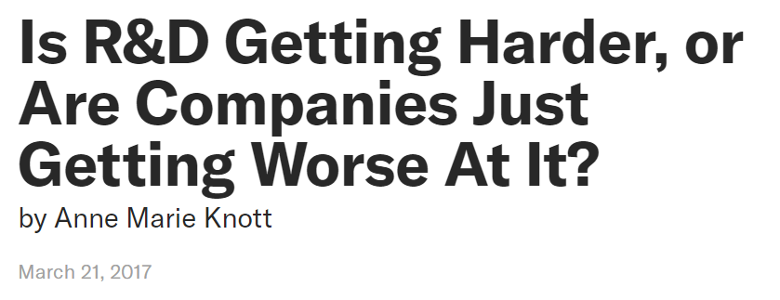
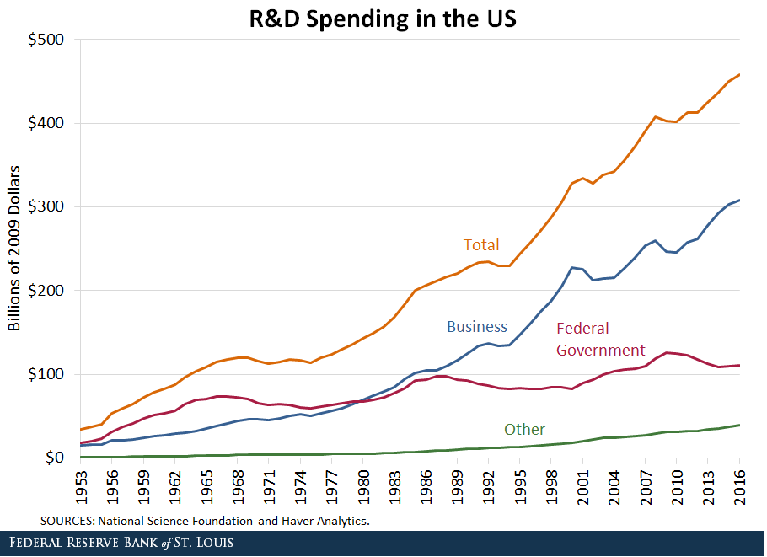
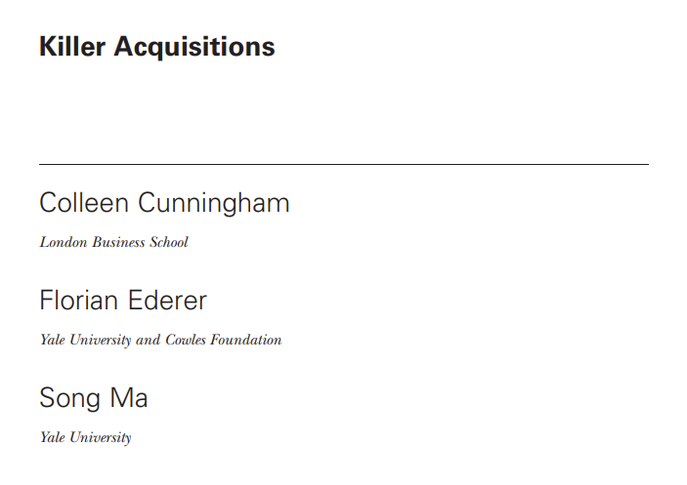
Do tech firms suppress innovation?
Corporate R&D
Schumpeter on firm size and innovation
Rise of science-based discovery
Decline in returns to corporate R&D?
Mazzucato and capitalist myopia?
Killer acquisitions
Problem of counterfactuals
Owner sovereignty and entrepreneurial judgment

Slide 16
Policy toward big tech
Breakups, public ownership
Regulation
Content neutrality (common-carrier status, the “public square,” etc.) to reduce woke bias
Bans on private-label placement
Mandatory data portability, bans on collecting user data (would then need alternative pricing models)
Note on privacy
In some ways, platforms create more privacy
We can pay (in $$$ or inconvenience, reduced
usability) for more privacy, yet very few do
Remove all privileges, protection
Sec 230, CDA

