Slide 1
Measurement in Economics
Karl-Friedrich Israel
kisrael@uco.fr
Université Catholique de l’Ouest Angers, France
Mises University 2023
Auburn, AL, USA
25 July 2023

Slide 2
Content
Introduction
The Program of Modern Econometrics
Utility and Welfare Economics
Econometrics as a Set of Descriptive Tools
Reference: K.-F. Israel, Pawel Ciompa and the meaning of econometrics: a comparison of two concepts, The European Journal of the History of Economic Thought, (2023, forthcoming)

Slide 3
1. Introduction
Two main developments in economics in the 20th century:
In theory: Keynesian economics
In methodology: Modern econometrics
Most dominant branch of economics after World War II is found at the intersection of both developments
Large-scale Keynesian macroeconomic models
The methodological development has arguably been more important for the discipline

Slide 4
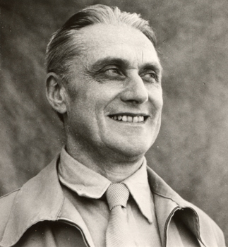
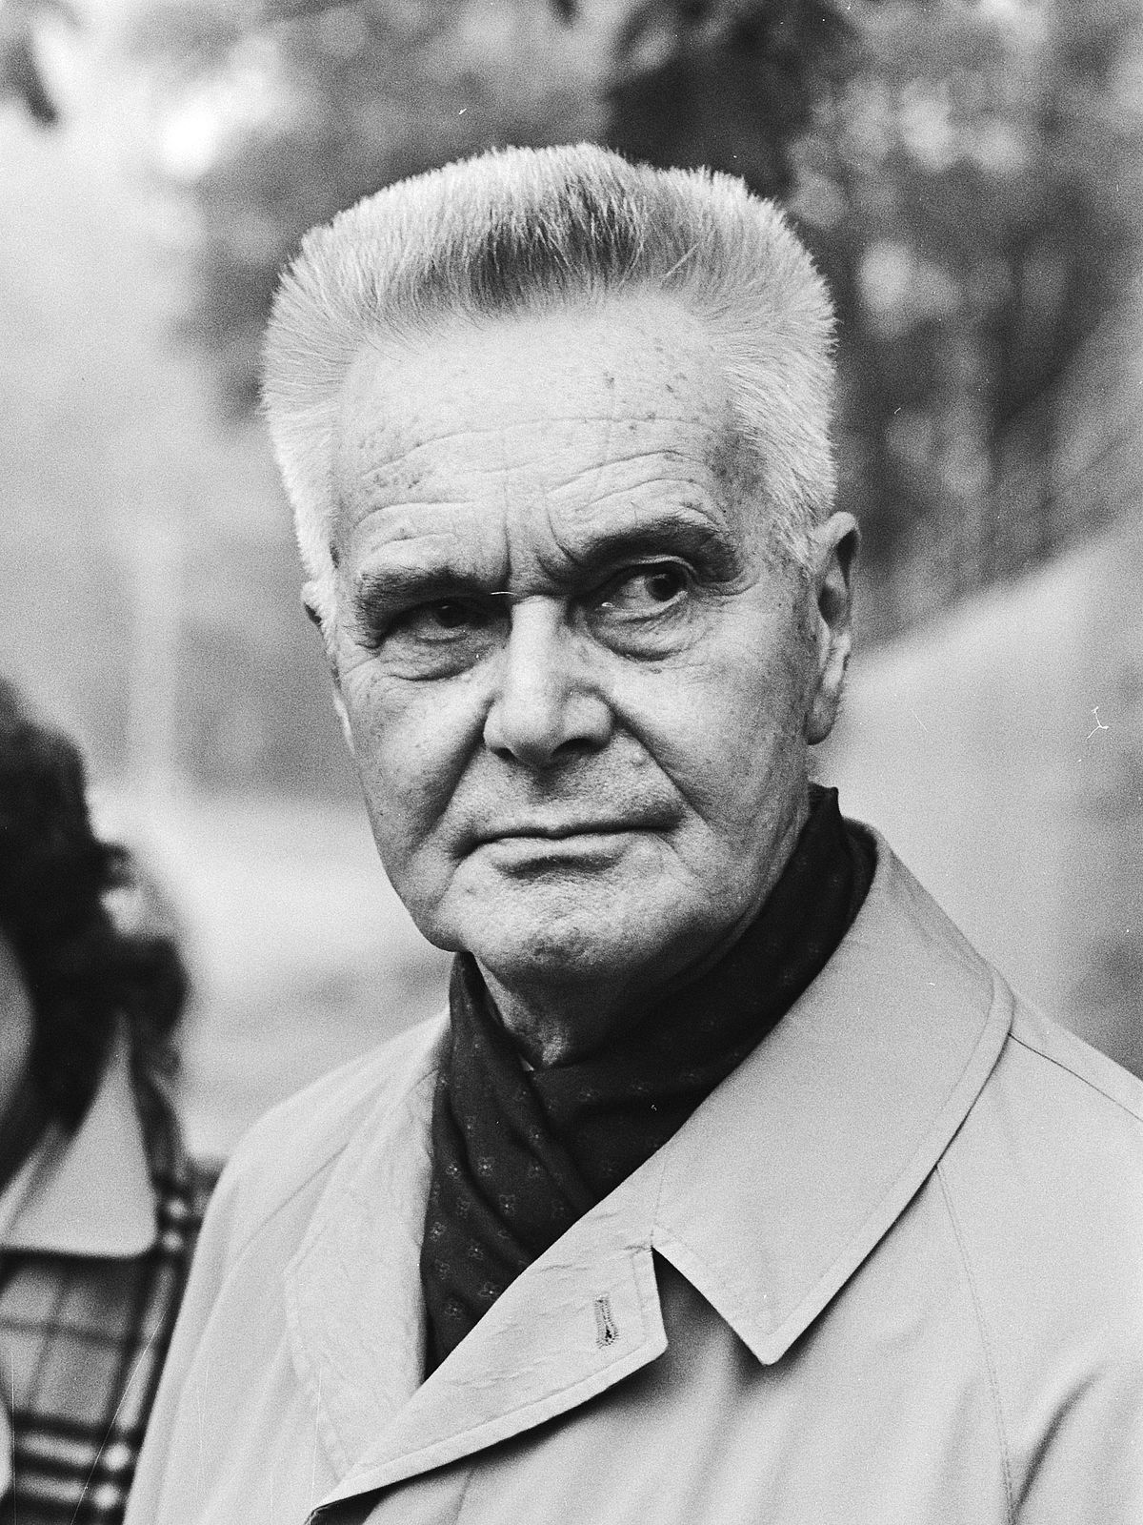
2. The Program of Modern Econometrics
Nobel Memorial Prize in Economics
(1969)
Ragnar Frisch (1895-1973)
Jan Tinbergen (1903-1994)

Slide 5
2. The Program of Modern Econometrics
“Intermediate between mathematics, statistics, and economics, we find a new discipline which for lack of a better name may be called econometrics. Econometrics has as its aim ... to turn pure economics, as far as possible, into a science in the strict sense of the word.”
R. Frisch (1926): “Sur un problème d’économie pure.” Norsk Matematisk Forenings Skrifter Series 1 (16)

Slide 6
2. The Program of Modern Econometrics
There are two aspects to modern econometrics:
Theoretical-quantitative: reformulating economic theory in quantitative-mathematical terms
Empirical-quantitative: empirically testing theoretical-quantitative propositions
“Unlike the attempts around 1838 (by Cournot) and 1870 (by Walras, Jevons and Menger) which did not succeed, the third ‘wave’ of quantification was successful.”
Tinbergen (1973)

Slide 7
2. The Program of Modern Econometrics
“The econometric study that we present is an attempt to realize Jevon’s dream [the author refers to the paragraph “Numerical Determination of the Laws of Utility” in the fourth edition of Jevons (1911)]: measure the variations of the marginal utility of economic goods.”
Frisch (1926)
“… since the break-through of econometrics–this is not a dream anymore but a reality”
Frisch (1970)

Slide 8
2. The Program of Modern Econometrics
How did the dream become true?
Mathematical axiomatization of economic theory (e.g.: determination, additivity, and transitivity of preferences)
Utility as a well-defined mapping from multidimensional bundles of goods to a cardinal scale of measurement
How to determine the mapping? - With choice questions (expériences par interrogation)
How to determine cardinal utility measurements from interview data? - With an appeal to everyday experience
The scientific basis is very thin, but the implications, if the project were to succeed, are obvious: assessment and maximization of total welfare

Slide 9
3. Utility and Welfare Economics
Utility theory analyzes the laws of value and choice of individuals
Welfare theory analyzes the relationships between the values of many individuals, with the objective of drawing scientific conclusions on the desirability of various alternatives
Assessing the welfare implications of
Taxes
Subsidies
Price controls
Monopoly
Partial and complete economic planning

Slide 10
3. Utility and Welfare Economics
Reservation prices of potential sellers:
Joe: $2
Jeff: $4
David: $6
Mark: $8
Shawn: $10
Reservation prices of potential buyers:
Mardy: 12€
Felicia: 10€
Pat: 9€
Suzy: 8€
Kristy: 6€

Slide 11
3. Utility and Welfare Economics
Price in $
Reservation prices of potential sellers:
Joe: $2
Jeff: $4
David: $6
Mark: $8
Shawn: $10
12
10
8
6
4
2
David
Shawn
Jeff
Mark
Joe
0
1
2
3
4
5
Quantity

Slide 12
3. Utility and Welfare Economics
Price in $
Reservation prices of potential sellers:
Joe: $2
Jeff: $4
David: $6
Mark: $8
Shawn: $10
12
Supply
10
8
6
4
2
0
1
2
3
4
5
Quantity

Slide 13
3. Utility and Welfare Economics
Price in $
Reservation prices of potential buyers:
Mardy: 12€
Felicia: 10€
Pat: 9€
Suzy: 8€
Kristy: 6€
12
Supply
10
Mardy
8
Felicia
Pat
Suzy
6
4
Kristy
2
0
1
2
3
4
5
Quantity

Slide 14
3. Utility and Welfare Economics
Price in $
Equilibrium:
Price: $8
Quantity: 4
12
Supply
10
8
6
Demand
4
2
0
1
2
3
4
5
Quantity

Slide 15
3. Utility and Welfare Economics
Price in $
Equilibrium:
Price: $8
Quantity: 4
Consumer surplus:
$4 + $2 + $1 + $0 = $7
Mardy ($4)
12
Felicia ($2)
Supply
10
Pat ($1)
Suzy ($0)
8
Kristy ($0)
6
Demand
4
2
0
1
2
3
4
5
Quantity

Slide 16
3. Utility and Welfare Economics
Price in $
Equilibrium:
Price: $8
Quantity: 4
Consumer surplus:
$4 + $2 + $1 + $0 = $7
Producer Surplus:
$6 + $4 + $2 + $0 = $12
12
Supply
10
Shawn ($0)
8
Mark ($0)
6
David ($2)
Demand
4
Jeff ($4)
2
Joe ($6)
0
1
2
3
4
5
Quantity

Slide 17
3. Utility and Welfare Economics
Price in $
Equilibrium:
Price: $8
Quantity: 4
Consumer surplus:
$4 + $2 + $1 + $0 = $7
Producer Surplus:
$6 + $4 + $2 + $0 = $12
Total welfare:
$7 + $12 = $19
12
Supply
10
8
6
Demand
4
2
0
1
2
3
4
5
Quantity

Slide 18
3. Utility and Welfare Economics
Price in $
Price floor
of $11
Welfare loss from price controls:
Price: $11
Quantity: 1
12
Supply
10
8
6
Demand
4
2
0
1
2
3
4
5
Quantity

Slide 19
3. Utility and Welfare Economics
Price in $
Price floor
of $11
Welfare loss from price controls:
Price: $11
Quantity: 1
Consumer surplus: $1
Producer surplus: $9
Total welfare: $10
Welfare loss: $9
12
Supply
10
8
6
Demand
4
2
0
1
2
3
4
5
Quantity

Slide 20
3. Utility and Welfare Economics
Price in $
Price floor
of $11
Welfare loss from price controls:
Price: $11
Quantity: 1
Consumer surplus: $1
Producer surplus: $9
Total welfare: $10
Welfare loss: $9
12
Supply
10
8
6
Demand
4
2
0
1
2
3
4
5
Quantity

Slide 21
3. Utility and Welfare Economics
Price in $
Price floor
of $11
Welfare loss from price controls:
Price: $11
Quantity: 1
12
Supply
10
8
That’s
ridiculous!!!
6
Demand
4
2
Muahaha!!!
0
1
2
3
4
5
Quantity

Slide 22
3. Utility and Welfare Economics
Price in $
Price floor
of $11
Welfare loss from price controls:
Price: $11
Quantity: 1
12
Supply
10
8
Consumer surplus: $1
Producer surplus: $1
Total welfare: $2
Welfare loss: $17 (Additional loss of $8)
6
Demand
4
2
0
1
2
3
4
5
Quantity

Slide 23
3. Utility and Welfare Economics
Price in $
Price floor
of $11
D. Schmidtz (2015): Are Price Controls Fair?, Supreme Court Economic Review 23(1): 221-233
The standard analysis only gives the lower bound of the welfare loss (the best-case scenario)
12
Supply
10
8
6
Demand
4
2
0
1
2
3
4
5
Quantity

Slide 24
3. Utility and Welfare Economics
Price
Welfare loss of an excise tax
The tax can be understood as an increase in costs
Supply
Demand
Quantity

Slide 25
3. Utility and Welfare Economics
Price
Welfare loss of an excise tax
The tax can be understood as an increase in costs
When demand is price-elastic, the reduction in the quantity exchanged is big
Welfare loss is big
Supply
Demand
Quantity

Slide 26
3. Utility and Welfare Economics
Price
Welfare loss of an excise tax
The tax can be understood as an increase in costs
Supply
Demand
Quantity

Slide 27
3. Utility and Welfare Economics
Price
Welfare loss of an excise tax
The tax can be understood as an increase in costs
When demand is price-inelastic, the reduction in the quantity exchanged is small
Welfare loss is small
Standard conclusion: tax markets with price-inelastic demand (and supply)
Supply
Demand
Quantity

Slide 28
3. Utility and Welfare Economics
Price
T. Fegley, K. Hansen, and K-F. Israel (2023): Clarifying the analysis of deadweight loss from taxation. Cahiers de recherche de l’AFREA, Document-002
Supply
Demand
Quantity

Slide 29
3. Utility and Welfare Economics
Price
Overall spending increases
T. Fegley, K. Hansen, and K-F. Israel (2023): Clarifying the analysis of deadweight loss from taxation. Cahiers de recherche de l’AFREA, Document-002
Some other market:
Additional loss
Standard analysis underestimates the welfare loss
Supply
Demand
Quantity

Slide 30
3. Utility and Welfare Economics
Both criticisms (Schmidtz; Fegley et al.) can be considered internal criticisms, but they point at an important problem: the fallacious assumption of constancy (ceteris paribus)
More fundamental criticism in Rothbard (1956): Toward a Reconstruction of Utility and Welfare Economics based on two principles:
Unanimity rule (Pareto principle)
Demonstrated preferences (contingent on time and circumstances)
Rothbard draws two main conclusions:
“the free market always increases social utility”
“no act of government can ever increase social utility”

Slide 31
3. Utility and Welfare Economics
We cannot measure utility quantitatively; it is not cardinal; it cannot be added or interpersonally compared – there is no such thing as a toral utility to be maximized (“all utilities are marginal”)
Even if you could (at least indirectly) measure utility from demonstrated preferences in a certain situation, it is unjustified to hold these measures constant to be applied in other situations
The lack of constancy jeopardizes not only the application of standard welfare economics to the real world, but also undermines an important part of the econometric program in general

Slide 32
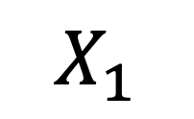

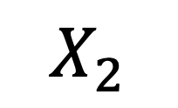
4. Econometrics as a Set of Descriptive Tools
Description vs. induction
The basic idea of inductive econometrics:
Measurable causes
Measurable effects
$$X_{1}$$
Model
(some functional
relationship)
$$Y$$
$$X_{2}$$

Slide 33
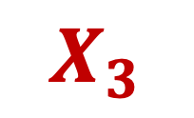
4. Econometrics as a Set of Descriptive Tools
The basic idea of inductive econometrics:
Measurable causes
Measurable effects
$$X_{1}$$
Model
(some functional
relationship)
$$Z$$
$$X_{3}$$
$$X_{2}$$

Slide 34
4. Econometrics as a Set of Descriptive Tools
The basic idea of inductive econometrics:
Measurable causes
Measurable effects
$$X_{1}$$
Model
(some functional
relationship)
$$Z$$
$$X_{3}$$
$$X_{2}$$
Maybe it is non-linear?

Slide 35
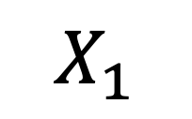

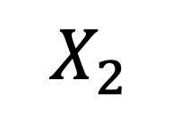
4. Econometrics as a Set of Descriptive Tools
The process of hypothesis testing and revising presupposes a constant underlying structure between causes and effects
Mises: “no constants in economics”
Hoppe (1983): the constancy principle (equal causes lead to equal effects & different effects imply unequal causes) does not hold in economics
Why?
$$X_{1}$$
$$Y$$
$$X_{2}$$
Human beings are capable of learning

Slide 36
4. Econometrics as a Set of Descriptive Tools
The inductive part of modern econometrics is problematic
The descriptive part is not
Pawel Ciompa (1910): econometrics (economographics) as a descriptive economics – “econometrics is then just the theory of accounting.”
Empirical-quantitative-statistical methods are tools to describe economic phenomena and developments
Their explanations come from economic theory

Slide 37
3. Utility and Welfare Economics
Reservation prices of potential sellers:
Joe: $10
Mark: $8
David: $6
Jeff: $4
Sean: $2
Price in $
10
8
6
4
2
0
1
2
3
4
5
Quantity

