Slide 1
The True Cost of Regulations
🍐
Per Bylund
@PerBylund
Mises University | July 27, 2022

Slide 2
How can we study regulations?
Statistically
Captures actual magnitudes
Lacks counterfactual
Retrospective
Theoretically
Lacks magnitudes
Provides short- and long-term counterfactuals
Future-oriented

Slide 3
Mainstream analysis (overview)
Comparative analysis of the “social” costs/benefits of a policy
Ex ante: status quo extrapolated into the future vs. made-up alternate reality
Ex post: empirical data vs. made-up alternate reality
Relies on prices, real and estimated, as representative of (social) value
Synthetic controls and statistical inferences
Statistical estimates and comparison of the short-term “seen” and the “unseen.”

Slide 4
The seen vs. unseen
“Between a good and a bad economist this constitutes the whole difference — the one takes account of the visible effect; the other takes account both of the effects which are seen, and also of those which it is necessary to foresee. Now this difference is enormous, for it almost always happens that when the immediate consequence is favourable, the ultimate consequences are fatal, and the converse. Hence it follows that the bad economist pursues a small present good, which will be followed by a great evil to come, while the true economist pursues a great good to come, — at the risk of a small present evil.”
Frédéric Bastiat

Slide 5
The seen vs. unseen: a restatement
“The bad economist sees only what immediately strikes the eye; the good economist also looks beyond. The bad economist sees only the direct consequences of a proposed course; the good economist looks also at the longer and indirect consequences. The bad economist sees only what the effect of a given policy has been or will be on one particular group; the good economist inquires also what the effect of the policy will be on all groups.”
Henry Hazlitt

Slide 6
What’s missing in mainstream
Consideration of long-term effects
Proper economic theory
How entrepreneurs make money

Slide 7
Proper economic theory
Subjective value
Market process
Entrepreneurship
Economic calculation

Slide 8
A theoretical study of regulations
What is a regulation?
How does it affect human action?
People’s (producers and consumers) value scales?
What is its economic impact?
Short term and long term
Effect on entrepreneurship, production, economic calculation

Slide 9
How do regulations relate to destruction?

Slide 10
Large-scale destruction
Assume bombs dropped over Dresden with massive property damage, but no deaths (a miracle!)
Before After
As the bombing stops, people get busy rebuilding
More economic ‘activity’ (what Krugman calls ‘growth’)
…
Buildings | ✔️
Other stuff | ➖
…
Big boy
…
Buildings | ➖
Other stuff | ➖
…

Slide 11
Large-scale destruction cont’d
The higher demand for construction materials causes prices to increase
Construction materials are shifted into Dresden from lower-priced regions in pursuit of profits
Increased production in existing supply chains
In other words: the market works as expected
Disaster relief offered by private citizens, charitable and for-profit organizations, maybe also government
Dresdeners have suffered a loss, but they still pursue their highest valued attainable ends

Slide 12
Economics of destruction
Temporary loss/setback
Loss of existing wealth (window, Dresden)
Prices and actions adjust to the new situation
Resources are reallocated to their better uses
Despite the exogenous shock (destruction), the market order remains intact
Actors pursue their highest valued attainable ends
A temporary setback (loss), followed by the (new) maximizing trajectory

Slide 13
How are regulations different?

Slide 14
Regulations
Restrictions (costs imposed) on actions
Prohibition on specified actions (bans)
Prohibition on actions unless complying with specific mandates (licensing, zoning, building codes etc.)
Effective regulations restrict/prohibit actions that are formally, physically, and economically feasible
Regulations are not destruction, but destructive

Slide 15
Regulations: value scale analysis
Assume the CDC issued a touchscreen ban in 2006 to stop the spread of some disease

Slide 16
Dr. Anthony “iPad” Fauci

Slide 17
Regulations: value scale analysis
Assume the CDC issued a touchscreen ban in 2006 to stop the spread of some disease
This is the effect on some user’s value scale:
No regulation Touchscreen ban
…
iPod Touch | ✔️
Walkman | ➖
Portable radio | ➖
…
…
iPod Touch | ❌
Walkman | ✔️
Portable radio | ➖
…

Slide 18
Regulations: value scale analysis
Note the implication: this is not a one-time loss
Reality is unchanged – the economy’s ability to satisfy this want remains
The option is lost
Someone to replace a broken device cannot
Someone frequently updating their device cannot
Actors can’t pursue their highest valued attainable ends
Every time a choice is made where the touchscreen option had been valued higher constitutes a loss
The economy is not static, it is a process – restrictions have long-term consequences

Slide 19
Regulations: production analysis
Producers are prohibited from selling touchscreens, so they will exit or shift production elsewhere
Relative consumer wants, there is under-production in touchscreens and devices using touchscreens
Investments are instead made elsewhere: non-touchscreen devices, television sets, etc.
Relative consumer wants, there is over-production in other lines of production
In sum, the production structure is distorted, malinvestments abound

Slide 20
So far, no big surprises
Regulations distort the production structure
Regulations cause value losses (lost options)
So, what about the “unrealized”?

Slide 21
Innovation is (r)evolutionary
iPod iPhone iPad
Innovations are cumulative, so where capital investments are made matters: they determine (facilitate) what entrepreneurs can do
Process perspective: effects in the unfolding market
Time

Slide 22
Implications of touchscreen ban
No continued innovation using touchscreens to satisfy consumer wants
Resources reallocated toward other (lesser) value production
Relevant knowledge and competencies will not be developed, generated, accumulated
Jobs, expertise, organizations will not be created
They may be created elsewhere (a further distortion)
Add-on and next-stage investments/firms/jobs will never see the light of day

Slide 23
The unrealized
Neither seen nor unseen, but what never comes to be because of regulations
The products, investments, jobs, and opportunities that would have existed were it not for artificial restrictions (regulations)
Where the market would be, structurally, from a consumer satisfaction perspective
“options that would have been available had the economy not been distorted” (p. 162)
Regulations do away with products but, more importantly, also jobs/careers, production possibilities, and value-creative trajectories

Slide 24
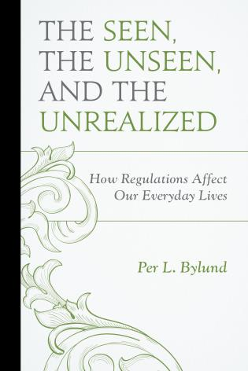
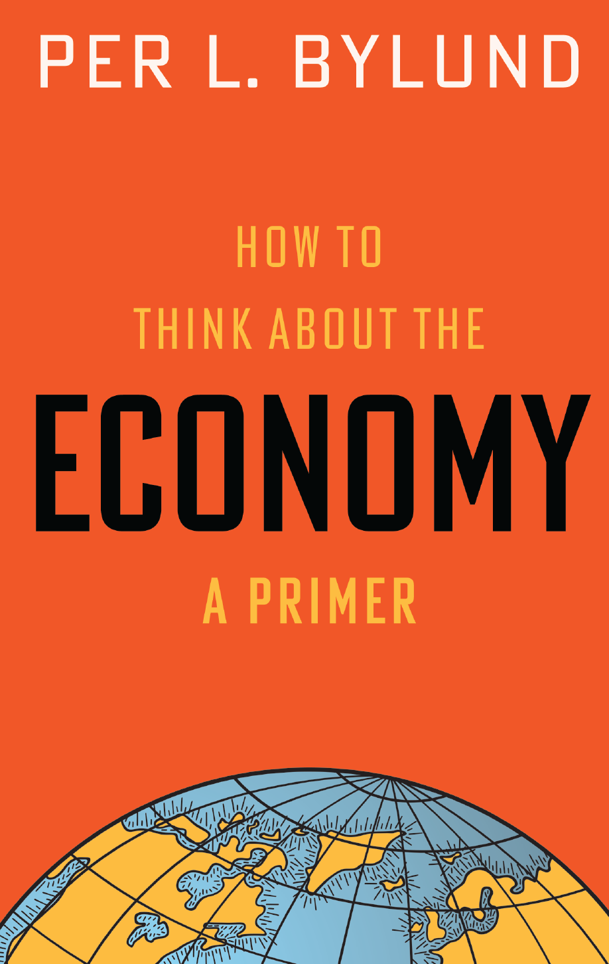
Summing up
Economic effects are distorted processes and trajectories
Misaligned production structure
Destruction of capital is no biggie, comparatively speaking
Temporary setback, but production structure aligned with cons. wants
(Even libertarians don’t understand how destructive regulations are!)

Slide 25
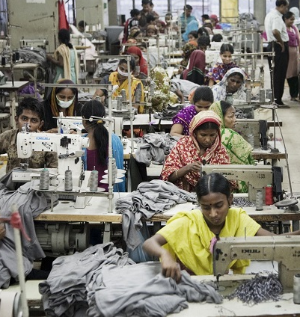
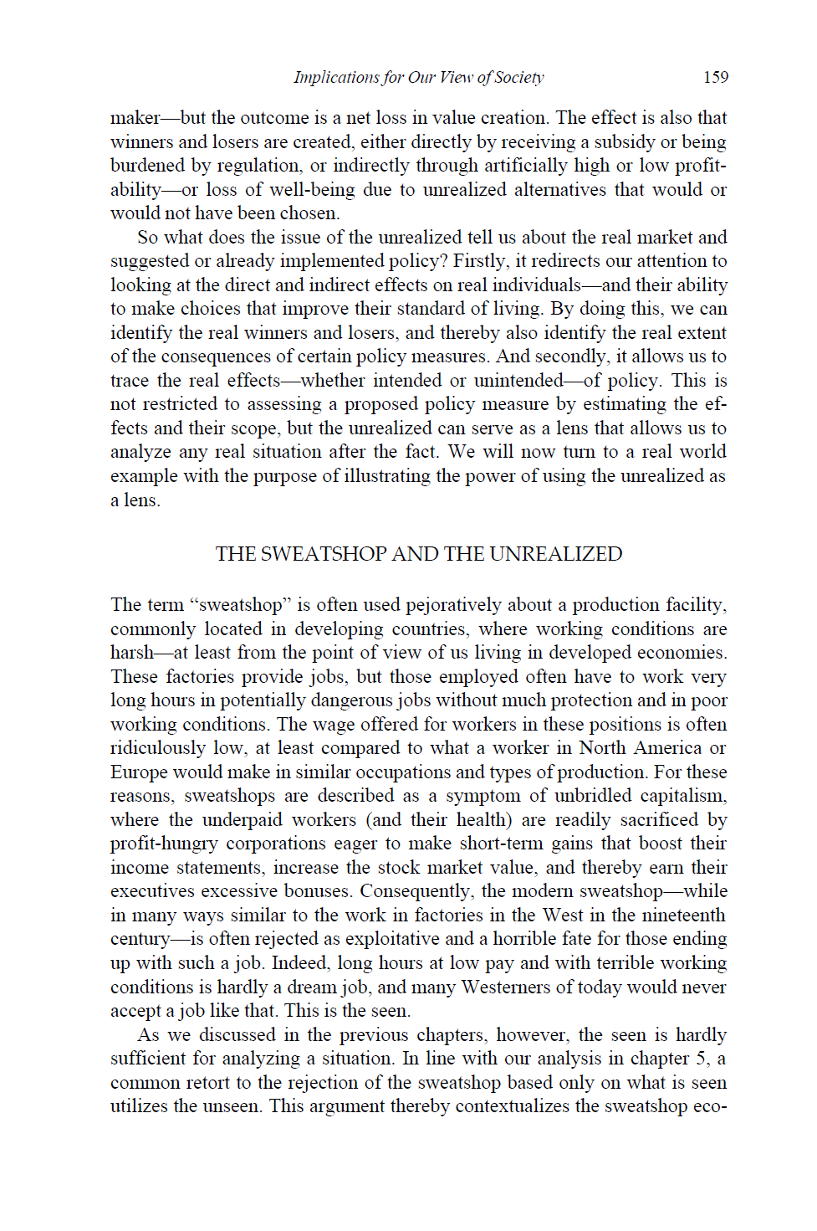
Analyzing the Unrealized
Sweatshops

Slide 26
Analyzing the Unrealized
“…the fact that there are no economic limitations … means the market is mature enough to support this type of production [sweatshops]. We can therefore conclude that the standard of living in the village would likely have been at par with that which is offered through employment in the sweatshop. In other words, the poverty experienced by the villagers is to a significant extent artificial, as is Rashid’s choice situation when he chooses between the comparatively high-paying job in the sweatshop and toiling in the fields or weaving baskets by hand.” (p. 163)

Slide 27
The ‘Unrealized’ summarized
Effect on entrepreneurs
Cannot pursue creating goods and services they expect will best satisfy consumers’ wants
Cannot make the most highly valued investment
May choose to not invest at all
May choose to invest elsewhere, thereby distorting the production structure
This means lower standard of living
Fewer and worse options for consumers
Fewer and lower-pay jobs for workers
Production structure not aligned with consumer value

Slide 28
Read more
The Seen, the Unseen, and the Unrealized: How Regulations Affect Our Everyday Lives
https://store.mises.org/The-Seen-the-Unseen-and-the-Unrealized-P11174.aspx

