Slide 1
THE DIRTY DATA OF LABOR COMPENSATION MYTHS
Gene Epstein
PorcFest 2022

Slide 2
“less and less and less”
“The share that goes to laborers has gotten less and less and less.”-Briahna Joy Gray, former National Press Secretary for Bernie Sanders' Presidential campaign, to Brown University Professor of Economics Glenn Loury, on her podcast, “Bad Faith.”

Slide 3
Sen Elizabeth Warren
“While corporate profits have soared, the share of national income that goes to labor has declined and is near its lowest point in almost 70 years.” -”Corporate Governance Working Group”-paper to “Fundamentally Reform the 21st Century American Economy”

Slide 4
“significant declines”
“significant declines in the labor share of income”—April 2021 Cato Institute in the course of inquiring whether remedy should be
“worker representation on corporate boards.”

Slide 5
The Ghost of Karl Marx
In “The Decline in Labor’s Share of U.S. Income,” free market economist David Henderson observes that in a course he taught, he “told the students that although I’m no Marxist, I did find this a little concerning.”

Slide 6
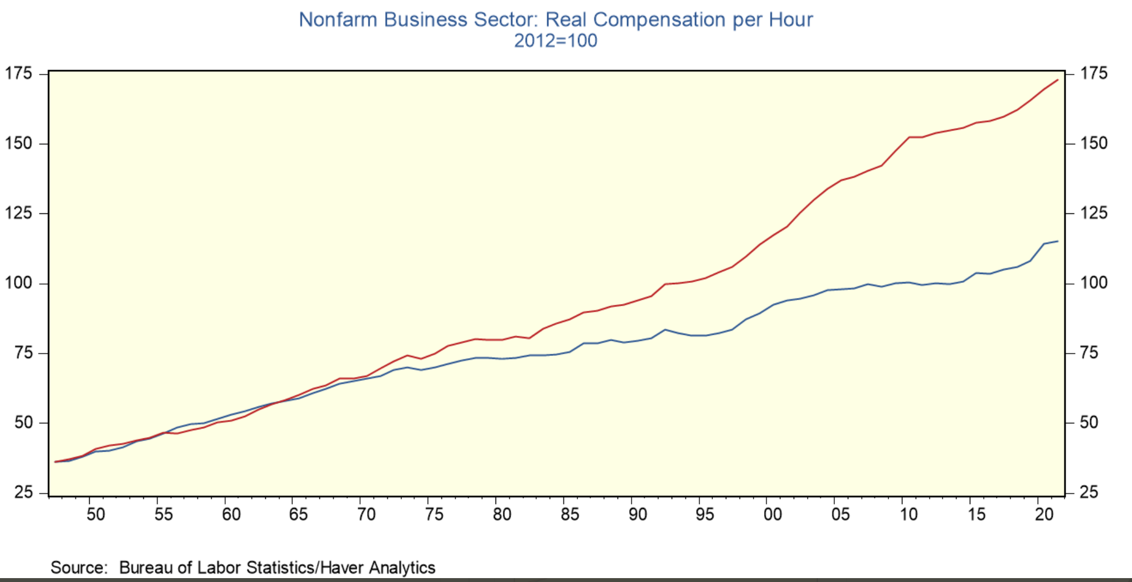
The Official Story (red line tracks “Real Output Per Hour of All Persons”)

Slide 7
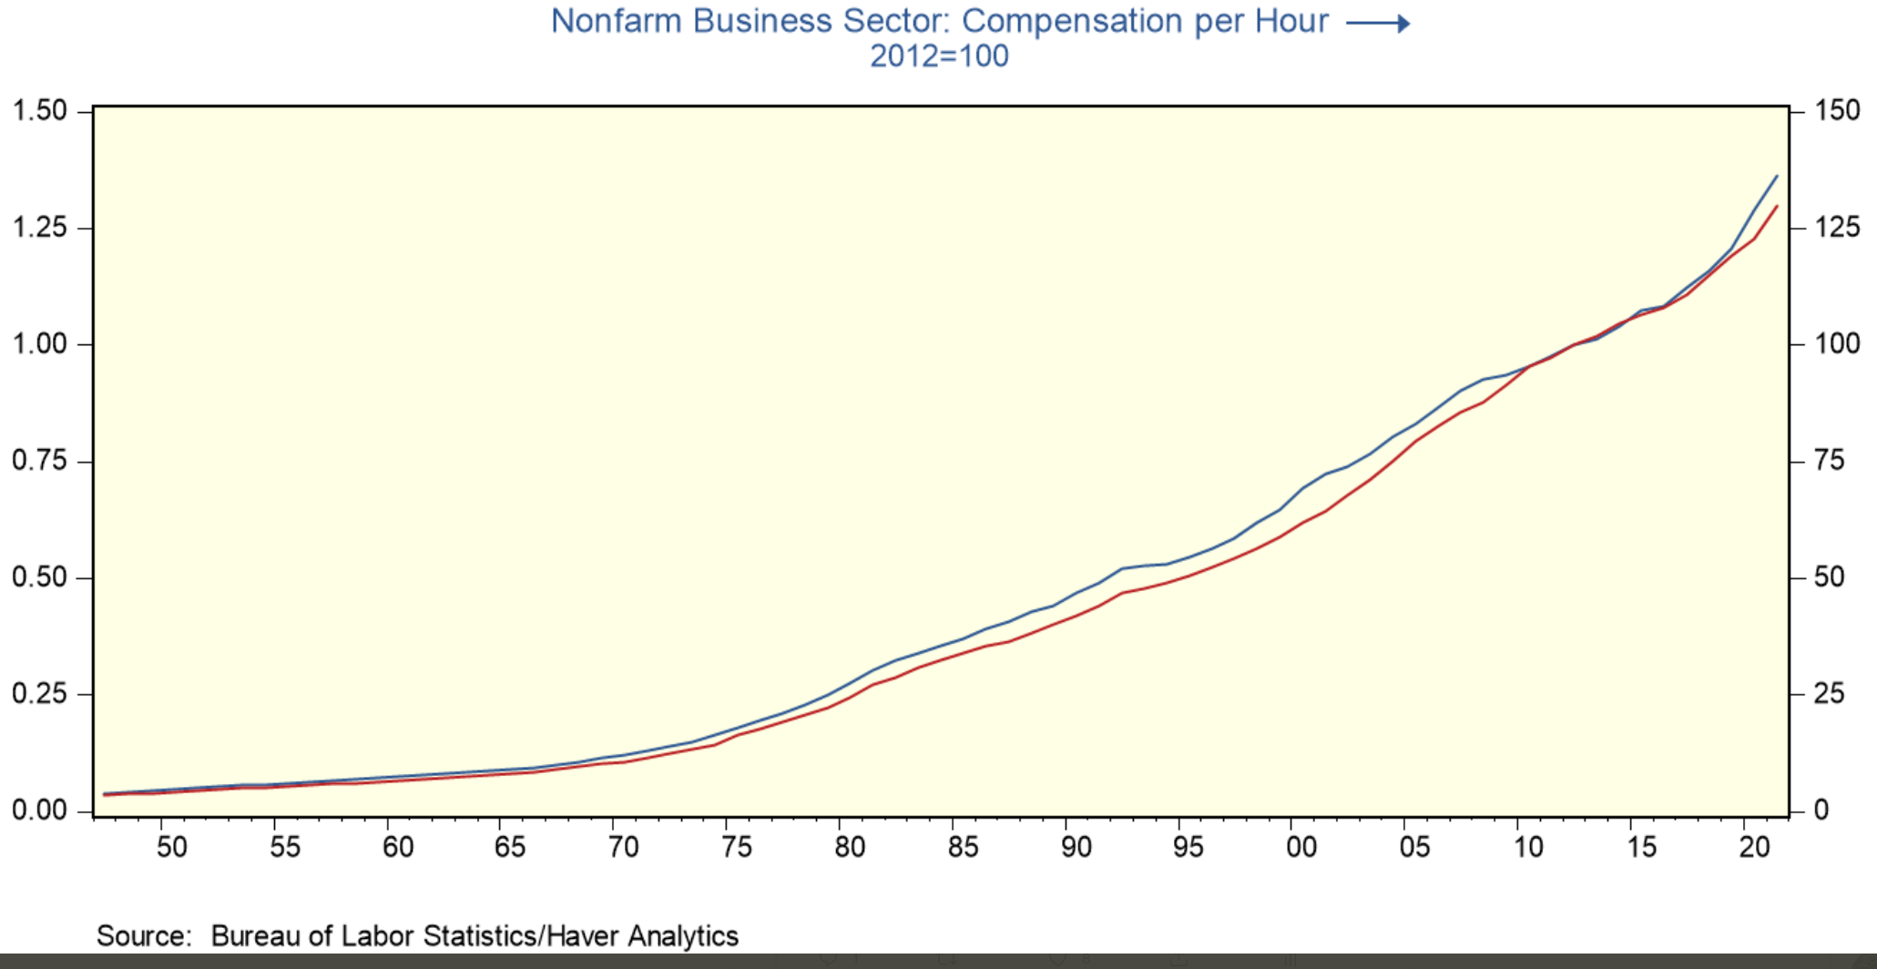
The Unofficial Story (red line tracks “Output Per Hour of All Persons” in nominal dollars)

Slide 8
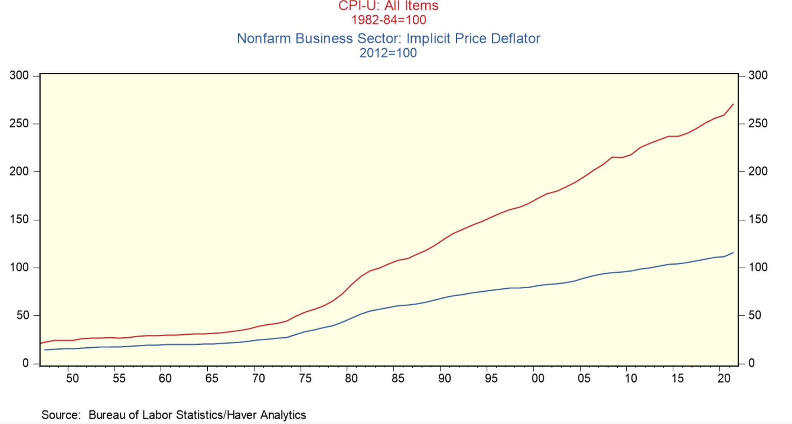
“Two Sets of Books”

Slide 9
Calculating the Ratio: “Labor Share”
Numerator: a measure of labor compensation, including benefits
Denominator: a measure of income and output

Slide 10
A Dissent from One Mainstream Economist
“Labor share remains within its historical range.”-- “Is Labor’s Loss Capital’s Gain? Gross versus Net Labor Shares,” Benjamin Bridgman, assistant chief economist at the Bureau of Economic Analysis.

Slide 11
“Historical Range”
The 75 years since World War II, with quarter data starting in 1947.

Slide 12
The Wall Street Journal, Feb 23 2019
Despite Tight Job Market, Labor Force’s Income Is Squeezed
Workers’ slice of the pie has been shrinking, confounding economists
By Peter Kiernan

Slide 13
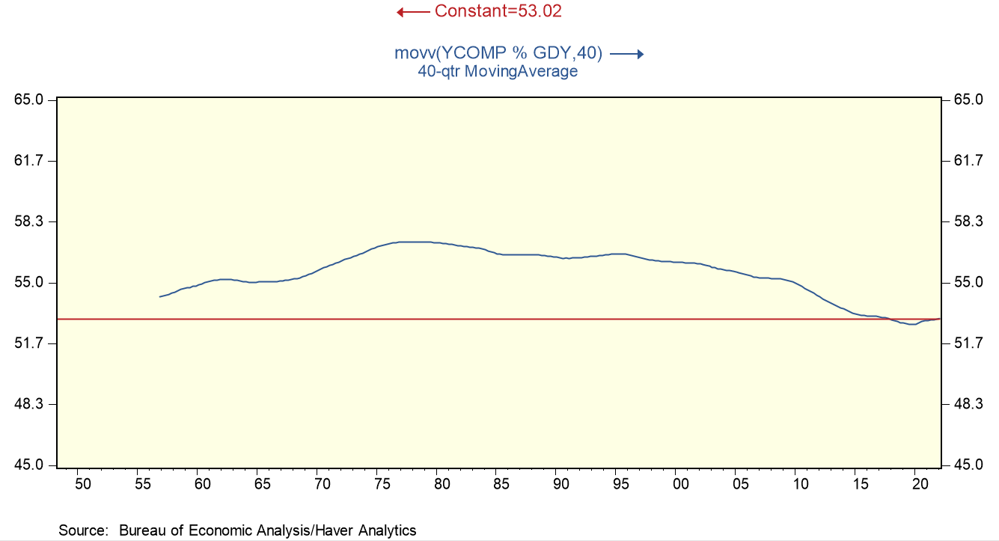
Labor Compensation/Gross Domestic Income

Slide 14
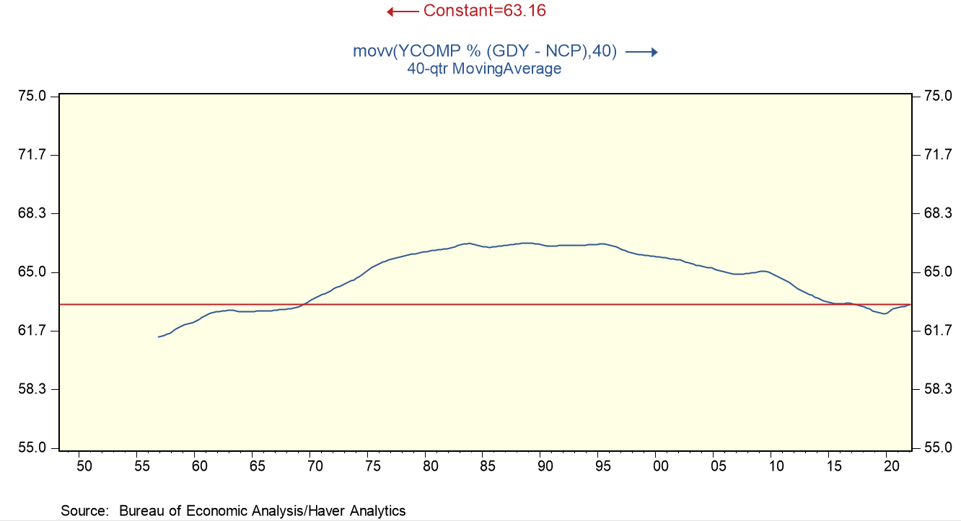
Labor Compensation/Net Domestic Income

Slide 15
Difference Between Gross Domestic Income vs. Net Domestic Income
Gross Domestic Income – Consumption of Fixed Capital (Depreciation)= Net Domestic Income

Slide 16
“Consumption of Fixed Capital”
“The charge for the using up of private and government fixed capital located in the United States. It is the decline in the value of the stock of fixed assets due to wear and tear, obsolescence, accidental damage, and aging.”-Bureau of Economic Analysis

Slide 17
“National Income”
“The sum of all incomes, net of consumption of fixed capital (CFC), earned in production.”-Bureau of Economic Analysis

Slide 18
Gross Domestic Product = Gross Domestic Income
Net Domestic Product = Net Domestic Income

Slide 19
Net Domestic Product and Depreciation (Ditto Net Domestic Income)
“Net Domestic Product may be viewed as an estimate of sustainable product, which is a rough measure of the level of consumption that can be maintained while leaving capital assets intact.”-Bureau of Economic Analysis

Slide 20
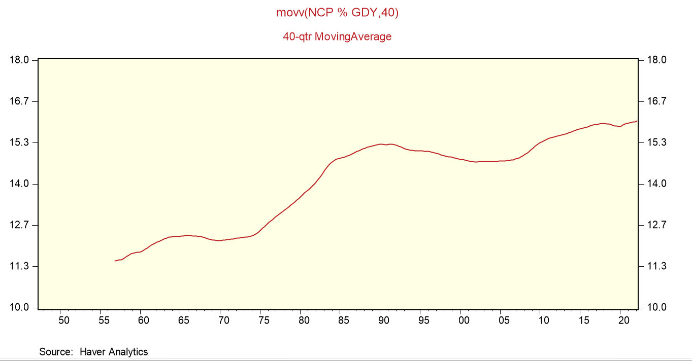
Depreciation Has Been Taking an Increasing Bite out of Gross Domestic Income

Slide 21
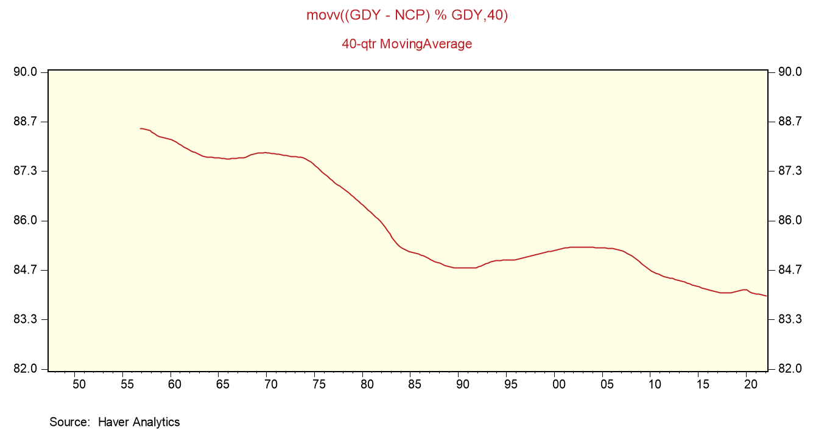
Result: Net Domestic Income Has Declined as Share of Gross Domestic Income

Slide 22
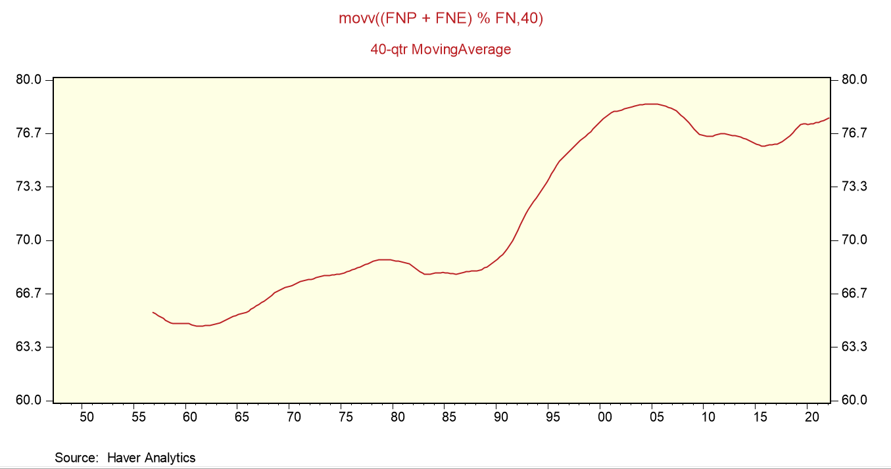
Investment in Equipment & Software as % of Private Sector Capital Investment-Nominal $

Slide 23
“Is Labor’s Loss Capital’s Gain?
Gross versus Net Labor Shares” Benjamin Bridgman, Ass’t Chief Economist, Bureau of Economic Analysis, May 2016
“Recent net labor share is within its historical range whereas gross share is at its lowest level.”
“I remove depreciation since paying for it only returns the economy to the production possibilities of the previous period. Using net production thus only includes output which can be used for current consumption or expanding future production.”

Slide 24
The Experts Still Stick to GDP
“The fall of labor’s share of GDP in the United States and many other countries in recent decades is well documented but its causes remain uncertain.”
“The Fall of the Labor Share and the Rise of Superstar Firms”∗
David Autor, MIT and NBER David Dorn, University of Zurich and CEPR Lawrence F. Katz, Harvard University and NBER Christina Patterson, Chicago Booth and NBER John Van Reenen, MIT and NBER October 2019 Quarterly Journal of Economics

Slide 25
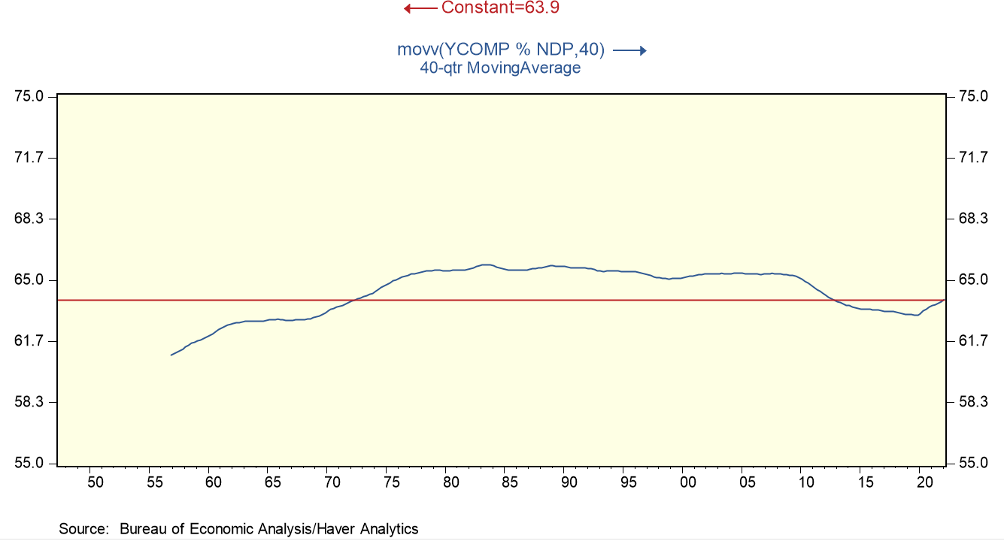
Labor Compensation/Net Domestic Product

Slide 26
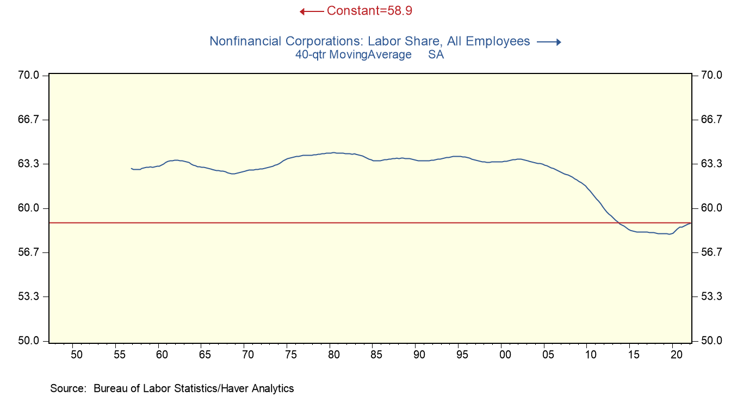
Labor Compensation as % of Gross Value Added

Slide 27
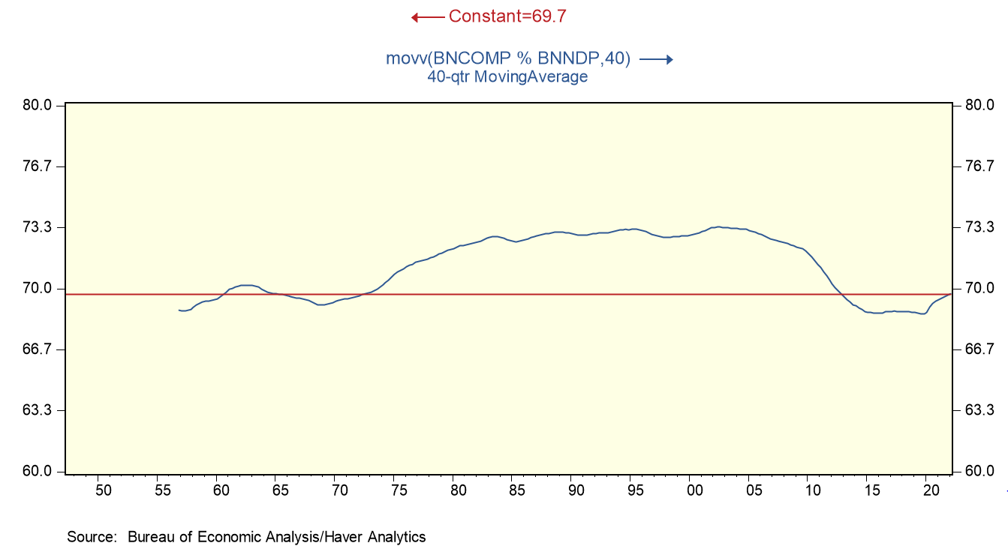
Labor Compensation as % of Net Value Added for Nonfinancial Corporations

Slide 28
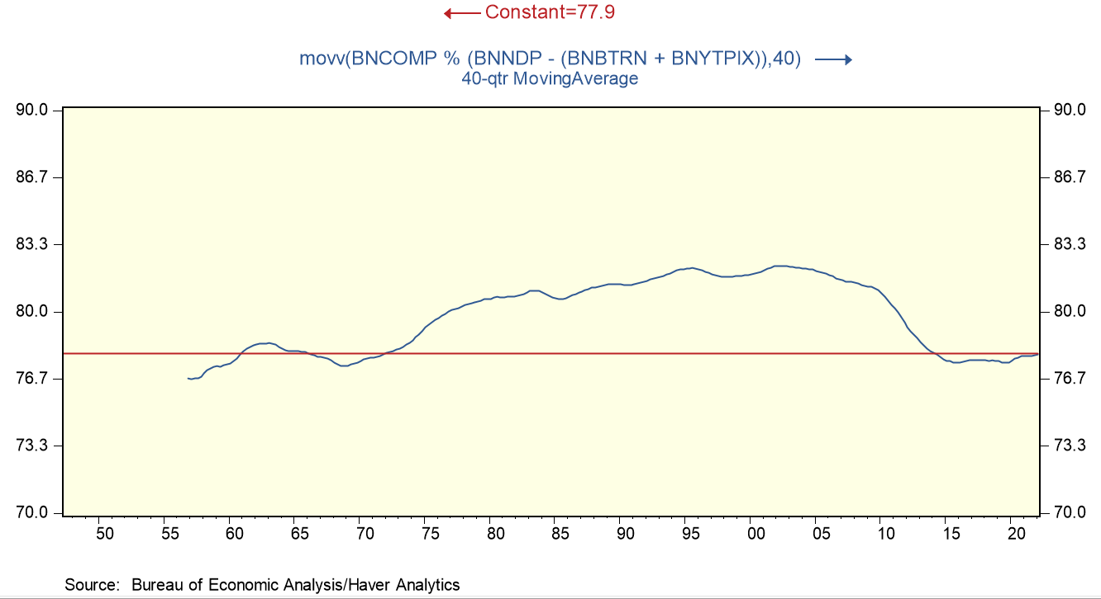
Labor Compensation for Nonfinancial Corporations as % of Net Value Added Minus Production Taxes

Slide 29
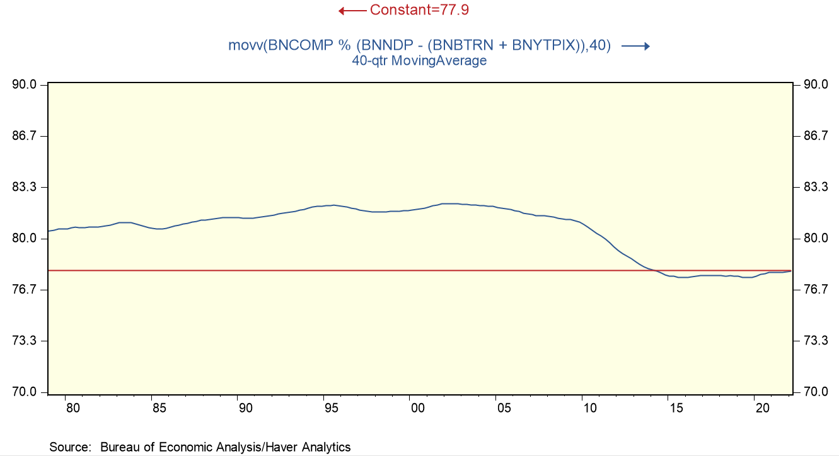
Labor Compensation For Nonfinancial Corporations of as % of Net Value Added Minus Production Taxes: 1970-2022

Slide 30
Rounding up the Usual Suspects
“Economists have offered various explanations for why workers are not doing better: the steady weakening of labor unions, the ability of American companies to find cheaper labor abroad or automate further, piddling productivity growth, and the rise of superstar companies that are extremely efficient with a relatively small labor force.”
“Paychecks Lag as Profits Soar, and Prices Erode Wage Gains”-New York Times, June 13, 2018

Slide 31
Weaker Unions, Soaring International Trade
“Economists cite a number of possible explanations for the change. One is that workers’ ability to negotiate wage increases has weakened. Union representation has fallen from about a quarter of the U.S. employed population in the 1970s to less than 12% now. Globalization and technology have also played a role. Soaring international trade, particularly after China’s entry to the World Trade Organization in 2001, gave manufacturers a cheap labor alternative overseas.” –Wall Street Journal 02/23/2019

Slide 32
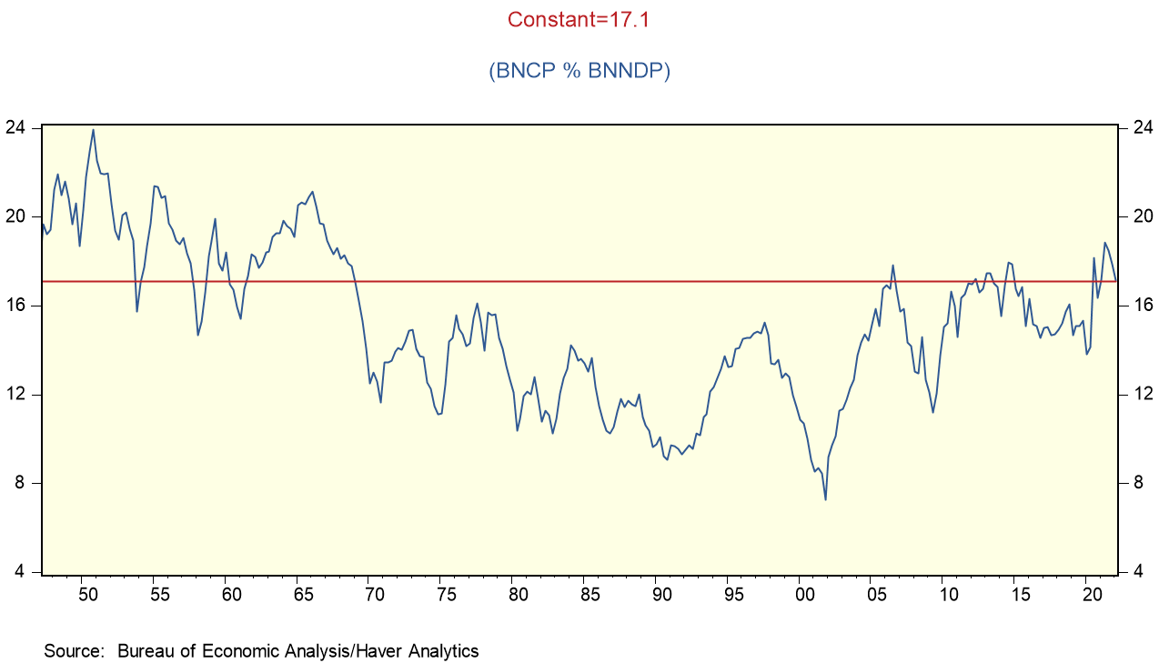
The Glory Days of Corporate Profits (pre-tax profits as % of income of nonfinancial corporations)

