Slide 1
Competition and Monopoly
Peter G. Klein
Mises University
2022
@petergklein
#MisesU

Slide 2
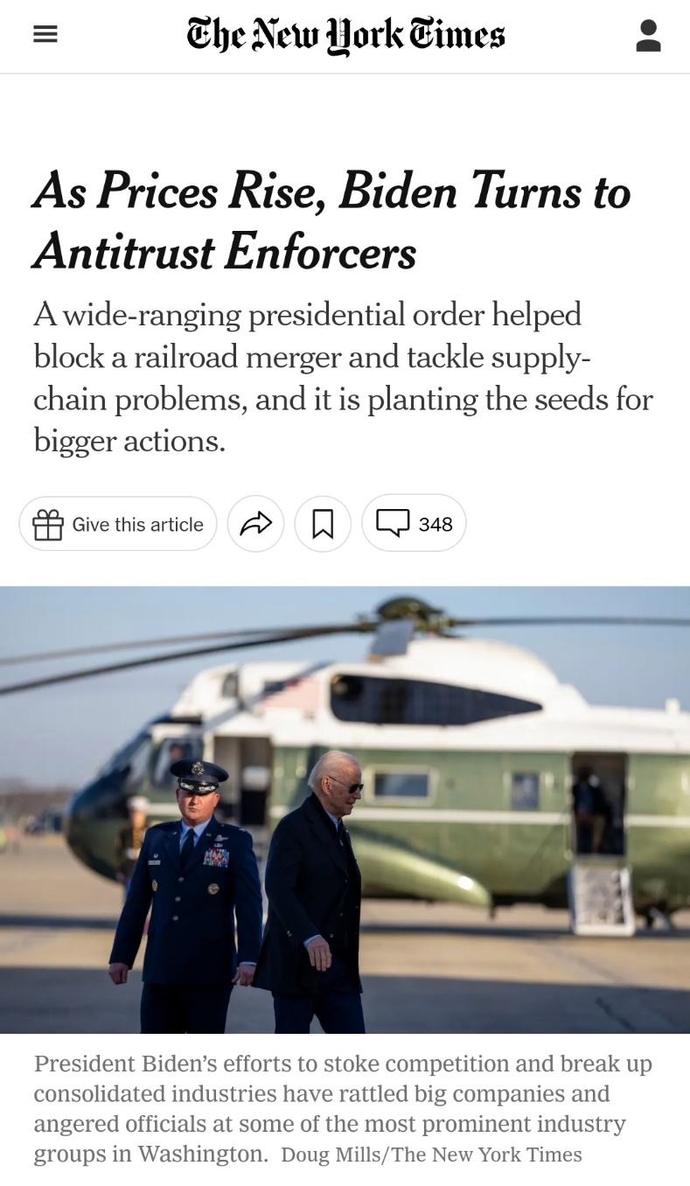
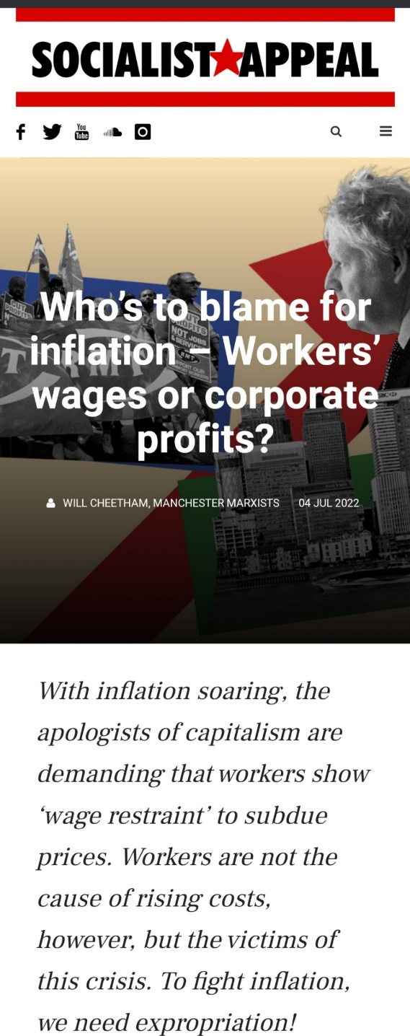
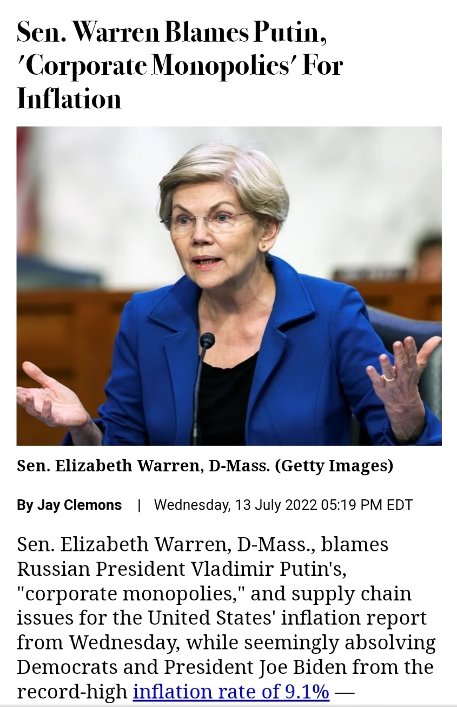

Slide 3
What is “monopoly”?
Mainstream economics
Firm with market share above X percent (where X = magic number to make the firm in question a “monopolist”)
Ability to raise price above marginal cost
Firm earning positive economic profits
Common-law, classical definition
Exclusive legal privilege to produce
or sell a product, enter a market
Austrian economics
Some differences of opinion

Slide 4
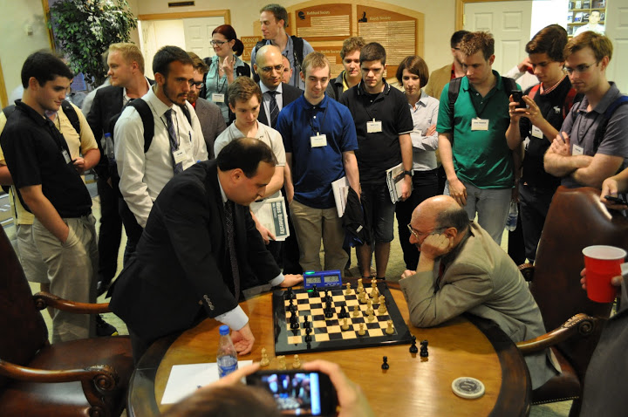
Monopoly as the absence of competition
“Competition” in everyday language
Effort to beat rivals at some task
(a “competition” at school, sports)
A particularly intense competition
(a “highly competitive” exam, process, contest)
The common-law meanings of competition and monopoly
Competition in economics
Neoclassical constructs of “perfect” and “imperfect” competition
Main issue: ability to raise price over marginal cost
Austrian approaches to monopoly

Slide 5
The perfectly competitive firm
Demand curve (= MR curve) assumed to be perfectly elastic.
Firm maximizes profit by producing the quantity at which MR = MC.
Long-run: entry and exit drive market price to the minimum of average cost and zero profits (“good” outcome).
P
MC
AC
P_{PC}
D = MR
Q
Q_{PC}

Slide 6
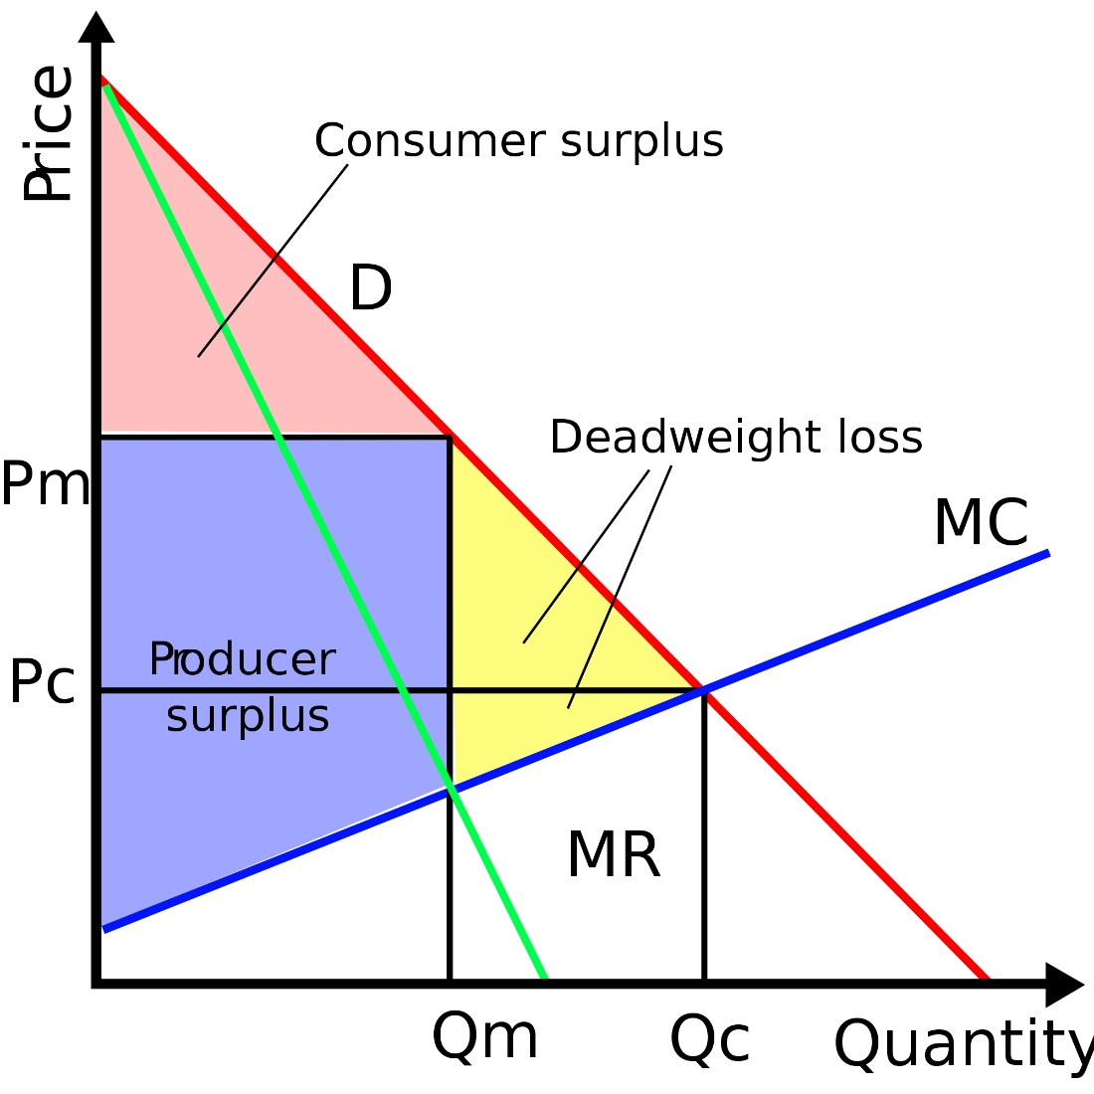
The firm with “market power”
“Market power” = downward-sloping demand curve.
Firm maximizes profit by producing the quantity at which MR = MC (and hence p > MC)
Firm “restricts” output to increase profit (assuming demand curve is inelastic above the “competitive” price), generating monopoly profits (bad outcome).

Slide 7
Austrian critiques of the market-power approach
Each seller contributes a discrete quantity to the market supply, so no such thing as perfectly elastic market demand curve.
No infinitesimally small units in the world of purposeful human action (Rothbard)
Requiring firms to increase output beyond the profit-maximizing quantity violates owners’ property rights, lowering social welfare.
Examples
Elasticity of demand reflects consumer preferences.
Existence of close substitutes (an economic, not a technological, concept)

Slide 8
Mises on monopoly prices
Monopoly prices emerge only under special conditions.
Single seller of a unique good (or sellers’ cartel)
Inelastic demand above the competitive price (the price that would otherwise have obtained)
Monopoly prices do violate consumer sovereignty.
But the conditions giving rise to monopoly prices are rare, and not usually relevant for policy.

Slide 9
Rothbard’s refinement of Mises’s monopoly theory
All sellers face a downward-sloping demand curve.
No way to distinguish a “monopoly” from a “competitive” price, in the absence of legal restrictions.
All firms try to maximize net income given their estimates of demand.
All firms price in the elastic range of their demand curve (and elasticity is the result of consumer preference, i.e., voluntary).
Government-granted monopoly
Patents
Exclusive grants, charters, licenses
Tariffs and quotas

Slide 10
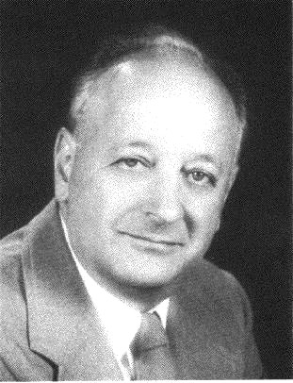
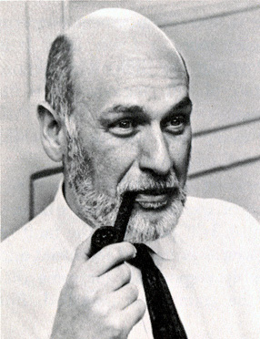
Antitrust and competition policy
The structure, conduct, performance (SCP) paradigm (emphasis on firm size and market concentration)
Oliver Williamson and transaction cost economics
The Chicago and UCLA schools
Hipster / neo-Brandeisian antitrust (SCP minus consumer welfare standard)

Slide 11
Recent empirical issues and debates
Measuring concentration (CR4, HHI)
Historical correlations between concentration and price, profit
Some evidence for increasing concentration in some industries
Hard to identify a causal effect of concentration on prices and profits
Note on profits: amounts, not rates

Slide 12
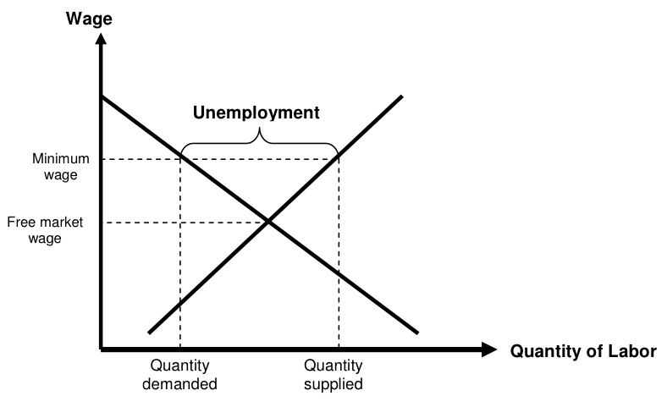
Monopsony (oligopsony) and the minimum wage
Labor supply
MRP = Labor demand

Slide 13
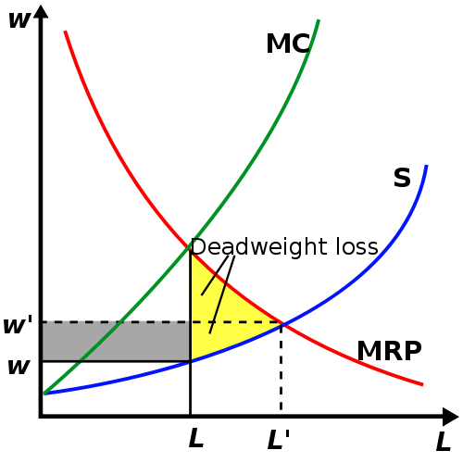
Monopsony (oligopsony) and the minimum wage
Monopsony: single buyer
Equilibrium under perfect competition: L’, w’
Equilibrium under monopsony: L, w
Minimum-wage law gets w closer to w’
= D

Slide 14
Problems with the monopsony argument
Monopsony in general
All supply curves are upward sloping (supply is never perfectly elastic) — no way to distinguish “competitive input price” from “monopoly input price” (Rothbard)
Absent legal restrictions, other firms should enter, paying above the monopsony wage.
Monopsony and the minimum wage
Hard to imagine a single buyer, or buyer’s cartel, for unskilled labor (a highly non-specific factor).
Labor is highly mobile.

Slide 15
Summary
Competition is a process of rivalry among entrepreneurs who are free to compete as they see fit, within the legal framework.
Few firms or many firms
Large firms or small firms
Profits and losses
Entry, exit, growth, innovation, experimentation
Government attempts to limit “monopoly power” cannot improve well-being.
Best government policy: don’t grant monopoly privilege!

