Slide 1
The Austrian Theory of the Business Cycle
Jonathan Newman
Mises University 2022

Slide 2
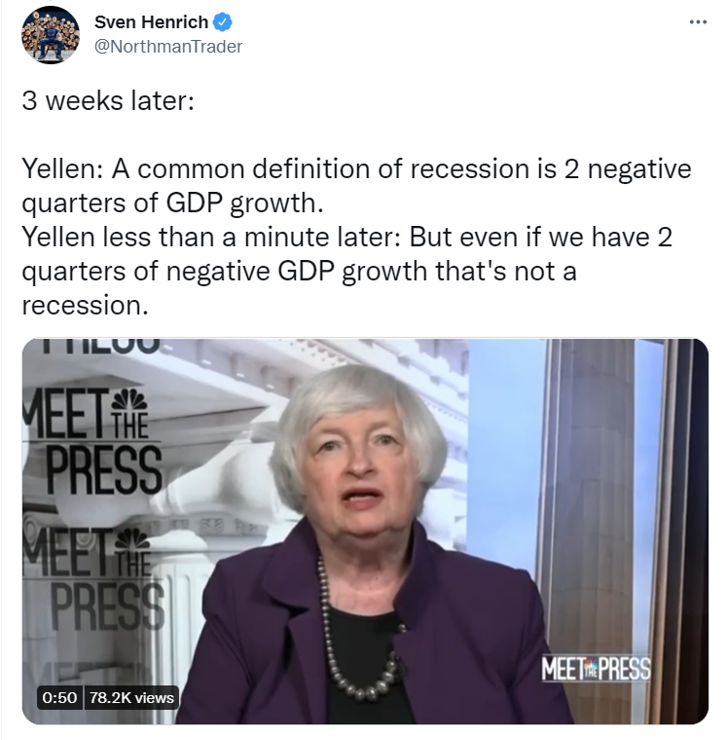
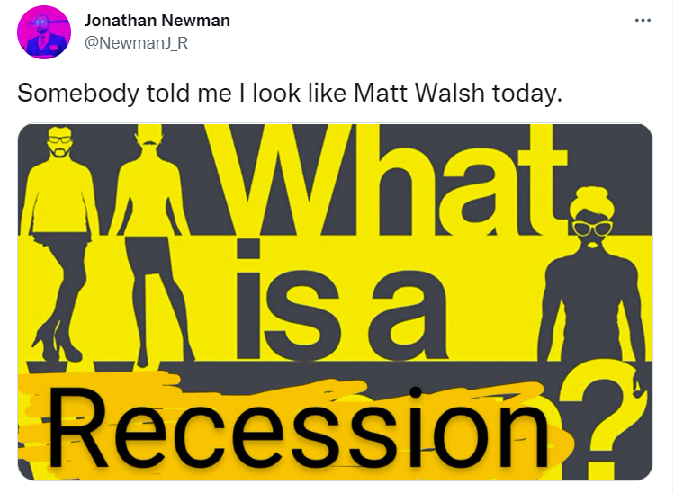

Slide 3
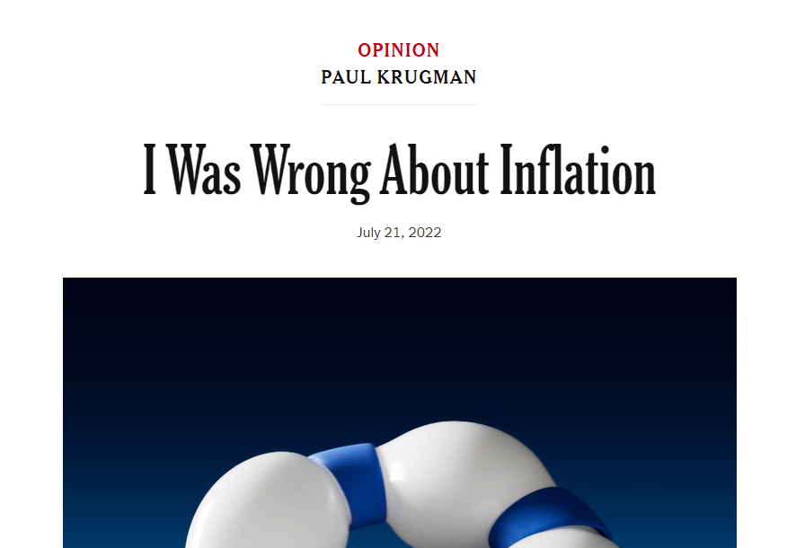
Recommended Reading
Meltdown – Woods
America’s Great Depression – Rothbard
The Causes of the Economic Crisis – Mises
“A Reformulation of Austrian Business Cycle Theory in Light of the Financial Crisis” (QJAE) – Salerno
Time and Money – Garrison
The Theory of Money and Credit - Mises

Slide 4
Unhampered vs. Hampered Market Economy
We have seen how unhampered individuals and individuals in society economize.
But what happens when the voluntary actions and exchanges are prohibited by the state?

Slide 5
Mises’s analogy
“The whole entrepreneurial class is, as it were, in the position of a master-builder whose task it is to erect a building out of a limited supply of building materials. If this man overestimates the quantity of the available supply, he drafts a plan for the execution of which the means at his disposal are not sufficient. He oversizes the groundwork and the foundations and only discovers later in the progress of the construction that he lacks the material needed for the completion of the structure. It is obvious that our master-builder's fault was not overinvestment, but an inappropriate employment of the means at his disposal.”
Human Action, p. 557

Slide 6
What is a business cycle?
What it is not: business fluctuations.
Changes happen all the time in the market economy (production, consumption, preferences, resources)
Entrepreneurs have the task of dealing with and anticipating these changes by putting resources on the line to satisfy consumer demands.

Slide 7
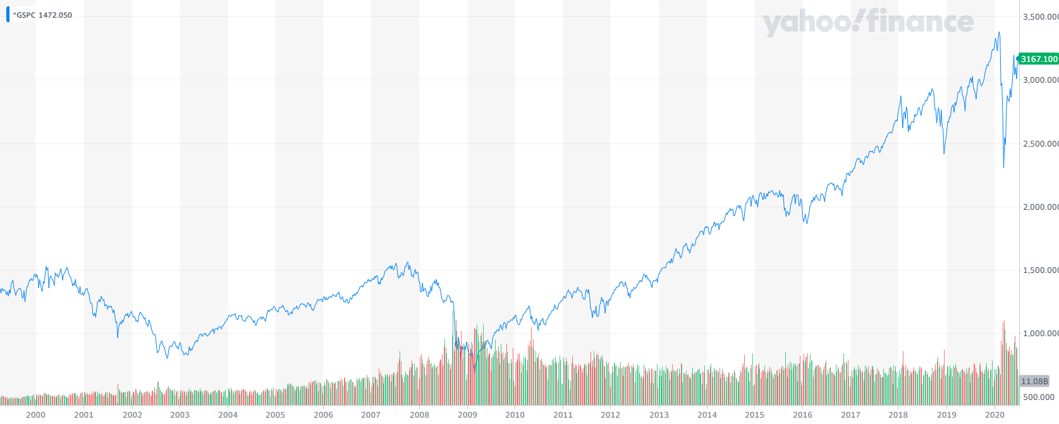
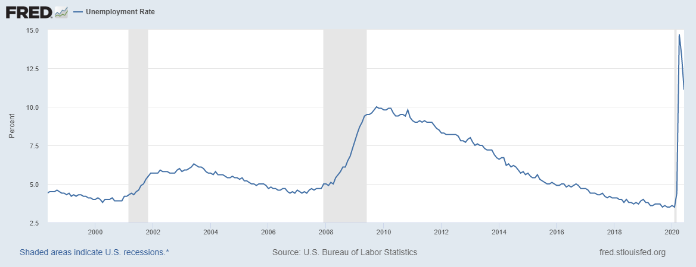
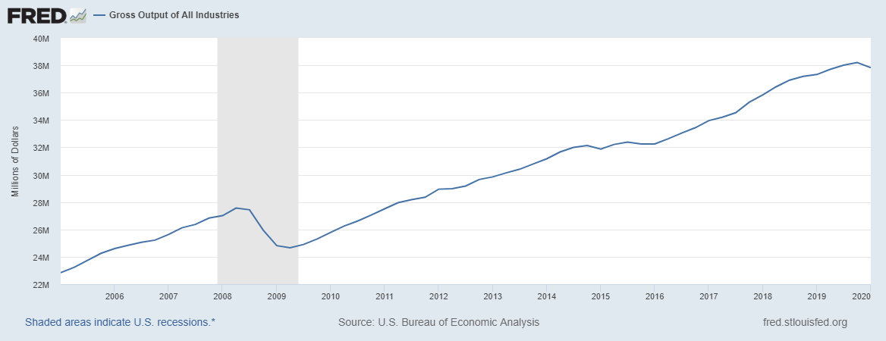
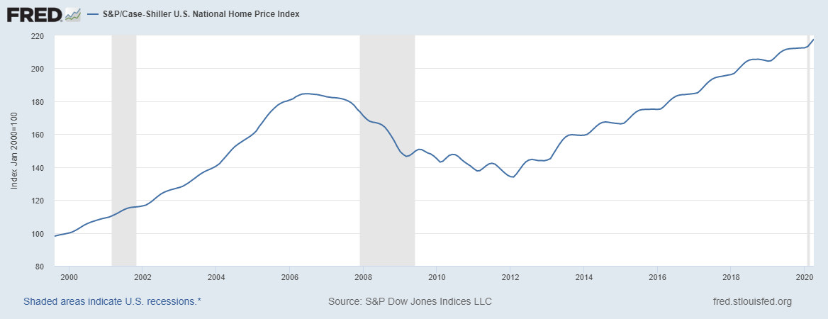
What is a business cycle?
General boom and general bust
We see patterns in economic data like this:

Slide 8
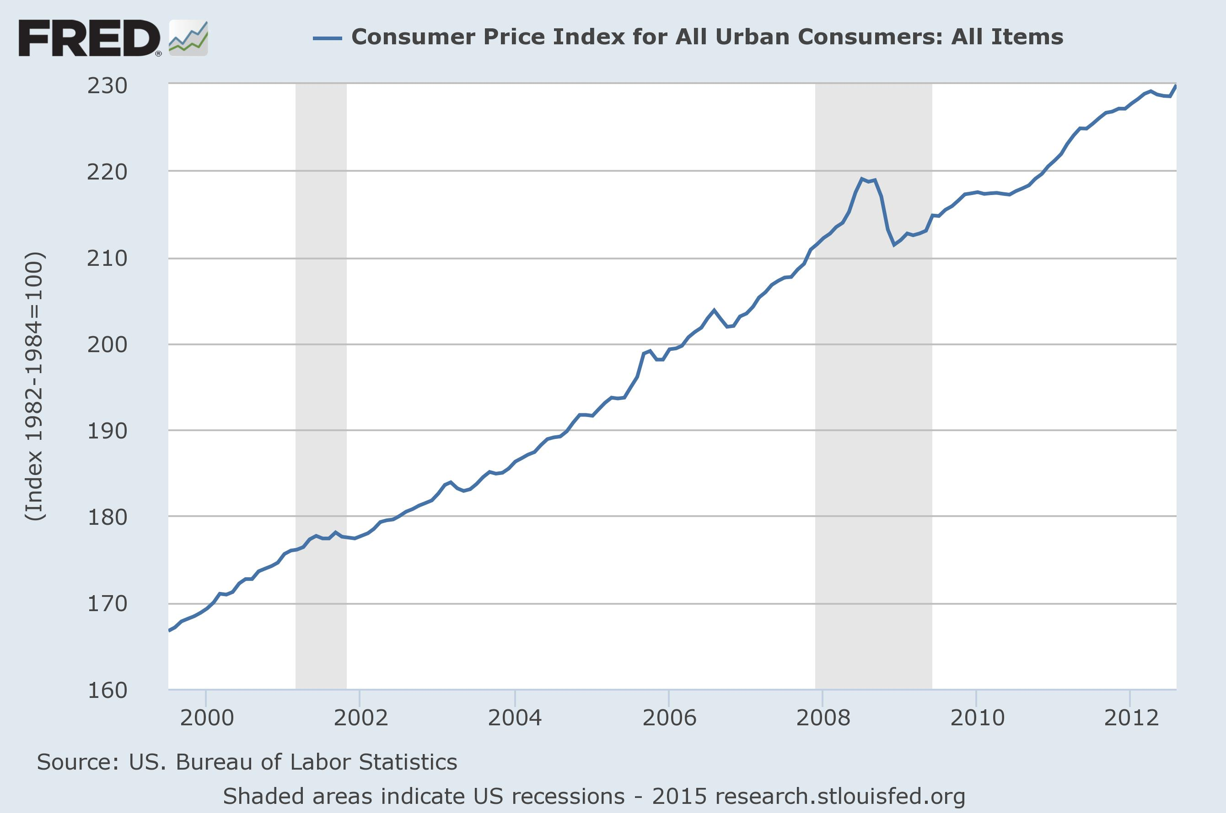
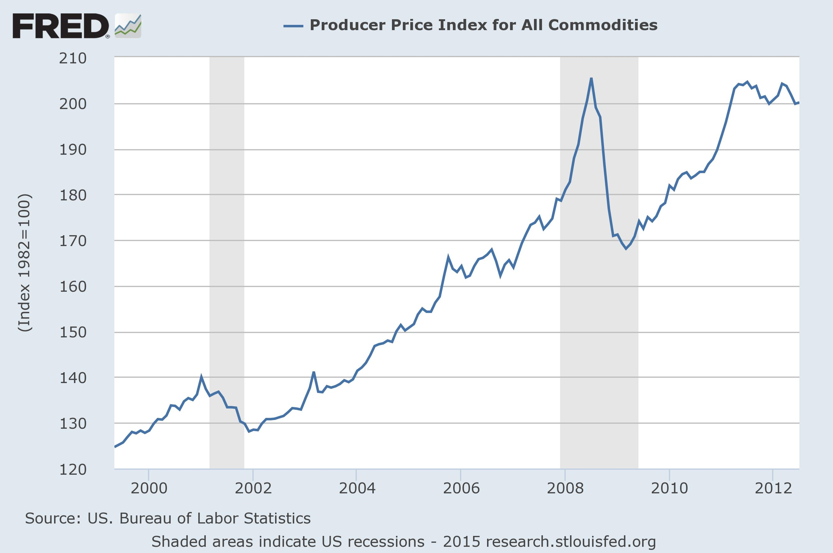
What is a business cycle?
General boom and general bust
Consumer prices vs. factor prices
Rothbard, America’s Great Depression, p. 9: “capital-goods industries fluctuate more widely than do the consumer-goods industries”

Slide 9
What is a business cycle?
General boom and general bust
Theory must account for these phenomena:
The “shape” or stages of the cycle: boom then bust
The cluster of entrepreneurial errors
The more dramatic fluctuations in capital-goods industries compared to consumer-goods industries
Suspects:
Money
Credit

Slide 10
Outline
Structure of production
Time preference and interest
Sustainable growth
Unsustainable growth
Overconsumption and malinvestment

Slide 11
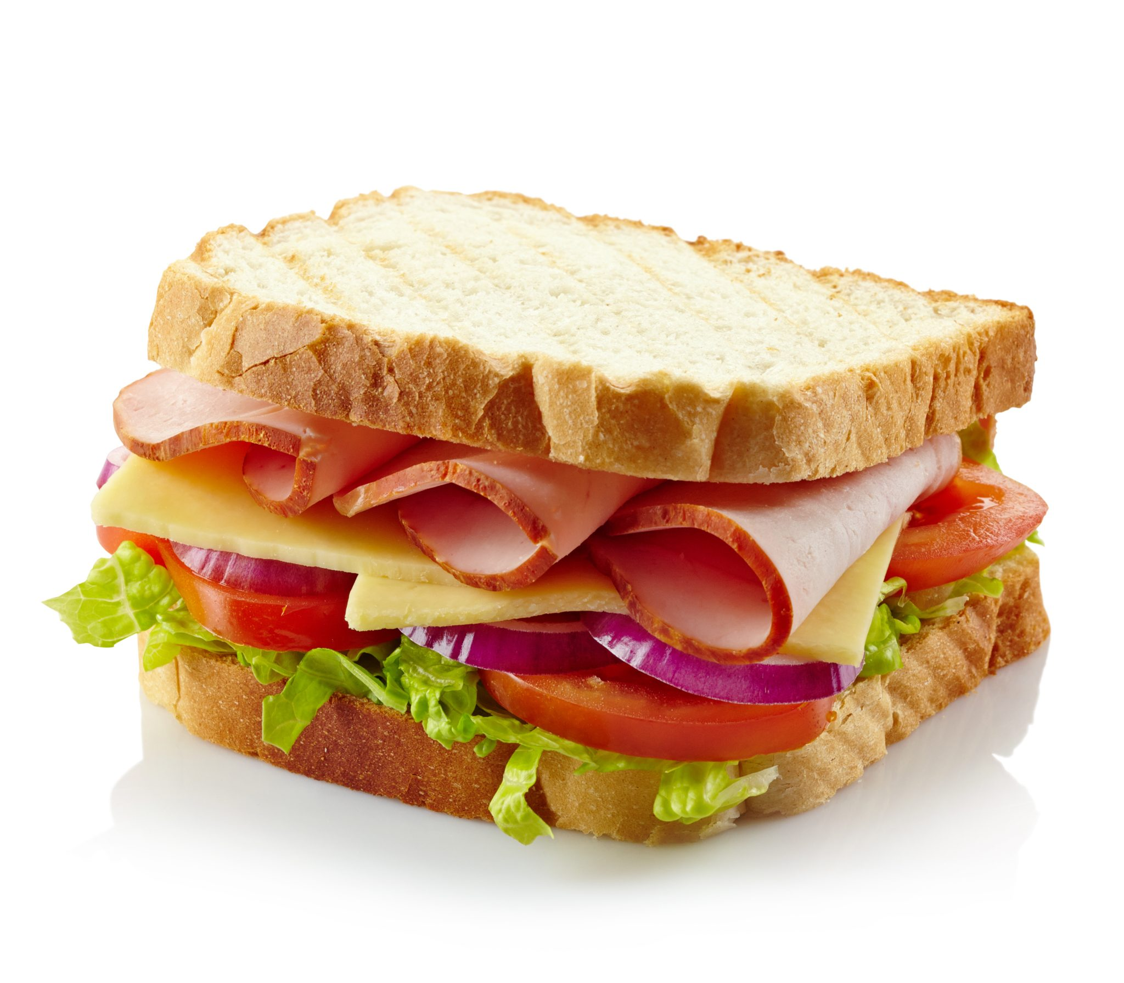

Slide 12
Labor
Land
Big metal machines
Labor
Metal mining
Land
Refrigerator
Knives
Oven
Land
Land
Labor
Oil refining
Fencing
Big metal machines
Labor
Land
Butcher
Bakery
Farming
Land
Flour
Labor
Metal refining
Labor
Plastic
Manufacturing
Ham
Bread
Lettuce
Metal manufacturing
Land
Labor
Labor
Ham Sandwich
Tomato
Big metal machines
Oil drilling
Labor
Labor
Land
Lumberyard
Land
Plate
Mayo
Coops
Land
Table/chairs
Chainsaws
Chicken Farm
Furniture Manufacturer
Paper Mill
Land
Land
Big metal machines
Labor
Labor
Tools
Land
Labor

Slide 13
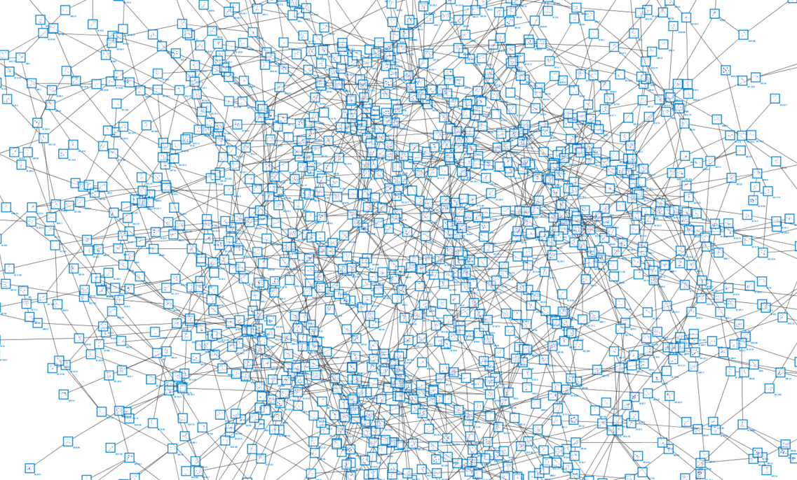

Slide 14
Labor
Land
Big metal machines
Labor
Metal mining
Land
Refrigerator
Knives
Oven
Land
Land
Labor
Oil refining
Fencing
Big metal machines
Labor
Land
Butcher
Bakery
Farming
Land
Flour
Labor
Metal refining
Labor
Plastic
Manufacturing
Ham
Bread
Lettuce
Metal manufacturing
Land
Labor
Labor
Ham Sandwich
Tomato
Big metal machines
Oil drilling
Labor
Labor
Land
Lumberyard
Land
Plate
Mayo
Coops
Land
Table/chairs
Chainsaws
Chicken Farm
Furniture Manufacturer
Paper Mill
Land
Land
Big metal machines
Labor
Labor
Tools
Land
Labor

Slide 15
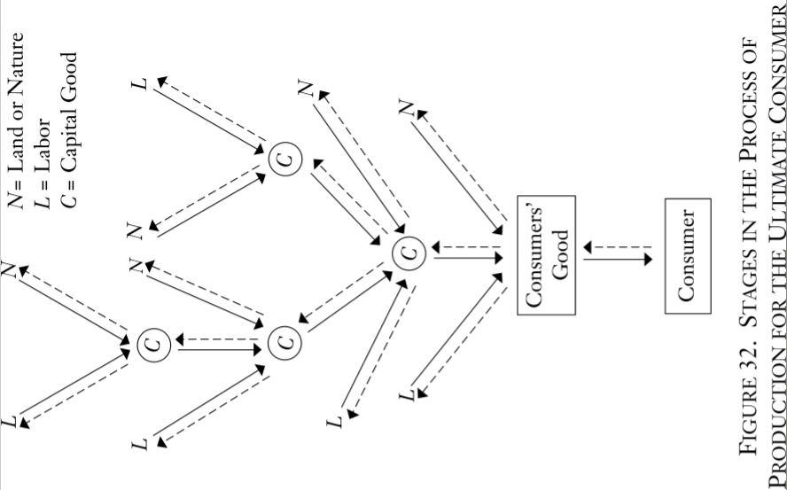

Slide 16
Structure of Production
 |  |  |  |  | $
 |  |  |  | $ | $
 |  |  | $ | $ | $
 |  | $ | $ | $ | $
 | $ | $ | $ | $ | $
$ | $ | $ | $ | $ | $
In the ERE, the only remaining price spread between stages is interest.

Slide 17
Time preference
We all prefer a given satisfaction sooner rather than later.
Variety of rates of time preference, so there is an opportunity to trade.
interest
rate
David
$1200 F
$1000 P
$1100 F
:
$1000 F
S
Jeff
$1100 F
$1000 P
$1050 F
:
$1000 F
D
loans

Slide 18
Intertemporal coordination
Entrepreneurs’ plans are limited by the social rate of time preference.
The only projects that are deemed profitable are the ones in which the discounted revenues exceed the costs of production.
Entrepreneurs do not undertake projects that would take too long, and “too long” means that there are insufficient resources to complete them or there are more urgently desired projects.
The rate of interest is uniform across lines of production and across consumption and production.

Slide 19
Increase in savings
Saving involves freeing up resources for production.
In credit markets, saved funds are made available to entrepreneurs to purchase factors of production.
New, longer lines of production are started, which is in line with consumers’ time preferences.
The additional investment (in excess of what is required for maintaining/replacing existing capital stock) pays off with an expanded set of resources in the future, i.e., economic growth.

Slide 21
Artificial credit expansion
Newly created money enters the economy through credit markets and represents an increased supply of loanable funds
Interest rate falls, but not because of a decrease in time preference
At the lower interest rate, saving decreases
Consumption and borrowing increase
Firms take the new funds and invest in new, longer lines of production
Factor prices are bid up across the board. Wages increase, employment increases, consumption increases, investment spending increases.
In short, we have a general boom.

Slide 22
Artificial credit expansion causes overconsumption and malinvestment
Overconsumption – new profits and incomes and higher net worth calculations encourage increased consumption. Resources move from early to late stages due to the increased consumption, so we have capital consumption, not “overinvestment” (Salerno, 2012).
Malinvestment – resources are misallocated due to the inflation and falsified interest rates. Specific capital goods are created for the new longer lines of production.
The credit expansion does not represent an increase in real resources available for consumption or investment.
Factors of production become increasingly scarce
Prices are bid up higher than entrepreneurs expected
Costs and interest rate increase, expected profits turn into losses
Projects are abandoned

Slide 23
The Bust
Firms liquidate malinvested capital.
Wages decrease and workers are laid off, but due to the relative non-specificity of labor, wages do not fall as much as capital goods.
Credit markets dry up.
Prices readjust to reflect consumer demands.
The bust is a correction phase as people try to find profitable uses for land, labor, and capital.

Slide 24
Contrast to Keynesian view
In the Keynesian view, busts come out of nowhere. An unexpected decrease in investment spending triggers a decrease in demand for labor, but wages are sticky and so persistent unemployment results. This worsens the recession as overall spending declines.
The only hope is government. Only an institution outside of the market can boost spending and demand back up to the point where we have full employment.
Y = C + I + G

Slide 25
Contrast to the Monetarist view
A sudden decrease in M causes prices and total expenditures to fall. Sticky wages prevent labor markets from clearing.
The only hope is the central bank, which can print more money to get us back to full employment expenditures.
MV = PQ

Slide 26
Lessons learned
If you look at highly aggregated data, you misdiagnose the problem and give bad solutions.
“Before we can meaningfully ask what might go wrong, we should first understand how things could ever go right.” – Hayek
Sustainable production is based on a real reallocation of resources away from consumption, i.e., real savings.
Unsustainable booms are caused by artificial increases in credit. Recessions are the time when we fix the mistakes of the past.

