Slide 1
Austrian Capital Theory
Mises University
Auburn, Alabama

Slide 2
Capital Defined
Capital: The sum of the whole complex of goods destined for acquisition evaluated in money terms
The starting point of economic calculation.
Mises: “There is no such thing as an abstract or ideal 'capital that exists apart from concrete capital goods . . . capital is always embodied in definite capital goods and is affected by everything that happens with regard to them. The value of an amount of capital is a derivative of the value of the capital goods in which it is embodied” (Human Action, p. 500).

Slide 3
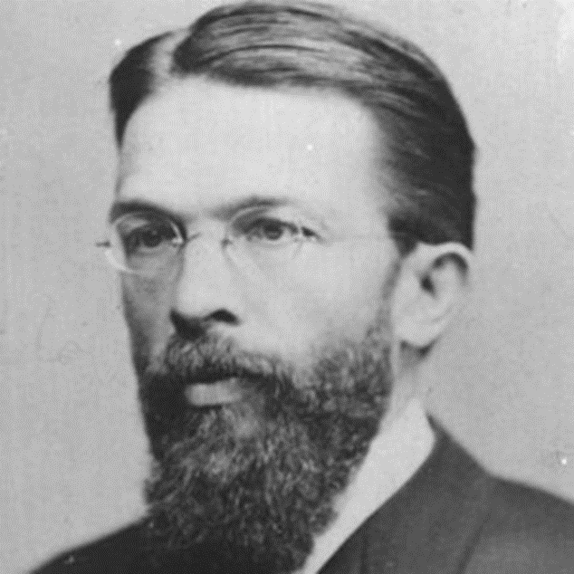
Interrelationship of Economic Goods
Consumer goods.
  Directly serviceable
  Goods of 1st order.
Higher order goods.
  Producer goods
  Indirectly serviceable.

Slide 4
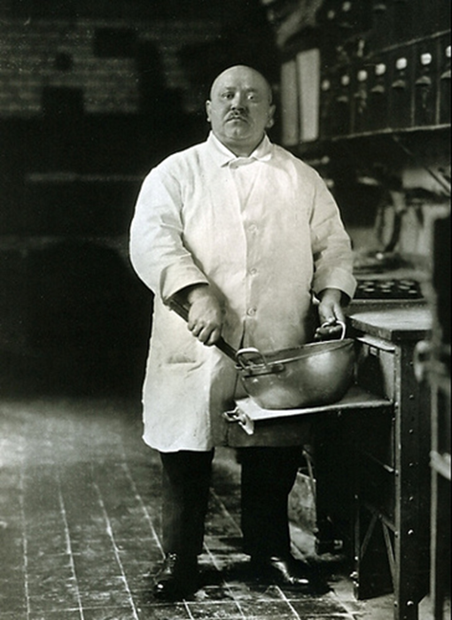
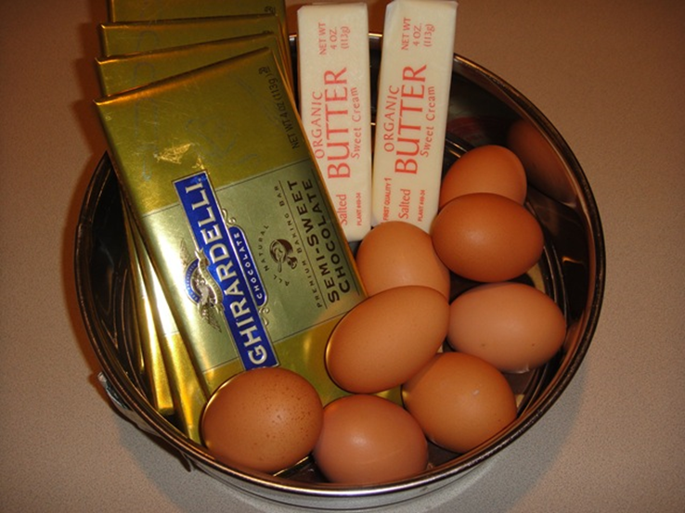
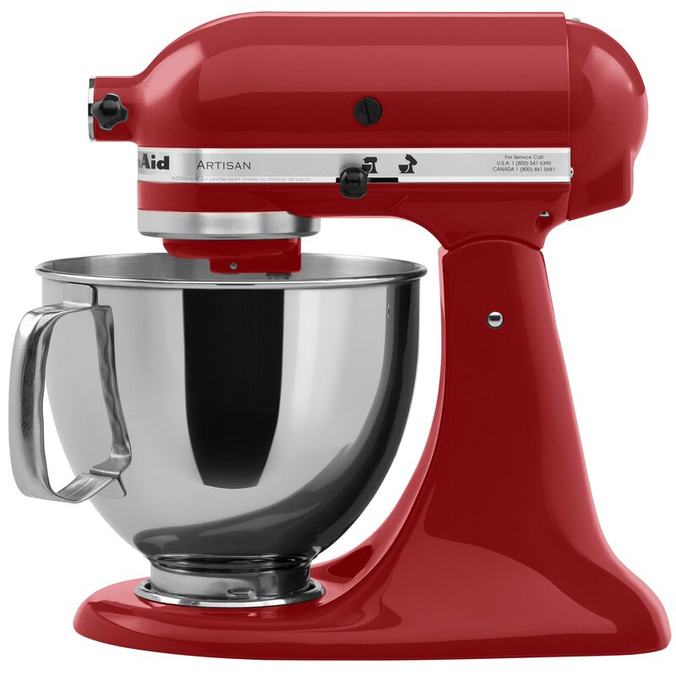
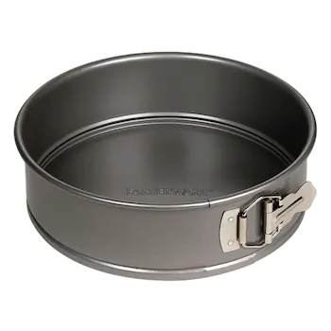
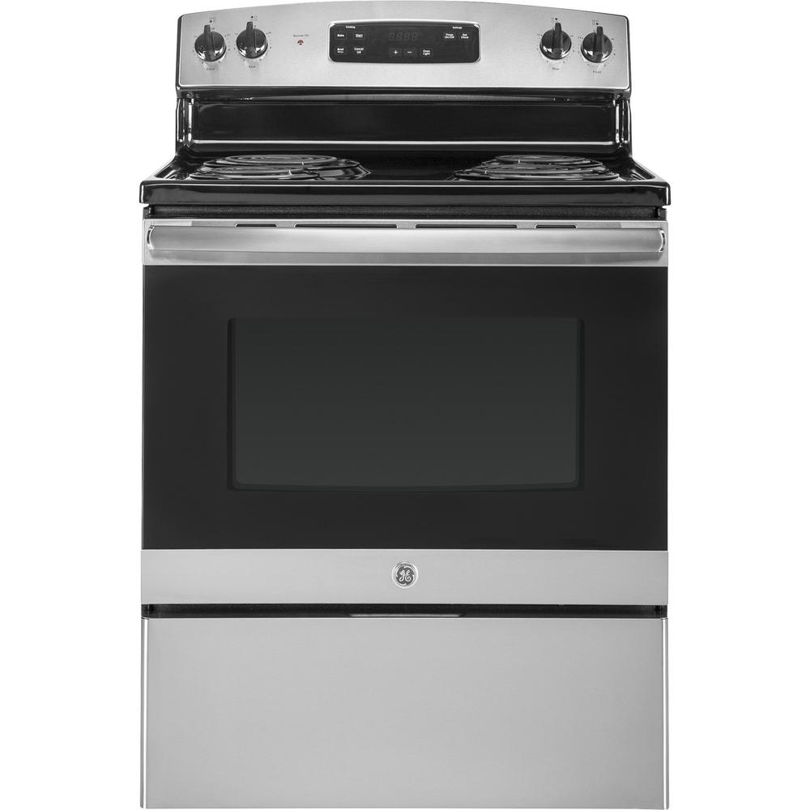
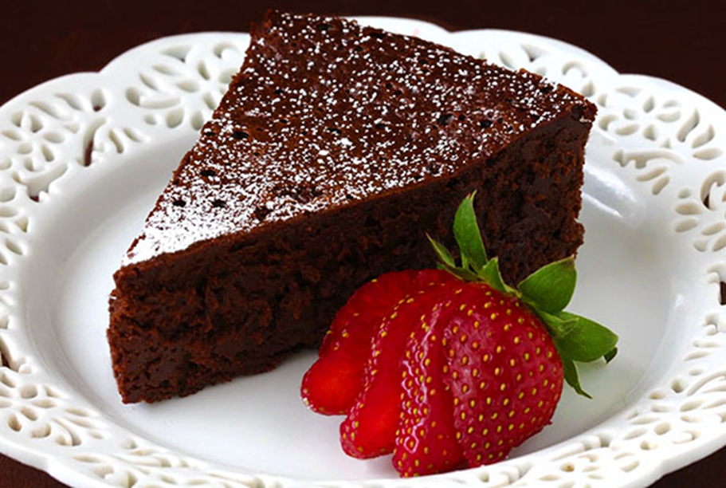
Structure of Production

Slide 6
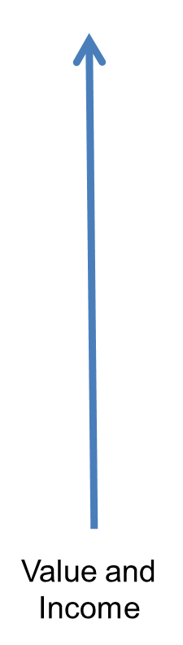
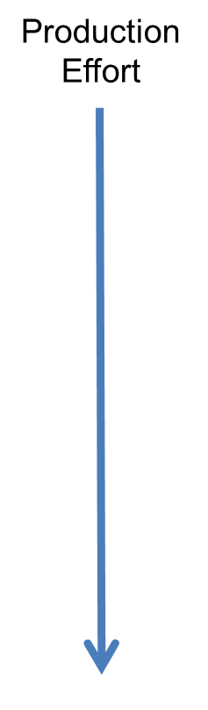

Slide 7
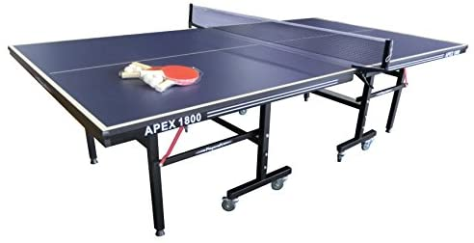
Benefits of Capital Goods
Using capital goods requires longer production processes
Ping Pong Table
Standing Mixer
  Saving: Restriction of consumption
  Investment: Transfer of resources to accumulation of capital goods

Slide 8

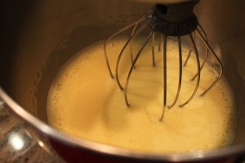
Benefits of Capital Goods
Increases productivity in two ways:
Increased productivity in tasks we can do without capital goods.
VS.

Slide 9
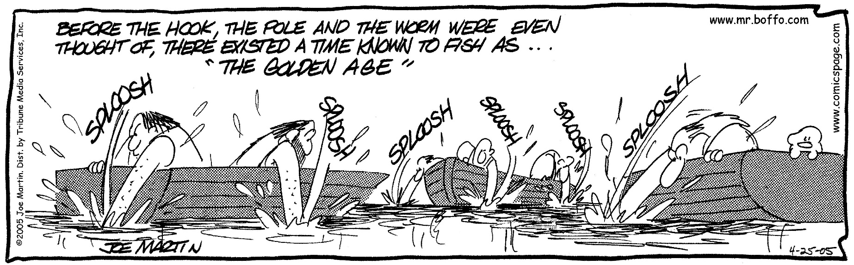
Benefits of Capital Goods
Increases productivity in two ways:
  Allows people to produce goods they otherwise could not obtain at all.
Advances people in time toward their objective in producing consumer good.

Slide 10
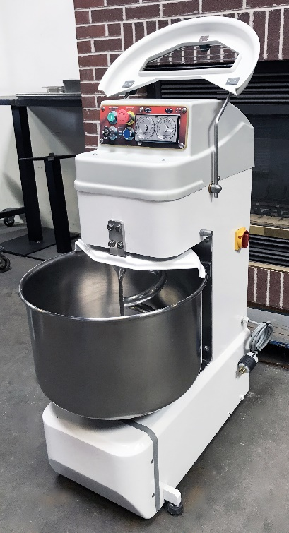

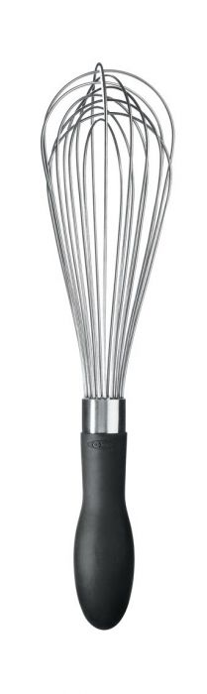
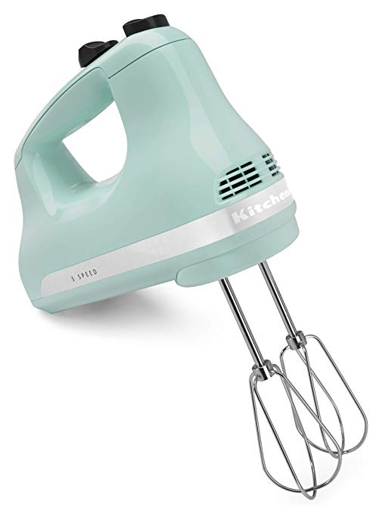
Choices about Capital Goods
VS.
VS.
VS.
VS.
More or less capital-intensive process

Slide 11
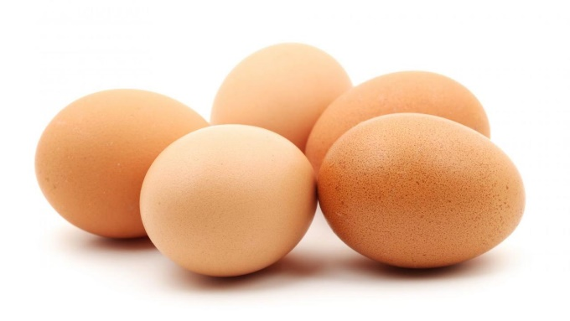
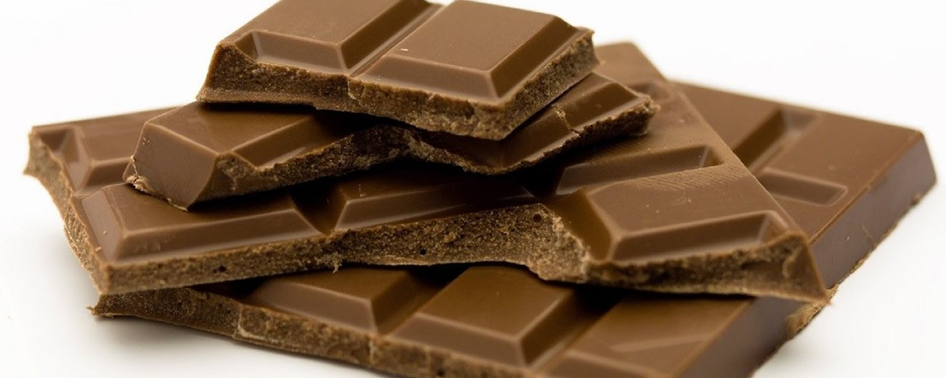
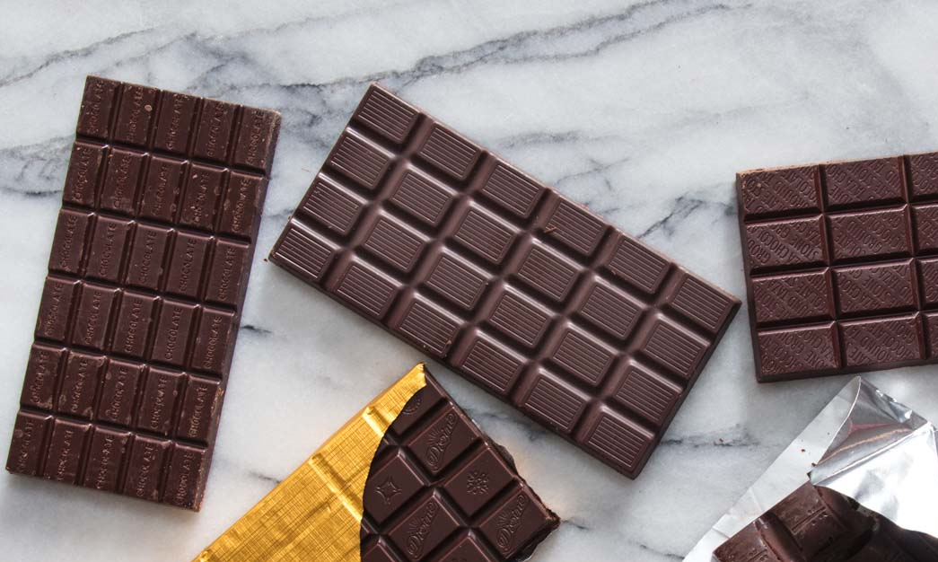
Choices about Capital Goods
VS.
VS.
Degree of specificity

Slide 12

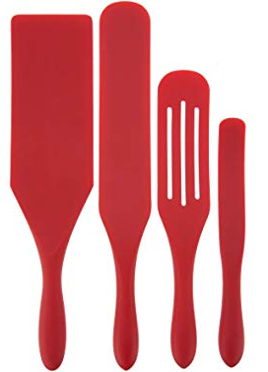
Choices about Capital Goods
VS.
More or less durable

Slide 13
Capital Structure
Difference between Austrian understanding and Keynesian and Neo-classical Approaches
Modern Macro
Keynesian: Y = C + I + G + NX
Neo-classical: Y_{t} = A_{t}F(K_{t} L_{t},)
Homogenous Aggregates
Austrian
Concentric Circles: Böhm-Bawerk
Hayekian Triangle: Hayek, Rothbard, Garrison, Huerta de Soto
Vast interrelated, very complex structure of multi-stage production

Slide 14
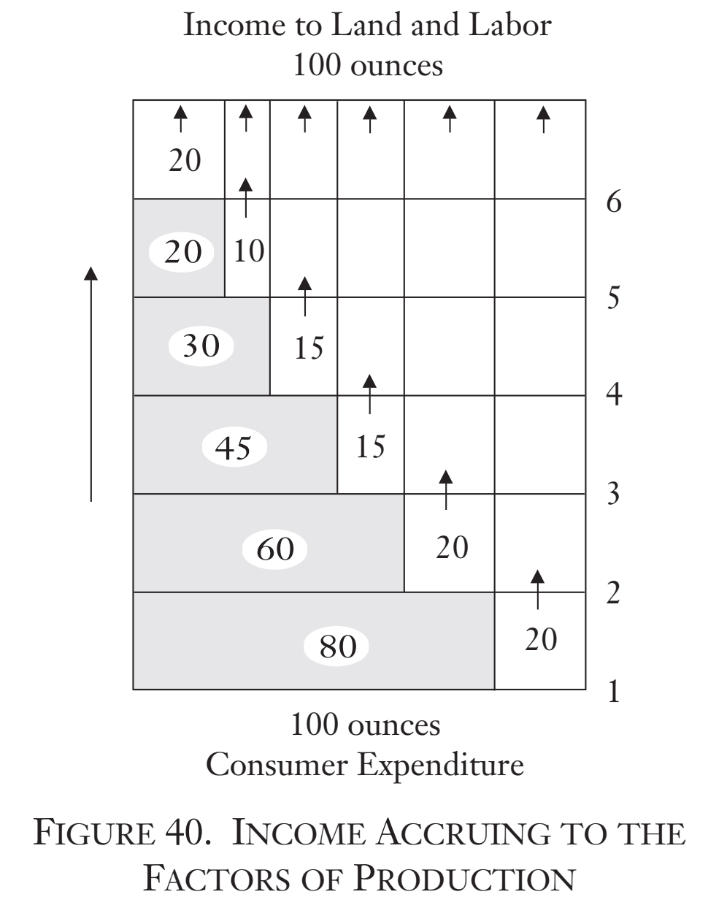
Capital Structure

Slide 15
Capital Structure
Production heavily weighted to production of capital goods.
Capitalist is laborers’ benefactor
The economic order is extremely complex

Slide 16
Production Structure Coordination
Horizontally via profit and loss calculations
Inter-temporally via comparisons of rate of return and interest rate
Stages | Rate of Return
Steel | 6%
Bolt | 5%
Mixer | 4%
Dessert Shop | 5%
Structure is flexible and can be changed

Slide 17
Capital Goods and Capital
Mises: “The fundamental notion of economic calculation”
Capital: the monetary value of capital goods.
Capital Value begins with rental value: DMRP
  Computer: MRP = 990 and r = 10% DMRP = 900
  DMRP = MRP / (1+r)^{n} → = DMRP = 990 / (1+.1)¹ = 900

Slide 18
Capital Value
Capital value of capital good = sum of DMRP of capital good over its duration of serviceability
Computer: MRP = 990 and r = 10% with 5 year duration of serviceability
Capital Value | = | DMRP₁ | + | DMRP₂ | + | DMRP₃ | + | DMRP₄ | + | DMRP₅
3755 | = | 900 | + | 818 | + | 744 | + | 676 | + | 615
Used to Make Production Decisions
The Basis of Capital Funding

Slide 19
Capital and Economic Progress
Decrease in time preferences result in more saving and investment
More capital-intensive production processes are more productive
We become relatively enriched
Process is sustainable

