Slide 1
Entrepreneurship
Peter G. Klein
Mises University
2022
@petergklein
#MisesU

Slide 2
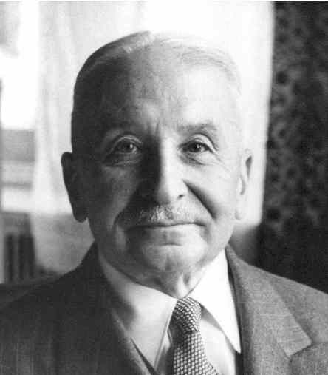
Thinking about entrepreneurship
Entrepreneurship in the broad sense: bearing uncertainty
“The term entrepreneur as used by [economic] theory means: acting man exclusively seen from the aspect of the uncertainty inherent in every action” (Mises, 1949).
“In using this term one must never forget that every action is embedded in the flux of time and therefore involves a speculation. The capitalists, the landowners, and the laborers are by necessity speculators. So is the consumer in providing for anticipated future needs. There’s many a slip ‘twixt cup and lip” (Mises, 1949).
Subjective benefit and cost
Subjective profit and loss

Slide 3
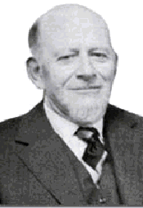
Thinking about entrepreneurship
Entrepreneurship in the broad sense: bearing uncertainty
“The term entrepreneur as used by [economic] theory means: acting man exclusively seen from the aspect of the uncertainty inherent in every action” (Mises, 1949).
Entrepreneurship in the narrow (commercial) sense: combining and recombining productive factors in pursuit of money profit
“We are living in a world of unexpected change; hence capital combinations . . . will be ever changing, will be dissolved and reformed. In this activity, we find the real function of the entrepreneur” (Lachmann, 1956).
Monetary (cardinal) revenues and costs
Monetary profit and loss

Slide 4
Why entrepreneurship matters
“[I]t is impossible to eliminate the entrepreneur from the picture of a market economy. The various complementary factors of production cannot come together spontaneously. They need to be combined by the purposive efforts of men aiming at certain ends and motivated by the urge to improve their state of satisfaction. In eliminating the entrepreneur one eliminates the driving force of the whole market system” (Mises, 1949, p. 248).

Slide 5
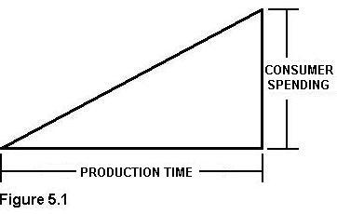
Why entrepreneurship matters
“[I]t is impossible to eliminate the entrepreneur from the picture of a market economy. The various complementary factors of production cannot come together spontaneously. They need to be combined by the purposive efforts of men aiming at certain ends and motivated by the urge to improve their state of satisfaction. In eliminating the entrepreneur one eliminates the driving force of the whole market system” (Mises, 1949, p. 248).
Austrian production theory
Inputs and outputs
Capital and stages of production (Ritenour, tomorrow)
Imputation
Need for economic calculation
(Salerno, tomorrow)

Slide 6
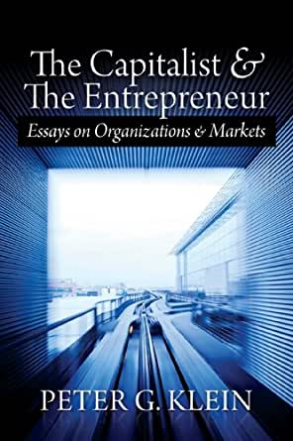
Entrepreneurship as judgment
Judgment: decision-making under uncertainty without a formal model or decision rule (intuition, gut feeling, Verstehen)
“[T]he real entrepreneur is a speculator, a man eager to utilize his opinion about the future structure of the market for business operations promising profits. This specific anticipative understanding of the conditions of the uncertain future defies
any rules and systematization. It can be neither
taught nor learned. . . . [The entrepreneur]
sees the past and the present as other people
do; but he judges the future in a different way”
(Mises, 1949, p. 585).
Judgment is manifest in ownership (Mises’s
capitalist-entrepreneur”).

Slide 7
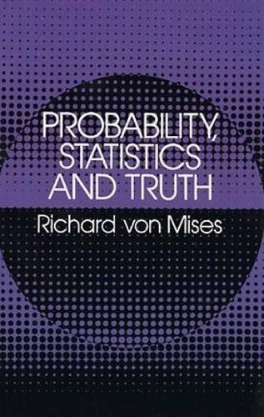
Conceptualizing uncertainty
Uncertainty versus risk (Knight, 1921)
Subjective probabilities (Keynes, 1921)
Neoclassical economics approach (with Bayesian updating)
Case versus class probability (R. von Mises, 1928)
Note on subjectivity

Slide 8
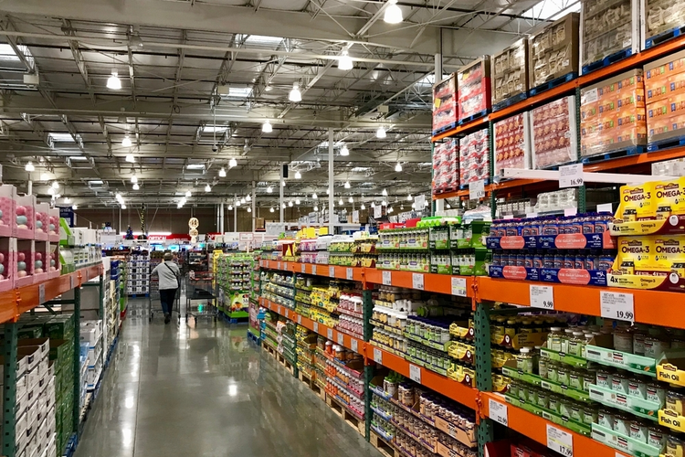
The Austrian theory of imputation
Discounted marginal revenue product: money revenue attributed (“imputed”) to one service unit of a factor, holding other factors constant, discounted by social rate of time preference (i.e., pure rate of interest)
Establishes entrepreneur’s maximum willingness to pay for one service unit of a factor.
Given competitive bidding by entrepreneurs, and absent uncertainty about future market conditions, the price of a factor will tend to equal its DMRP.
Certain exceptions
Notes:
Isolable – value of the factor’s service can be appraised separately from those of the other factors
Specific factors – can only be used in one production process [largely ignored by mainstream production theory, which treats factor categories as schmoo]
Note that DMRP gives the maximum willingness to pay on the part of factor users; the actual price will depend on supply conditions as well [bargaining]

Slide 9
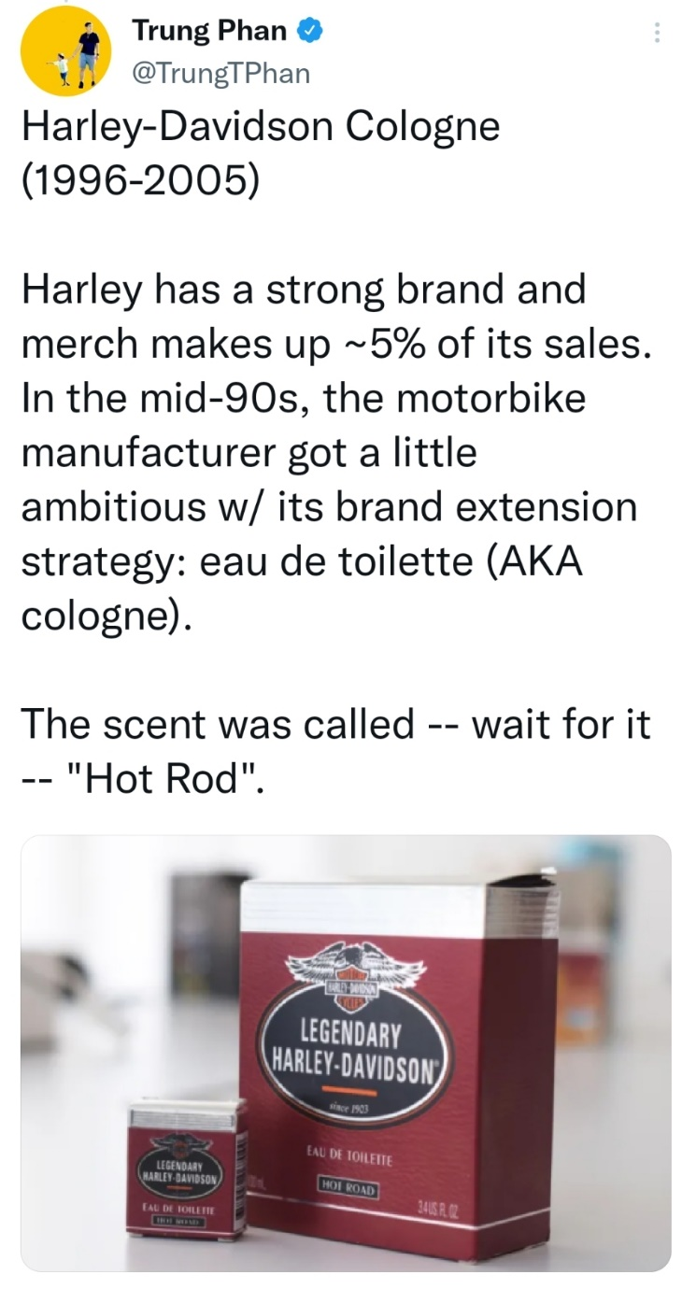
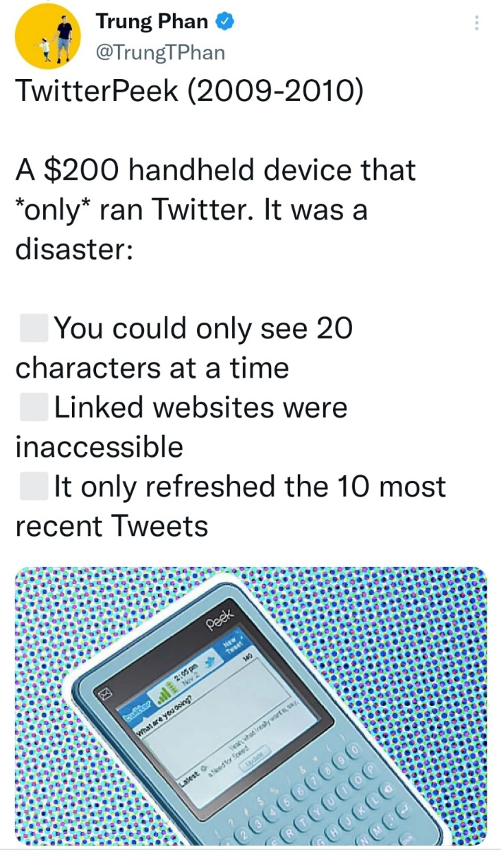
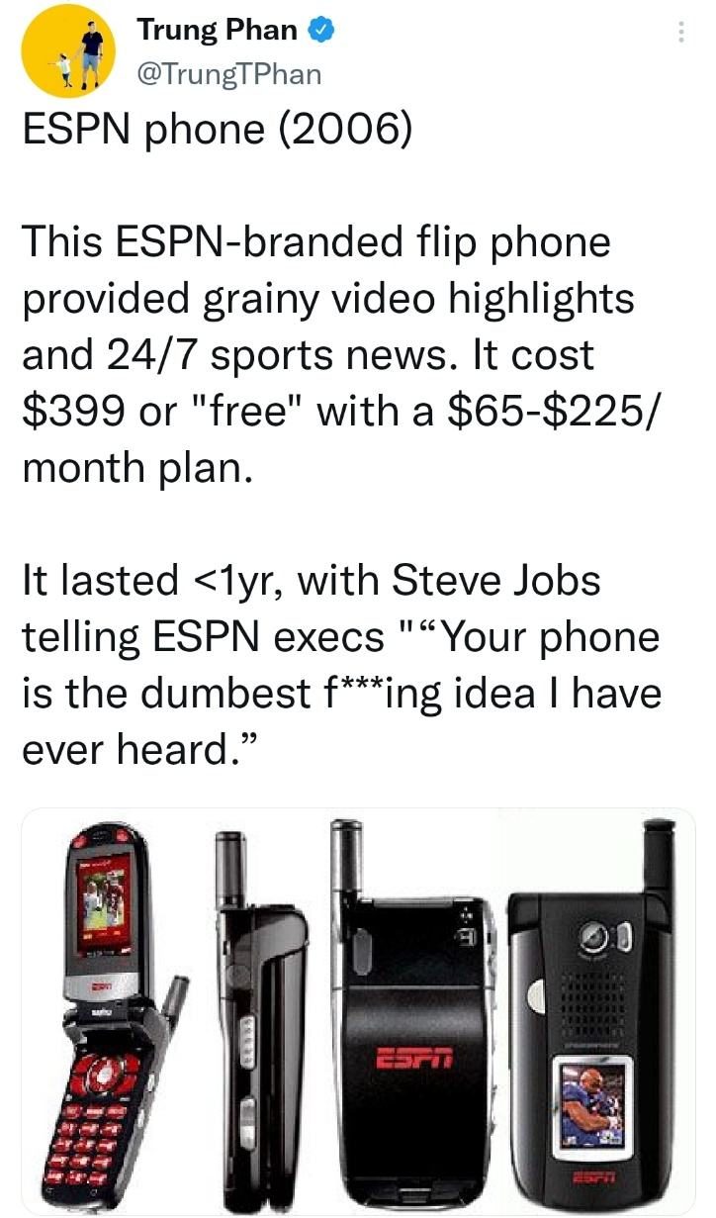
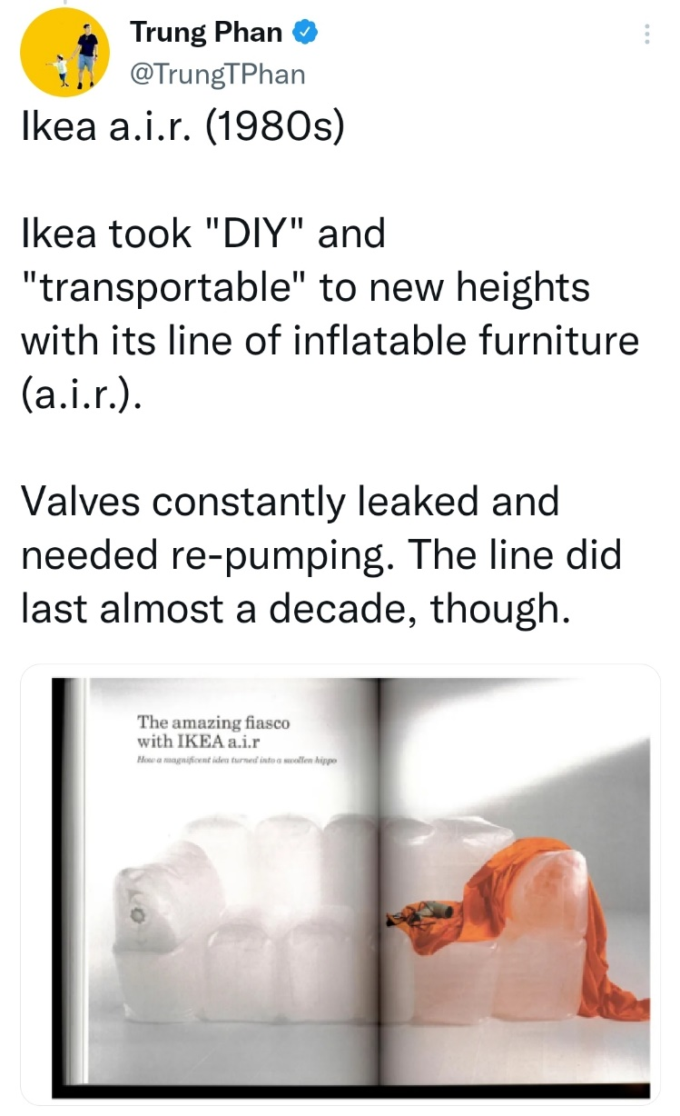
Entrepreneurial profit and loss
In equilibrium (Mises’s and Rothbard’s evenly rotating economy)
Each factor earns its DMRP.
Owner-managers of firms earn implicit wages.
Capitalists earn interest.
In the real world of uncertainty / case probability
Entrepreneurs compete for factors, based on their knowledge and beliefs about
The present: technology, productive capabilities, resource availability
The future: consumer demand, institutional conditions, competitor actions
Results: profit or loss!

Slide 10
Other concepts of entrepreneurship
Personality traits (charisma, creativity, leadership, persistence)
Phenomena associated with startups, small business, tech
Starting a business
Managing a small business
Starting and growing a particular type of business (small, tech, high-growth, VC-backed, with patents)
Starting a business in a particular way (e.g., lean startup)
Pursuit of “opportunity”

Slide 11
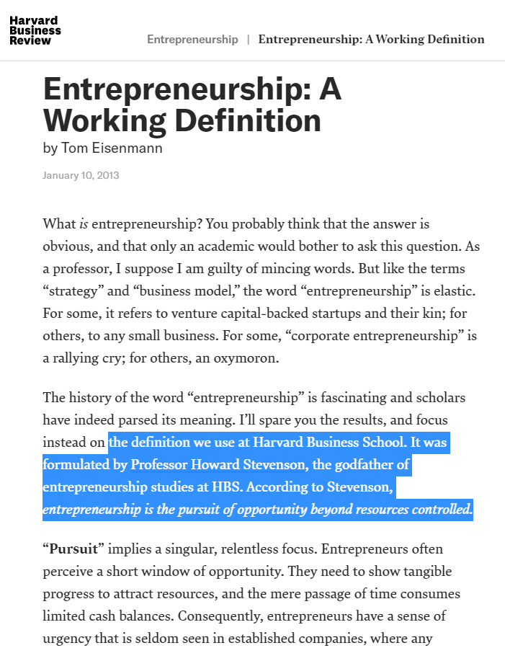
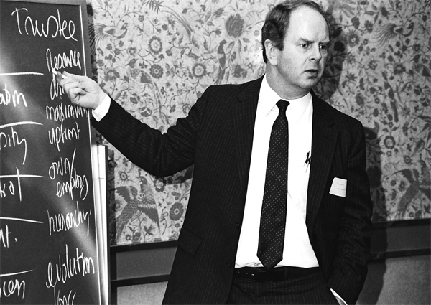

Slide 12
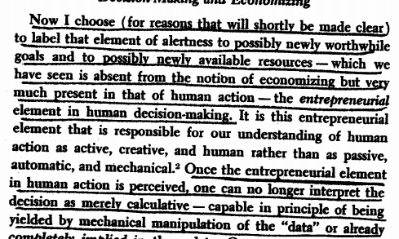
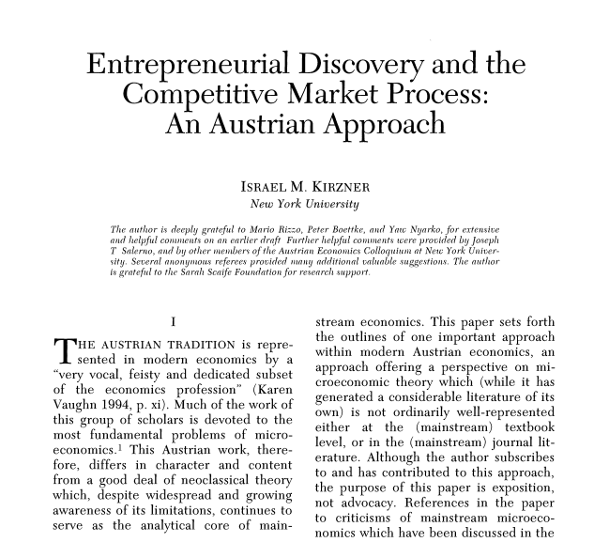

Slide 13
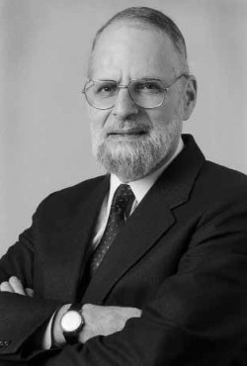
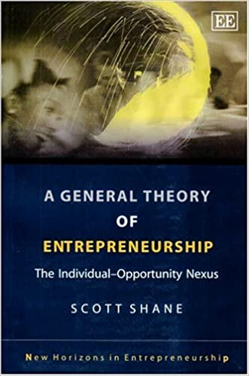
The opportunity-discovery approach
Entrepreneurship as alertness to profit opportunities
Contrast with mechanistic notions of search and optimization
Emphasis on serendipitous discovery, without antecedents
Separation of entrepreneurship and resource ownership (pure entrepreneur owns no capital)
Claim that discovery, not investment, drives the market process
In applied work, attempts to measure opportunities, link to individual characteristics

Slide 15
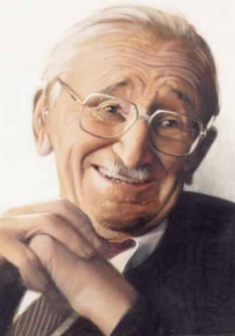
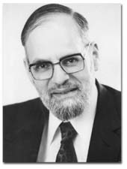
Problems with the discovery view
Hayek (1968): competition “is important primarily as a discovery procedure whereby entrepreneurs constantly search for unexploited opportunities that can also be taken advantage of by others.”
Kirzner (1973): entrepreneurship is alertness to “changing buying and selling possibilities,” “relevant new information,” and “potentially worthwhile goals hitherto unnoticed, as well as toward unnoticed potentially valuable, available resources.” The entrepreneur “notices [a] price discrepancy before others do.”
Problems
Entrepreneurs don’t discover, they create. Entrepreneurship looks to the future!
“Opportunity” is a metaphor.
If profit comes from successful discovery, whither loss?
Under uncertainty, entrepreneurs must own capital.

Slide 16
Entrepreneurship and the market process 1/
“If [entrepreneurs] fail to produce in the cheapest and
best possible way those commodities which the
consumers are asking for most urgently, they suffer
losses and are finally eliminated from their entrepreneurial
position. Other men who know better how to serve the
consumers replace them” (Mises, 1951, p. 7).
Not the same as the “convergence toward equilibrium”
“[T]he profit-maker is allocating factors where they had been undervalued as compared to the consumers’ desires. The greater a man’s profit has been, the more praiseworthy his role, for then the greater is the maladjustment that he alone has uncovered and is combatting. The greater a man’s losses, the more blameworthy he is, for the greater has been his contribution to maladjustment” (Rothbard, 1962, p. 515).

Slide 17
Entrepreneurship and the market process 2/
“Of course, we should not be too hard on the bumbling loser. He receives his penalty in the form of losses. These losses drive him from his poor role in production. If he is a consistent loser wherever he enters the production process, he is driven out of the entrepreneurial role altogether. He returns to the job of wage earner. In fact, the market tends to reward its efficient entrepreneurs and penalize its inefficient ones proportionately. In this way, consistently provident entrepreneurs see their capital and resources growing, while consistently imprudent ones find their resources dwindling. The former play a larger and larger role in the production process; the latter are forced to abandon entrepreneurship altogether.” (Rothbard, 1962, pp. 515-16).

Slide 18
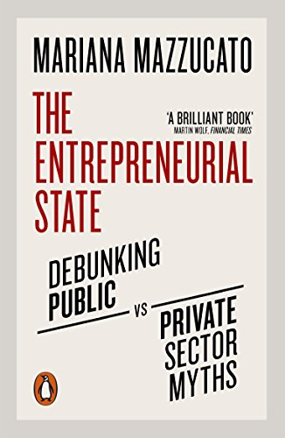
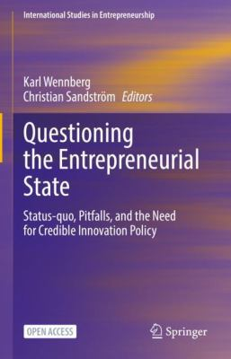
Can non-market actors be entrepreneurial?
Entrepreneurship versus “entrepreneur-like” behavior
Objectives, incentives, performance evaluation

