Slide 1
Cronyism: Liberty versus Power in Early America, 1607-1849
Dr. Patrick Newman
2021 Mises University

Slide 2
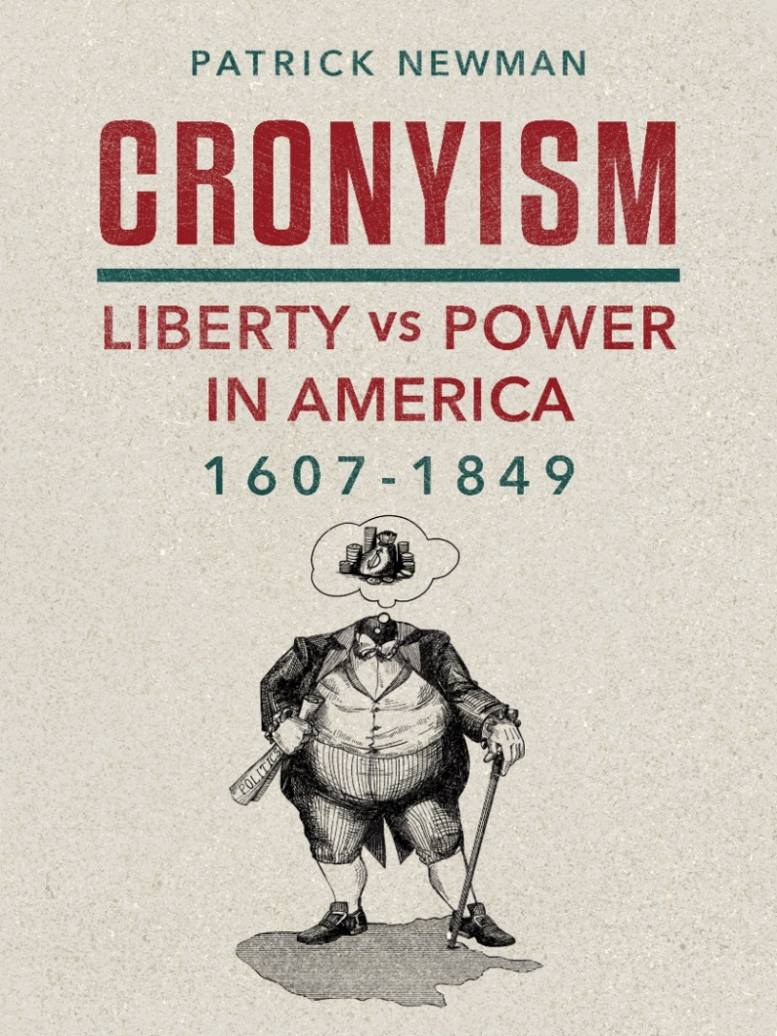
What’s this presentation about, and why should I care?
Forthcoming book (October 2021)
Cronyism: special-interest policies that enrich insiders at the public’s expense.
My narrative briefly covers Rothbard’s Conceived in Liberty series and then extensively covers the period after

Slide 3
Okay, so what’s the thesis?
Cronyism increased in a jagged fashion. It went up, then slightly declined before increasing again (rinse and repeat)
The Liberty versus Power theory explains why:
History is a clash between liberty and power
Power corrupts (increases the tendency to cronyism)
Reform is difficult because power corrupts
The proximate driver of cronyism was the desire to build an American Empire
an Empire of Power versus an Empire of Liberty

Slide 4
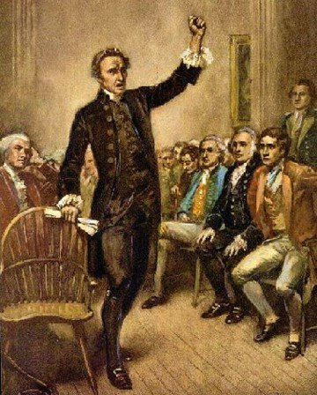
Part I: The Road to Empire, 1607-1790
Chapter 1: The Path to American Independence
The Old Orders of Europe
Salutary Neglect versus the Grand Design
Revolution!
Patrick Henry: “Give me liberty, or give me death!”

Slide 5
Part I: The Road to Empire, 1607-1790
Chapter 2: The American Revolutionary War: The Triumph of Liberty
The Declaration of Independence versus the Articles of Confederation
Robert Morris and the Bank of North America
The Proposed Federal Tariff

Slide 6
Part I: The Road to Empire, 1607-1790
Chapter 3: The U.S. Constitution: The Triumph of Power
Debt holders, bankers, manufacturers and shippers, transportation companies, land speculators and merchants, military officials
Federalists Robert Morris, Alexander Hamilton, and James Madison versus Antifederalists George Clinton and Patrick Henry
Henry: The Constitution will “convert this country into a powerful and mighty empire.”

Slide 7
Part II: The Hamiltonian Era, 1790-1801
Chapter 4: Prime Minister Hamilton: The Fiscal Program
The Funding Act
The Bank of the United States
Protective Tariffs

Slide 8
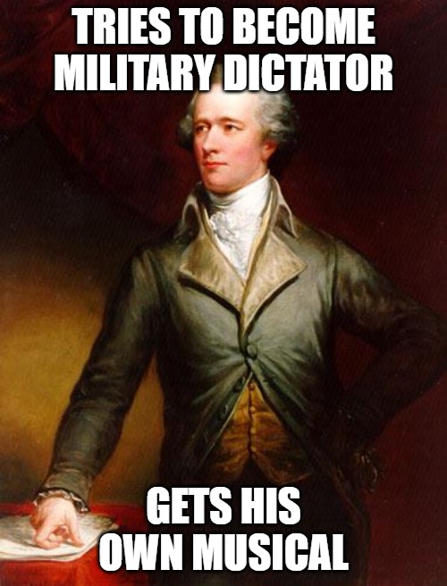
Part II: The Hamiltonian Era, 1790-1801
Chapter 5: Prime Minister Hamilton: The Imperial Program
The Whiskey Rebellion
Inspector General Alexander Hamilton
Hamilton: When it comes to the “riches of Mexico and Peru,” “the command in this case would very naturally fall upon me.”

Slide 9
Part II: The Hamiltonian Era, 1790-1801
Chapter 6: The Jeffersonian Revolution and the Defeat of Hamilton
The Republican Party
Federalist: “We hear, incessantly, from the old foes of the Constitution, ‘this is unconstitutional, and that is’.”
The Revolution of 1800
The Judiciary Act of 1801 and Chief Justice John Marshall

Slide 10
Part III: The Failed Jeffersonian Revolution, 1801-1817
Chapter 7: President Jefferson: The Supremacy of Moderation
Old Republicans (John Randolph and John Taylor) versus the moderates (James Madison)
Jefferson is in the middle

Slide 11
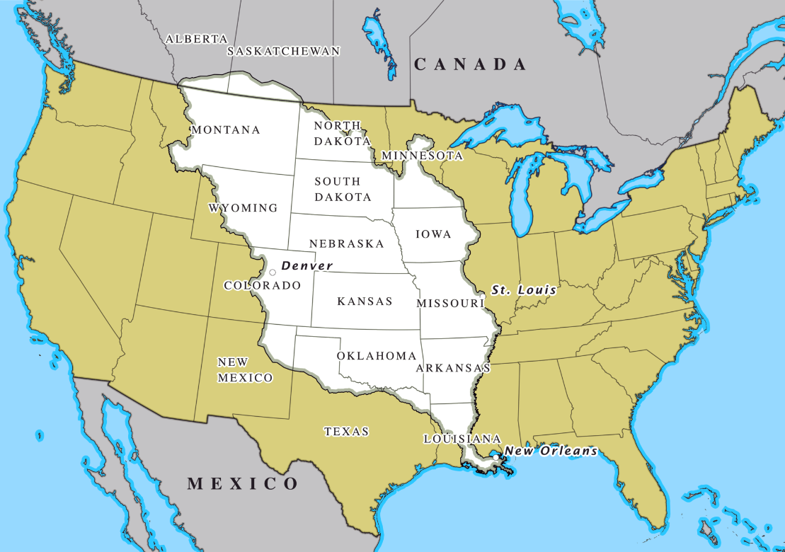
Part III: The Failed Jeffersonian Revolution, 1801-1817
Chapter 8: President Jefferson: The Corruption of Land
The Louisiana Purchase → Canada and Florida
John Randolph: the Louisiana Purchase was “the greatest course that ever befell us.”

Slide 12
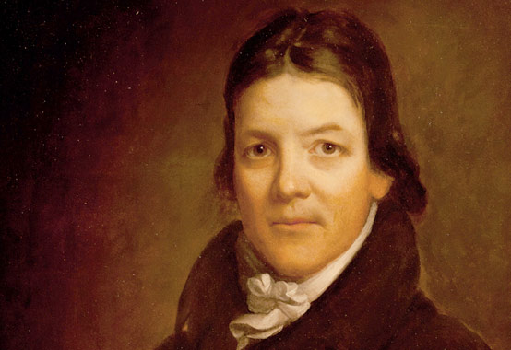
Part III: The Failed Jeffersonian Revolution, 1801-1817
Chapter 9: President Madison: The Empire of Power
The War of 1812 a (failed) land grab!
Second Bank of the United States and the Tariff of 1816
John Randolph tried to fight the postwar cronyism that “out-Hamiltons Alexander Hamilton.”

Slide 13
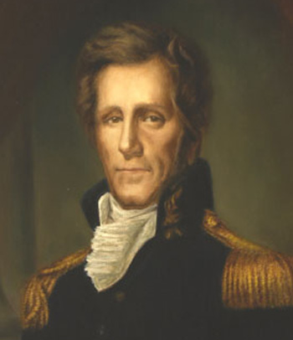
Part IV: The Era of Corruption, 1817-1829
Chapter 10: Erecting the American System: The Monetary Infrastructure
The Panic of 1819
Andrew Jackson, Martin Van Buren, Thomas Hart Benton, and James K. Polk versus Henry Clay, Daniel Webster, John Quincy Adams, Nicholas Biddle, and John Marshall
Jackson: We must stop the central bank’s “attendant evils and corruption.”

Slide 14
Part IV: The Era of Corruption, 1817-1829
Chapter 11: Erecting the American System: Sectional Fissures
The Tariff of 1824
Clay’s “the master spirit of the age” was Napoleon Bonaparte!
The Tariff of 1828
Manufacturer Abbott Lawrence exulted it would “keep the South and West in debt to New England the next hundred years.”
The General Survey Act of 1824

Slide 15
Part IV: The Era of Corruption, 1817-1829
Chapter 12: The Culmination of the American System: Enlarging the Empire
Adams–Onís Treaty acquired Florida and assumed merchant losses
Historians: bailout “marked unprecedented American underwriting of private commercial losses.”
Clay and Adams scheme to get Cuba

Slide 16
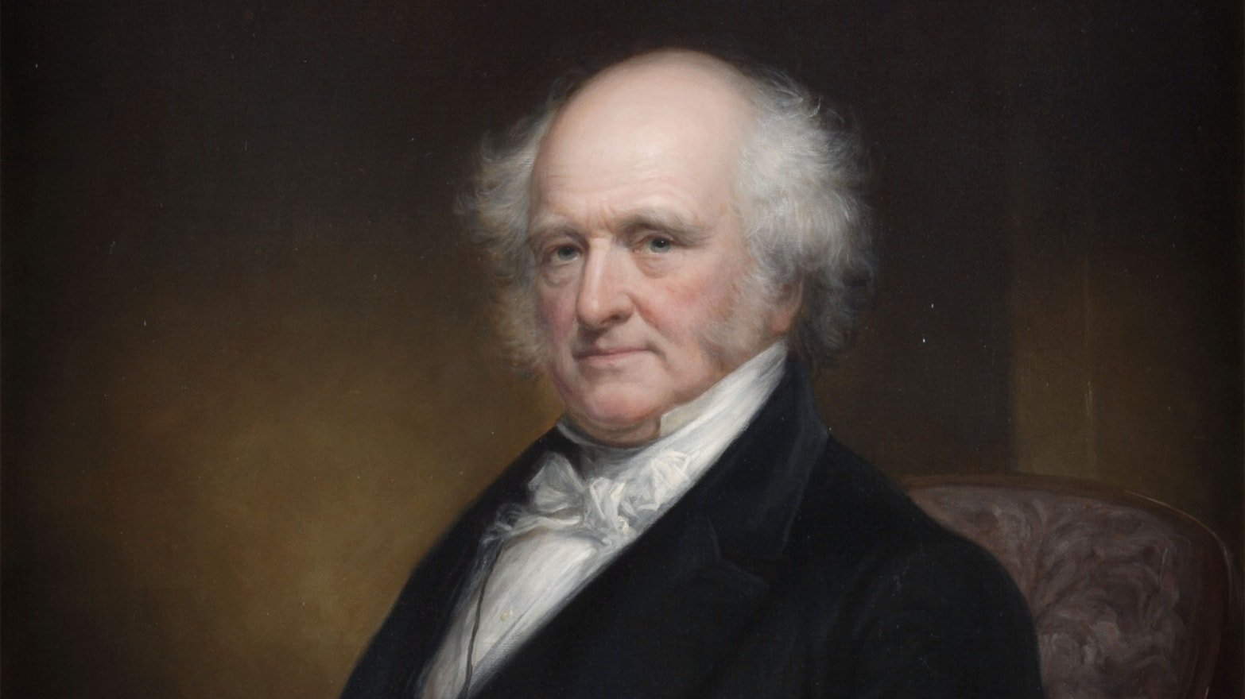
Part IV: The Era of Corruption, 1817-1829
Chapter 13: The Jacksonian Revolution and the Defeat of the National Republicans
The Corrupt Bargain of 1825
Jackson: “The Judas of the West has closed the contract, and received the thirty pieces of silver. His end will be the same.”
The Revolution of 1828
Van Buren: “If Gen Jackson & his friends will put his election on old party grounds . . . our success when achieved will be worth something.”

Slide 17
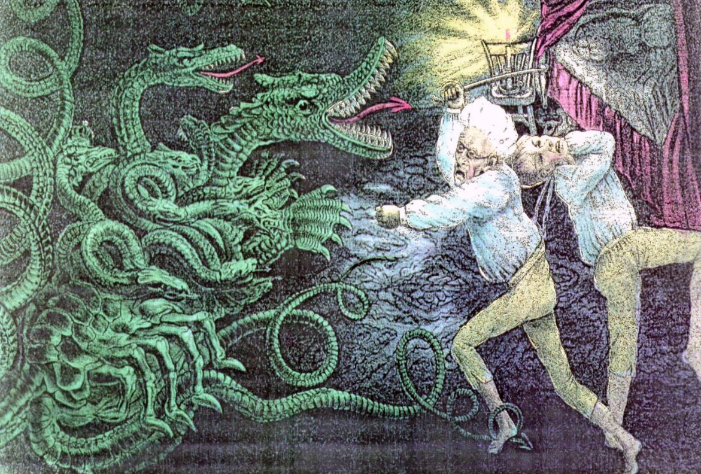
Part V: The Failed Jacksonian Revolution, 1829-1849
Chapter 14: Dismantling the American System: Decentralizing Money
Jackson vetoes the Second Bank of the United States’ early recharter
Jackson: “the hydra of corruption is only scotched, not dead.”

Slide 18
Part V: The Failed Jacksonian Revolution, 1829-1849
Chapter 15: Dismantling the American System: A Laissez-Faire Economy
Walker Tariff of 1846
The Cincinnati Enquirer: “The simultaneous triumph of free trade in the United States and Great Britain . . . is the greatest event of our age.”
Maysville Road veto, paying off the national debt, Rivers and Harbors veto, general incorporation laws

Slide 19
Part V: The Failed Jacksonian Revolution, 1829-1849
Chapter 16: Resurrecting the American System: The Growth of Imperialism
Texas annexation
Debt holders (Biddle!), land speculators, and slave interests
Van Buren and Benton split with Jackson and Polk
Rothbard: “this tragic split in the Democratic Party” cost the organization “its libertarian conscience and drive”
The Mexican War for the California ports

Slide 20
In conclusion
Cronyism will be great, although I can’t promise anything
You should buy the book when it comes out in October
Perfect for Thanksgiving, Christmas, and Valentine’s Day gifts

