Slide 1
The Economics (and Politics) of Big Tech
Peter G. Klein
Mises University
2021
@petergklein
#MisesU

Slide 2
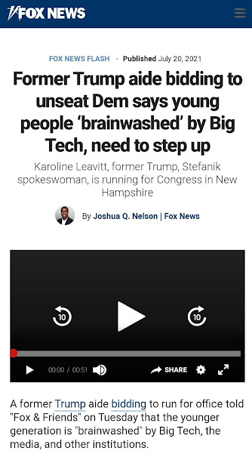
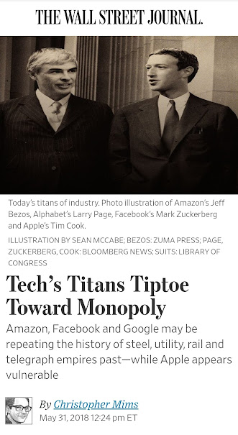
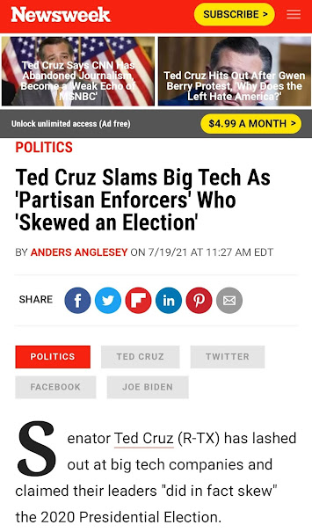
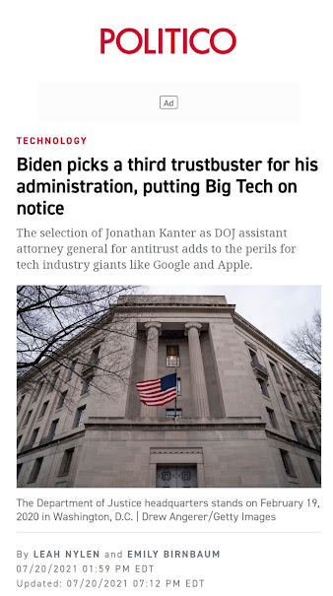
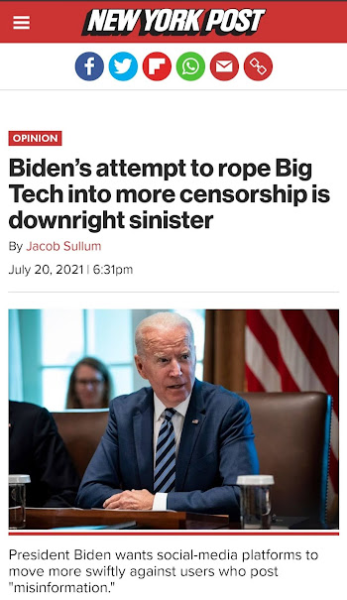

Slide 3
Hating on big tech
Abusing consumer privacy
Spreading misinformation
Threatening democracy
Exploiting monopoly power
Retarding innovation

Slide 4
heterogeneity

Slide 5
Key terms and concepts
Information goods
Network effects
First-mover advantage
Winner-take-all markets
Platforms and ecosystems
Two-sided markets
Freemium pricing

Slide 6
Information goods
What’s traded on the market is marginal units of goods and services, not “information.”
Information goods are economic goods (evaluated, subjectively, on the margin, like all consumer and producer goods).
Information goods are nothing new (books, maps, lectures, guides, directories).
The production process for information (high fixed cost, low variable cost) implies particular investment and pricing strategies.
Two-part pricing (often with free giveaways to increase installed base)
Price discrimination
Increasing returns and incumbent advantages

Slide 7
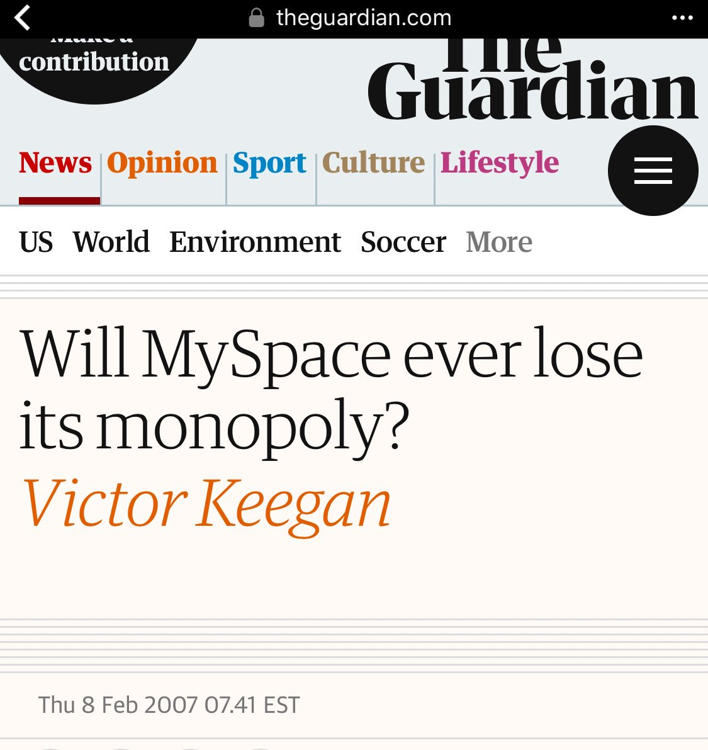
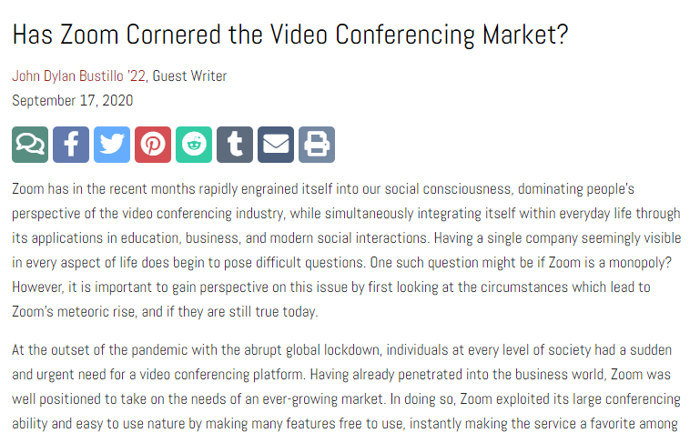
Network effects and path dependence
Network effects, first-mover advantage, and winner-take-all markets
Examples: QWERTY, VHS, MS-DOS,
A/C power, internal-combustion engine, social media platforms
Do network effects cause “market failure”?
Imperfect knowledge
The political process
Are there any real-world examples?

Slide 8
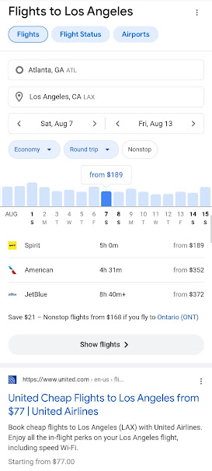
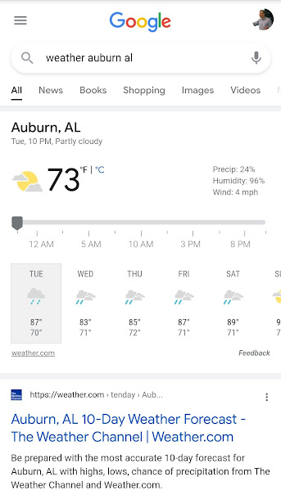
Platforms, ecosystems, and two-sided markets
Platforms
Access restrictions
Competition with providers

Slide 9
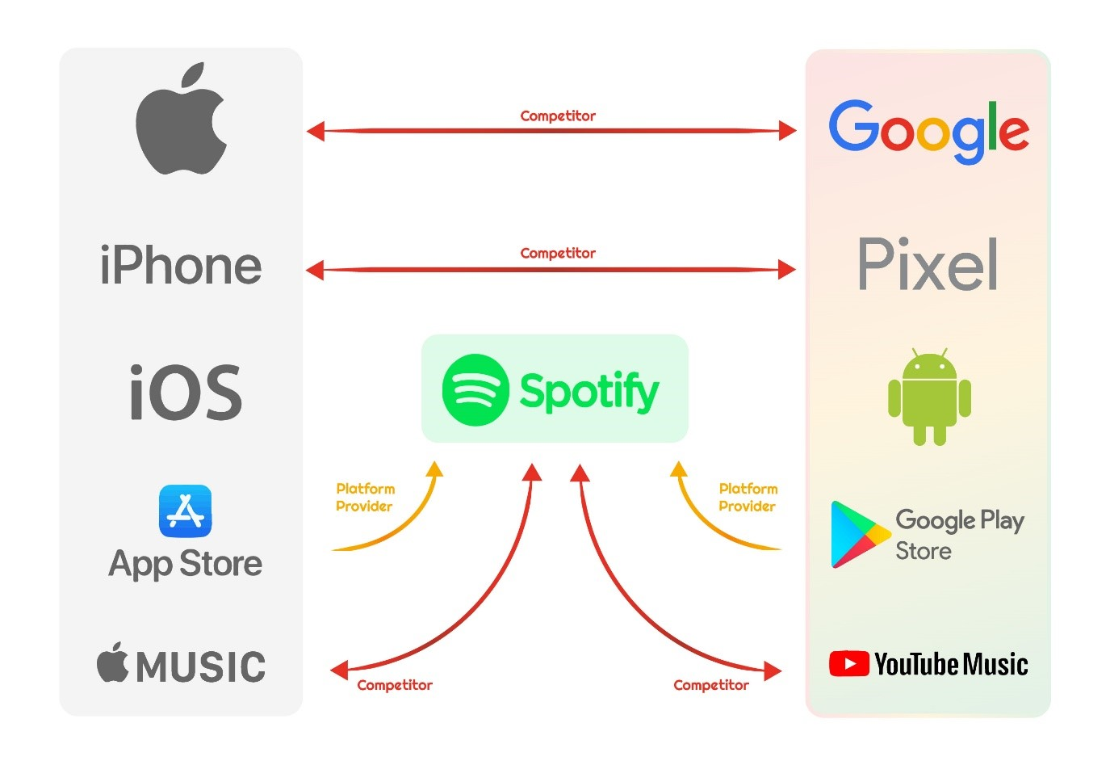
Platforms, ecosystems, and two-sided markets
Platforms
Access restrictions
Competition with providers
Ecosystems

Slide 10
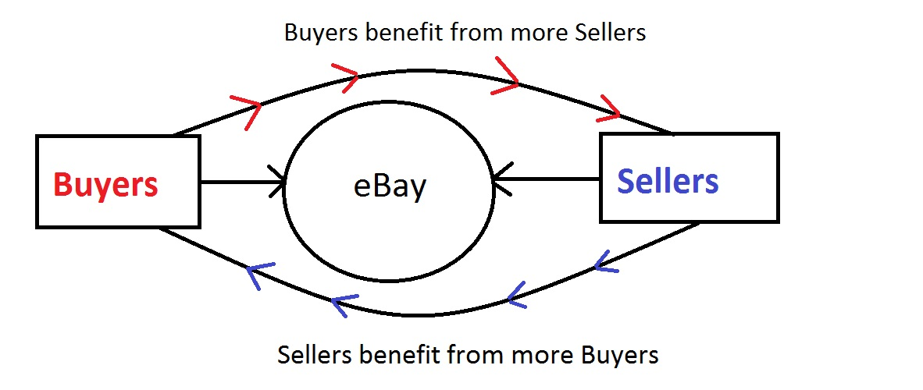
Platforms, ecosystems, and two-sided markets
Platforms
Access restrictions
Competition with providers
Ecosystems
Two-sided markets

Slide 11
Platforms, ecosystems, and two-sided markets
Platforms
Access restrictions
Competition with providers
Ecosystems
Two-sided markets
Freemium pricing
Other business-model issues: subscriptions or ads, data collection and sharing, upgrade strategies, licenses or subscriptions, etc.

Slide 12
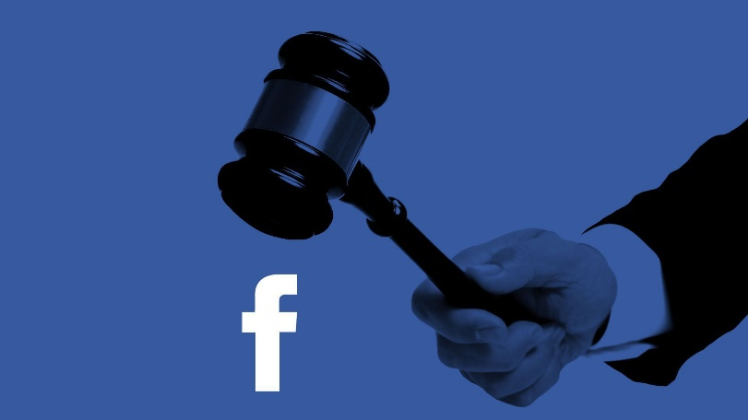
Should big tech firms be regulated or broken up?
Standard monopoly arguments
“Natural monopoly”
Platforms as public utilities
“Misinformation”
Are tech firms “part of the state”?
Origins in public funding
Data sharing
Deplatforming
Section 230 and other privileges
The public-private boundary in a mixed economy
Ownership
Control

