Slide 1
Austrian Economics in Business
Per Bylund
School of Entrepreneurship
Oklahoma State University
per.bylund@okstate.edu
@PerBylund

Slide 2
A ‘curious’ perspective…
Entrepreneurs create business firms to produce new goods, anticipating to earn profits by serving consumers better than other entrepreneurs
Austrians assert that the business firm exists within and is part of the market process
To Austrians, the economic function of the business firm is to deal with and organize production

Slide 3
The firm in economics
Y = AL^{α}K^{β}
inputs
K, L
Goods
outputs
FC+VC=TC
TC=Y
Y = P*Q
where:
Y = total production (the real value of all goods produced)
L = labor input (the total number of person-hours worked)
K = capital input (a measure of all machinery, equipment, and buildings; the value of capital input divided by the price of capital)
A = total factor productivity
α and β are the output elasticities of capital and labor, respectively. These values are constants determined by available technology.
Q = number of goods produced
P* = equilibrium price for the good

Slide 4
The firm in economics
In equilibrium, there’s no…
entrepreneur
management
heterogeneity
uncertainty
organization
differentiation
innovation
profits

Slide 5
The firm in business admin
The entrepreneur starts the firm
The manager runs the firm
Firms seek unique, valuable resources
Firms develop specific capabilities
Firms seek differentiation for above-normal profits and competitive advantage

Slide 6
The firm in business admin
Entrepreneurship
How to start a firm
Who starts a firm, when and why
No place in mainstream economics; “expunged”
Strategy (strategic management)
How to position the firm (wrt industry forces)
Seeks sustained competitive advantage
Economics flipped upside-down
Management
Directs and organizes human resources
Psychology, motivation, organizational structure
Managerial economics
Maximize by finding P=MC

Slide 7
Where Austrians stand
Menger, Principles of Economics, p. 160

Slide 8
Where Austrians stand
Entrepreneurship drives the market process
Rivalrous entrepreneurial production
Opportunities are speculations of how to better satisfy (future) consumer wants
Economic goods as means to satisfy wants
Production precedes consumption

Slide 9
The main issue for business
Produce goods to facilitate consumption
Profit from facilitating value
Trade is not production

Slide 10
The main issue for business
Cost < Price < Value

Slide 11
The main issue for business
Cost < Price < Value
Production
Valuation

Slide 12
The main issue for business
Cost < Price < Value
Entrepreneur’s money profit
Consumer’s psychic profit

Slide 13
Entrepreneurship
Entrepreneurship in the broadest sense
Uncertainty-bearing aspect of every action
Entrepreneurship in the broad sense
Speculator bearing uncertainty regarding what consumers will value
Division of intellectual labor lessens uncertainty
The narrower case: the entrepreneur-promoter
Innovative, disruptive entrepreneurship
The ‘driving force’ of the economy, which contributes to uncertainty

Slide 14
The driving force
The entrepreneur-promoter
Mises, Human Action, p. 256

Slide 15
The driving force
The entrepreneur-promoter
Mises, Human Action, p. 255

Slide 16
The driving force
The entrepreneur-promoter (Mises)
“unceasing innovation and improvement”
“pioneers of economic improvement”
“great adjustments” of production
Different from alertness (Kirzner), discovery (Hayek)
Correcting ‘errors’ in the economic system
Within-system (re)allocation

Slide 17
A praxeological definition
Bylund, PL. 2020. “Finding the Entrepreneur-Promoter: A Praxeological Inquiry,” Quarterly Journal of Austrian Economics, Vol. 23, Issue 3-4, pp. 355-389
https://doi.org/10.35297/qjae.01007

Slide 18
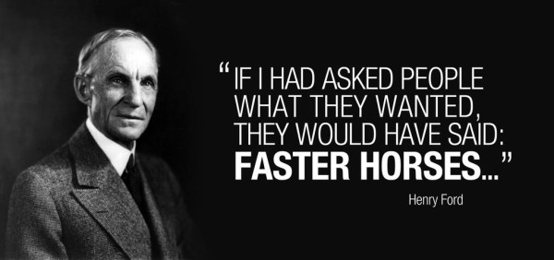
Entrepreneurial production

Slide 19
Entrepreneurial production
Entrepreneurial imagination
Speculative investment
Production takes time
Uncertain future market conditions
Other entrepreneurial undertakings change the consumer’s value calculus

Slide 20
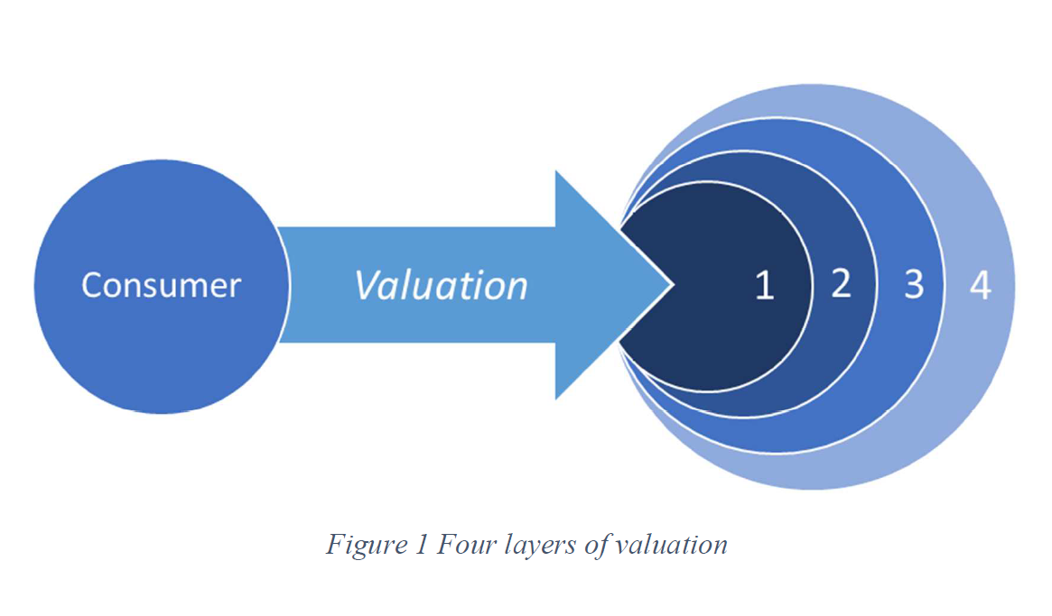
The consumer’s value calculus
Satisfaction from using the good (expected)
Other goods satisfying the same want
Other goods satisfying other wants
Expectations of (better) future goods
Bylund, unpublished manuscript

Slide 21
Entrepreneurial production
Entrepreneurial imagination
Speculative investment
Production takes time
Uncertain future market conditions
Other entrepreneurial undertakings change the consumer’s value calculus
Economic calculation through market prices
But not within the firm

Slide 22
The firm to Austrians
The firm is the entrepreneur’s creation
The manager works for the entrepreneur
Mises, Human Action, p. 301

Slide 23
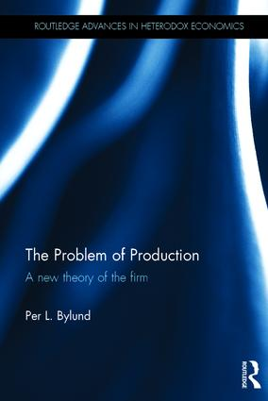
The firm to Austrians
The firm is the entrepreneur’s creation
The manager works for the entrepreneur
‘Islands of specialization’
New production structure
Beyond what the market can coordinate

Slide 24
The Austrian business
Begins and ends with the consumer
Consumer sovereignty
Value in satisfaction through consumption
Focus on value of the entire experience
Selling price is a part of the bundle for sale
Low enough to offer ‘profit’ for the consumer
Ultimately a function of consumer value
Cost-plus pricing

Slide 25
The Austrian business
Prefer market prices
Focus on the core value facilitation
Outsource functions when (as soon as) possible
Main tasks of the entrepreneur
Imagine how to satisfy consumers – value first
Bear uncertainty of speculative production

Slide 26
The Austrian business
The entrepreneur answers one question
How can I best serve consumers?
Management answers only two questions
How can we strengthen our value proposition to the consumer?
How can we operate more effectively (increase the price-cost difference)?

Slide 27
From theory to practice
Trained economists are semi-useless
Equilibrium doesn’t apply
Most entrepreneurs fail most of the time
Often because they are not Austrians
Successful businesses create the future
Actively pursue consumer satisfaction
Experienced entrepreneurs are Austrians
Develop gut feel through trial-and-error
Lack explanation (theory) and terminology

Slide 28
Thank you

