Slide 1
Environmental and Resource Economics
Timothy D. Terrell
Mises University 2020
Notes:
Interest in environmental issues as one of the toughest set of issues for free market economists to deal with

Slide 2
Environmental Issues
Resource Use
Deforestation, oil reserves, fisheries, recycling
Externalities (spillover effects)
Smoking, paper mills, fireworks, litter, water pollution
Core issue for both: property rights
Notes:
Best to avoid the temptation to become an amateur climatologist.
Two basic subsets of issues:
Environmental resource use
Deforestation (mention that if you want more trees, better to use more paper, not recycled)
“local food” (http://www.nytimes.com/2010/08/20/opinion/20budiansky.html)
endangered species
CFL or LED light bulbs
CAFE
“Externalities” or spillover effects
Role of the State
Key to both is understanding the role of the State
Governments suffer from at least two problems:
Knowledge insufficiency (socialist calculation problem)
Incentive incompatibility (principal-agent problem)
Some of the thinking on these issues assumes that government is seeking environmental purity in the first place. The public choice theorists have shown that much environmental intervention can be explained if we simply assume that policymakers are seeking their own ends like the rest of us. Congressmen and bureaucrats are not disinterested philosopher-kings—they have campaigns to fund, children to send to college, careers to further, etc.

Slide 3
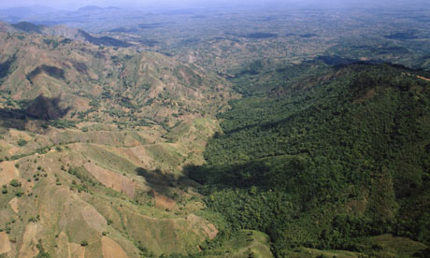
Haiti Dominican Republic
Economic Freedom Index
(rank): 103 62
“Protection of Property
Rights” (rating) 2.79 4.82
Economic Freedom Index at https://www.fraserinstitute.org/sites/default/files/economic-freedom-of-the-world-2018.pdf

Slide 4
Where We’re Going
Subjectivity, Efficiency, and the Environment
Some principles for understanding environmental issues
Government and Environmental Crisis
Are environmental crises the result of capitalism run amok? What role does government play?
Energy, Emissions, and Growth
Energy is key to growth, but energy production causes pollution. What happens as people grow wealthier and use more energy?

Slide 5
Subjectivity, Efficiency, and the Environment
Fundamental Principles for Environmental Economics

Slide 6
Rationale for Regulation
Allegations of market failure:
Underproduction or overproduction of products creating externalities (side effects of behavior that confer benefits or impose costs on others)
Underproduction of public goods (nonexclusive, nonrival)
Inefficiencies from market power (e.g., monopoly, monopsony)
Problems with externalities and public goods usually arise where property rights are poorly defined.
Merely to show that the market has failed to arrive at some ideal standard is not enough. The second step is to show that the possible government intervention would produce results that are superior. It may be the case that the government intervention is actually worse than the initial market failure.

Slide 7
Three Basic Approaches to Environmental Problems
Pigouvian approach (tax/subsidy schemes)
Regulatory approach (government forces reductions in emissions to a level deemed socially efficient)
Property rights approach
common law, torts, Coase, Demsetz
natural law, torts, Rothbard, Block

Slide 8
Two Key Problems with Mainstream Approaches
Efficiency is an “individual goal-seeking problem, not a value-maximization problem” (Roy Cordato)
From the Austrian perspective, efficiency is attained when legal institutions allow individuals to pursue their ends.
Conflicts will arise over the use of scarce goods—but the Austrian does not try to assess the value of alternative uses. This is because…

Slide 9
Two Key Problems with Mainstream Approaches
Costs are subjective, and cannot be measured
Marginal private benefit (MPB) and marginal social cost (MSC) are not measurable
MPC, MSC, MPB
MSC
Deadweight loss (DWL)
MPC
Overproduction
MPB
Q*
Q^{M}
Qty. of output

Slide 10
Two Key Problems with Mainstream Approaches
MPC, MSC, MPB
MSC
MPC
Tax?
MPB
Q*
Q^{M}
Qty. of output

Slide 11
Two Key Problems with Mainstream Approaches
MPC, MSC, MPB
MSC
MPC
MPB
Q tradable permits?
Q*
Q^{M}
Qty. of output

Slide 12
Two Key Problems with Mainstream Approaches
From any regained DWL, subtract:
DWL from “overshoot”
Costs of bureaucracy and enforcement
Costs of waste from political lobbying by, e.g., purveyors of preventive care
MPC, MSC, MPB
MSC_{est}
MSC
Overshooting tax on negative externality
DWL_{T}
DWL
MPC
MPB
Q^{T}
Q*
Q^{M}
Qty. of output

Slide 13
Political Considerations
Art Carden:
“The information needed to know whether a particular regulation ‘works’ quite literally does not exist, and the key difference between firms and governments is that firms … have market tests for their decisions. Governments do not.”
– “What Should Austrian Economists Do?...” in QJAE vol. 17, no. 2.

Slide 14
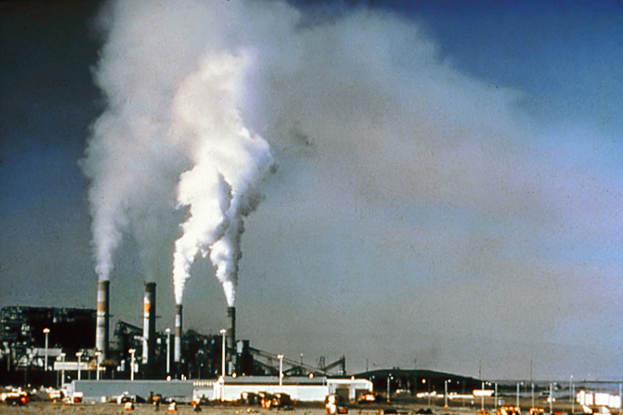
Efficiency vs. Property
“Efficiency” and ethics
Even if we could calculate the efficient quantity of pollution, how can this trump property rights?
The issue becomes a matter of violating the property rights of another person, not about exceeding some level of emissions or damaging the environment.

Slide 15
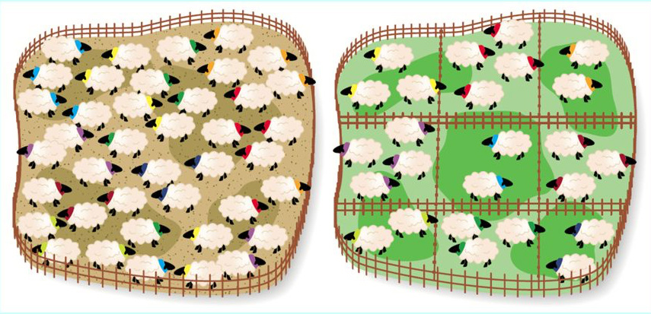
Tragedy of the Commons
If livestock are placed on a common pasture, where no one is an owner, herders gain all the benefits of the grass their animals eat, but suffer only part of the costs.
Image: http://www.crashcoursecriticism.com/2016/03/24/market-failures-taxes-and-subsidies-episode-21-part-1/

Slide 16
The Tragedy of the Commons
Rancher Al
1 cow
2 cows
Al: 5
Bob: 5
Al: 6
Bob: 3
1 cow
Rancher Bob
Al: 3
Bob: 6
Al: 4
Bob: 4
2 cows
Adapted from Baland and Platteau (1996, p. 29)

Slide 17
The Tragedy of the Commons
Menger: “When all members of society compete for a given quantity of goods that is insufficient… a practical solution to this conflict of interest is… only conceivable if the [goods] pass into the possession of some of the economizing individuals, and if these individuals are protected by society in their possession to the exclusion of all other individuals.”

Slide 18
The Tragedy of the Commons
Rancher Al
1 cow
2 cows
Al: 5
Bob: 5
Al: 6
Bob: 3
1 cow
Rancher Bob
Al: 3
Bob: 6
Al: 4
Bob: 4
2 cows
Adapted from Baland and Platteau (1996, p. 29)

Slide 19
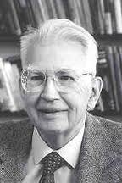
Coasean Approach
Coase Theorem: in the absence of transaction costs, the outcome (the amount of pollution) will be the same regardless of the initial assignment of property rights.
Transaction costs aren’t zero, so for Coase, courts should balance costs and benefits to both sides and make a determination.
The Coasean approach neglects the problem of the subjectivity of costs and benefits.
Notes:
“Coasean world” is not a zero-transaction cost world. The Austrian approach stands over against the Coasean approach, which says that a court should balance the costs and benefits to both sides and make a determination.

Slide 20
Subjective Costs
Railroad vs. Orchards
Orchards destroyed by sparks from passing train
$100,000 reduction in market value of property (farmer has to suffer loss of trees; market value of property now $15,000)
$120,000 cost of spark-reduction devices
Should the sparks fly or should the orchard grow? What is more valuable—allowing the railroad to proceed in using the space as a dumping ground for its effluent or allowing the farmer to use the space to grow fruit?
Mainstream: $120,000 > $100,000 so railroad’s use is more valuable. Growing trees would be inefficient.

Slide 21
Subjective Costs
$100,000 reduction in market value of property (farmer has to suffer loss of trees; market value of property now $15,000)
$120,000 cost of spark-reduction devices
Case 1: Farmer gets rights
Railroad pays $100,000 to compensate farmer
Devices not installed, trees gone
“Society” gains by $20,000 relative to alternative.

Slide 22
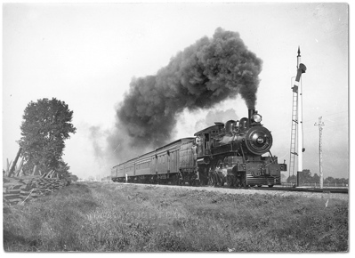
Subjective Costs
$100,000 reduction in market value of property (farmer has to suffer loss of trees; market value of property now $15,000)
$120,000 cost of spark-reduction devices
Case 2: Railroad gets rights
Farmer won’t pay $120,000 to induce railroad to install devices
Devices not installed, trees gone
“Society” gains by $20,000.

Slide 23
Subjective Costs
$100,000 reduction in market value of property (farmer has to suffer loss of trees; market value of property now $15,000)
$900,000 psychological loss to farmer
$120,000 cost of spark-reduction devices
Case 2: Railroad gets rights
Total market value of property was only $115,000
Farmer can’t raise $120,000 to induce railroad to install devices
Devices not installed, trees gone
“Society” loses by ($100,000 + $900,000) –$120,000 “savings” from no spark-reduction device = $880,000
Notes:
[READ]
Coase and Demsetz have a proviso in their indifference thesis that all “transaction costs” be zero. If they are not, then they advocate allocating the property rights to whichever route entails minimum social transaction costs. But once we understand that costs are subjective to each individual and therefore unmeasurable, we see that costs cannot be added up. But if all costs, including transaction costs, cannot be added, then there is no such thing as “social transaction costs,” and they cannot be compared in Cases 1 or 2, or indeed, in any other situation.
Efficiency and ethics
Another problem with the Coase-Demsetz approach is that pretending to be value-free, they in reality import the ethical norm of “efficiency,” and assert that property rights should be assigned on the basis of such efficiency. But even if the concept of social efficiency were meaningful, they don’t answer the questions of why efficiency should be the overriding consideration in establishing legal principles or why externalities should be internalized above all other considerations. We are now out of Wertfreiheit and back to unexamined ethical questions.
Efficiency implies a goal. A car that is “efficient” might be fuel-efficient or efficient in the use of the materials used to manufacture it, or in some other way. So what is the goal? Liberty? Lower dollar costs? Conservation of some other resource?

Slide 24
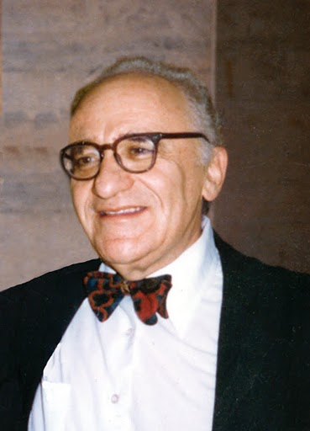
Efficiency vs. Ethics
“…we cannot decide on public policy, tort law, rights, or liabilities on the basis of efficiencies or minimizing of costs.”
-- Murray Rothbard, in Mario Rizzo, Time, Uncertainty, and Disequilibrium
http://picasaweb.google.com/MisesInstitute/RothbardImages#5400723609019072930
Notes:
[READ] In a chapter in Mario Rizzo’s book Time, Uncertainty, and Disequilibrium (1979), Rothbard says,
…we cannot decide on public policy, tort law, rights, or liabilities on the basis of efficiencies or minimizing of costs. But if not costs or efficiency, then what? The answer is that only ethical principles can serve as criteria for our decisions. Efficiency can never serve as the basis for ethics; on the contrary, ethics must be the guide and touchstone for any consideration of efficiency.
…Economists will have to get used to the idea that not all of life can be encompassed by our own discipline. A painful lesson no doubt, but compensated by the knowledge that it may be good for our souls to realize our own limits—and, just perhaps, to learn about ethics and about justice. [Rothbard, Logic of Action 2, p. 273]

Slide 25
Property Rights
Murray Rothbard (1973)
“If a private firm owned Lake Erie… then anyone dumping garbage in the lake would be promptly sued in the courts for their aggression against private property and would be forced by the courts to pay damages and to cease and desist from any further aggression.

Slide 26
Property Rights
“Thus, only private property rights will insure an end to pollution — invasion of resources. Only because the rivers are unowned is there no owner to rise up and defend his precious resource from attack. If, in contrast, anyone should dump garbage or pollutants into a lake which is privately owned (as are many smaller lakes), he would not be permitted to do so for very long — the owner would come roaring to its defense.”
Murray Rothbard, in For a New Liberty (https://mises.org/library/libertarian-manifesto-pollution)
Walter Block and Peter Nelson, Water Capitalism: The Case for Privatizing Oceans, Rivers, Lakes, and Aquifers (2015)

Slide 27
About All That Plastic….
“[A]bout 90 percent of all the plastic that reaches the world's oceans gets flushed through just 10 rivers: The Yangtze, the Indus, Yellow River, Hai River, the Nile, the Ganges, Pearl River, Amur River, the Niger, and the Mekong (in that order).”
https://www.dw.com/en/almost-all-plastic-in-the-ocean-comes-from-just-10-rivers/a-41581484?fbclid=IwAR2I7_TmAi_DwihdTU1M9IJf6IAQx6gadw_sm3Zma2XWbkMEZmBEWGFlUyA

Slide 28
“…fishing nets account for 46 percent of the trash, with the majority of the rest composed of other fishing industry gear, including ropes, oyster spacers, eel traps, crates, and baskets. Scientists estimate that 20 percent of the debris is from the 2011 Japanese tsunami.” https://news.nationalgeographic.com/2018/03/great-pacific-garbage-patch-plastics-environment/

Slide 29
Non-Aggression Principle
“No action should be considered illicit or illegal unless it invades, or aggresses against, the person or just property of another”
-- Murray Rothbard, “Law, Property Rights, and Air Pollution”
http://picasaweb.google.com/MisesInstitute/RothbardImages#5400723609019072930
Notes:
[READ]
Rothbard would have people “homestead” unclaimed property, and this would include “homesteading” a certain level of environmental cleanliness. If another party alters that level without permission, the property owner can sue for cessation.
The normative principle I am suggesting for the law is simply this: No action should be considered illicit or illegal unless it invades, or aggresses against, the person or just property of another. Only invasive actions should be declared illegal, and combated with the full power of the law. The invasion must be concrete and physical.

Slide 30
Property Invasions
Decline in value of property not an invasion
Wal-Mart
Schumpeter’s “creative destruction”
“Anyone has the right to defend his property against an overt act initiated against it”
“A strict causal connection must exist between an aggressor and a victim, and this connection must be provable beyond a reasonable doubt.” – Rothbard (LPRAP)
Notes:
Rothbard says it has to be a physical invasion. What are called “pecuniary externalities” whereby the value of my property is affected by the presence or actions of another, are not something to be corrected by law.
Everyone has the right to have the physical integrity of his property inviolate; no one has the right to protect the value of his property, for that value is purely the reflection of what people are willing to pay for it.
Wal-Mart: other firms have no right to their customers, and even if Wal-Mart’s entry into a market decreases the value of those other firms, Wal-Mart has committed no ethical wrong, in Rothbard’s system.
What constitutes an “invasion” to a person’s property? How should one respond to imminent attack, in the libertarian view?
“Reasonable man” standard: what would a judge or jury think was a reasonable apprehension of imminent attack?
Libertarian theory adopts a “strict liability” approach.
Jones assaults and attacks Smith; Smith, in self-defense, shoots. The shot goes wild and accidentally hits Brown, an innocent bystander. Should Smith be liable? Unfortunately, the courts, sticking to the traditional “reasonable man” or “negligence” doctrine, have held that Smith is not liable if indeed he was reasonably intending self-defense against Jones. But, in libertarian and in strict liability theory, Smith has indeed aggressed against Brown, albeit unintentionally, and must pay for this tort. Thus, Brown has a proper legal action against Smith. Since Jones coerced or attacked Smith, Smith also has an independent and proper action for assault or battery against Jones. Presumably, the liability or punishment against Jones would be considerably more severe than against Smith. [Why]
One of the great flaws in the orthodox negligence approach has been to focus on one victim’s (Smith’s) right of self-defense in repelling an attack, or on his good-faith mistake. But orthodox doctrine unfortunately neglects the other victim—the man frowning across the street, the plainclothesman trying to save someone, the innocent bystander. The plaintiff’s right of self-defense is being grievously neglected. The proper point to focus on in all these cases is: Would the plaintiff have had the right to plug the defendant in his self-defense? Would the frowning man, the plainclothesman, the innocent bystander, if he could have done so in time, have had the right to shoot the sincere but erring defendants in self-defense? Surely, whatever our theory of liability, the answer must be “yes”; hence, the palm must go to the strict liability theory, which focuses on everyone’s right to self-defense and not just that of a particular defendant. For it is clear that since these plaintiffs had the right to plug the defendant in self-defense, then the defendant must have been the tortious aggressor, regardless of how sincere or “reasonable” his actions may have been.

Slide 31
Homesteading and Pollution
Noise homesteading
Air pollution homesteading
Air as dumping ground
Air as source of breathable air
Coming to the nuisance
Bove v. Donner-Hanna Coke Co. (1932)
Notes:
Most of us think of homesteading unused resources in the old-fashioned sense of clearing a piece of unowned land and farming the soil. There are, however, more sophisticated and modern forms of homesteading, which should establish a property right. Suppose, for example, that an airport is established with a great deal of empty land around it. The airport exudes a noise level of, say, X decibels, with the sound waves traveling over the empty land. A housing development then buys land near the airport. Sometime later, the homeowners sue the airport for excessive noise interfering with the use and quiet enjoyment of the houses.
Excessive noise can be considered a form of aggression but in this case the airport has already homesteaded X decibels worth of noise. By prior claim, the airport now “owns the right” to emit X decibels of noise in the surrounding area. In legal terms, we can then say that the airport, through homesteading, has earned an easement right to creating X decibels of noise. This homesteaded easement is an example of the ancient legal concept of “prescription,” in which a certain activity earns a prescriptive property right to the person engaging in the action.
On the other hand, if the airport starts to increase noise levels, then the homeowners could sue or enjoin the airport from its noise aggression for the extra decibels, which had not been homesteaded. Of course if a new airport is built and begins to send out noise of X decibels onto the existing surrounding homes, the airport becomes fully liable for the noise invasion.
It should be clear that the same theory should apply to air pollution…. [p. 146]
“Coming to the nuisance”
Bove v. Donner-Hanna Coke Co. (1932). Plaintiff had moved into an industrial region, where the defendant was operating a coke oven on the opposite side of the street. When plaintiff tried to enjoin the coke oven out of existence, the court rejected the plea with these exemplary words:
With all the dirt, smoke, and gas which necessarily come from factory chimneys, trains, and boats, and with full knowledge that this region was especially adapted for industrial rather than residential purposes, and that factories would increase in the future, plaintiff selected this locality as the site of her future home. She voluntarily moved into this district, fully aware of the fact that the atmosphere would constantly be contaminated by dirt, gas, and foul odors; and that she could not hope to find in this locality the pure air of a strictly residential zone. She evidently saw certain advantages in living in this congested center. This is not the case of an industry, with its attendant noise and dirt, invading a quiet, residential district. This is just the opposite. Here a residence is built in an area naturally adapted for industrial purposes and already dedicated to that use. Plaintiff can hardly be heard to complain at this late date that her peace and comfort have been disturbed by a situation which existed, to some extent at least, at the very time she bought her property.

Slide 32
Trespass vs. Nuisance
Prosser (Law of Torts):
Trespass is an invasion of the plaintiff’s interest in the exclusive possession of his land, while nuisance is an interference with his use and enjoyment of it. The difference is that between… felling a tree across his boundary line and keeping him awake at night with the noise of a rolling mill.

Slide 33
Trespass vs. Nuisance
Boundary crossings:
Radio waves?
Air traffic?
Rothbard:
The proper distinction is between visible and tangible or “sensible” invasion, which interferes with possession and use of the property, and invisible, “insensible” boundary crossings that do not and therefore should be outlawed only on proof of harm. (LPRAP)
Image: beforeitsnews.com
Notes:
…consider the case of radio waves, which is a crossing of other people’s boundaries that is invisible and insensible in every way to the property owner. We are all bombarded by radio waves that cross our properties without our knowledge or consent. Are they invasive and should they therefore be illegal, now that we have scientific devices to detect such waves? Are we then to outlaw all radio transmission? And if not, why not?
The reason why not is that these boundary crossings do not interfere with anyone’s exclusive possession, use, or enjoyment of their property. They are invisible, cannot be detected by man’s senses, and do no harm. They are therefore not really invasions of property, for we must refine our concept of invasion to mean not just boundary crossing, but boundary crossings that in some way interfere with the owner’s use or enjoyment of this property. What counts is whether the senses of the property owner are interfered with.
So we see that the proper distinction between trespass and nuisance, between strict liability per se and strict liability only on proof of harm, is not really based on “exclusive possession” as opposed to “use and enjoyment.” The proper distinction is between visible and tangible or “sensible” invasion, which interferes with possession and use of the property, and invisible, “insensible” boundary crossings that do not and therefore should be outlawed only on proof of harm.
What about the size of the unit of property under one’s control?
Do you own all the land below and above your parcel of real estate? Clearly not. There is a “zone of ownership” that constitutes the part of the airspace necessary to enjoy your use of the land.
Rothbard points out that there is a difference between a “right to clean air” and a “right not to have his air invaded by pollutants generated by an aggressor.

Slide 34
Key Principles of Liability
Polluter is liable if the polluter has not previously established a homestead easement
While visible pollutants or noxious odors are per se aggression, in the case of invisible and insensible pollutants the plaintiff must prove actual harm
The burden of proof of such aggression rests upon the plaintiff
Notes:
[DON’T READ] Key principles of liability for air pollution: Liability by the aggressor exists provided that:
The polluter has not previously established a homestead easement
While visible pollutants or noxious odors are per se aggression, in the case of invisible and insensible pollutants the plaintiff must prove actual harm;
The burden of proof of such aggression rests upon the plaintiff;

Slide 35
Key Principles of Liability
The plaintiff must prove strict causality from the actions of the defendant to the victimization of the plaintiff
The plaintiff must prove such causality and aggression beyond a reasonable doubt
There is no vicarious liability, but only liability for those who actually commit the deed.
-- Rothbard, LPRAP
Notes:
The plaintiff must prove strict causality from the actions of the defendant to the victimization of the plaintiff;
The plaintiff must prove such causality and aggression beyond a reasonable doubt
There is no vicarious liability, but only liability for those who actually commit the deed. [pp. 157-158]
Only the victim can press suit. Others, like district attorneys, have no standing.

Slide 36
Multiple Emitters
What if there are many dispersed nuisance-creators and/or victims?
Is the host responsible? (e.g., private road ownership)
No compulsory joining in suits
Dolan: “environmental mass torts” present a coordination problem that prevents mutually beneficial exchanges. This is a “missing link” in Austrian environmental economics, he says.
Notes:
Multiple emitters of pollution
The prevalence of multiple sources of pollution is a problem. How are we to blame emitter A if there are other emitters or if there are natural sources of emission? Whatever the answer, it must not come at the expense of throwing out proper standards of proof, and conferring unjust special privileges on plaintiffs and special burdens on defendants.
Private road ownership could solve a number of these problems with regard to auto emissions.
Defendants should not be compulsorily joined except “when all the parties acted in concert in a joint tortious enterprise.” Where injuries are committed separately (as is the case in many air pollution cases), the only way to deal with them is to sue separately.
Joining plaintiffs is fine, but not in “class action” suits, where victims who didn’t participate in the suit are bound by the suit’s outcome.

Slide 37
Government and Environmental Crisis
Political Incentives and Environmental Policy

Slide 38
Love Canal
Love Canal was a 3,000 foot long trench from a failed canal project from the 1800s) on the outskirts of Niagara Falls, New York. In the 1920s it was turned into a dumping ground for toxic waste. The clay soil and the clay cover placed over the waste protected against leakage.
Privately owned companies—but also the US Army and the city government—dumped toxic waste into the canal.*
In 1953, the city government, warned by then-owner Hooker Chemical of what had been buried in the canal, paid $1 for the property to build a school, under threat of eminent domain.
Image: https://www.wired.com/2011/11/1121love-canal-birth-defects/
*See https://reason.com/1981/02/01/love-canal/
Notes:
Further reading: https://atlassociety.org/commentary/commentary-blog/6273-toxic-waste-at-love-canal-who-really-cares-about-the-environment

Slide 39
Love Canal
Eric Zuesse* pointed out that Hooker took great pains to point out to the local government that the land had been filled with chemical waste products, and escorted school board officials to the property and made eight test borings in their presence to confirm the presence of chemicals. Borings over the site turned up chemicals; on the sides of the canal, there were none.
*See https://reason.com/1981/02/01/love-canal/
Notes:
Further reading: https://atlassociety.org/commentary/commentary-blog/6273-toxic-waste-at-love-canal-who-really-cares-about-the-environment

Slide 40
Love Canal
Hooker Chemical placed an explicit warning in the deed that the land had been filled with chemical waste, and tried to have additional special provisions placed in the deed, e.g., requiring that the land ”be used for park purposes only.” When the school board tried to sell land to a developer in 1957, Hooker Chemical objected.
*See https://reason.com/1981/02/01/love-canal/
Notes:
Further reading: https://atlassociety.org/commentary/commentary-blog/6273-toxic-waste-at-love-canal-who-really-cares-about-the-environment

Slide 41
Love Canal
Rick Stroup:
Only when the waste site was taken over by local government... was the site mistreated in ways that led to chemical leakage. The government decision makers lacked personal or corporate liability for their decisions. They built a school on part of the site, removed part of the protective clay cap to use as fill dirt for another school site, and sold off the remaining part of the Love Canal site to a developer without warning him of the dangers as Hooker had warned them. The local government also punched holes in the impermeable clay walls to build water lines and a highway. This allowed the toxic wastes to escape when rainwater, no longer kept out by the partially removed clay cap, washed them through the gaps created in the walls.
Image: https://grist.org/justice/love-canal-the-toxic-suburb-that-helped-launch-the-modern-environmental-movement/
https://www.econlib.org/library/Enc/FreeMarketEnvironmentalism.html
Notes:
Further reading: https://atlassociety.org/commentary/commentary-blog/6273-toxic-waste-at-love-canal-who-really-cares-about-the-environment

Slide 42
Love Canal
People living near the canal complained for decades about odors and foul-smelling substances emanating from the soil. The city government’s response was to cover up the offending toxins with more soil. In 1976, the city finally hired a private firm to investigate, and toxic residues were found in homes and storm drains. The city responded only by installing window fans in a few homes.*
In 1978 the New York State Department of Health got involved and limited evacuations were begun. A homeowners’ association was founded to combat government recalcitrance.*
*http://chej.org/wp-content/uploads/Love-Canal-Factpack-PUB-001.pdf
Notes:
Further reading: https://atlassociety.org/commentary/commentary-blog/6273-toxic-waste-at-love-canal-who-really-cares-about-the-environment

Slide 43
Love Canal
The Love Canal episode led to Senator Al Gore’s 1980 CERCLA law (”Superfund”) which required firms to pay for cleanup of toxic waste sites, even if they were only “potentially responsible.” Hooker Chemical was hit with massive lawsuits.*
*https://www.econlib.org/library/Enc/FreeMarketEnvironmentalism.html
Notes:
Further reading: https://atlassociety.org/commentary/commentary-blog/6273-toxic-waste-at-love-canal-who-really-cares-about-the-environment

Slide 44
Deepwater Horizon Oil Spill
On April 20, 2010, a deep water oil well in the Gulf of Mexico, BP’s “Deepwater Horizon,” had a blowout on a well about 1 mile deep, about 41 miles off the Louisiana coast. Eleven oil rig workers were killed, and over a period of almost 3 months, about 210 million gallons of oil were leaked. Oil appeared on the coasts of every state along the Gulf.
Image: https://phys.org/news/2018-04-deepwater-horizonthe-impact-america-largest.html
Notes:
Michael Novak Mises Daily article from June 23, 2010
…the government specifically passed laws that gave the oil companies incentives to drill far offshore—that is, in deeper water where risk is presumably higher. In addition to the higher risk of accidents, the cost of solving any problems are necessarily greater in five thousand feet of water than in, say, 250 feet of water.

Slide 45
Deepwater Horizon Oil Spill
Matthew Novak:
…the government specifically passed laws that gave the oil companies incentives to drill far offshore—that is, in deeper water where risk is presumably higher.
In addition to the higher risk of accidents, the cost of solving any problems are necessarily greater in 5000 feet of water than in, say, 250 feet of water.
Mises Daily, June 23, 2010 http://mises.org/daily/4488
Notes:
Michael Novak Mises Daily article from June 23, 2010
…the government specifically passed laws that gave the oil companies incentives to drill far offshore—that is, in deeper water where risk is presumably higher. In addition to the higher risk of accidents, the cost of solving any problems are necessarily greater in five thousand feet of water than in, say, 250 feet of water.

Slide 46
Image: SwordPress, at https://www.awesomestories.com/asset/view/Location-of-Oil-Rigs-in-the-Gulf-of-Mexico/1

Slide 47
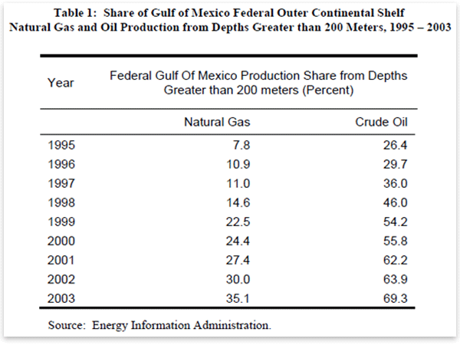
BP Oil Spill
Matthew J. Novak, Mises Daily June 23, 2010: http://mises.org/daily/4488
Notes:
There was something like a five-times increase in the amount of oil they could pump royalty-free in deep water. From 1995 to 2003, there was something like a 250 percent increase in the percentage of oil coming from deep water regions of the Gulf.

Slide 48
Deepwater Horizon Oil Spill
Other factors:
“Tragedy of the commons”
Bureaucratic rights assignment (no market prices)
Federal cap on liability at $75 million
Notes:
William Shughart in Human Events, July 21, 2010 http://www.independent.org/newsroom/article.asp?id=2831
Shughart mentions a tragedy of the commons problem:
…existing regulatory rules that assign “ownership” of crude oil deposits underneath the U.S. outer continental shelf to the federal government.
Rights are auctioned off periodically by the Minerals Management Service.
Since they cannot benefit personally from the decisions they make… the bureaucrats in charge of the auctions have no incentive to consider the values of the alternatives foregone, such as recreational uses, commercial fishing, exploiting other mineral deposits or simply maintaining a pristine ocean environment, when exploration rights are awarded.
…leases are auctioned willy-nilly, frequently ignoring safety concerns in the process in order to maximize governmental revenue rather than to ensure that the natural resources on the outer continental shelf are allocated efficiently.
The federal cap on liability at $75 million also plays a role:
Shughart, in New Republic July 21, 2010 http://www.independent.org/newsroom/article.asp?id=2832
A second contributor to the disaster is the federal law limiting liability for damages caused by offshore oil spills. Although the $75 million limit can be waived in cases of proven gross negligence (and likely will be in this case), BP probably would have been far more cautious from the beginning if it knew that a major blowout could cost the company billions rather than millions. Even in 2009, with energy prices sharply down from the recession, BP reported a $14 billion profit. The slim prospect of a $75 million liability “hit” may not have even raised an eyebrow.

Slide 49
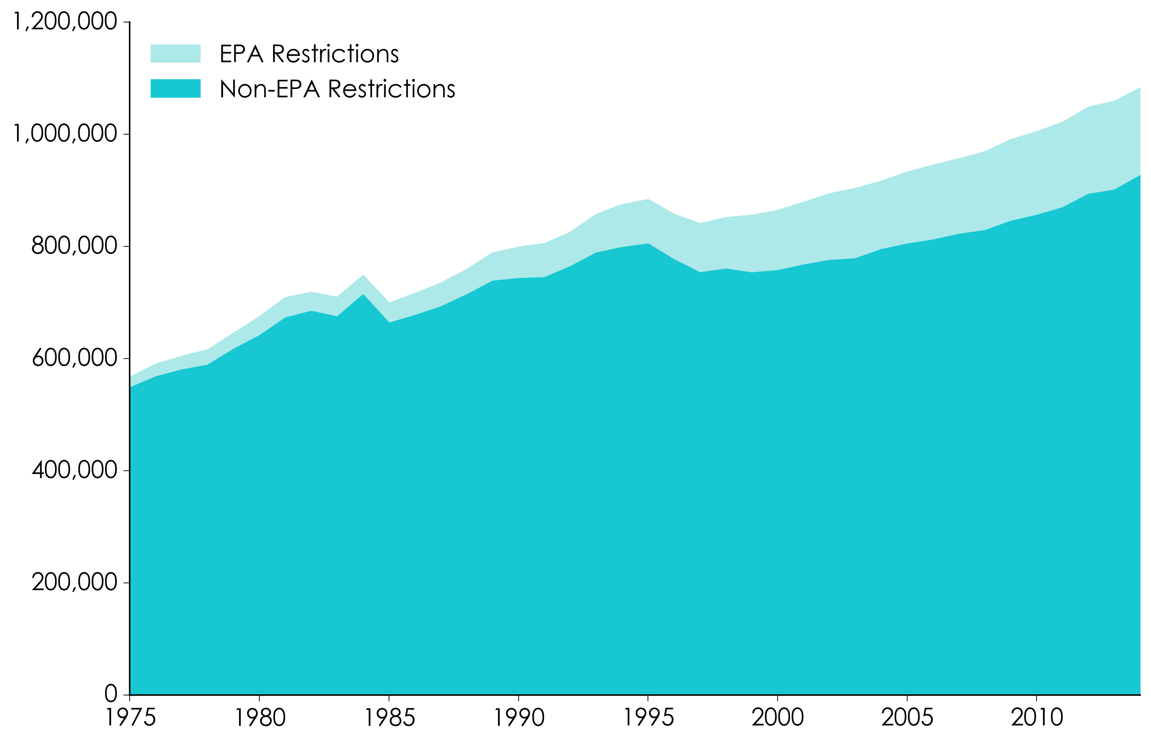
Environmental Regulations
Graphic from Patrick McLaughlin

Slide 50
Risk Trade-Offs
You can’t just do one thing.
Back away from one risk, into another:
Lower income = lost life (Lutter & Morrall: $10-$50 million?)
OSHA regulations: 1.5 lives lost for every life saved
EPA formaldehyde standard: 25:1
MC
Safety
Notes:
To the extent that regulation reduces disposable income, it damages health. Disposable income is used partially to increase personal health and safety. In developing nations, higher incomes may be used to purchase adequate food and clean water, obtain medical care, and perhaps provide for an education that allows the individual to avoid dangerous employment. In industrialized nations, higher incomes mean that people can buy safer cars, choose more healthful foods, move away from crime-ridden neighborhoods, and install smoke detectors in their homes. Taxing $7.6 million away from citizens so an EPA regulation can extend one human life by one year means there is less money available for individuals to take any one of thousands of steps to extend and better their lives.
Testimony I gave to the Energy And Power Subcommittee of the Energy And Commerce Committee, U.S. House Of Representatives in Feb. 2012
“A 2009 EPA-funded study analyzing 40 species of freshwater fish at 137 sites in the western U.S. found that while 56 percent of the fish had quantities of mercury above what has been considered a “safe” threshold, 97.5 percent of the fish had enough selenium to counteract the effects of the mercury. All but one of the fish in the 468-fish sample that had an insufficient ratio of selenium to mercury were pikeminnows (also called squawfish), which are commonly considered a “trash” fish and are not normally consumed as food.
“…erring on the side of caution can be a serious error indeed. Alarmism about mercury in fish could discourage people from consuming this valuable but inexpensive source of protein, which can make up an important part of good maternal nutrition and aid cardiac and brain function in adults. Unwarranted concern about mercury could cause Americans to back into a more threatening problem from the loss of nutrition.”
Spencer A. Peterson, Nicholas V. C. Ralston, David V. Peck, John Van Sickle, J. David Robertson, Vickie L. Spate, and J. Steven Morris, “How Might Selenium Moderate the Toxic Effects of Mercury in Stream Fish of the Western U.S.?” Environmental Science and Technology 43, no. 10 (2009): 3919–3925.
G. Myers, P. Davidson, C. Cox, C. Shamlaye, D. Palumbo, E. Cimichiari, J. Sloane-Reeves, G. Wilding, L. Huang, and T. Clarkson, Statement by the University of Rochester Research Team Studying the Developmental Effects of Methylmercury before the U.S. Senate Committee on the Environment and Public Works, July 29, 2003. Available at http://epw.senate.gov/hearing_statements.cfm?id=212851.
If we look at the cost per premature death averted (from Office of Management and Budget data), we can see the enormous imbalance in costs, under regulation:
Aircraft cabin fire protection $100,000
Auto fuel-system integrity standard $400,000
Trenching and excavating standard $1,500,000
Asbestos ban $110,700,000
Hazardous waste disposal ban $4,190,400,000
Proposed solid waste standards $19,107,000,000
Atrazine drinking water standard $92,069,700,000
(The maximum allowable amount of atrazine in drinking water is 3 parts per billion─equivalent to half an aspirin dissolved in a 16,000 gallon railroad tank car.)
Doctors for Disaster Preparedness Newsletter, vol. 10, no. 1 (Jan. 1993).

Slide 51
Risk Trade-Offs
Regulations on mercury emissions from coal-fired power plants in the US:
Concern is for bioaccumulation of mercury in maternal blood, affecting fetus brain development.
Freshwater, farm-raised fish have low methylmercury levels. The connection from US power plants to fetal health is tenuous.
Perspective: Yellowstone National Park produces more natural mercury emissions than all eight of Wyoming’s coal-fired power plants. Forest fires in the US emit roughly the same amount of mercury as all US power plants.
Excessive concern about mercury in fish could cause people to back into a more serious problem from the loss of nutrition.
Notes:
To the extent that regulation reduces disposable income, it damages health. Disposable income is used partially to increase personal health and safety. In developing nations, higher incomes may be used to purchase adequate food and clean water, obtain medical care, and perhaps provide for an education that allows the individual to avoid dangerous employment. In industrialized nations, higher incomes mean that people can buy safer cars, choose more healthful foods, move away from crime-ridden neighborhoods, and install smoke detectors in their homes. Taxing $7.6 million away from citizens so an EPA regulation can extend one human life by one year means there is less money available for individuals to take any one of thousands of steps to extend and better their lives.
Testimony I gave to the Energy And Power Subcommittee of the Energy And Commerce Committee, U.S. House Of Representatives in Feb. 2012
“A 2009 EPA-funded study analyzing 40 species of freshwater fish at 137 sites in the western U.S. found that while 56 percent of the fish had quantities of mercury above what has been considered a “safe” threshold, 97.5 percent of the fish had enough selenium to counteract the effects of the mercury. All but one of the fish in the 468-fish sample that had an insufficient ratio of selenium to mercury were pikeminnows (also called squawfish), which are commonly considered a “trash” fish and are not normally consumed as food.
“…erring on the side of caution can be a serious error indeed. Alarmism about mercury in fish could discourage people from consuming this valuable but inexpensive source of protein, which can make up an important part of good maternal nutrition and aid cardiac and brain function in adults. Unwarranted concern about mercury could cause Americans to back into a more threatening problem from the loss of nutrition.”
Spencer A. Peterson, Nicholas V. C. Ralston, David V. Peck, John Van Sickle, J. David Robertson, Vickie L. Spate, and J. Steven Morris, “How Might Selenium Moderate the Toxic Effects of Mercury in Stream Fish of the Western U.S.?” Environmental Science and Technology 43, no. 10 (2009): 3919–3925.
G. Myers, P. Davidson, C. Cox, C. Shamlaye, D. Palumbo, E. Cimichiari, J. Sloane-Reeves, G. Wilding, L. Huang, and T. Clarkson, Statement by the University of Rochester Research Team Studying the Developmental Effects of Methylmercury before the U.S. Senate Committee on the Environment and Public Works, July 29, 2003. Available at http://epw.senate.gov/hearing_statements.cfm?id=212851.
If we look at the cost per premature death averted (from Office of Management and Budget data), we can see the enormous imbalance in costs, under regulation:
Aircraft cabin fire protection $100,000
Auto fuel-system integrity standard $400,000
Trenching and excavating standard $1,500,000
Asbestos ban $110,700,000
Hazardous waste disposal ban $4,190,400,000
Proposed solid waste standards $19,107,000,000
Atrazine drinking water standard $92,069,700,000
(The maximum allowable amount of atrazine in drinking water is 3 parts per billion─equivalent to half an aspirin dissolved in a 16,000 gallon railroad tank car.)
Doctors for Disaster Preparedness Newsletter, vol. 10, no. 1 (Jan. 1993).

Slide 52
Regulatory Costs
Is the solution simply a matter of putting political pressure on policymakers?
Remember, costs are subjective, and no amount of political pressure can solve the calculation problem
Policymakers are responding to other incentives

Slide 53
Bootleggers and Baptists
“Both bootleggers and Baptists favor statutes that shut down liquor stores on Sunday. The Baptists because of their religious preferences. The bootleggers because it expands their market.”
-- Bruce Yandle
Support Prohibition

Slide 54
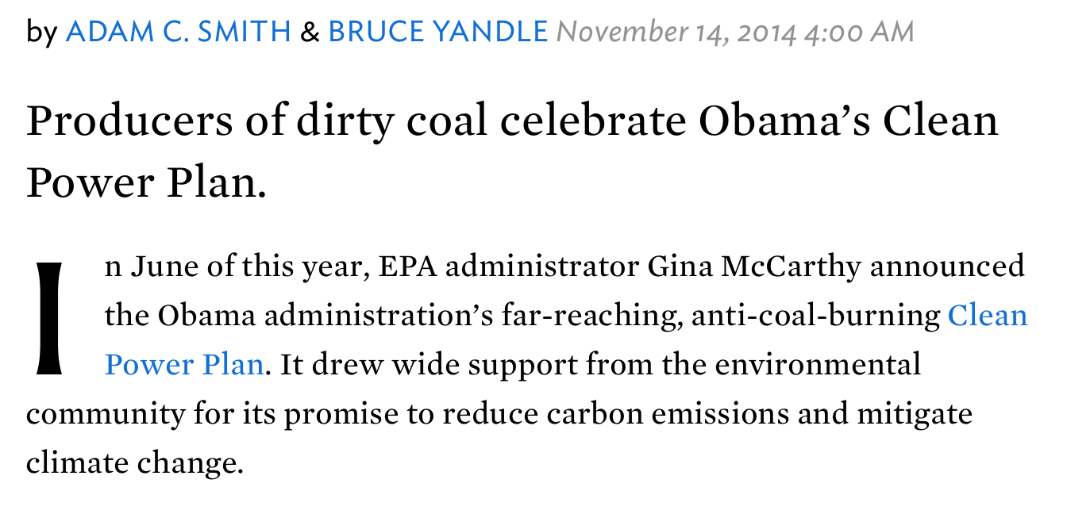

Slide 55
“…dirty-coal producers in Obama’s home state of Illinois are chief among the bootleggers laughing all the way to the bank as they ship trainloads of coal to generators far and wide. The Obama administration’s Clean Power Plan has made lots of people happy — environmentalists, producers of clean-power technologies, and producers of dirty coal.”
http://www.nationalreview.com/article/392613/bootleggers-and-baptists-agree-energy-adam-c-smith-bruce-yandle

Slide 56
Energy, Emissions, and Growth
Does Growth Imply Environmental Degradation?

Slide 57
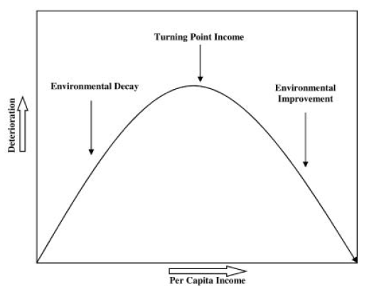
Environmental Quality and Income
Economist Simon Kuznets argued that economic inequality first increases, then decreases, as economic growth occurs
Environmental quality, as measured by the concentrations of various pollutants, initially increases with GDP, but then falls.
Some EKCs are “N-shaped,” with the decline followed by a second increase in the pollutant.
Image: Yandle, Bhattarai, Vijayaraghavan (2004)

Slide 58
Environmental Quality and Income
Indur Goklany:
“The level of affluence at which a pollutant level peaks (or environmental transition occurs) varies. A World Bank analysis concluded that urban [particulate matter] and [sulfur dioxide] concentrations peaked at per capita incomes of $3,280 and $3,670, respectively. Fecal coliform in river water increased with affluence until income reached $1,375 per capita [and then declined].
Image: Yandle, Bhattarai, Vijayaraghavan (2004)

Slide 59
Global SO₂ Emission Projections
Stern et al. (1996)

Slide 60
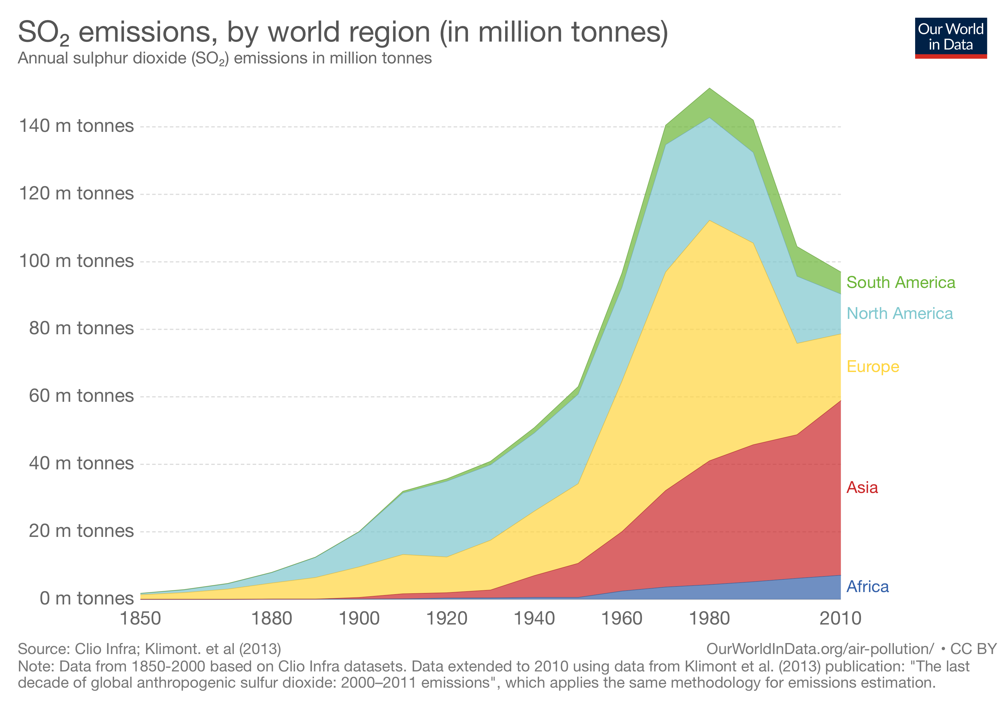

Slide 61
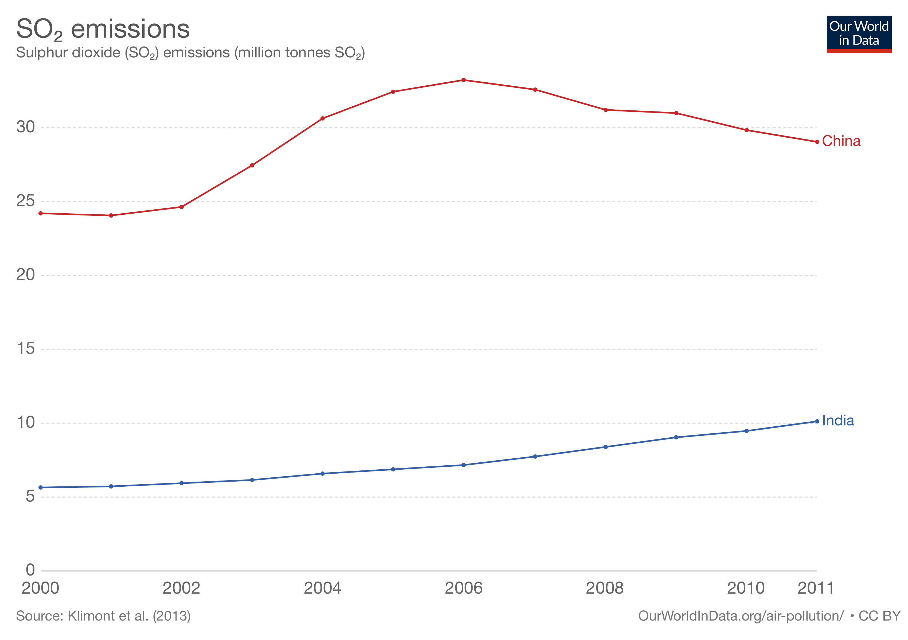

Slide 63
What Really Matters?
No measure of pollution that uses pollution concentrations will account for varying subjective valuations of individuals. This undermines target pollution concentrations as a policy goal.
Using pollution concentrations to measure environmental quality is also problematic if we do not take into account human adaptability to the environment. For example, people will trade off air quality against other goods.
For example, humans may be better off with higher PM_{2.5} and higher income than with lower PM_{2.5} and lower income, not just generally, but even with regard to the specific hazards from PM_{2.5}.
One way to measure the real impact of environmental quality is to look at deaths from environmental hazards.

Slide 64
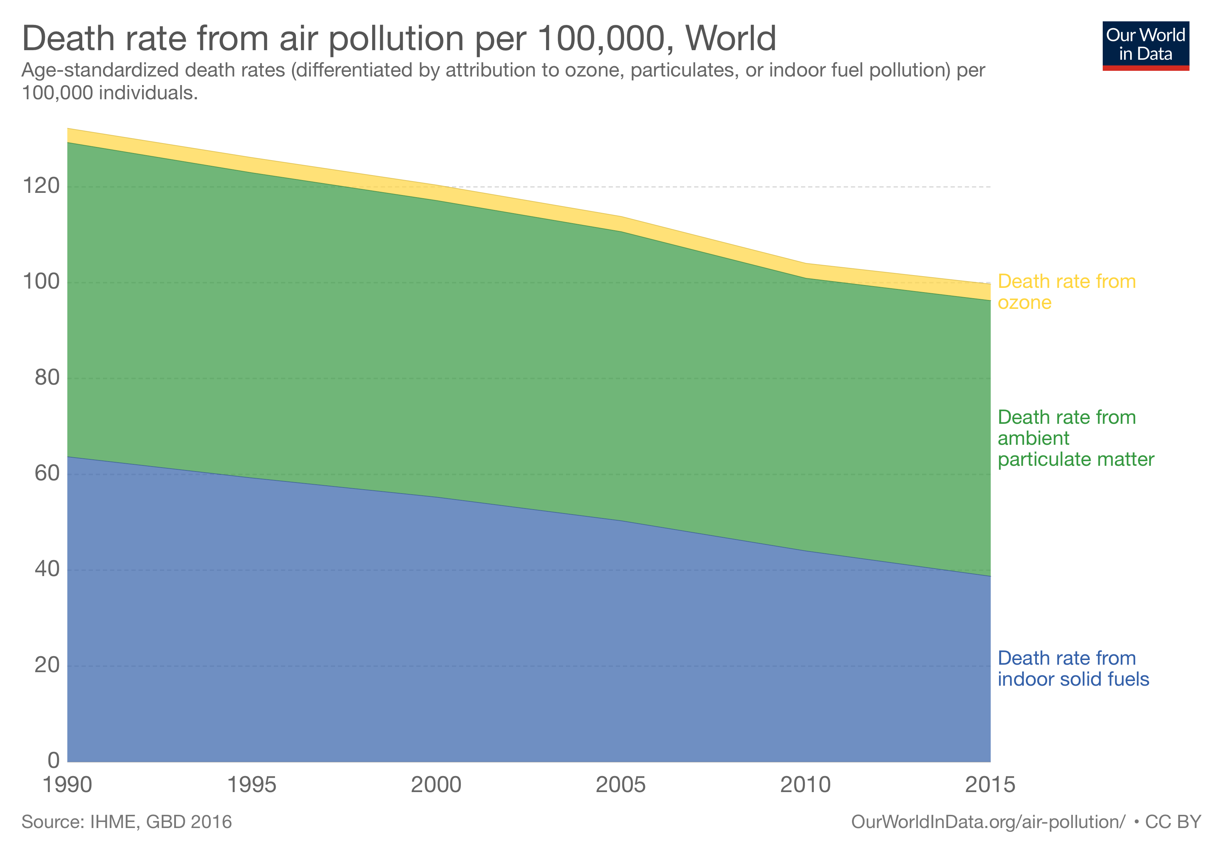

Slide 65
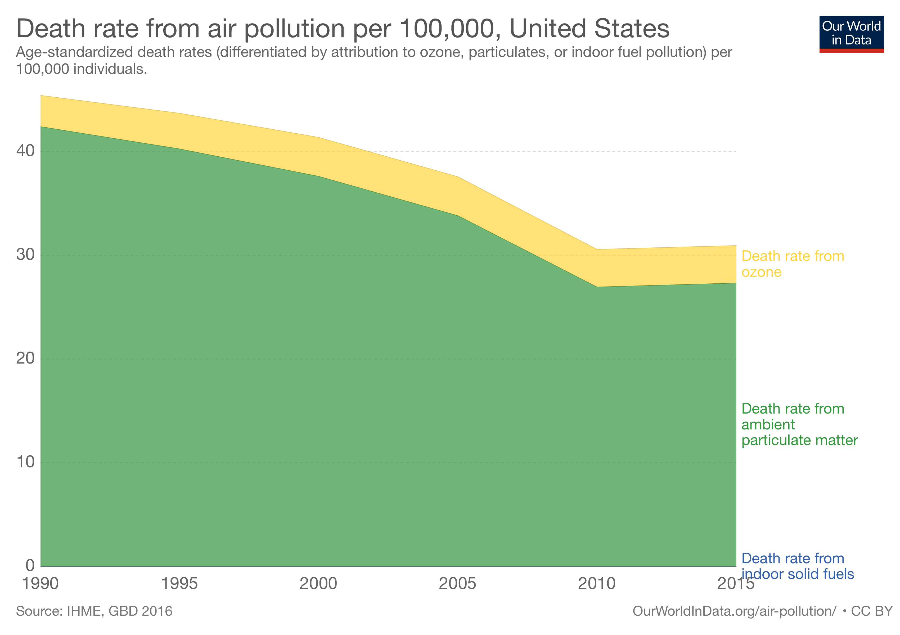

Slide 66
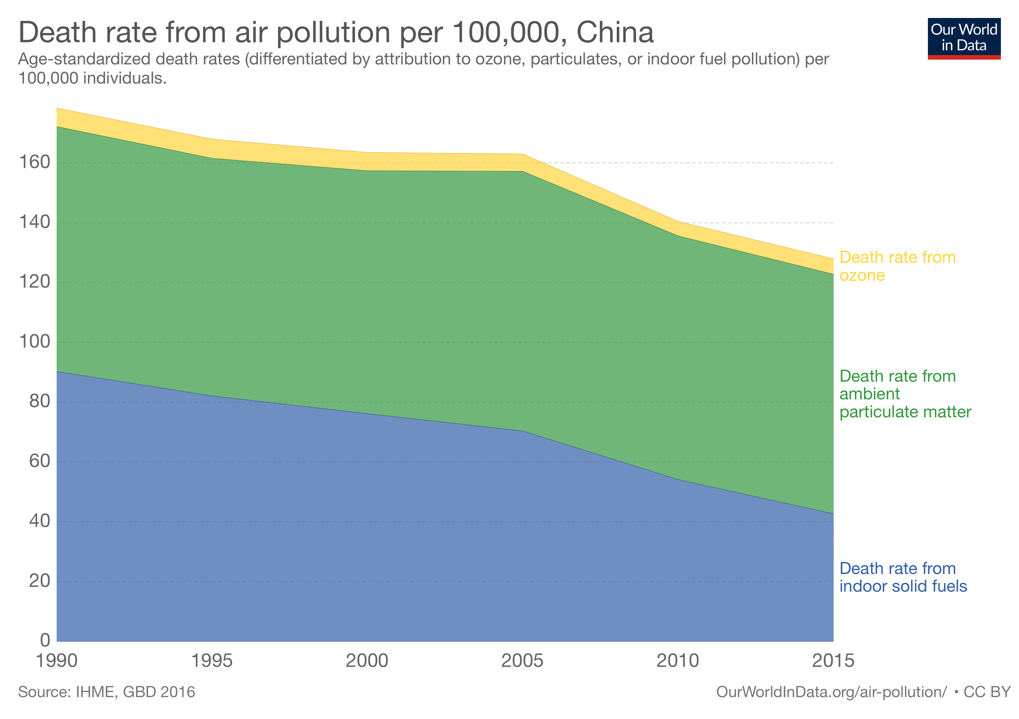

Slide 67
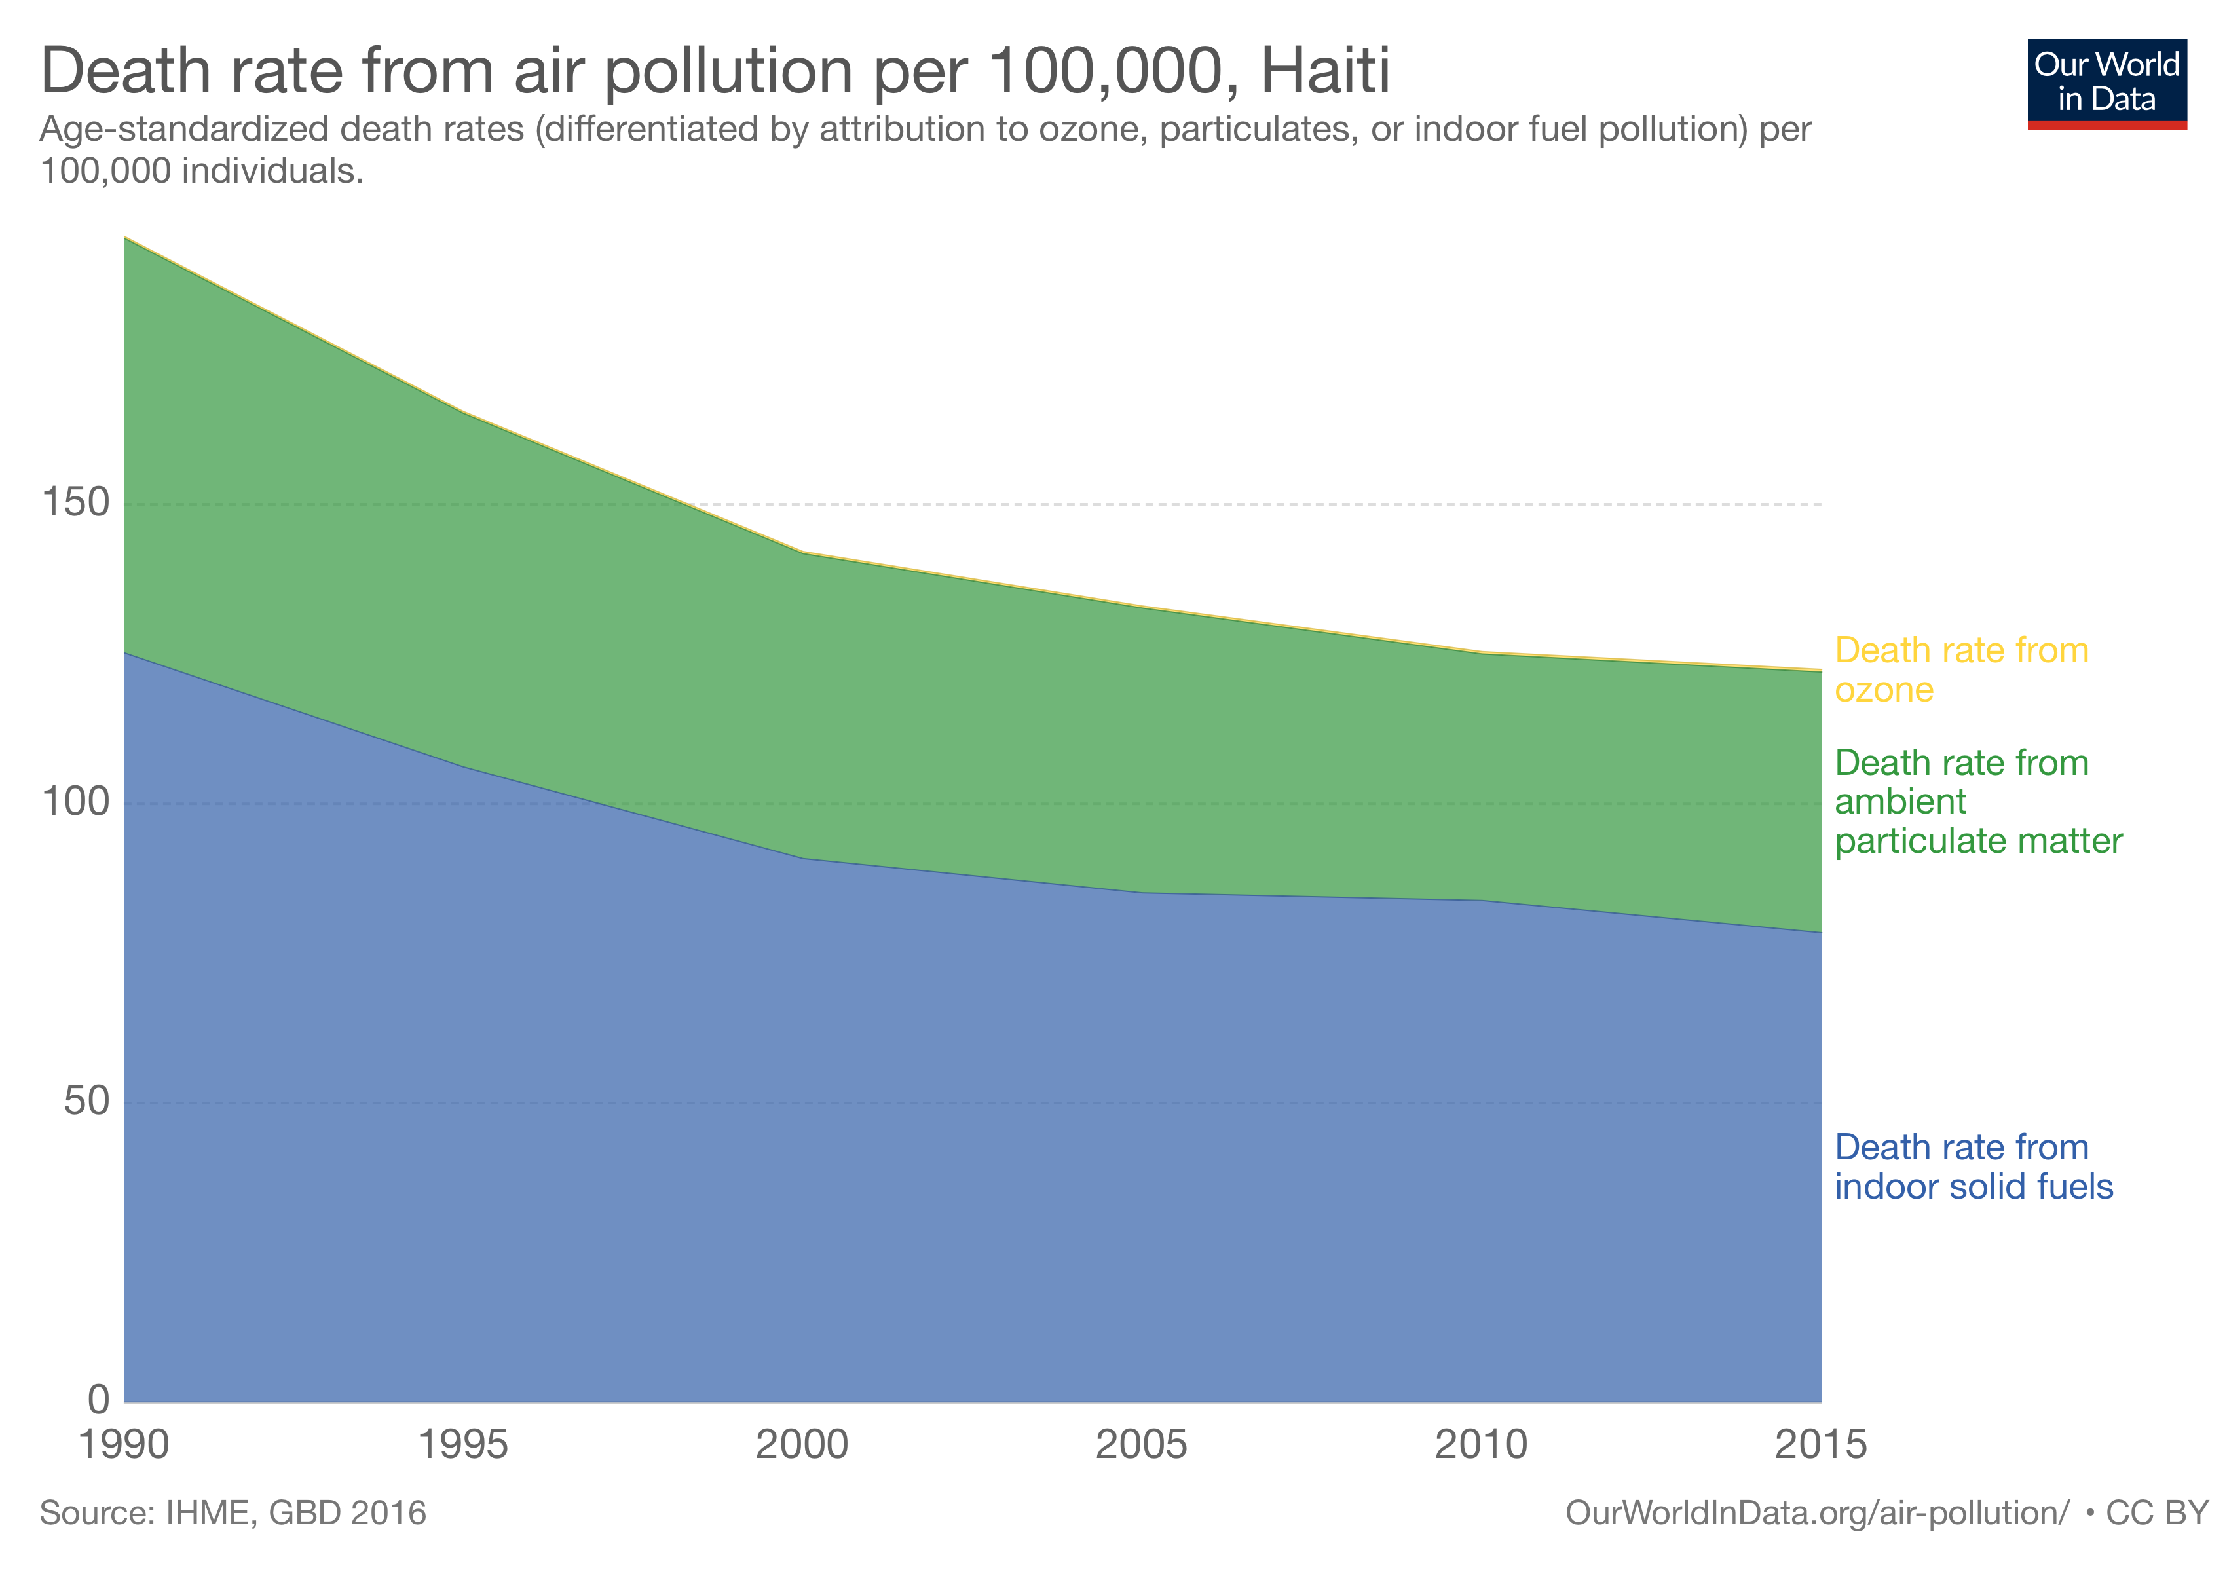

Slide 68
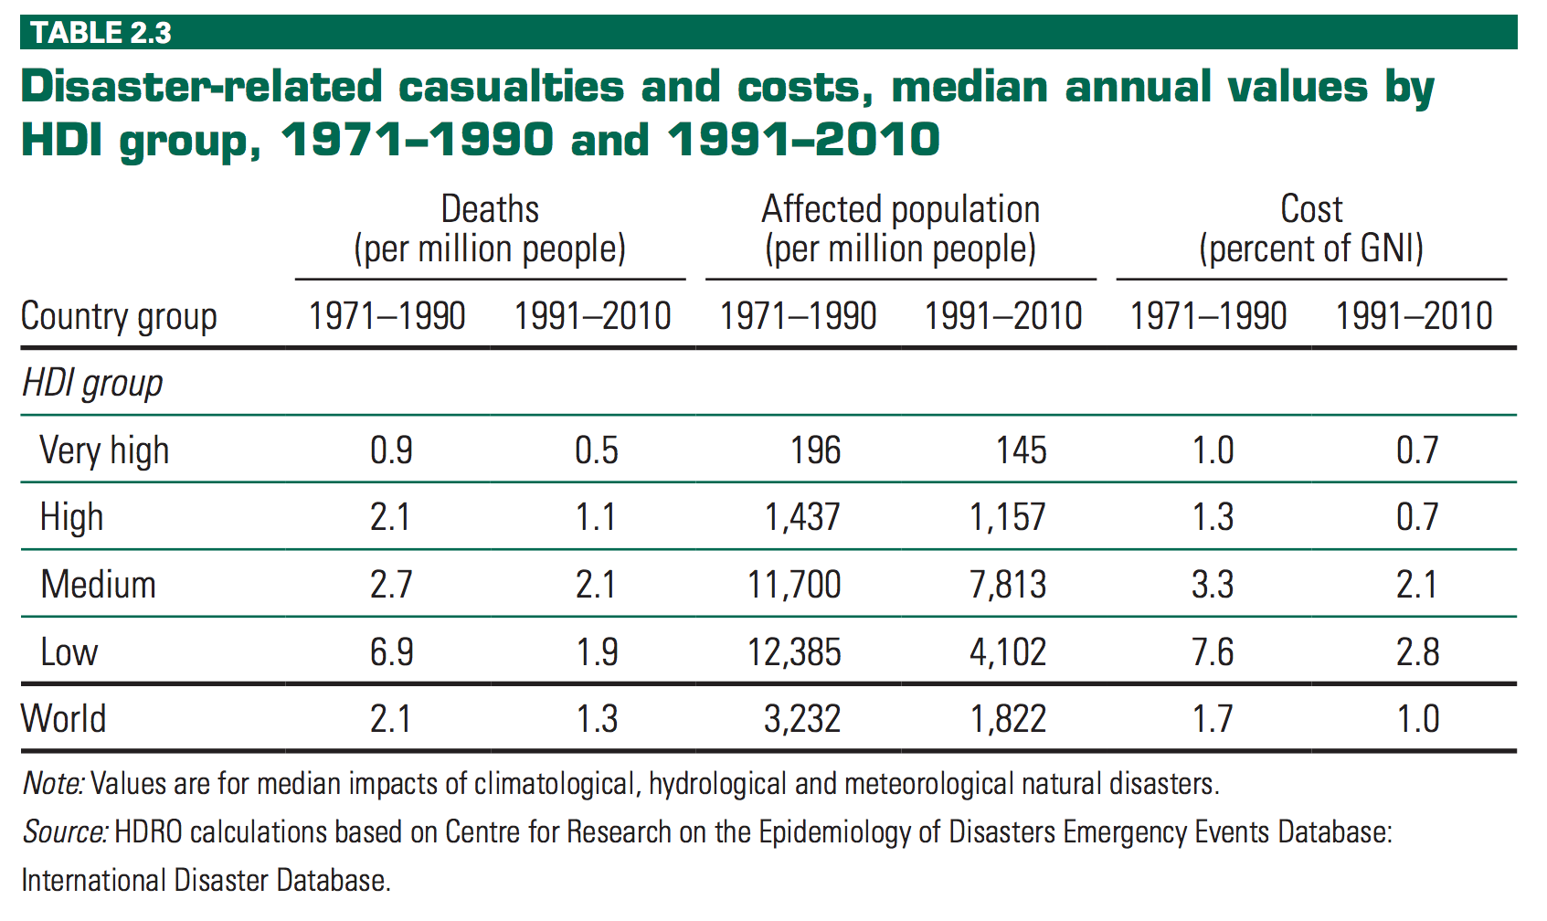
https://ourworldindata.org/natural-disasters

Slide 69
Correlation between multidimensional poverty (MPI) and deaths due to environmental causes (per million people) – Human Development Report 2011
Source: https://ourworldindata.org/natural-catastrophes/
Notes:
“The clear link between poverty and a higher death rate due to environmental causes is also shown in the following scatterplot. The definition of environmental causes however is very wide in this case and includes deaths caused by indoor air pollution, sunburn, pollution, and other “environmental causes”.”

Slide 70
Energy and Growth
Inexpensive energy is a critical tool for economic growth
Energy-fueled growth is the single best pathway out of poverty
Subsidizing particular energy sources, and other consequences of rent-seeking, can mean slowing economic growth by misallocating resources

Slide 72
Energy and Growth
“Around three billion people cook and heat their homes using open fires and simple stoves burning biomass (wood, animal dung and crop waste) and coal.”
“over 4 million people die prematurely from illness attributable to the household air pollution from cooking with solid fuels.” This is c. 45x the number dying from natural catastrophes.
”the lack of access to electricity for at least 1.2 billion people (many of whom then use kerosene lamps for lighting) creates other health risks, e.g., burns, injuries and poisonings from fuel ingestion, as well as constraining other opportunities for health and development, e.g. studying or engaging in small crafts and trades, which require adequate lighting.” Most of the victims are women and young children.
Source: http://www.who.int/mediacentre/factsheets/fs292/en/

Slide 73
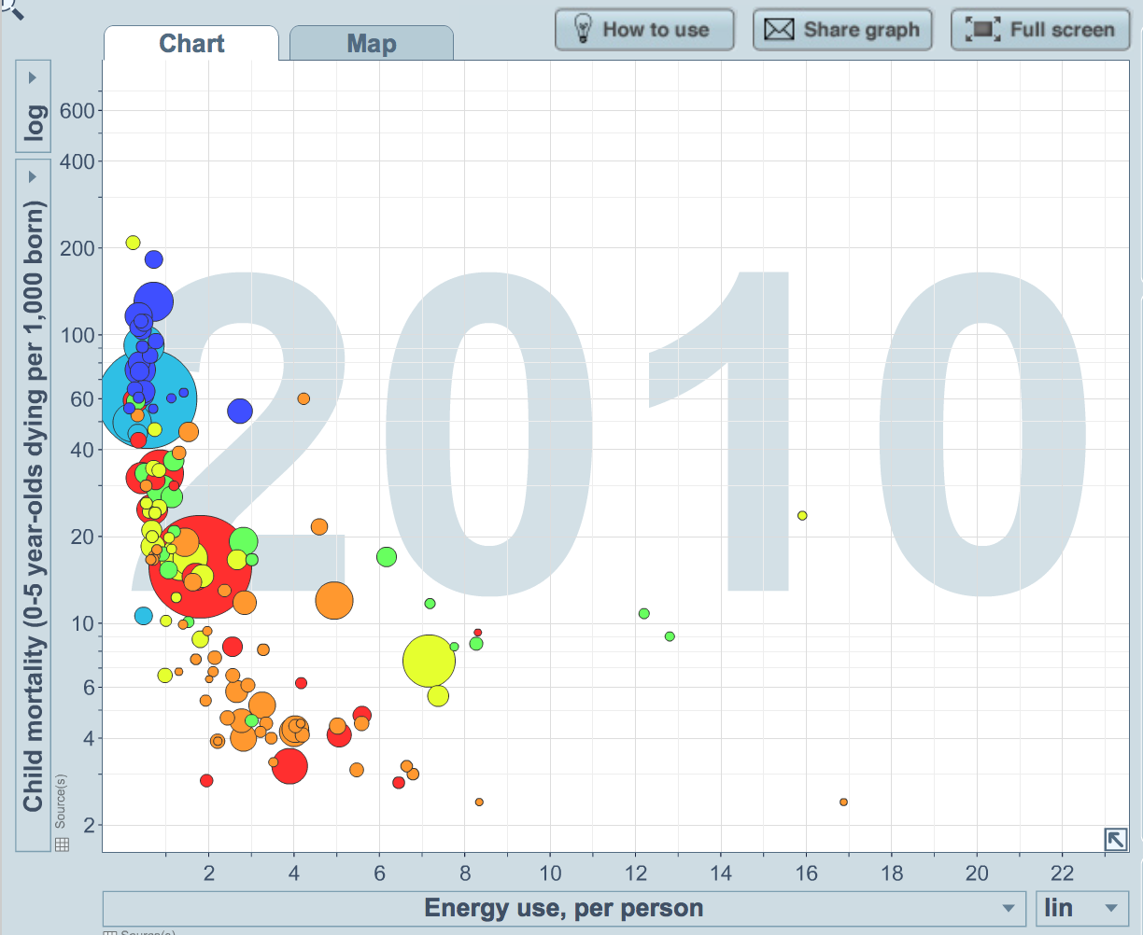
Source: gapminder.org

Slide 74
Indoor air pollution indicator from Environmental Performance Index, 2006 – SEDAC (NASA)
Source: https://ourworldindata.org/indoor-air-pollution/

Slide 75
Share of population without access to modern fuels (i.e., electricity, liquid fuels, and gaseous fuels such as LPG, natural gas, and kerosene) in developing countries, 2007
– UNDP & WHO (2009)
Source: https://ourworldindata.org/indoor-air-pollution/

Slide 76
Renewables
Is there wisdom in using a renewable energy source, or for that matter a renewable raw material of any kind?
Should we use wind, solar, geothermal, hydroelectric, biomass, or another renewable source of energy, no matter what the cost?
Image: https://www.forbes.com/sites/michaelshellenberger/2019/05/06/the-reason-renewables-cant-power-modern-civilization-is-because-they-were-never-meant-to/#da5f6e8ea2b9
Notes:
Suppose there are two energy sources, A and B. A is a fixed stock and once used, will never ”grow back.” B

Slide 77
Renewables
Keep in mind that harnessing some renewables requires the expenditure of scarce resources which have alternative uses. Solar power, for instance, requires the use of land for the solar arrays, and for the power transmission lines. It requires human labor to manufacture these arrays. And while the sun may shine indefinitely, the capital used to harness the sun will wear out.
To produce the same amount of energy, solar farms take 450 times as much land as nuclear plants; wind farms take 700 times as much land as natural gas power plants.
Notes:
Suppose there are two energy sources, A and B. A has an up-front cost and then dips into a fixed stock which, once used, will never ”grow back.” The fixed stock has no value other than to be used as an energy source. B has an up-front cost that must be paid every 20 years, but no marginal costs in the intervening period (like wind, solar, or hydroelectric). Under certain circumstances, A will make economic sense, and under other circumstances, B will make economic sense. What happens if A is foregone because of the renewability of B? The savings A could have generated would be foregone, and the savings could have been used to fund other projects that would have enhanced human life.

Slide 78
Renewables
“A new wind farm in Kenya… is located on a major flight path of migratory birds. Scientists say it will kill hundreds of endangered eagles. ‘It’s one of the three worst sites for a wind farm that I’ve seen in Africa in terms of its potential to kill threatened birds,’ a biologist explained.” (Michael Shellenberger, “The Reason Renewables Can’t Power Modern Civilization Is Because They Were Never Meant To,” Forbes, May 6, 2019)
Increasingly scarce resources will result in higher prices, creating stronger and stronger incentives to search for alternatives.
Notes:
Suppose there are two energy sources, A and B. A has an up-front cost and then dips into a fixed stock which, once used, will never ”grow back.” The fixed stock has no value other than to be used as an energy source. B has an up-front cost that must be paid every 20 years, but no marginal costs in the intervening period (like wind, solar, or hydroelectric). Under certain circumstances, A will make economic sense, and under other circumstances, B will make economic sense. What happens if A is foregone because of the renewability of B? The savings A could have generated would be foregone, and the savings could have been used to fund other projects that would have enhanced human life.

Slide 79
Renewables
A ”non-renewable” fuel helped save the whales.
In the mid-1800s, whaling fleets were having to go farther and farther to find whales, which were harvested for the clean-burning lamp oil that could be extracted from their carcasses.
Whale oil prices rose from 23 cents per gallon in 1820 to $1.42 per gallon in 1850, because of higher demand and more difficulty finding whales.
Petroleum provided a solution, with kerosene as a cheap alternative to whale oil for lighting.

Slide 80
“Green Jobs”
“… the green-economy predictions rest on extremely optimistic estimates of the impact of spending on new technologies. Almost no advocates of these policies deduct the jobs lost from replacing existing technologies with the new, green ones. Refinery workers, coal miners, fossil-fuel power plant workers, and many others will all lose their jobs if the proposed shift to nonfossil fuels takes place.
-- Andrew Morriss, “The Green-Economy Mirage,” The Freeman (2010).
Notes:
Continuing, Morriss says, “Some of those workers may find jobs insulating public buildings or bolting together windmills, but many will not. Because all that public spending to produce these new technologies comes from taxes (whether today or in the future), it reduces private spending and so eliminates the jobs that would have been created by the higher private spending displaced by the taxes.”

Slide 81
Final Comments
Environmental problems are real, but the common view that capitalism destroys the environment while government saves it is problematic.
Bad incentives
Socialist calculation problem
”Poster child” environmental crises are often linked to government intervention
Economic growth can lead to environmental improvement.
Property rights are key.

Slide 82
Further Reading
“Law, Property Rights, and Air Pollution” by Murray Rothbard
Free Market Environmentalism by Walter Block
“Toward an Austrian Theory of Environmental Economics,” by Roy Cordato (QJAE vol. 7, no. 1, 2004)
“Five Erroneous Ways to Argue about Resource Economics,” by Matthew McCaffrey (QJAE vol. 15, no. 1, 2012)
“Economic Calculation in the Environmentalist Commonwealth,” by Art Carden (QJAE vol. 16, no. 1, 2013)
“The Austrian Paradigm in Environmental Economics,” by Ed Dolan (QJAE vol. 17, no. 2, 2014)
“What Should Austrian Economists Do? On Dolan on the Austrian Paradigm in Environmental Economics,” by Art Carden (QJAE vol. 17, no. 2, 2014)
“Comment on Dolan on Austrian Economics and Environmentalism,” by Walter Block (QJAE vol. 17, no. 2, 2014)
“Austrian Environmental Economics Redux,” by Edwin Dolan (QJAE vol. 18, no. 1, 2015)

