Slide 1
Austrian Economics VS Keynesian Macroeconomics and Modern Monetary Theory
Mises University
Auburn, Alabama

Slide 2
Macroeconomics
First Use of Term:
Jacob Marschak, “A Cross Section of Business Cycle Discussion” The American Economic Review, Vol. 35, No. 3 (Jun., 1945), pp. 368-381
“Across the distinction between statics and dynamics cuts another one: that between aggregative or "macro"-economics, and the "micro"- economics of a single firm or household.”

Slide 3
Macroeconomics
Key topics:
Purchasing power of money
Recession
Economic Expansion and Development
Must grasp how each individual market is integrated into the broad social economy

Slide 4
Macroeconomics
Modern Macroeconomics Is Dominated by Modeling
Model-Building: Abstract construction of only a few of the many relationships in economy or society.
What are some common characteristics?

Slide 5
Austrian Economics
Proceeds from human action to derive principles that allow us to ultimately analyze topics relevant for entire economic order.
Sound Macroeconomics must incorporate what incorporates entire social economy.
Economic progress is result of increases in voluntary saving.

Slide 6
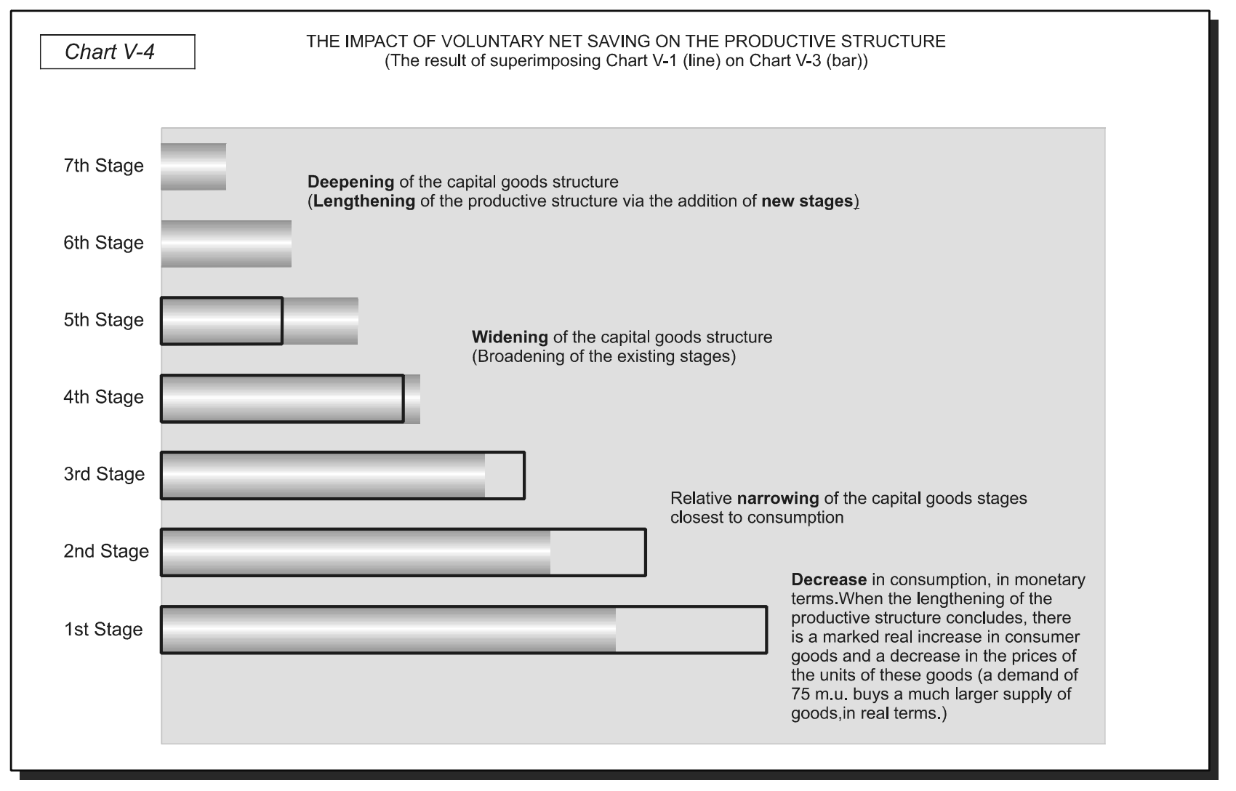
Austrian Economics

Slide 7
Keynesian Macro
Represents National Income (Y) as sum of spending in various sectors of the economy.
Y = C + I + G
Believe that economy is inherently unstable and easily tends to recession.
Due to volatile business investment (I)
Resulting from collapse of Marginal Efficiency of Capital (MEC) driven by changes in “animal spirits.”

Slide 8
Keynesian Macro
Important issue is the relative levels of MEC and the interest rate.
Interest rate: “Obviously measures…the premium which has to be offered to induce people to hold their wealth in some form other than hoarded money.”
Determined by S of and D for money: Liquidity Preference Theory of Money.
Rate of payed and received in loanable funds market.

Slide 9
Keynesian Macro
If MEC < r,
Investment (I) in production decreases
Decreased Investment causes decreased aggregate demand
↓ I → ↓ AD = C + I + G
Results in decreased output and decreased demand for labor.
Wages and prices are “sticky” downward: results is a general glut of goods and unemployment.

Slide 10
Keynesian Macro
Two solutions:
State managed interest rates to continually insure “appropriate volume of investment.”
Limitations on Monetary Policy Effectiveness.
Socialize investment.
Fiscal Keynesians (Samuelson): Make-up gap left by ↓ I with ↑ G

Slide 11
Modern Monetary Theory
Key premises:
Money is creation of state
Government cannot become insolvent; can always print money to pay its debts and finance new spending.
Unemployment is due to insufficient government spending.

Slide 12
Modern Monetary Theory
Arrives at conclusions by manipulating Keynesian income equation:
Y = C + I + G
Y = C + S + T
In equilibrium: C + S + T = Y = C + I + G.
S + T = I + G.
G – T = S – I
Government Budget Deficit = Net Private Saving.

Slide 13
Modern Monetary Theory
Policy Conclusions:
Government can and should monetize government deficit spending.
If monetary inflation results in high price inflation, government can fix problem by increasing taxes.

Slide 14
Modern Monetary Theory
Not Exactly New
Not Exactly Monetary
Not Exactly a Theory

Slide 15
Consequences
Massive inflation
Capital consumption
What if Treasury issues new bonds, which are resold to Fed in bond market?
What if newly created money will go directly into the Treasury?

