Slide 1
Entrepreneurship
Peter G. Klein
Mises University
2020
@petergklein
#MisesU

Slide 2
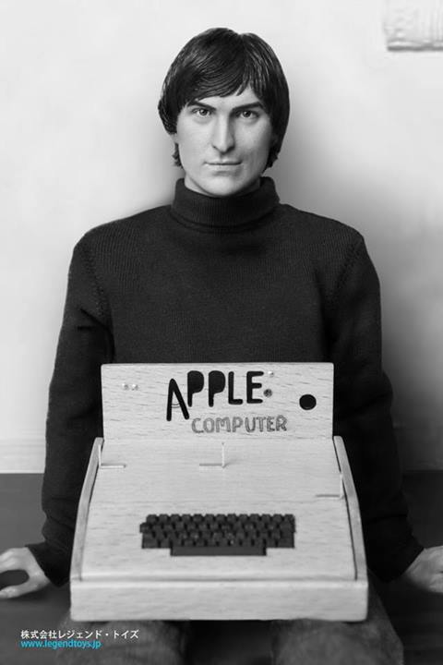
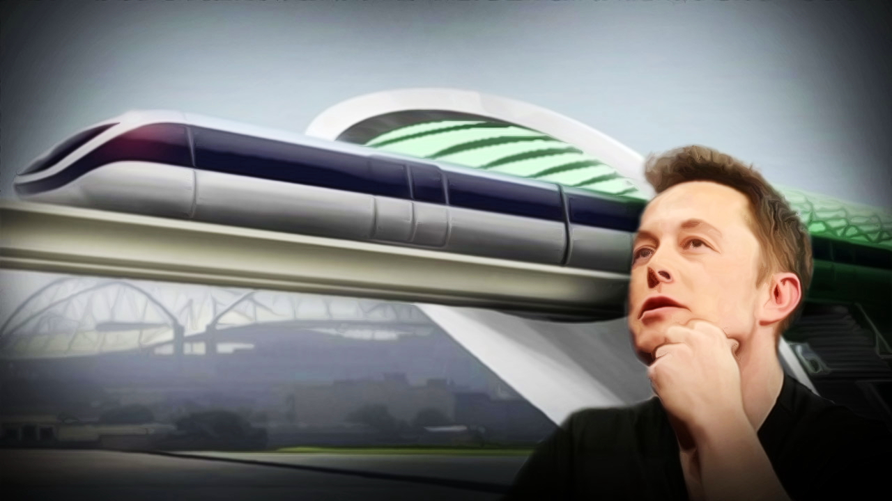

Slide 3
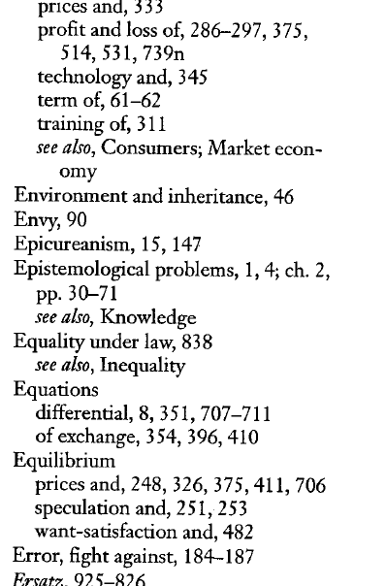
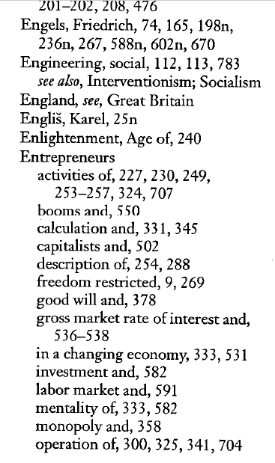
Notes:
527 occurrences of the word “entrepreneur” or its cognates. Usually absent from the index of mainstream economics texts

Slide 4
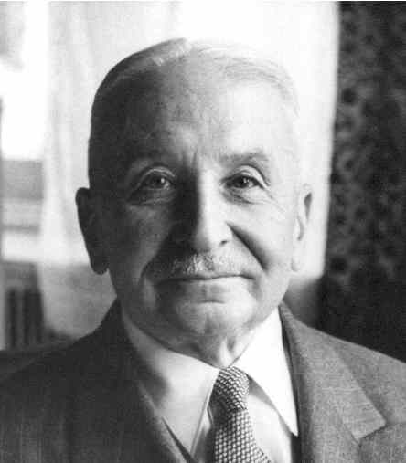
[I]t is impossible to eliminate the entrepreneur
from the picture of a market economy. The
various complementary factors of production
cannot come together spontaneously. They
need to be combined by the purposive efforts
of men aiming at certain ends and motivated
by the urge to improve their state of satisfaction. In eliminating the entrepreneur one eliminates the driving force of the whole market system. — Human Action, p. 248.
Entrepreneurship as a general feature of the market economy
Not just self-employment, startups, tech firms

Slide 5
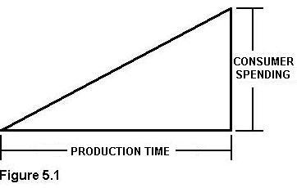
Austrian production theory
Inputs and outputs (means and ends)
Original factors, intermediate goods, and final goods
Typically, many possible factor combinations!
Austrian capital theory (Menger, Böhm-
Bawerk, Mises, Rothbard, Garrison)
Time
Imputation
Marginal product
Marginal revenue product
Uncertainty

Slide 6
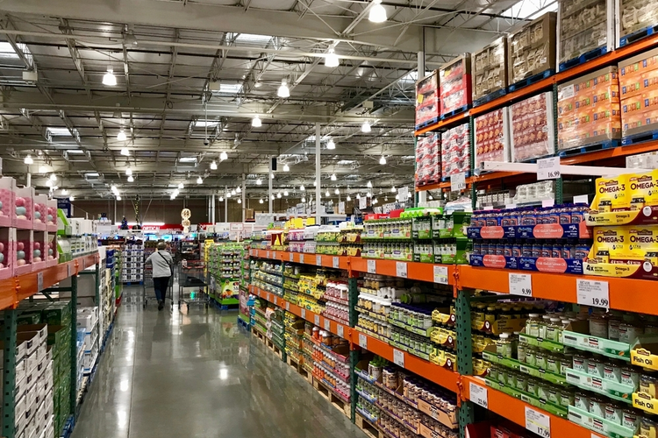
More details on imputation
Discounted marginal revenue product: money revenue attributed (“imputed”) to one service unit of a factor, discounted by social rate of time preference (i.e., pure rate of interest)
Establishes entrepreneur’s maximum willingness to pay for one service unit of a factor.
Given competitive bidding by entrepreneurs, and absent uncertainty about future market conditions, the price of a factor will tend to equal its DMRP.
Certain exceptions
Notes:
Isolable – value of the factor’s service can be appraised separately from those of the other factors
Specific factors – can only be used in one production process [largely ignored by mainstream production theory, which treats factor categories as schmoo]
Note that DMRP gives the maximum willingness to pay on the part of factor users; the actual price will depend on supply conditions as well [bargaining]

Slide 7
Entrepreneurial profit and loss
In equilibrium (Mises’s and Rothbard’s evenly rotating economy)
Each factor earns its DMRP.
Owner-managers of firms earn implicit wages.
Capitalists earn interest.
Outside the evenly rotating economy?
Entrepreneurs compete for factors, based on their knowledge and beliefs about
The present: technology, productive capabilities, resource availability
The future: consumer demand, institutional conditions, competitor actions
Results: profit or loss!

Slide 8
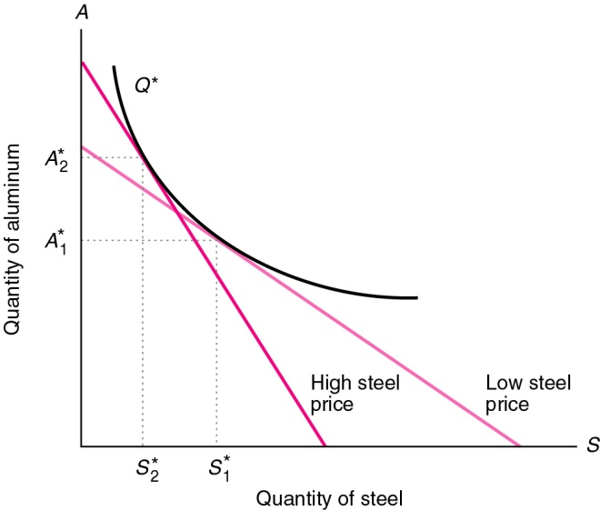
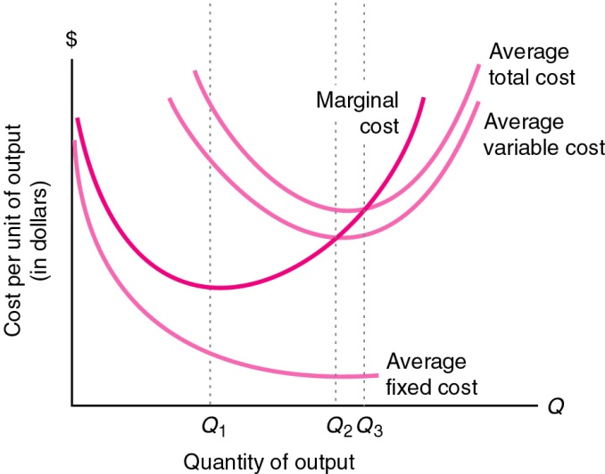
Contrast with neoclassical production theory
Take factor and output prices as given, solve for profit-maximizing level of output.
Extensions: downward-sloping demand curves, price discrimination, multiple products, strategic interaction
Problems: no time or uncertainty; no causal explanation for factor prices; emphasis on the wrong problems
Notes:
Problems
No time or uncertainty (production takes time and receipts are uncertain)
No causal explanation for factor prices:
Assumes factor prices are given, then uses changes in factor prices to determine changes in factor usage (isoquant/isocost analysis), uses this to make factor demand curves, then uses these to explain factor prices! Not a causal explanation
(Rothbard: error stems from looking at the economy from the individual entrepreneur's point of view [Marshall’s “representative firm”])
Emphasis on the wrong problems: manager’s point of view, technical aspects of production, vast and misleading oversimplification of the entrepreneur’s decision problem

Slide 9
Conceptualizing entrepreneurship
Entrepreneurship in the broad sense: bearing uncertainty
“The term entrepreneur as used by [economic] theory means: acting man exclusively seen from the aspect of the uncertainty inherent in every action” (Mises, 1949).
Uncertainty (case probability) versus risk (class probability)
Entrepreneurship in the narrow (commercial) sense: combining and recombining productive factors in pursuit of money profit
“We are living in a world of unexpected change; hence capital combinations . . . will be ever changing, will be dissolved and reformed. In this activity, we find the real function of the entrepreneur” (Lachmann, 1956).
Need for economic calculation (Salerno, tomorrow)

Slide 10
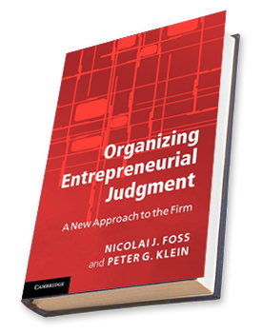
Entrepreneurship, judgment, and ownership
Judgment: decision-making under uncertainty without a formal model or decision rule (intuition, gut feeling, Verstehen)
“[T]he real entrepreneur is a speculator, a man eager to utilize his opinion about the future structure of the market for business operations promising profits. This specific anticipative understanding of the conditions of the uncertain future defies any rules and systematization. It can be neither taught nor
learned. . . . [The entrepreneur] sees the past
and the present as other people do; but he
judges the future in a different way” (Mises,
1949, p. 585).
Judgment is manifest in ownership (Mises’s
capitalist-entrepreneur”).

Slide 11
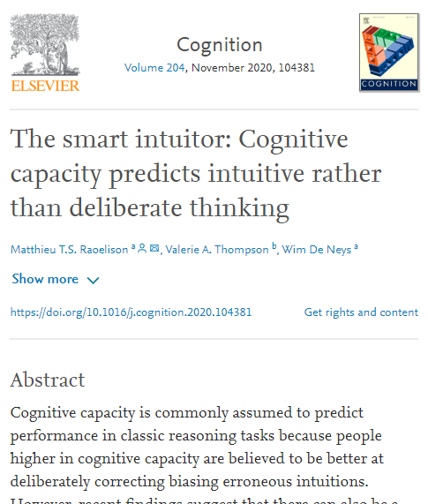
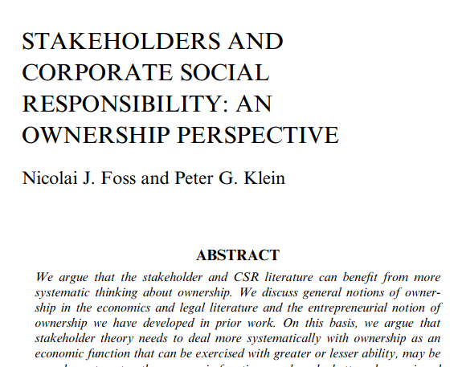
Ownership competence
Owners vary in their ability to exercise judgment under uncertainty (Foss, Klein, Lien, Zellweger, and Zenger, 2020)
Matching competence: what to own
Governance competence: how to own
Timing competence: when to own
This ability may be correlated with cognitive capability.
Ownership can be exercised in groups, but
homogenous groups are usually higher in
ownership competence (Hansmann, 1996).
Implications for
stakeholder theories
of the firm

Slide 12
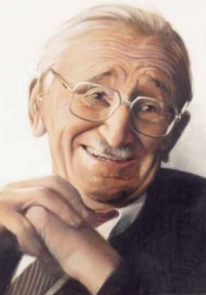
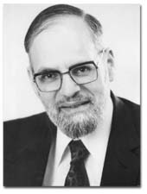
Entrepreneurship as discovery?
Hayek (1968): competition “is important primarily as a discovery procedure whereby entrepreneurs constantly search for unexploited opportunities that can also be taken advantage of by others.”
Kirzner (1973): entrepreneurship is alertness to “changing buying and selling possibilities,” “relevant new information,” and “potentially worthwhile goals hitherto unnoticed, as well as toward unnoticed potentially valuable, available resources.” The entrepreneur “notices [a] price discrepancy before others do.”
Problems
Entrepreneurs don’t discover, they create. Entrepreneurship looks to the future!
“Opportunity” is a metaphor.
If profit comes from successful discovery, whither loss?
Under uncertainty, entrepreneurs must own capital.

Slide 13
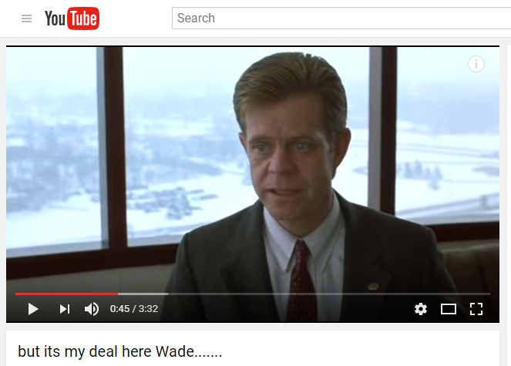
Note on the “pure entrepreneur”
“Let us try to think the imaginary construction of a pure entrepreneur to its ultimate logical consequences. This entrepreneur does not own any capital. The capital required for his entrepreneurial activities is lent to him by the capitalists in the form of money loans. . . . If he succeeds, the net profit is his. If he fails, the loss must fall upon the capitalists who haw lent him the funds” (Mises, 1949, p. 254). [Kirzner’s pure entrepreneur]
“Such an entrepreneur would, in fact,
be an employee of the capitalists who
speculates on their account and takes
a 100 per cent share in the net profits
without being concerned about the
losses. . . . A capitalist is always also
virtually an entrepreneur and
speculator” (same page).

Slide 14
Austrian economics and mainstream entrepreneurship theory
Huge growth in entrepreneurship research and education.
Mainstream entrepreneurship research is very Austrian friendly.
Outstanding issues
Conceptualizing entrepreneurship (self-employment, firm growth, innovation)
Entrepreneurship and firm performance
Entrepreneurship and economic growth
Public policy toward entrepreneurship

