Slide 1
Growth Theory: Two Views
Mises University
Auburn, Alabama

Slide 2
Recommended Literature
Foundational: Menger, Bohm-Bawerk, Mises, and Rothbard
Espinosa, Victor I. (2020) ‘Epistemological Problems of Development Economics’, Procesos de Mercado: Revista Europea de Econnomía Política, XVII (1), 55–93.
Holcombe, Randall. (2007) Entrepreneurship and Economic Progress
Huerta de Soto, Jesus. (2006) Money, Bank Credit, and Economic Cycles, Chapter 5
_______. (2009) The Theory of Dynamic Efficiency.
Shenoy, Sudha. (2007) ‘Investment Chains through History or an Historian's Outline of Development, Using Goods of Ever Higher Orders’, Indian Journal of Economics and Business, Special Issue, 185-215.
_______. (2010) Towards a Theoretical Framework for British and International Economic History: Early Modern England. A Case Study.

Slide 3
General Theory of Economic Progress
Product of Analysis and Synthesis
Engines of Prosperity
Market division of labor
Capital accumulation
Technology
Entrepreneurship
Economic progress is the happy consequence of a highly developed division of labor, taking advantage of an increasing capital stock embodying better technology, wisely invested by entrepreneurs.

Slide 4
Implications for Institutions
Private Property
Necessary for voluntary exchange
Encourages capital investment
Enables seeking of entrepreneurial profit
Meaningful prices for economic calculation
Sound Money

Slide 5
Modern Development Economics
Culmination of historical process incorporating many factors:
The “Golden Age of Keynesianism” (1948–73).
The Marshall Plan
National income statistics documenting economic inequalities
Creation of international aid agengies (UN, IMF, and WB)
Development of “gap theory” of the “poverty trap”

Slide 6
Modern Macro Growth Models and the Poverty Trap
Harrod–Domar Model
Simple Keynesian Cross framework: Y = C + I
Growth rate = savings rate/capital-to-output ratio – depreciation
Key Conclusion: positive relationship between rate of savings and investment and the rate of growth

Slide 7
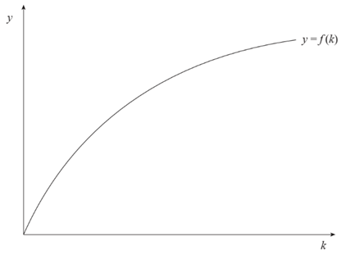
Modern Macro Growth Models and the Poverty Trap
Neoclassical Growth Model:
Production constraint: Y_{t} = A_{t}F(K_{t})
Y = Output
K = Capital
A = Productivity shift factor: Often assumed to represent technology.

Slide 8
Modern Macro Growth Models and the Poverty Trap
Diminishing Returns to Capital:
Increased capital investment eventually will yield maximum output.
Solow predicted there would be convergence between MDCs and LDCs.

Slide 9
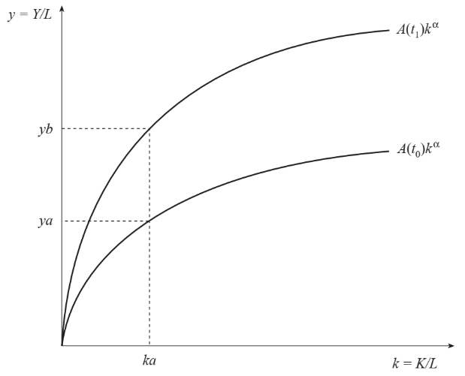
Modern Macro Growth Models and the Poverty Trap
Diminishing Returns to Capital:
Continued economic expansion requires increased technology.

Slide 10
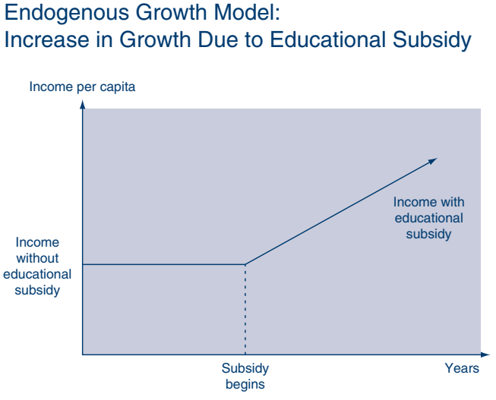
Modern Macro Growth Models and the Poverty Trap
Endogenous Growth Model:
Diminishing marginal returns to capital are offset by increases in technology
The more we know, the easier it is to discover more knowledge
The US had/has more people devoted to knowledge discovery process
US developed Research Universities and Research Grants
Source: David M. Gould & Roy J. Ruffin, “What Determines Economic Growth?

Slide 11
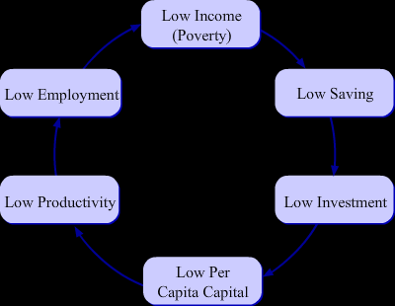
Gap Theory and the Poverty Trap

Slide 12
Modern Growth Theory: Critique
Poverty trap theory refuted by empirical evidence
Modern growth theory is severely weakened by various forms of scientism:
Model Building
Mathematical Method
Measurement
Social Engineering

Slide 13
Modern Growth Theory: Critique
Math Models:
Good at describing equilibrium conditions; bad at describing dynamic economic order
Take individual preferences as known and given
Feature superficial consideration of time
Economic problem becomes simple technical engineering constrained maximization problem

Slide 14
Modern Growth Theory: Critique
Several weaknesses in the conception of key contributors to economic prosperity
Leave out the market division of labor
Focus on increasing inputs perceived as homogenous
Poor at defining economic progress
Poor at depicting entrepreneurship
National Income Accounting contributes to bias of planning and focusing on inputs and growth of output rather than on economic progress

