Slide 1
Austrian Capital Theory
Dr. Patrick Newman
2021 Mises University

Slide 2
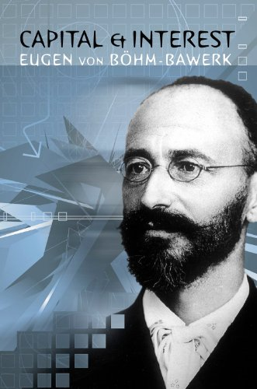
What’s this presentation about, and why should I care?
You will learn about capital theory:
The study of mankind’s network of produced inputs and what causes this structure to change
Importance of time, savings, specificity, roundaboutness
Capital theory is neglected in modern economics. Time and the heterogeneity of capital goods are “unimportant”

Slide 3
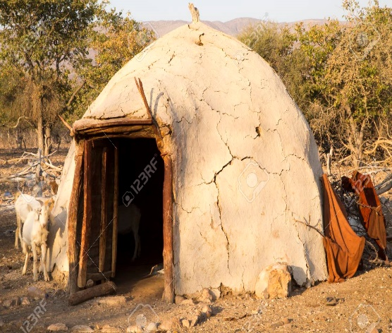
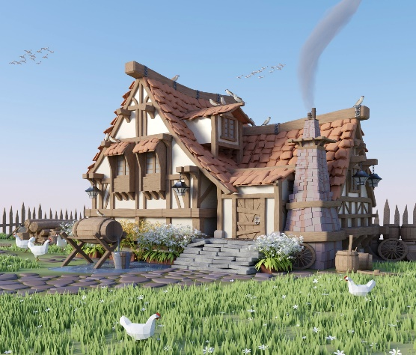
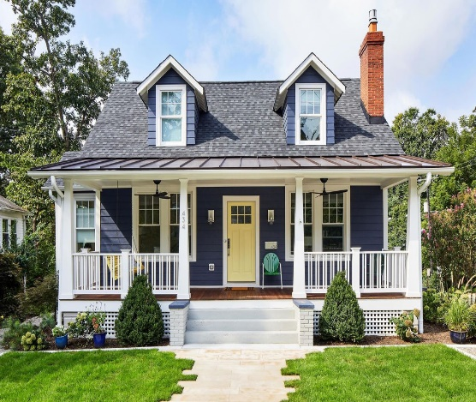
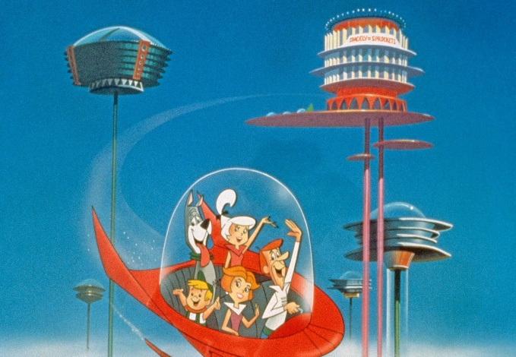
All this “stuff”—that’s what makes humans unique!
Standards of living have risen from barbarism to the modern level because of an increasingly intricate edifice of capital goods
Beavers are still making dams, but humans have moved past huts!

Slide 4
What are capital goods?
We know from praxeology that humans act, they use means to achieve ends
Say you are hungry. You buy food at the grocery store. Then you make a sandwich. Finally, you eat the sandwich
The finished sandwich is a good of the first order, also known as a consumer good
Sandwich made in the kitchen is a good of the second order
Purchased ingredients are goods of the third order
Second to nth order goods are also known as higher order goods

Slide 5
What are capital goods?
Four factors of production:
Labor: humans, “produced” by other humans
Land: nature-given resources and the space we stand on
Capital goods: produced materials made from labor, land, and other capital goods
Circulating capital goods: the raw materials turned into another good
Fixed capital goods: the produced tools used to transform the circulating capital goods
Technology: recipes

Slide 6
What are capital goods?
Important to note:
Land and labor are called the original factors of production
A more advanced talk would further distinguish land and capital goods
There is a difference between capital and capital goods
Factors differ in terms of their specificity. They are heterogeneous
To summarize: in a production process, actors use their technological knowledge and apply original factors and fixed capital goods to transform circulating capital goods into consumer goods

Slide 7
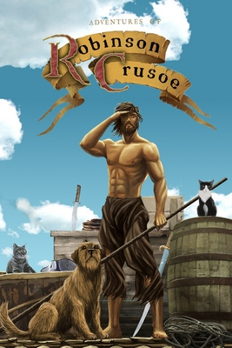
Let’s start from the beginning: Robinson Crusoe (1719) economics
Or Tom Hanks in Castaway (2000)
Robinson Crusoe is stuck on a desert island with some supplies from his ship, and he is hungry
He can satisfy this end by picking berries (consumption)
Ten hours is the period of production
He could also produce capital goods (a bow and arrow) to hunt animals
Leads to greater consumption, but requires more time (thirty hours)

Slide 8
Crusoe’s structure of production
Fortunately, Crusoe recovered a knife and twine from his ship
Even better, he went on wikihow.com before his ship crashed
There are three stages in the production process
Stage #1: Find the right wood and sticks
Stage #2: Use his knife to sharpen the wood and sticks
Stage #3: Add notches and tie twine to bow
How can Crusoe do this and not starve? He must save (restrict present consumption) and invest (build capital goods)
Time preference (later)
For two weeks Crusoe eats less of berries than usual and accumulates them
At the end, Crusoe creates a tool that increases his future consumption

Slide 9
Crusoe’s structure of production
Crusoe can continue to save berries and other goods to further increase his future consumption
Improves bow, adds heads to arrows, builds a net and spear to catch fish, etc.
Capital widening refers to creating more of the same capital good, capital deepening is creating new kinds of capital goods
Capital widening and deepening always take more time
They lengthen the period of production and add higher order stages to the structure
In other words, more productive processes (those that lead to greater increases in consumption) take more time
Roundabout production processes!
Capital accumulation versus capital consumption

Slide 10
What have we learned from our simple Crusoe thought experiment?
Factors of production differ in terms of their specificity
The creation of capital goods requires savings and takes time
Increases in future consumption requires longer production processes
Crusoe’s standard of living is based on his stock of capital goods

Slide 11
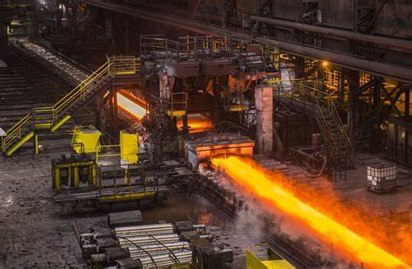
Now let’s look at the modern economy
Monetary economy with specialization. Capital goods are produced in various stages of production
E.g., the iron and steel industry
Stage #1: Mine ore, coal, and limestone
Stage #2: Smelt ore into iron
Stage #3: Refine iron into steel
Stage #4: Shape steel into plates
Stage #5: Fabricate plates into railway cars

Slide 12
Iron and steel industry
Relevant factors of production with varying degrees of specificity:
Labor (foundry workers)
Land (where ore is found, where factories and plants are located)
Fixed capital (mining implements, blast furnace, hammers, tongs, etc.)
Circulating capital: ore → iron → steel → plate → railway car
Some of these factors can be used in other lines of production. Others cannot
Advances in this capital structure
Widening (building more blast furnaces and factories)
Deepening (research and development into new steel processes)

Slide 13
Enter the capitalist
At each stage, capitalists save money and invest by purchasing factors, which they use to create a new capital good that they sell to a later capitalist
For this saving, the capitalist earns interest (he may also earn profit for his entrepreneurial judgement)
E.g., the stage 3 capitalist buys $1 million of iron and other factors, makes steel, sells steel for $1.1 million (10% interest return)

Slide 14
The overall structure of production
We can depict it with the same stages, each with specific and nonspecific capital goods
Stage #1: Mining/harvesting raw materials
Stage #2: Refining raw materials
Stage #3: Manufacturing goods
Stage #4: Packaging and distributing goods
Stage #5: Selling consumer goods
We can define the lower orders as those production processes that produce consumer goods in the near future and the higher orders as those production processes that produce goods in the remote future
Textiles versus iron and steel

Slide 15
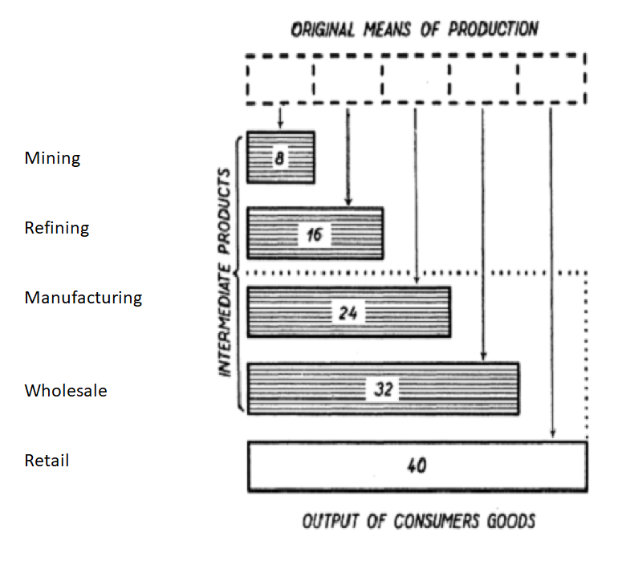
The Hayekian triangle shows this

Slide 16
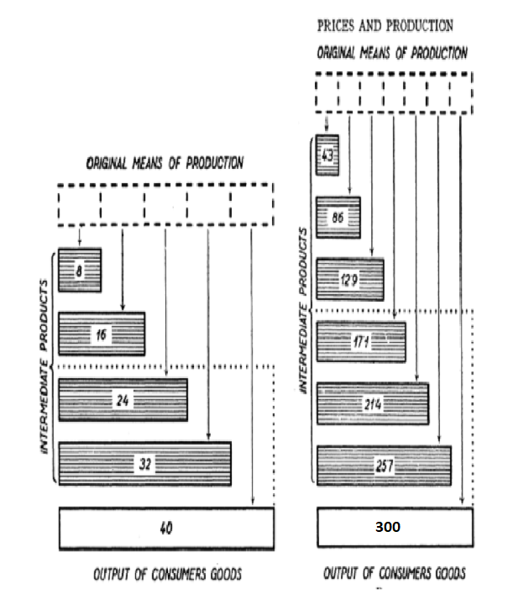
Changes in the structure
The primary reason for economic growth is through capitalists increasing savings (just like Crusoe!)
This leads to the creation of additional stages and “lengthens” the structure of production (makes it more roundabout). More capital goods leads to additional consumer goods
Vice versa
Technology is secondary to savings
Savings are needed to implement recipes

Slide 17
Differences with neoclassical economics
Capital goods are heterogeneous. The structure of production is a latticework of capital goods
Neoclassical economics lumps all capital goods together, “clay”
Time is a crucial part of any production process
Neoclassical economics abstracts from time. In general equilibrium, production is instantaneous
Savings is the most important ingredient for economic growth
Neoclassical economics argues that technology is more important. Furthermore, savings can decrease growth (paradox of thrift)

Slide 18
Future
The importance of time preference and interest rates
How do changes in the interest rate affect the present value of long-term production processes relative to short-term production processes?
How do changes in time preference and credit expansion affect the structure of production?
Oh no! Herbener and Jonathan Newman’s classes are tomorrow?
Can you wait?!

Slide 19
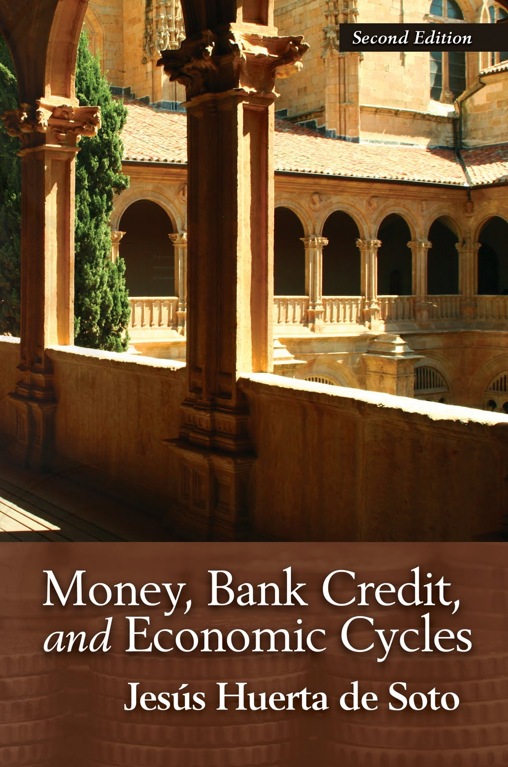
Thanks for listening!
For more, read Mark Skousen’s The Structure of Production (1990), Roger Garrison’s Time and Money (2001), and Huerta de Soto’s Money, Bank Credit, and Economic Cycles (2006)
Are you sick of me yet? Too bad. I’m on the panel!

