Slide 1
The Case for Free Trade
Mark Brandly
Mises University 2020
Notes:
It at first appears to be difficult to make the case for free trade because economists concede the basic point of the arguments for tariffs: The government has the ability to transfer wealth from one region of the country to another. If the government can enrich Alabama at the expense of Michigan, why can’t the government enrich Alabama at the expense of China?

Slide 2
The goal of the free traders and the protectionists is not the health of the world economy, but the standard of living of our national economy
Ludwig von Mises: Liberals “believe that peaceful international cooperation is a more appropriate means than conflict for attainment of the end which they and the nationalists are both aiming at: their own nation's welfare. They do not, as the nationalists charge, advocate peace and free trade in order to betray their own nation's interests to those of foreigners. On the contrary, they consider peace and free trade the best means to make their own nation wealthy. What separates the free traders from the nationalists is not ends, but the means recommended for attainment of the ends common to both. (Human Action)
Notes:
Human Action, p,183

Slide 3
“The Daily Chicago Times candidly admitted that the tariff was indeed a tool used by Northerners for the purpose of plundering the South. The editor of the newspaper warned that the benefits of this political plunder would be threatened by the existence of free trade in the South.” (Thomas J. DiLorenzo, The Real Lincoln)
Notes:
Tariff proponents argue that the state can also plunder Asia in order to benefit the US

Slide 4
Gains from Trade
We recognize that there are benefits of trade
Ludwig von Mises, “Autarky: The Road to Misery.” Mises argues that the international division of labor is the foundation of European culture.
Adam Smith: “The division of labour, however, so far as it can be introduced, occasions, in every art, a proportionate increase of the productive powers of labour.”
Smith makes the case that the division of labor leads to increasing productivity
Smith also emphasized that the gains from trade are limited by the extent of the market. The greater the extent of the market, the greater the gains from trade.

Slide 5
Gains from Trade
David Ricardo’s law of comparative advantage (On the Principles of Political Economy, and Taxation, 1817)
A group of individuals, regions, or nations can produce a larger joint output if each specializes in the production of goods in which it is a low-opportunity cost producer and trades for goods for which it is a high opportunity cost producer. There are mutual gains from trade.
Paul Samuelson, when challenged to cite a theory in the social sciences that is true and nontrivial, answered the law of comparative advantage.
Paul Krugman: “If there were an Economist's Creed, it would surely contain the affirmation “I understand the Principle of Comparative Advantage”

Slide 6
Gains from Trade
Ricardo’s “magic numbers”
England can produce a given amount of cloth using the labor of 100 men and can produce a given amount of wine with the labor of 120 men
Portugal requires the labor of 90 men to produce the same amount of cloth and only 80 men to produce wine
Portugal has an absolute advantage in the production of both goods
Portugal has a comparative advantage in the production of wine
Both countries gain from trade if England produces and exports cloth and Portugal produces and exports wine
Ricardo’s formulation is based on the labor theory of value
Gottfried Haberler develops the law of comparative advantage in terms of opportunity costs
Notes:
Haberler has a chapter in Austrian Theory of the Trade Cycle and Other Essays

Slide 7
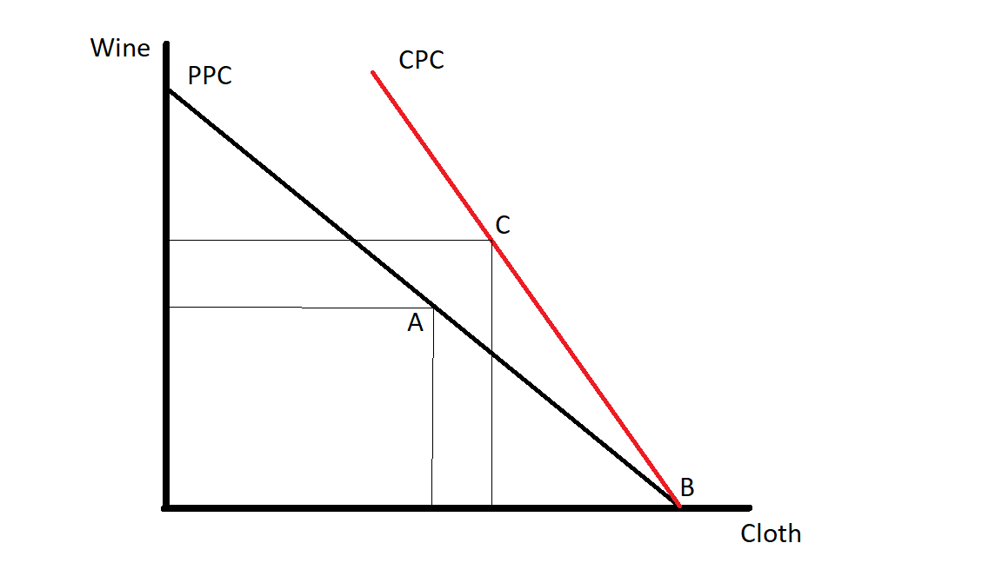

Slide 8
The law of comparative advantage does not directly imply that free trade is economically superior to tariffs and other protectionist policies
However, we can use the principle of comparative advantage to make a case for free trade, if we make certain assumptions
Terms of trade are favorable for both countries
A tariff does not affect the terms of trade
Trade is balanced
Trade surplus may lead to trade harming a countries welfare, within the law of comparative advantage model
Capital and labor are perfectly mobile within a country
Capital and labor are perfectly immobile internationally
Notes:
I can’t find anyone who has defended this position using Austrian price theory
Ricardo simply asserts that the terms of trade will be favorable for both countries
Neoclassical theorists invoke perfectly competitive markets to justify this point
Terms of trade are favorable for both countries

Slide 9
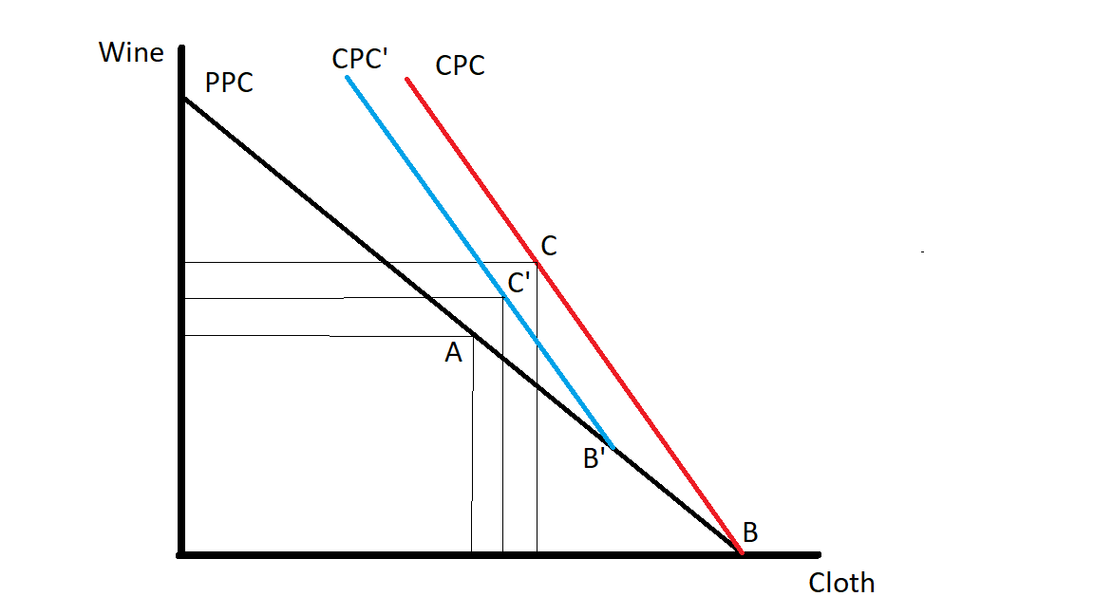

Slide 10
Protectionist Arguments That Contradict the Law of Comparative Advantage
Increased employment argument: A tariff will lead to more jobs for our workers
Counterargument
Imposition of a tariff will transfer jobs from industries that have a comparative advantage to the protected industry
Even Paul Krugman, when discussing protectionism, admits that “constant employment is a reasonable approximation”

Slide 11
Protectionist Arguments That Contradict the Law of Comparative Advantage
We need a tariff to protect us from low priced imports
Cheap foreign labor
Dumping
Counterargument: Lower import prices = improved terms of trade
Trade deficit argument: We need a tariff to reduce our trade deficit
The foundation of this argument is the mercantilist position that the benefits of trade are derived from exporting goods
Counterargument: Consider the benefits of a trade deficit
Foreigners send us goods. Instead of sending them goods in return, they invest in our economy. Trade deficit is associated with net capital flows into the country.
See Henry Hazlitt, “The Drive for Exports”
Low priced imports and a trade deficit generate a more favorable terms of trade
Notes:
See Hazlitt’s The Drive for exports

Slide 12
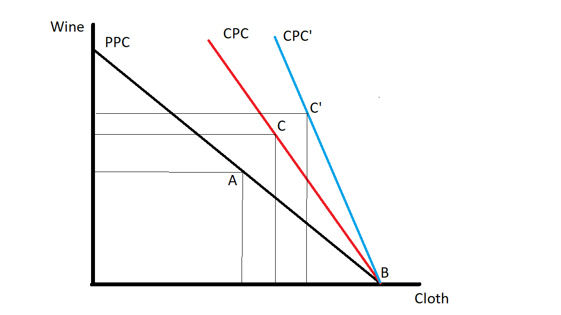

Slide 13
Stronger arguments for tariffs
1. Infant industries argument: industries must be protected during their infancy. Once an industry is mature, we can reap the gains from free trade.
Counterarguments:
Protected industries never mature, never admit that they are ready to compete internationally without the protectionist policies in place
Main issue: private investors will fund the appropriate industries, the ones that profitable over the life of the industry
Notes:
The stronger arguments for tariffs admit that there are gains from trade.

Slide 14
Stronger arguments for tariffs
Murray Rothbard: “In fact, if long-run prospects in the new industry are so promising, why does not private enterprise, ever on the lookout for a profitable investment opportunity, enter the new field? Only because entrepreneurs realize that such investment would be uneconomic, i.e., it would waste capital, land, and labor that could otherwise be invested to satisfy more urgent desires of the consumers.” (Power and Market)
Note the assumption that the capital for the infant industry is being reallocated from another domestic industry, not from foreign investment
Notes:
The stronger arguments for tariffs admit that there are gains from trade.

Slide 15
Stronger arguments for tariffs
2. Terms of trade argument: A tariff that leads to a decrease in the world price of an imported good will improve a country’s terms of trade. If the benefits of the improved terms of exceed the efficiency loss of the tariff, then the net benefits of the tariff are positive.
We can use the law of comparative advantage model to explain this argument

Slide 16
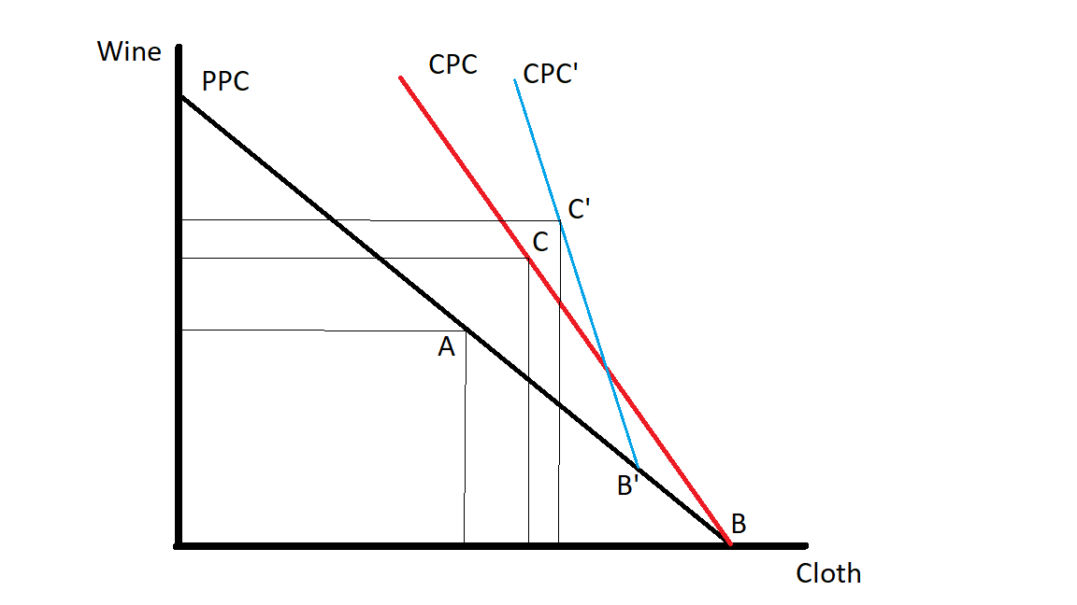

Slide 17
Stronger arguments for tariffs
Capital flows argument: A tariff will enrich us due to the increase in foreign investment in our economy
Pat Buchanan “Tariffs: The Taxes That Made America Great”
A tariff could lead to an increase in net capital flows to the protected industry
Increased net capital flows generates benefits for the domestic economy (see Mises, “Foreign Investment”).
If the benefits of the increased capital stock outweigh the efficiency losses due to the tariff, then the tariff leads to net benefits for the economy
Notes:
The opportunity cost of the domestic production is shifted to some degree to the foreign country

Slide 18
Stronger arguments for tariffs
Capital flows argument: A tariff will enrich us due to the increase in foreign investment in our economy
Counterargument:
It’s unlikely that a tariff will lead to an overall increase in the capital stock (Haberler, 1936).
Tariff policy is not the main determinant of investment decisions. The general condition of the economy and governmental policies have more to do with the capital flows than do trade barriers (Yeager and Tuerck, 1976).
Notes:
There is no homogenous blob of capital. The capital structure of the economy is a complex web of connections. If one industry expands, other industries expand and contract. The effects

Slide 19
Case for Free Trade
How can we respond to the stronger arguments for tariffs?
The arguments for tariffs tend to make the following false assumptions
Foreign governments will not retaliate with tariffs of their own
The agents of the state will resist political pressures when imposing tariffs. Paul Krugman, “Governments do not necessarily act in the national interest, especially when making detailed microeconomic interventions. Instead, they are influenced by interest group pressures.”
Government officials can precisely identify the appropriate tariff rate
Notes:
The South retaliated against the North throughout the 1800s
Government officials can precisely identify the appropriate tariff rate
Haberler makes this point, as does Paul Krugman

Slide 20
Impossibility of Implementing Ideal Protectionist Policies
It is impossible for government officials to determine a protectionist policy that enhances economic welfare.
Free trade is an implementable policy.
Welfare enhancing protectionist policy is not.
Notes:
The market is a process
The entrepreneur is acting under uncertainty

Slide 21
Leland Yeager and David Tuerck (1976) put it thusly, “The protectionist slogan that free trade may be right in theory but wrong in practice becomes more sensible when the word ‘protectionism’ replaces ‘free trade.’” And “Free trade is a meaningful, specific, discussable policy proposal; ideal protec­tionism is not.”
Notes:
Minimum wage is wrong in theory but right in practice
Protectionism may be right in theory, in the sense that we can model a welfare enhancing tariff, but free trade is right in practice

Slide 22
Thank you.

Slide 23
Impossibility of Socialism
Mises on the impossibility of socialism: “The theory of economic calculation shows that in the socialistic community economic calculation would be impossible.”
And further, calculation is “possible only when prices for all kinds of goods and services are established in the market and furnish a basis of reckoning. Where there is no market there is no price system, and where there is no price system there can be no economic calculation.”

Slide 24
In countering these unsophisticated arguments, Paul Krugman comes to mind, “I am convinced that many economists, when they try to argue in favor of free trade, make the mistake of overestimating both their opponents and their audience. …. it is remarkably easy to make fools of your opponents, catching them in elementary errors of logic and fact. This is playing dirty, and I advocate it strongly.” (“Ricardo’s Difficult Idea”)

Slide 25
Ludwig von Mises, “Capitalism versus Socialism”
“Capitalism has radically transformed all human affairs. Population figures have multiplied. In the few countries where neither the policies of the governments nor obstinate preservation of traditional ways on the part of the citizens put insurmountable obstacles in the way of capitalistic entrepreneurship, the living conditions of the immense majority of people have improved spectacularly. Implements never known before or considered as extravagant luxuries are now customarily available to the average man. The general standard of education and of material and spiritual well-being is improving from year to year. All this is not an achievement of governments or of any charitable measures. More often than not it is precisely governmental action that frustrates beneficial developments which the regular operation of capitalistic institutions tends to bring about.”

