Slide 1
Deflation: Myth and Reality
Mises University 2020
Joseph T. Salerno

Slide 2
The Changing Meaning of Deflation
19th century: A decrease in the supply of money in the economy. Period.
Early 20th century: a change in the money supply that is insufficient to serve the expanding “needs of trade,” resulting in “a general fall in prices.”
Modern definition: a decrease in the “price level” (CPI, PCE).

Slide 3
The Meaning and Uses of Deflationphobia
A morbid and irrational fear of falling prices
Central bankers promote this fear among the public to justify more inflationary monetary policy.
Federal Reserve officials promoted the spread of deflationphobia by making obscure and ominous statements (Fedspeak) in the 2002 when inflation was low (1.6%).

Slide 4
Ben Bernanke—Fedspeak
“Deflation: Making Sure It Doesn’t Happen Here” (Speech, November, 2002):
[T]he chance of significant deflation in the United States in the foreseeable future is extremely small . . . .[T]he Fed would take whatever means necessary to prevent significant deflation in the United States and ... has sufficient policy instruments to ensure that any deflation that might occur would be both mild and brief. . . . So having said that deflation in the United States is highly unlikely, I would be imprudent to rule out the possibility altogether.

Slide 5
Alan Greenspan—Fedspeak
Congressional testimony, April 2003:
A further drop in inflation would be “an unwelcome development.”
“[W]e see no credible possibility that we will at any point . . . run out of monetary ammunition to address problems of deflation.”

Slide 6
The Media Promote Deflationphobia
Financial writers, media commentators, celebrity economists, and think tanks vigorously promoted the central bank’ message with articles and blog posts with lurid titles:
“The Deflation Monster Still Lives”
“The Specter of Deflation”
“Why We Should Fear Deflation”
“The Deflation Boogey-man Haunts Fed”
“The Greatest Threat Facing the U.S. Economy: Deflation”
“Defeating Deflation”
“The Deflation Dilemma: To Be Concerned or Not to Be”

Slide 7
What Causes Deflation?
Like the price of any other good, the value of money is determined by Supply and Demand.
An increase in the value of money or falling prices is caused by a decrease in the supply of money or an increase in the demand for money.
People increase the demand for money when: 1) they produce and sell more goods for money; or 2) they wish to hold more money and spend and invest less.
The money supply decreases when the central bank (the Fed) reduces the total amount of currency and bank reserves in the economy or banks fail, causing depositors’ checking and saving accounts to disappear. This rarely occurs in the modern world.

Slide 8
Kinds of Deflation
There are 3 basic kinds of deflation:
Growth deflation
Cash-building/speculative deflation
Confiscatory deflation—governments demonetizing currency notes or limiting withdrawal of cash from banks by depositors
The first two kinds are a natural outcome of the free market economy and promote economic growth but the third infringes on property rights and distorts the economy.

Slide 9
Deflation: Myth and Reality 1
Myth: If the money supply does not grow fast enough, prices will fall and stifle economic growth.
Reality: Falling prices are the natural and benign effect of rapid economic growth in a dynamic capitalist economy where technology is improving and capital investment is growing and the expansion of the money supply is restrained by a market-based money like the gold standard.

Slide 10
Growth Deflation
Caused by an increase in the production and supply of goods and services in the economy, that is, “economic growth.”
Rapid economic growth is caused by increased investment in capital goods and technological progress, which reduce production costs and increase profits.
The increased supply of goods causes greater competition for $ by sellers, and therefore increases the exchange demand for money.
If money supply increases very slowly, this will result in an increased value of money and falling prices—so “deflation”

Slide 11
History of Deflation in the U.S.
Growth deflation occurred in U.S. and other market economies throughout the 19th century.
The economic growth rate exceeded the growth rate of the money supply under gold standard.
It was good deflation because it was a natural part of the process of economic growth
Example: U.S. 1880 to 1896:
Prices fell by 30% or 1.75%/yr.
Real GDP grew by 85% or 5%/yr.

Slide 12
Prices , Income, and Consumption 1870-1898
Wholesale prices dropped 34 percent, a 1.7 percent annual rate of decline, and consumer prices fell 47 percent, or 2.5 percent annually.
Real gross national product grew 4.5 percent each year.
Consumption per capita jumped 2.3 percent a year.

Slide 13
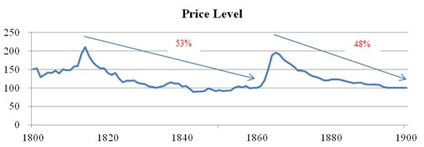
U.S. Growth Deflation in the 19th Century

Slide 14
Recent Examples of Growth Deflation

Slide 15
Computers
Mainframe computer: $4.7 million in 1970; today PCs are 20x faster and with more memory sell for less than $500 with accessories
1980-1999: PC prices fell by 90% but the industry grew
1980—490,000 PCs shipped
1999—43 million shipped
2013—315.9 million shipped.
PC memory prices:
1980: $6.48 /Mbyte 2014: <$0.01 ($0.0085)/Mbyte

Slide 16
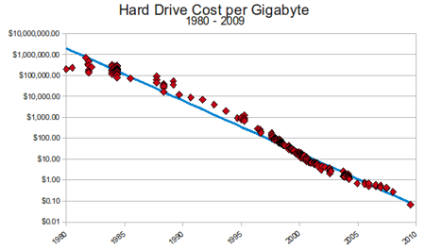
Hard Drive Prices

Slide 17
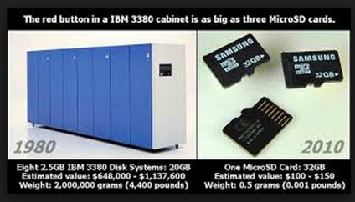
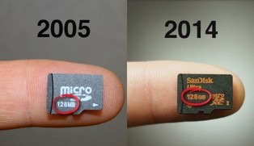
Hard Drive Size

Slide 18
HDTVs
2004: 32 million television sets sold in North America for an average price of $400 with an average size of 27 inches.
2015, 44 million sets sold in North America, with an average price of $460 and an average size of 38 inches.
Price per diagonal inch fell from $14.81 to $12.10
Long-term fall in prices of HDTVs:
1990--$36,000; 2003--$3,000 to $5000; today--<$500.

Slide 19
Laser Eye and Cosmetic Surgery
Lasik eye surgery:
1998, $4000 per eye; 2013, $300 per eye.
Botox treatment:
2001, $365; 2013, $99-$149 on discount websites
Liposuction
1992, $1,622; 2013, $999 on discount websites

Slide 20
Deflation: Myth and Reality 2
Myth: Deflation prolongs and intensifies recession and turns a mild recession into a great depression.
Reality: Deflation is the cure for recession and speeds up the recovery of the economy. It prevents recessions from degenerating into depression.

Slide 21
Deflation Adjusts Costs to Prices
Businesses increase cash holdings during recessions, because production costs such as wages and other input prices have risen too high during the inflationary boom and wiped out profit margins. They are speculating that wage rates will soon fall back to normal levels.
Entrepreneurs would rather hold cash and wait until wages and other costs adjust to the reduced product demand and prices before they begin to invest again
Deflation speeds up the readjustment of input prices to output prices and restores the profitability of investment which is the real stimulus for an economy in recession

Slide 22
Deflation Shortens Recessions
Households desire to hold more money during recessions as a precaution against wage cuts, job losses, a more uncertain future or because they expect consumer prices will fall in the future. Example: housing and auto prices after the financial crisis of 2007-2008.
Only when prices fall to their expected levels will business and household demand and spending begin to increase again
If government and central bank policies prevent the fall in wages and prices, then the price/cost adjustment does not occur and the recession and hoarding drags on even with ZIRP and QE Fed policies in force.

Slide 23
The Forgotten Depression of 1920-1921
Inflationary Boom, 1915-1919
1915-1919: Fed increased the money supply by 15.5% per year
1916-1920: U.S. product prices (GDP deflator) rose 15.4% per year
1917-1920: consumer prices (CPI) increased 14.1 % per year

Slide 24
The Forgotten Depression of 1920-1921
Deep Depression
nominal GNP fell 24%, from $91.5 billion in 1920 to $69.6 billion in 1921
real GNP shrank by 9% between 1920 and 1921
Unemployment reached 15.3% in 1921.

Slide 25
The Forgotten Depression of 1920-1921
Steep Deflation
Money supply grew 2.9% per year in 1920
Money supply declined 7.5% per year in 1921
General prices fell 16.6% in 1921 and 8.1% in 1922
Consumer prices fell 10.9% in 1921 and 6.3% in 1922
Wholesale price fell 56% from mid-1920 to mid 1921
Wages fell 11% over the two years 1920-1921
James Grant, The Forgotten Depression 1921: The Crash That Cured Itself, Simon and Shuster, NY, 2014

Slide 26
Two Depressions Compared
Recovery: Deflation and laissez-faire government policy quickly cured the depression. The depression ended by August 1921, only 18 months after it had begun.
The Great Depression lasted from 1929-1940
Reasons: government interference with labor markets (minimum wage, forced collective bargaining); product markets (price supports for farm products); money (destruction of the gold standard, devaluation, monetary expansion), higher taxes and more regulations on business; and higher tariffs.

Slide 27
The Keynesian View of the 1920-21 Depression
Modern Keynesians cannot explain and are surprised by the swift recovery from the deep 1920-21 depression.
“The downswing . . . was severe . . . but relatively short. Its outstanding feature was the extreme decline in prices. . . . Government policy to moderate the depression and speed recovery was minimal. The Federal Reserve authorities were largely passive. . . . Nor was any use made of fiscal policy. . . . [T]he Federal budget was deflationary while the downswing was in progress. Despite the absence of a stimulative government policy, however, recovery was not long delayed.” (Robert A. Gordon, 1974)

Slide 28
Myths and Reality 3
Myth: the empirical evidence indicates a strong link between deflation and depression
Reality: aside from the Great Depression (1929-34), there is no empirical evidence of a link between deflation and depression. The Great Depression is an outlier in major empirical studies that show no statistically and economically significant link between falling prices and falling real output.
Deflationphobia of modern mainstream economists like Greenspan, Krugman, Bernanke, Yellen, etc. rests solely on the experience of the Great Depression in the U.S. and a few other countries

Slide 29
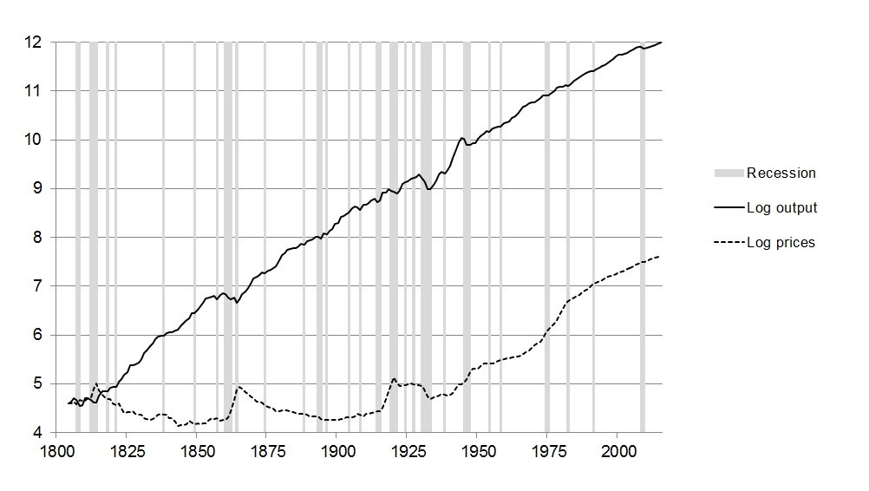
U.S. Prices and Output—1804-2015

Slide 30
Empirical Studies of Deflation-Depression Link 1
Andrew Atkeson and Patrick J. Kehoe, “Deflation and Depression: Is Their an Empirical Link?” AER Papers and Proceedings 94 (May 2004)
Atkeson and Kehoe studied 16 countries over 100 years or more, broken into 5-year periods and covering 73 deflation episodes and 29 depression episodes.

Slide 31
What the Study Found
Excluding the Great Depression, Atkeson and Kehoe find that 65 of 73 deflation episodes involved no depression while 21 of 29 depression episodes were not associated with deflation. In other words, 90 percent of deflation episodes did not result in depression.

Slide 32
The Authors’ Conclusion
Atkeson and Kehoe conclude:
“The data suggest that deflation is not closely related to depressions. A broad historical look finds more periods of deflation with reasonable growth than with depression, and many more periods of depression with inflation than with deflation. Overall the data show virtually no link between deflation and depression.”

Slide 33
Empirical Studies of Deflation-Depression Link 2
Pavel Ryska, “Deflation and Economic Growth: The Great Depression as the Outlier,” QJAE, 20/2 (2017). A more comprehensive study than Atkeson/Kehoe study
Ryska studied 20 countries from 1804 to 2015. Using annual data, there are 3,293 observations with reading for both price and output growth.
72% of all annual observations saw positive inflation and 28% saw either zero or negative inflation (deflation).

Slide 34
Results
The average annual output growth rate for inflationary years was 2.85% and for deflationary years 2.73%. However, the difference between the growth rates in inflationary and deflationary years was not statistically significant at any level of significance, nor was the difference in the variances of output growth in the two cases.

Slide 35
Ryska’s Regression Analysis
Ryska develops a regression model using this data set in which output growth is the dependent variable and the independent variable is inflation/deflation.
He finds that inflation does have a statistically significant effect on output growth. However it is not economically significant. According to his model, it would take a 17 percentage point increase in inflation to increase real output by 1 percent, which is close to the estimate of the Atkeson/Kehoe study.
Using the same model for the Great Depression data (1929-34) does yield a statistically and economically significant effect of inflation on output growth.

Slide 36
Ryska’s Conclusion
“[T]he Great Depression stands out as the only episode in the sample with both a statistically significant and economically important (positive) relationship between output and prices. When one leaves out the Great Depression, which represents only 90 out of 2158 observations used in the regressions, correlations between inflation and output growth in the rest of the sample lose their significance entirely.”

Slide 37
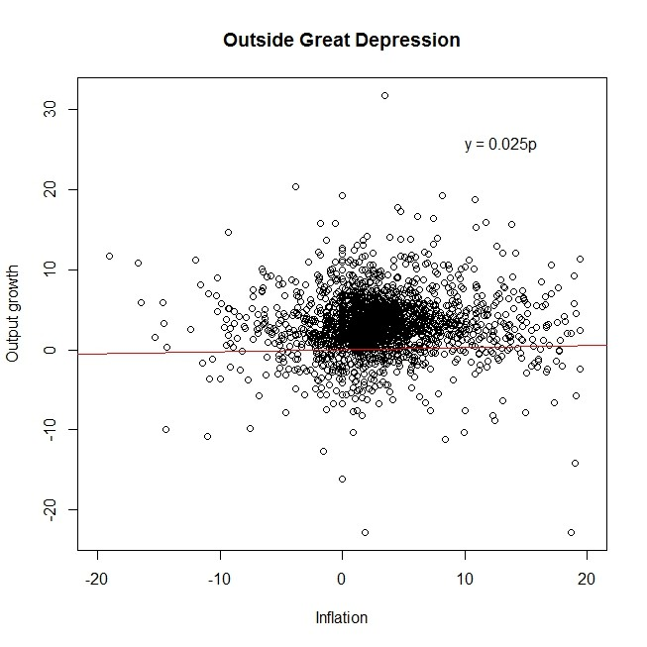
Regression Line—Outside Great Depression

Slide 38
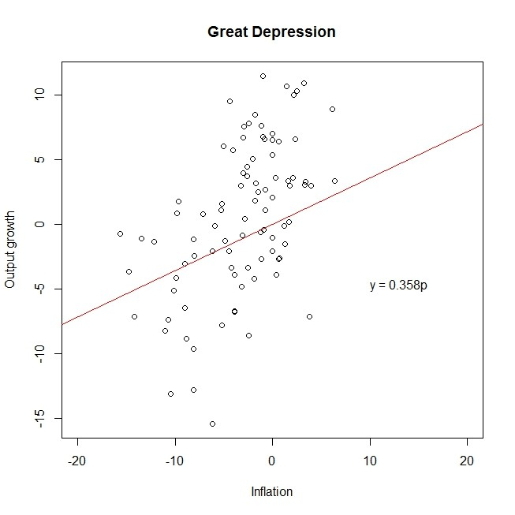
Regression Line—Great Depression

Slide 39
Confiscatory Deflation: The Case of India
India’s Demonetization program
Cash is used in 90% of transactions. 86% of the cash in circulation exists in the form of two banknotes, the 500 (roughly $7.5 USD) and 1000 (roughly $15 USD) bills.
Nov. 8, 2016, these two notes were declared by gov’t no longer legal tender.
People forced to go to bank and exchange notes for deposit credits. They could also withdraw money from their accounts in the form of valid bills. But the RBI placed limits for both of these mechanisms.
Justifications included (a) eliminating black money; (b) reducing the prevalence of counterfeit currency, which is allegedly used to fund terrorism.
Long lines and economic disruption as people did not have access to money for a long period of time.

Slide 40
Inflationary Bubble or Deflation
While the Fed and the mainstream media were fear of inflation, Fed monetary policy was creating massive bubbles n housing and financial markets.
From the beginning of 2001 to end of 2005, the Fed increased the money supply by about 50%, from $4 trillion to $6 trillion, an average about $750 million to $1 billion per week depending on which monetary aggregate you use.

Slide 41
The Fed’s Unconventional Monetary Policies since 2009
Three rounds of quantitative easing 2009-2014.
Credit easing—purchasing toxic MBS and long-term government bonds to lower long term interest rates.
A massive expansion of the Fed’s balance sheet from $800 billion to over $4 trillion.
Zero interest rate policy that has devastated savers and insurance companies and pension funds.
Another massive increase in the money supply.

